Slide 1
Guardrail to Guardrail

Slide 2
W- Beam (27" to 31")

Slide 3
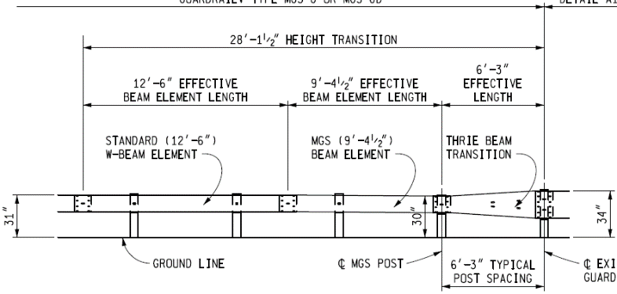
w-beam to thrie beam (34' to 31")

Slide 4
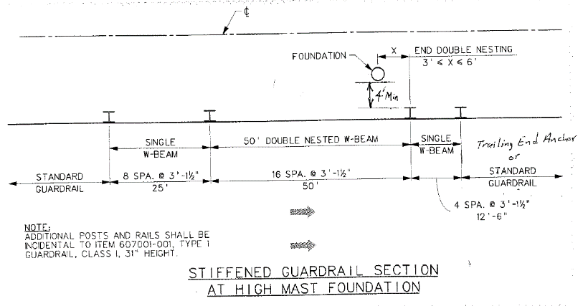
Stiffened Guardrail

Slide 5
Standard to Reduced Post Spacing (31' to 31")

Slide 6
Guardrail to Concrete

Slide 7
Pennsylvania W Beam 31"

Slide 8
18’9” Thrie Beam
(TxDOT T131C)

Slide 9
18’9” Thrie Beam
(Median Application)

Slide 10
Stacked W-Beam
(T604581-1)

Slide 11
25’ Thrie Beam
(MWTSP-3)

Slide 12
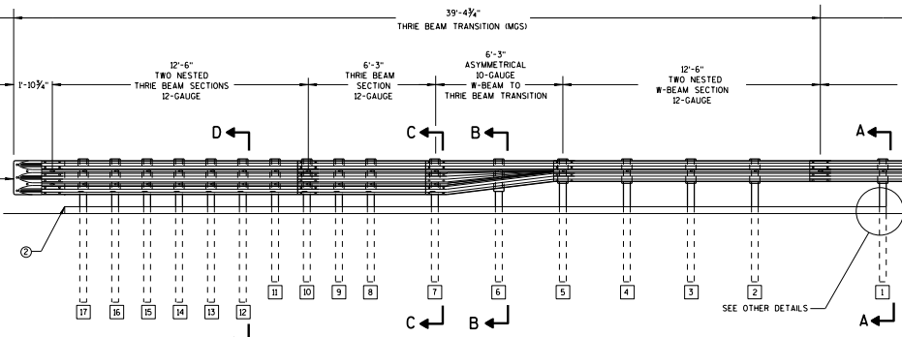
40’ MGS Thrie Beam Transition

Slide 13
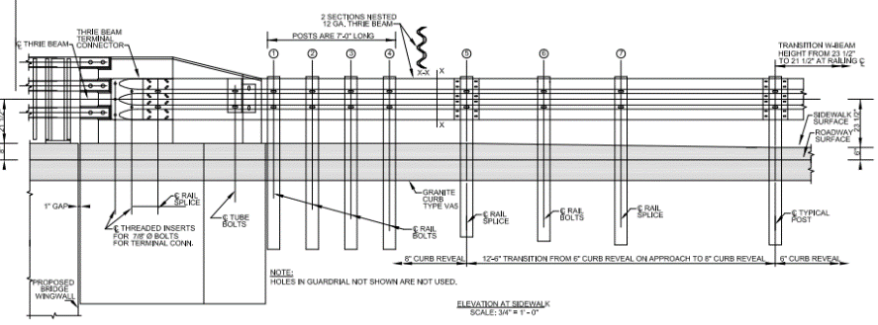
31" W-Beam Transition to Bridge Rail

Slide 14
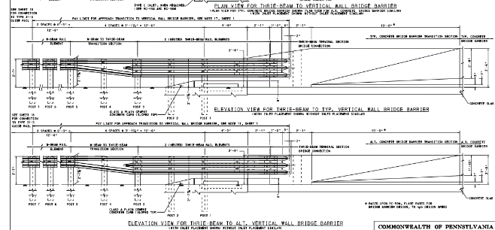
31" Short Asymmetrical Thrie-Beam to Vertical Parapet

Slide 15
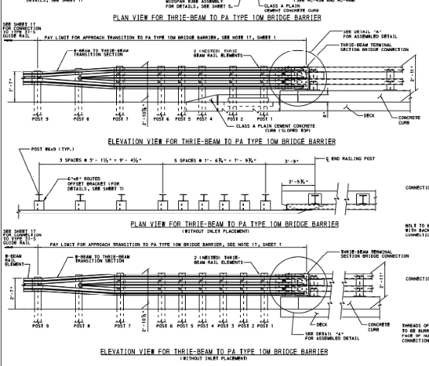
31" Short & Long Symmetrical Thrie-Beam to Bridge Rail

Slide 16
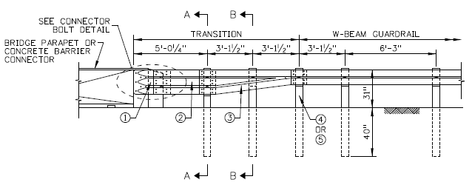
“Texas Low Speed”

Slide 17
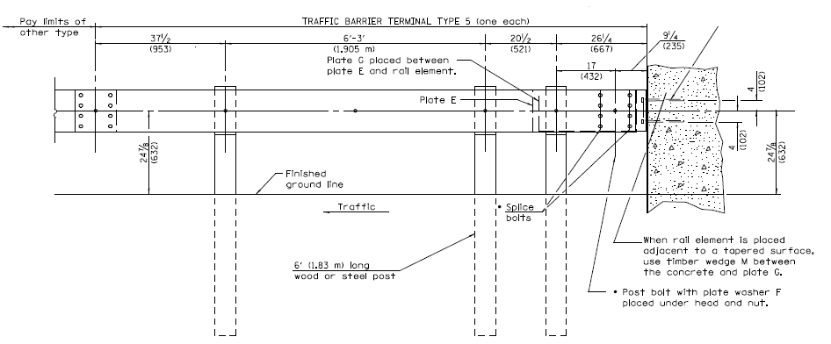
Illinois Type 5

Slide 18
Retrofit

Slide 19
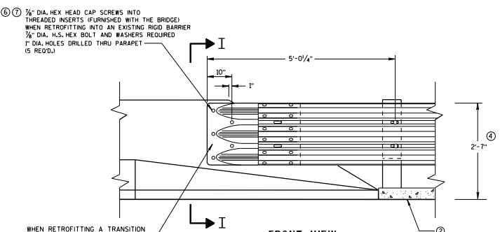
Thrie Beam Retrofit

Slide 20
Downstream Connection

Slide 21
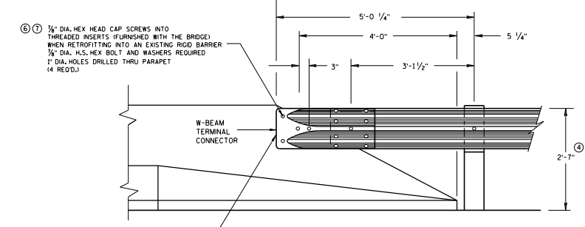
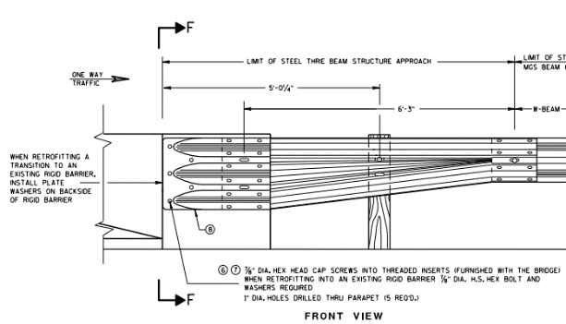
W- Beam * Thrie Beam Downstream Connection

Slide 22
Concrete to Concrete

Slide 23
Free Standing to Pinned Concrete Barrier

Slide 24
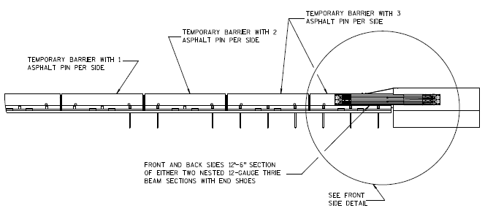
Free Standing to Rigid Barrier
(TTCB-1,TCBT-1, TCBT-2)

Slide 25
Pinned to Rigid Barrier
(605641-1)

Slide 26
Guardrail to Bridge Rail

Slide 27
31" Asymmetrical Thrie-Beam to Vertical Parapet

Slide 28
Other Transitions

Slide 29
High Tension Cable Guardrai to 31” (w-beam) Guardrail

Slide 30
Nested thrie-beam transition with Drainage Structure

Slide 31
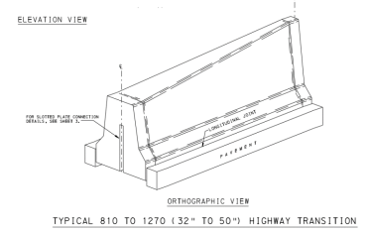
Concrete to Concrete

Slide 32
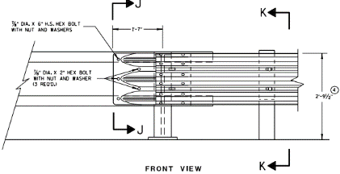
Guide rail system,concrete barrier, type X connection

Slide 33
Guide rail system,concrete barrier, type X connection

Slide 34
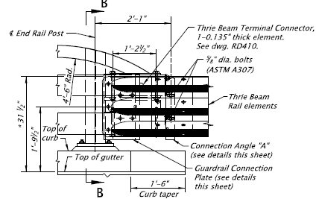
3 tube curb mount rail transition

Slide 35
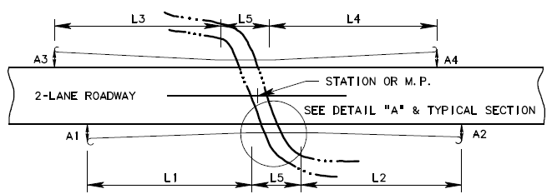
Guardrail installation on box culverts and bridges

Slide 36
Guardrail connection to bridge end for local roads

Slide 37
Michigan temporary concrete barrier limited deflection

Slide 38
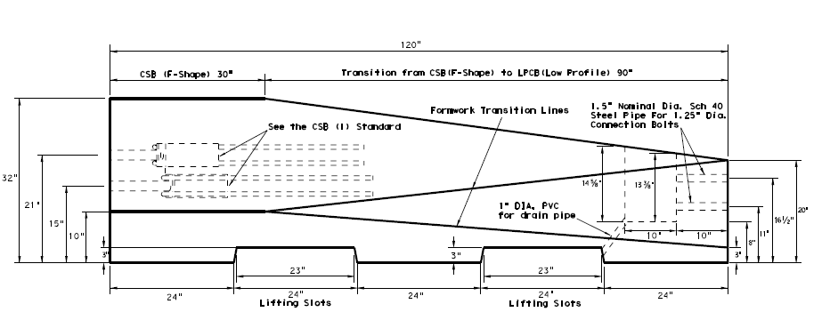
F-shape to low-profile barrier transition

Slide 39
Traffic Barrier Terminal Type 11

