Slide 1
Roadside Safety Pooled Fund Program Research Update
Roger Bligh, Ph.D., P.E.
Senior Engineer
TTI - Roadside Safety & Physical Security Division
Ph.: 979-845-4377
E-Mail: R-Bligh@tti.tamu.edu
Roadside Safety Pooled Fund Program – Fall Meeting 2018
Denver, Colorado
September 18th 2018

Slide 2
Additional Projects
Analysis and Testing of Florida Department of Transportation Barrier Systems for MASH Compliance
MASH Implementation Support for WSDOT
W-beam Guardrail Evaluation with Posts in Sleeves
MASH Testing of Massachusetts S3-MTL4 Curb Mounted & Back of Sidewalk Mounted Bridge Railings
MASH Testing of Transition from Weak Post MGS System to Strong Post MGS System
MASH Testing and Evaluation of the Merritt Parkway Guiderail

Slide 3
Analysis and Testing of Florida Department of Transportation Barrier Systems for MASH Compliance
TTI Researcher: James Kovar
Technical Representative: Derwood Sheppard (FDOT)

Slide 4
Analysis and Testing of Florida DOT Barrier Systems for MASH Compliance
Task 1: MASH Testing of Special Baseplate Posts
Subtask 1.1: Analysis and Design of Guardrail Posts on Concrete Structures Detail
Subtask 1.2: Pendulum Testing of Two Post Designs
Subtask 1.3: MASH Testing of Final Post Design (MASH Test 2-11)
Task 2: MASH 4-11 Testing of Combination Traffic-Pedestrian-Bicycle Bridge Railing
Subtask 2.1 – System Construction
Subtask 2.2 – Full-Scale Crash Test and Report (MASH Test 3-11)
Task 3: MASH Testing of W-Beam Median Guardrail w/ Rub Rail
Subtask 3.1: Construction and Demolition
Subtask 3.2: Crash Testing and Reporting (MASH Tests 3-11 and 3-10)

Slide 5
MASH Implementation Support for WSDOT
TTI Researcher: Nauman Sheikh
Technical Representative: Jeff Petterson (WSDOT)

Slide 6
MASH Implementation Support for WSDOT
Need
WSDOT needs assessment of various safety hardware to determine which systems may need testing, and/or formal engineering opinions for MASH compliance
Objective
Based on past testing and literature review, TTI is to assess systems prioritized by WSDOT and report whether they are likely to be MASH compliant, and if not, what tests or analyses may be needed

Slide 7
MASH Implementation Support for WSDOT
Progress
Three systems were prioritized in the first round
TTI has provided assessment on one of the three
Embedded single slope barrier with drainage scuppers
Future Tasks
TTI to provide assessment on remaining two systems
A new list of revised systems will be provided by WSDOT for further assessment by TTI

Slide 8
W-beam Guardrail Evaluation with Posts in Sleeves
TTI Researcher: Nauman Sheikh
Technical Representative: Carolyn Morehouse (AKDOT)

Slide 9
W-beam Guardrail Posts in Sleeves
Need
Due to frozen soil, guardrail and terminal posts are sometimes installed in steel tubes (sleeve)
It is not know if this practice alters the performance of the guardrail to be MASH compliant
Objective
Perform a series of bogie testing with posts installed in standard soil and in sleeve to compare post reponse
Perform a full-scale MASH crash test on a generic system with posts installed in sleeve

Slide 10
W-beam Guardrail Posts in Sleeves
Progress
Project was on hold due to funding issues
Notice to proceed received Sep. 13, 2018
Work will commence shortly
Future Tasks
Work will commence shortly

Slide 11
MASH Testing of Massachusetts S3-MTL4 Curb Mounted & Back of Sidewalk Mounted Bridge Railings
TTI Researcher: Chiara S. Dobrovolny
Technical Representative: Alex Bardow (MassDOT)

Slide 12
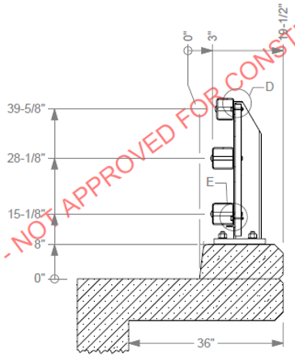
MASH Testing of MassDOT S3-MTL4 Curb Mounted & Back of Sidewalk Mounted Bridge Railings
MASH Testing of Massachusetts S3-MTL4 Curb Mounted Railing
Full Matrix MASH TL-4

Slide 13
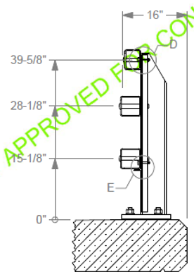
MASH Testing of MassDOT S3-MTL4 Curb Mounted & Back of Sidewalk Mounted Bridge Railings
MASH Testing of Massachusetts S3-MTL4 Back of Sidewalk Mounted Railing
Full Matrix MASH TL-4

Slide 14
MASH Testing of Transition from Weak Post MGS System to Strong Post MGS System
TTI Researcher: Chiara S. Dobrovolny
Technical Representative: David Kilpatrick (CTDOT)

Slide 15
MASH Testing of Transition from Weak Post MGS to Strong Post MGS
Full Scale MASH Tests 3-21 and 3-20 on Downstream End of Weak to Strong Transition

Slide 16
MASH Testing and Evaluation of the Merritt Parkway Guiderail
TTI Researcher: Chiara S. Dobrovolny
Technical Representative: David Kilpatrick (CTDOT)

Slide 17
MASH Testing and Evaluation of the Merritt Parkway Guiderail
Planned full scale MASH tests:
Test 3-11 & 3-10 on LON, no Curb
Test 3-11 & 3-10 on LON, With Curb
Test 3-21 & 3-20 on Transition to Concrete Parapet

