Slide 1
09/10/18
Fall Meeting Guide
MASH Implementation Pooled Fund
Annual Meeting
Fall 2018
PURPOSE OF THIS SUPPLEMENT
Extensive outreach took place prior to this year’s meeting in order to constrain the scope of discussions to those items most important to the team. Those items have been listed in this supplement. We have a limited time, and can only discuss a limited number of things. It is important that the team stay true to the team-endorsed n topics listed.

Slide 2
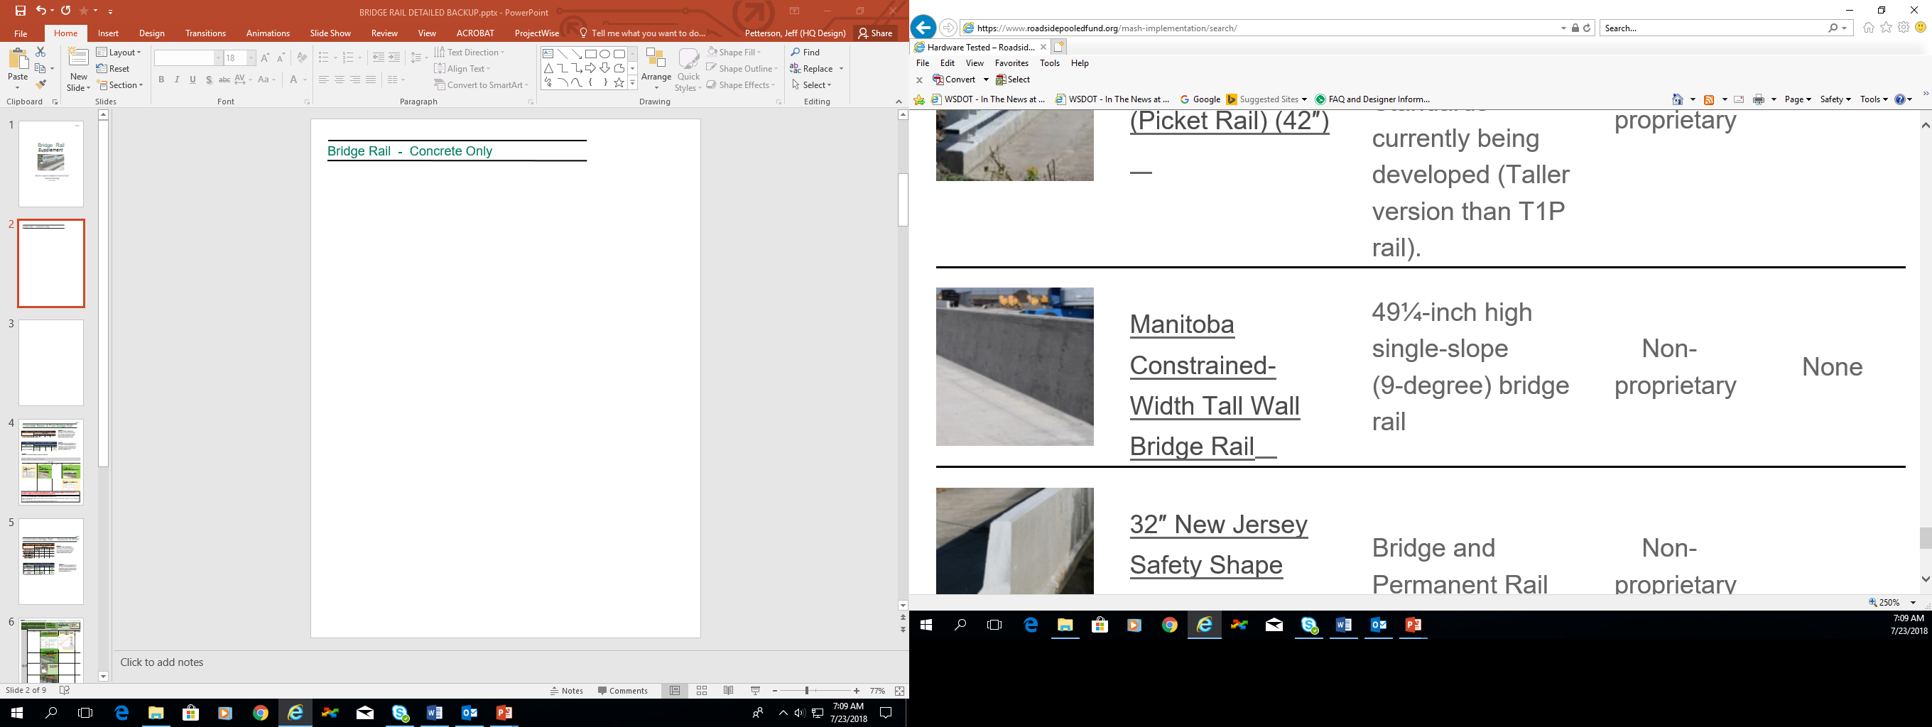
Bridge Rail Concrete Only
Reminder:
Bridge Rail Concrete Only developed tables
NCHRP 20-07 Task 395 – global equivalency and rail specific analysis
MASH Database
Potential Projects | Discussion | PO Item | To voting
Compliance determination of 10.8 degree (42”) single slope barrier for TL-5 | What remains for this to be completed is a formally recognized opinion on this system. TTI feels that we have the experience to classify the system as MASH compliant, but need a formal document that doesn’t currently exist to confirm this. TTI could make this if directly requested.
Compliance determination of 10.8 degree 42” and 54” single slope barrier for TL-5
TL-5 Permanent median precast concrete barriers embedded in asphalt | Comment from Ontario’s: “cast-in-place design was crash tested by TTI in 1990 (TL-5) and is detailed as Type TW in attached MTOD 911.132 (Jan/18) which now includes an equivalency note regarding MASH TL-5. The details for the precast version are provided in attached OPSD 911.143 (Nov/13), which has the same geometry and 3” embedment depth into pavement as MTOD 911.132. However, the precast version has not been crash tested and we have not tried to evaluate the design from a “strength” perspective as TTI had done for bridge rails under Project 20-07/Task 395”. This project would require engineering evaluation for strength determination and full-scale testing 5-12
Strain Gauges on Deck Reinforcement for data collection purposes | From Oregon: “is it possible we put strain gauge at the deck overhang to obtain data on the actual demand on the deck overhang with new round of MASH testing? Then, we would have correlation on the impact load, rail resistance and deck overhang.” If there is someone willing to fund the extra instrumentation on one or more tests, TTI can certainly do that.
The items listed above were generated from the following comments from then Survey:
•What work remains for confirming the 10.8 single slope barrier is MASH TL-5 compliant and when will that be done? It is currently shown as light green meaning TTI feels it is MASH compliant but is not yet completed. (IL)
•MnDOT is interested in seeking a “Professional Opinion” validating the 10.8 degree 42” tall single slope barrier meets MASH TL-5. Seeking the same for 54” tall 10.8 degree single slope barrier (used for glare screen protection). (MN)
•Precast concrete barrier options for TL-5 permanent median concrete barriers embedded in asphalt on both sides. (ONT)

Slide 3
Concrete Beam & Post Bridge Rail
Reminder:
Bridge Rail Concrete Beam and Post developed tables
NCHRP 20-07 Task 395 – global equivalency and rail specific analysis
MASH Database
From Caltrans:
Working/will be working on:
• State historic concrete bridge rail (post and beam), in the concept phase.
Potential Projects | Discussion | PO Item | To voting
Taller (e.g. 54”) concrete post & beam railing (TL-4) | Michigan Appears to be looking for something like drawings B-26-F (only practiced option), TL-4, Intended for metal only but a concrete option could be equally beneficial
TL-3 concrete post & beam | Concrete Beam & Post developed table shows already a MASH TL-3 concrete post beam system. https://www.roadsidepooledfund.org/concrete-beam-post-bridge-rail/ Is there a need for different design details to be considered (different height rail?) Project would require design and full-scale test (3-11 and 3-10)
TL-4 42” Concrete Post & Beam | Caltrans research project for 36” vehicular bridge rail/42” combination bridge rail (vehicular & bicycle) (w/ metal rail on top) TL-4 systems by 2019. Design complete. If a 42” entirely as concrete post & beam is desired, project would require design and full-scale test (4-12, -11, -10)
The items listed above were generated from the following comments from then Survey:
• Taller railing options (e.g., 54" tall) should be considered for agencies that use 54" tall barriers for certain applications involving pedestrian/bicyclists“ (MI)
• “Does the group want to develop a generic MASH TL-3 concrete post beam system? (TEN)
• Discuss potential for an (aesthetic) 42" TL-4 Post & Beam parapet, not a high priority, but something of interest. (UT)
NOTES:

Slide 4
Metal Only Bridge Rail – Deck Mounted
Reminder:
Bridge Rail Metal Only – Deck Mounted developed tables
NCHRP 20-07 Task 395 – global equivalency and rail specific analysis
MASH Database
Potential Projects | Discussion | PO Item | To voting
Taller (e.g. 54”) metal only deck mounted railing (TL-4) | Michigan Appears to be looking for something like drawings B-26-F (only practiced option), TL-4 (See previous document with Concrete Beam & Post)
Modified 42” TL-4 (Caltrans) or 42” TL-5 (B274) to 48” or 53” | The Caltrans ST-70 is mounted on a curb. Caltrans will replace it by ST-75, which is 36” vehicular bridge rail /42” combination bridge rail (vehicular & bicycle) TL-4 system. Design completed. Testing by 2019. Project would require re-design and full-scale testing (4-12, 4-11 and 4-10). But it would be side mounted. B274 is for Triborough Bridge and Tunnel Authority (TBTA) Bridge Rail, all steel rail.
The items listed above were generated from the following comments from then Survey:
• Taller railing options (e.g., 54" tall) should be considered for agencies that use 54" tall barriers for certain applications involving pedestrian/bicyclists“ (MI)
• Is there an opportunity to easily modify the 42" TL-4 (CalTrans) or 42" TL-5 (B-274) rails to also meet combination traffic/cycling barrier requirements with a height of 48" or 53"? (ONT)
NOTES:

Slide 5
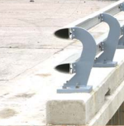
Metal Only Bridge Rail – Side Mounted
Reminder:
Bridge Rail Metal Only – Side Mounted developed tables
NCHRP 20-07 Task 395 – rail specific analysis
MASH Database
Potential Projects | Discussion | PO Item | To voting
 | Discussion /Needs on existing systems available and on proper transitions to W-Beam. (W. VA) Is there a potential project the Members would be interested in funding?
Concrete & Metal Bridge Rail –Traffic Only with Curb
Reminder:
Bridge Rail Combination Concrete Metal – Traffic Only with Curb developed tables
NCHRP 20-07 Task 395 – rail specific analysis
MASH Database
Potential Projects | Discussion | PO Item | To voting
Alaska Multi-State Bridge Rail on curb (or similar), TL-4, 36” height | TTI currently working on a project related to Alaska Multi-State Bridge Rail at TL-4 (full matrix testing).
Oregon 3 Tube Bridge Rail (FHWA letter B-118) | TTI has completed PO analysis on the Oregon-3 Tube to display to members.
Colorado TY 10 MASH, TL-4 | Colorado currently working on a TL-4 Mash Bridge rail. See provided drawings
TL-2 or TL-3 Curb Mounted Railings or Traffic Mounted on top of Culvert | MwRSF completed WisDOT Strong Post, Culvert Mounted MGs, TL-3 (passed -11 and -10). See MwRSF presentation dated June 27, 2018, slide 34.
 | Discussion /Needs on existing systems available and on proper transitions to W-Beam. (W. VA) Is there a potential project the Members would be interested in funding?
The items listed above were generated from the following comments from then Survey:
• Would like to see a rail similar to the Alaska Multi State Bridge Rail (mounted on a small curb) but at a TL-4, 36" height. Also similar is the Oregon 3 Tube Bridge Rail (FHWA letter B-118)". (LA)
• Are there TL2 or TL3 curb mounted railings or traffic mounted with parapet that can be used on top of culverts? (MASS)

Slide 6
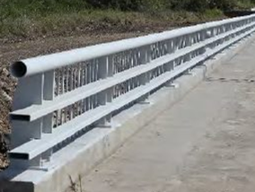
Concrete & Metal Bridge Rail - Traffic Only w/ Parapet
Reminder:
Bridge Rail Concrete Metal – Traffic Only w/ Parapet developed tables
NCHRP 20-07 Task 395 – global equivalency & rail specific analysis
MASH Database
Potential Projects | Discussion | PO Item | To voting
Concrete & Metal Bridge Rail – Traffic/Pedestrian w/out Sidewalk
Reminder:
Bridge Rail Concrete Metal – Traffic & Pedestrian w/out sidewalk developed tables
NCHRP 20-07 Task 395 – global equivalency & rail specific analysis
MASH Database
Potential Projects | Discussion | PO Item | To voting
TL4 Combination Concrete & metal meeting 48” to 54” requirement for bicycles. Includes looking at modifying any existing 42” systems. | Similar comments from IL and ON. MwRSF working on Iowa combination bridge separation barrier /bicycle railing (2-11 planned). Project would require design and full-scale testing (4-12, 4-11 and 4-10).
42” Aesthetic Rail for introduced shared path to the existing shoulder on bridge deck | From TN: “Anything but W-beam GR or concrete barrier. Products such as structural tubing or decorative concrete parapets are available but I don’t know if they are satisfying the height requirements since they were developed evaluating vehicle only.” Project would require design and full-scale test (TL-3? - 3-11 and 3-10).
42” TL2 or TL3 metal railings for low volume roads | See attached documents from Massachusetts, “These are designed for low speed roads and they have the advantage of just running the guardrail without having to transition to a bridge rail and back.” Project would require design and full-scale test (-11 and -10).
• An aesthetically pleasing rail system at minimum 42" tall when a bike lane or a shared use path is introduced to the existing shoulder on a bridge deck". (TN)
• Any Combination Bridge Rail – Concrete and Metal that meet TL-4 vehicular requirements and also meet the 48” to 54” height requirement (and other geometry requirements) for bicycles? Testing underway for such a rail? This would be used on the outside of a bridge where bicycle traffic is expected on the shoulder, or to separate traffic from bicycles and pedestrians such that the back side of the rail would need to be bicycle/ped compliant. (IL)
•Is there an opportunity to easily modify any of the 42" high systems to also meet combination traffic/cycling barrier requirements with a height of 48" or 53"? (ONT)
• TL2 or TL3 metal railings for low volume roads where pedestrians are not prohibited (MA).

Slide 7
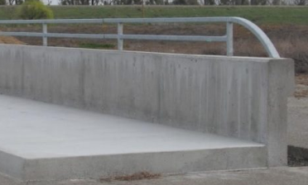
Concrete & Metal Bridge Rail –
Traffic and Pedestrian WITH Sidewalk
Reminder:
Bridge Rail Combination Concrete Metal – Traffic & Pedestrian with sidewalk developed tables
NCHRP 20-07 Task 395 – global equivalency & rail specific analysis
MASH Database
Caltrans tested 732SW system (vertical, reinforced concrete wall on a sidewalk with a pedestrian steel tubular handrail on top) (B259)
https://www.roadsidepooledfund.org/longitudinal-barrier/caltrans-type-732sw-bridge-rail/
Test 3-10 resulted in a ridedown acceleration outside MASH 09 limits. Was further reduced to TL-2.
Potential Projects | Discussion | PO Item | To voting
Investigating curb/sidewalk impact to parapet wall height | Comment from Tennessee: “Guardrail placement offset distance from the curb is based on posted speed so, the question is when a 6” curb added wit 5 ft. sidewalk is the existing 32” parapet is still OK or 10 ft. sidewalk or 36” barrier etc. is needed to mitigate.”
Modifying 42” systems to reach 48”+ Height, TL-4 | Comment from Ontario: “Can the pooled fund consider a design modification to the NM design (Project 20-07/Task 395, page 129, see attached document to this question) to add additional lighter railing(s) on top (or angled away from traffic to accommodate TL-4 ZOI) of the 42” TL-4 system to increase overall height to 48” or 54” for cycling without compromising TL-4 performance or become detached to potentially fall on traffic below bridge? Could this be done for an installation on top of a concrete curb (instead of the steel angle iron) or on a sidewalk?” Project would require design and full-scale testing (TL-4?, 4-12, 4-11 and 4-10).
Comments from the survey:
• Investigate the potential impact of curb/sidewalk to previously studied bridge parapet wall height (TN)
• Is there an opportunity to easily modify any of the 42" high systems adjacent to sidewalks to also meet combination traffic/cy cling barrier requirements with a height of 48" or 53"? (ONT)
NOTES:

Slide 8
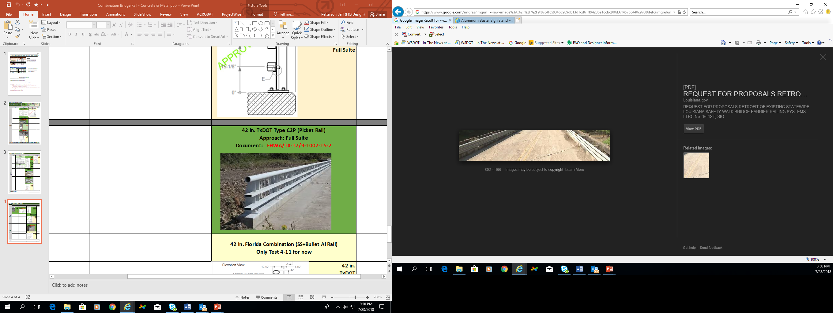
Retrofits
TTI (W. Williams) is analyzing some retrofits for TxDOT
Please review MASH Database:
TxDOT Type T131RC (MASH Test 3-11)
https://www.roadsidepooledfund.org/longitudinal-barrier/txdot-t131rc-bridge-rail/
Potential Projects | Discussion | PO Item? | To voting?
TL2/TL3 Retrofit for Aesthetic/Historic Railings | Project would require design and full-scale testing (-11 and -10).
Thrie Beam Retrofit Option | Project would require design and full-scale testing (-11 and -10).
TL-3 Old Bridge Deck Retrofit | Project would require design and full-scale testing (3-11 and 3-10).
Retrofitting replacement concrete barriers into existing bridge decks | Dowelling is possible if the bar strength can be developed based on epoxy & available embedment depth (e.g. 6”)
Information collection for retrofitting bridge rail | This was a need that was brought up at the last Webex call with the Members. Erik (WI) submitted document WI created for this purpose.
Many states commented on the need for retrofit options:
• Are there TL2 or TL3 curb mounted that can be used as retrofit in front of existing railings that need to be kept for aesthetic or historic purposes? (MASS)
• A Thrie Beam Retrofit option should be considered (Michigan)
• We are more interested in options for retrofitting old bridge decks. In that case we suggest TL-3 (Utah)
• Discussion or guidance for retrofitting (dowelling) replacement concrete barriers into existing bridge decks. For example, with reference to Fig. 4.46 or 4.48 from TTI Task 395 report, is guidance available for dowelling the TL-5 F-Shape barriers into existing bridge decks, more specifically , the angled bar adjacent to the lower traffic face of barrier? (ONT)
Information collection for retrofitting bridge rail (WI)
NOTES:

Slide 9
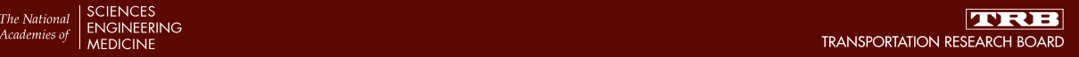
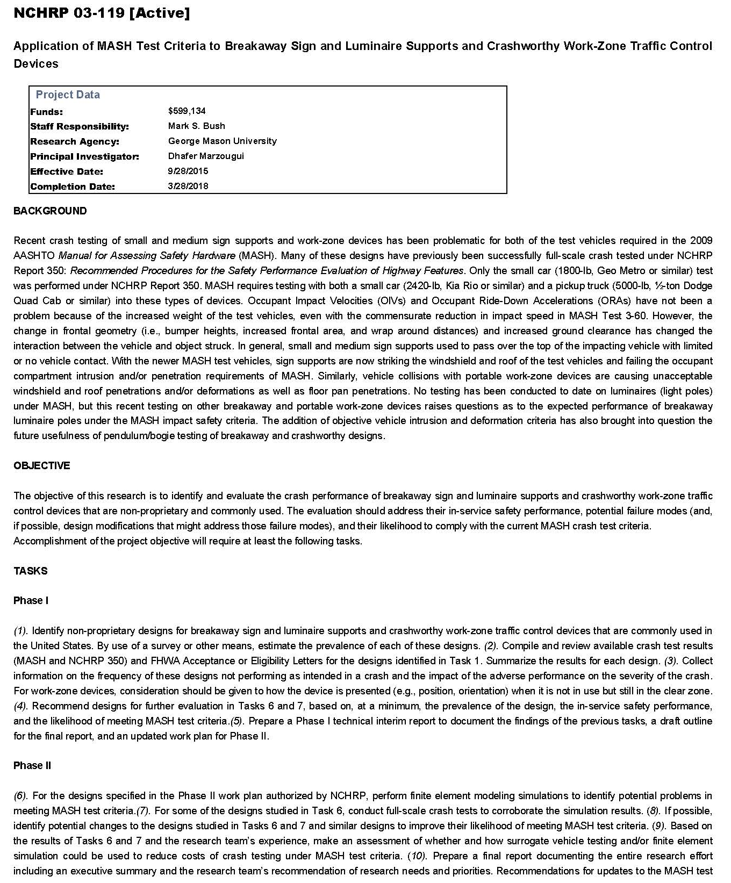
Before discussing sign supports, other breakaway hardware and temporary work zone devices....

Slide 10
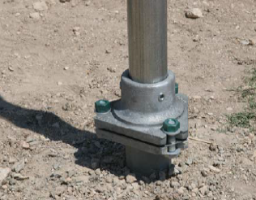
Breakaway Devices (see Scorecard 3f)
Consider NCHRP 03-119, active project
http://apps.trb.org/cmsfeed/TRBNetProjectDisplay.asp?ProjectID=3857
Proposed, but not yet approved, simulations of:
(1) Luminaire poles with TB1-17 transformer base (varying pole sizes)
Some might be selected for testing, not a list yet
Please refer to MASH Database as well for existing projects.
Potential Projects | Discussion | PO Item | To voting
Luminaire Supports | Currently, no luminaire supports are MASH compliant. NCHRP 03-119 to look into simulations and possibly testing of one luminaire system base only. DOTs expressed need for luminaire support compatible with MASH.
Conventional / Non-conventional size Mailbox supports | Very limited testing with mailbox supports, mainly from TxDOT. Any need from conventional / non-conventional size mailbox supports?
Comments from the Survey:
Slip-Base Luminaire Supports (OR)
Light Poles on Frangible/Breakaway Transformer Base (FL)
No Survey comments were made on Mailboxes, however we wanted to offer an opportunity for states to propose any individual issues on the matter that may benefit other states.
NOTES:

Slide 11
Sign Supports (see Scorecard 3f)
Consider NCHRP 03-119, active project
http://apps.trb.org/cmsfeed/TRBNetProjectDisplay.asp?ProjectID=3857
Proposed, but not yet approved, simulations of:
(1) 7’ wood post signs (single, dual, and triple posts with various post dimensions)
(2) 7’ PSST post signs (single and dual posts with various post dimensions)
(3) 7’ U-channel post signs (single and duals posts with varying weights, yield strengths, and splices)
From Caltrans:
Working/will be working on:
• An 18 ft. tall breakaway Flashing Beacon Pole System (Type 15 FBS) testing commenced but it is a lower priority at the moment.
• Two post sign support (project not started yet)
Please refer to MASH Database for existing systems, as well as TTI, Caltrans and MwRSF planned testing.
Potential Projects | Discussion | PO Item | To voting
Wood Sign supports | TxDOT tested 4x4 wood support and failed. Any other size that would become priority for testing?
Multi-Directional Slip Bases | Request from multiple DOTs. Also, this device need arose already a few years ago.
Comments from the Survey:
4x6 Wood Post - In foundation with sleeve (not direct embed) (Michigan)
Timber posts being MASH acceptable (Washington)
Small wooden sign support systems such as AASHTO SSF20a-b and PDP20-24 (4x4 through drilled 6x8 rectangular timbers - will also need to discuss wood grade and species) (Ontario)
Multi-post Slip-Based Sign Supports w/Hinge Plates or Fuse Plates (Florida)
Multi-Directional triangular slip base for 2", 3", and 4" nominal diameters (Louisiana)
Multi-post Breakaway Sign Supports (Oregon)
NOTES:

Slide 12
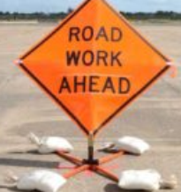
Temporary Work Zone Devices
Please refer to MASH Database for existing projects.
NCHRP 03-119: proposed, but not yet approved, simulations of:
1- Potentially some work zone signs – TBD
2- Generic Type III barricade
Some might be selected for testing, not a list yet
Potential Projects | Discussion | PO Item? | To voting?
Sign Supports /stands | TxDOT has funded and conducted a variety of testing. Anything needed that hasn’t been covered yet?
Arrow board and VMS/PCMS | Project would require R&D effort and full-scale testing per MASH matrix.
Barricades (Type III?) | Project would require full-scale testing per MASH matrix. See NCHRP 03-119.
NOTES:

Slide 13
Fences, Glare Screens, noise walls etc. on top of barrier & parapets
An NCHRP Problem Statement (PS) is being submitted for FY2020 on “Crashworthiness of barrier attachments” (Keep in mind the PS needs to be first prioritized for project consideration and, if it makes it, research won’t start until at least Spring 2020)
Potential Projects | Discussion | PO Item | To voting
Noise Walls on Parapet | Project requires design and full-scale test (?4-12?, -11 and -10).
Fence Attachment to top of Barrier (Parapet?), such as glare screen or visual barrier. | Project requires design and full-scale test (4-12, -11 and -10).
Debris/ Glare Screens/Visual Barriers on top of barriers (Parapets? Guardrail?) | Project requires design and full-scale test (-11 and -10).
State comments on these topics:
Noise Walls on Parapet: The AASHTO BDS does not provide much guidance, but indicates that as long as the parapet remains rigidly connected to the base that the noise wall on parapet maintains its crashworthiness. Does a noise wall need other criteria such as limitations to reveal depths or locations of expansion joints? (Utah)
TN Has also expressed interest in Noise Walls as a Crashworthy Device.
The enclosed is the AASHTO LRFD bridge code excerpt related to noise wall protection. I would like to have this code to be evaluated during our meeting: “Owners may select to ignore vehicular collision forces in the design of sound barriers at locations where the collapse of the sound barrier or portions of thereof has minimal safety consequences”…The statement below from the subject document is confusing. One could conclude a noise wall could be crashworthy device. (Tennessee)
Debris screen or glare screen for top of 32" PCB. (Ontario)
Glare Screens/Visual Barriers (Florida FDOT)
TL-3 and 4. Potentially discuss a fence attachment to the top of a parapet. (Delaware)
Breakaway splash fence or chainlink atop rails within zone of intrusion (Colorado)
NOTES:

Slide 14
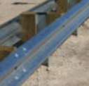
“Past Categories (Guardrails)”
Potential Projects | Discussion | PO Item | To voting
TL-2 Configuration (12'-6" Post Spacing) with Curb. | Existing MASH system: MGS Offset 6 ft behind 6-in. curb, MASH compliant for TL-2 applications, post spacing 6’ 3”. Also, TL-3 MGS w/ 6” curb 6” in front of w-beam rail. Project would require design and full-scale testing (-11 and -10). Also, Project previously discussed but didn’t make the cut.
Thrie Beam | Project would require re-design and full-scale testing (-11 and -10).
Investigating more space on a W-beam 6-in behind curb and gutter | Existing TL-3 MGS w/ 6” curb 6” in front of w-beam rail. Project would require design and full-scale testing
Guardrail evaluation on 6:1 slope | The more the slope increases (from 10:1 to 6:1, for example), the more space you will have from the local ground to the bottom of the W-beam rail. The MGS has been tested with a mounting height of 36” to accommodate layovers. 3-10 passed. It might be safe to assume that if you place your 31” MGS system on a 6:1 slope at a lateral distance in the slope that gives you a total MGS height of 36” (from local ground), you should be fine. However, it might require more engineering evaluation on how the post would behave on a 6:1 slope rather than 10:1 or flatter, with little less embedment at back of the post.
MGS down to 8:1 slope break (TL-3) | Project previously discussed but didn’t make the cut. Project would require (design mod?) and full-scale testing (3-11 and 3-10)
MGS non-blocked with reduced post spacing | Non-blocked MGS w/ 6’3” post spacing has FHWA Eligibility Letter B243. Project previously discussed but didn’t make the cut. Project would require (design mod?) and full-scale testing (3-11 and 3-10)
MGS Median Barrier (Non-Blocked or 12” block) | MGS Median Barrier with 8” Block already MASH compliant https://www.roadsidepooledfund.org/longitudinal-barrier/w-beam-median-barrier/ Item submitted for PO last year. Our PF mostly interested in 8” Blocks.
MGS (8” Blocks) w/ breakaway steel posts on curb | Item from previous years discussions. Project would require design and full-scale testing (3-11 and 3-10)

Slide 15
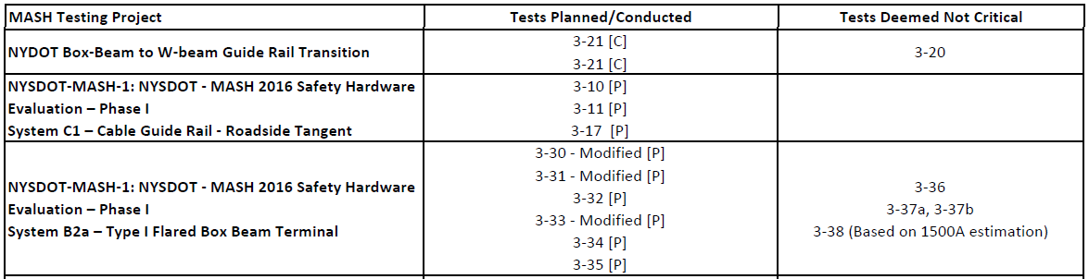
“Past Categories (Guardrails)” Continued
Comments from the survey:
• W-beam, half-spacing, quarter-spacing (MN) Project funded last year through PF.
• W-beam installed 6-inches behind a 6-in curb and gutter. Installing face of guardrail directly above the face of curb is acceptable, however, a little more space would be desirable. Any information on this? (AK).
• Check with FHWA/pool fund, etc if Weathering Steel is MASH compliant. (PA)
https://safety.fhwa.dot.gov/roadway_dept/countermeasures/faqs/qa_bttabr.cfm#brrs1
Not aware of any generic crash testing using A588; FHWA strongly recommends if specifying A588 steel to adopt TTI inspection procedure. TTI opinion is that is MASH compliant provided that structural integrity is maintained.
• We are proposing only using guide rail on 10:1 slopes or flatter. Under NCHRP 350 slopes up to 6:1 was allowed for standard installations. Has the Type 31-S been MASH crash tested on 6:1? Or can we use engineering judgement to keep allowing installations on 6:1 slopes? (PA)
• Box beam? To what extent? G3 Weak Post Box-Beam Guardrail (3-11) passed under NCHRP 22-14(3)
https://www.roadsidepooledfund.org/longitudinal-barrier/g3-weak-post-box-beam-guardrail/
Also, Wyoming DOT funded an effort for testing 3-10
MwRSF conducting the following:
• Thrie beam? Thrie beam failed MASH. We could fund a research effort to modify and re-test the new design. (Suggestions: reduce length (height) of blockouts, leaving lower corrugation unsupported)
• TL-2 Configuration (12'-6" Post Spacing) with Curb. (FL)
NOTES:

Slide 16

“Past Categories (Cast-in-Place / Precast)”
Potential Projects | Discussion | PO Item | To voting
Evaluating CIP flaring around fixed objects (20:1 or steeper flare) | Project would require FEA analysis to determine critical CIP flaring and possibly full-scale testing (3-11).
Evaluating min. LON for CIP before barrier performance failure | Project would require FEA analysis to determine minimum LON for CIP and full-scale testing (3-11, 3-10).
Post Tensioned, Segmental Precast bolt-on/combination bridge rail | Project would require design and full-scale testing (4-12?, -11 and -10).
Oregon 42” pin & loop design for professional opinion | Current barrier evaluated in PF is based on Oregon TL-3 Pin & Loop – what advantage of 42”? TL-4?
CIP w/ grade separation | Previously funded PF project for TN https://www.roadsidepooledfund.org/tl-4-design-and-analysis-for-sloped-meidan-wall-for-grade-separations-405160-35/ Need for new project – other type of foundation?
CIP (TL-3, 4 or 5) (unreinforced or steel reinforced) no asphalt embedment on back side | Tested SS (TL3) (B225) - Offset 2-ft from 1.5:1 Slope https://www.roadsidepooledfund.org/longitudinal-barrier/single-slope-barrier/
Comments from the survey:
• I'm not sure that the cast in place around fixed objects has been tested or even if it needs to be tested. I have been operating with the understanding that flaring around a fixed object with a 20:1 or flatter flare was acceptable. (TX)
• We are in need of knowing how close to the end of a barrier run can a vehicle impact without barrier failure. For example, can a vehicle impact the last 10 feet of cast-in-place barrier run without barrier failure such as barrier rotation exposing a parapet end? (UT)

Slide 17
“Past Categories (Cast-in-Place / Precast)” Continued
Comments from the survey:
• A bolt-on steel or combination bridge rail suitable for use with post tensioned, segmental precast bridges.
•"Oregon has a 42" pin & loop design that we would like to test or get a professional opinion. Are any of the other states interested in our design?" (note that the pooled fund is committed to a different barrier, and has done much testing on it)
• CIP barrier w/ grade separations (“step barrier”): “We would like to have a tested option for "step“ barrier, where the opposing roadways with a median barrier are at different elevations” (MN). is a professional opinion warranted?
• CIP roadside concrete barriers (TL-3, 4 or 5) (unreinforced or steel reinforced) with no asphalt embedment on back side (just granular base with 2' width to 2H:1 V fill slope).
NOTES:

Slide 18
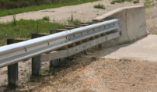
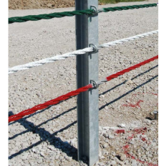
“Past Categories
(Transitions, Cable Barriers,
End Terminals)”
Potential Projects | Discussion | PO Item | To voting
Generic Cable Systems | Project would require design and full-scale testing per MASH matrix. MwRSF is working on re-design of high tension cable median barrier (3-11 narrow spacing; 3-17 wide spacing). Also, see at testing effort funded by NYDOT on “Cable Guide Rail – Roadside Tangent and Terminal” (MWRSF)
Deck Mounted TL-3 TxDOT: need for transition to W-Beam transitions for other unique rail designs | Project would require design and full-scale testing (3-21, 3-20?)
Buttress w/out Curb with Small Footprint | Project proposed by Tennessee – “look into use of a buttress w/out curb, with a smaller footprint than the one MwRSF had:”
Stacked W-Beam to MGS (TL-3) | Stacked W-beam FAILED MASH. The possibility for a re-design and re-test project was previously discussed but didn’t make the cut. Still DOTs expressed interest in this. Project would require design mod\ and full-scale testing (3-21 (and 3-20?))
W-beam downstream connection (TL-3) | This need was previously discussed but didn’t make the cut. (crash test?)
Buried-in-Backslope on 6:1 slope without rubrail | The BIB was tested and deemed MASH compliant with inclusion of Rubrail, installed on a 4:1 foreslope with 2:1 backslope. Project would include computer simulations and 2 full-scale crash tests.
Comments from the survey:
• Generic cable systems
• Deck Mounted TL-3 TxDOT, discuss need for transition to W-Beam Transitions for other unique rail designs (W. VA)

Slide 19
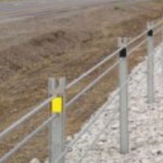
Proprietary Systems Roundtable Discussion
(cable, flared terminals, attenuators)
Cable Barrier
Note that after the team survey, the implementation date for cable barrier was pushed out to Dec. 31 2019. Team comments on cable barrier are listed below.
• Cable Barrier; can anyone in the Pooled Fund update the group on the "state" of cable barrier testing under MASH?
Manufacturers are working on testing. Likely not all will go to MASH.
MwRSF: RPFP‐19‐CABLE‐1: Redesign of the High Tension Cable Median Barrier (Continuation)
3‐11 Narrow Spacing [P]
3‐17 Wide Spacing [P]
• Cable Barrier; Is there a MASH 2016 compliant Cable Barrier on the market?
• Cable Barrier Also no barrier for 4:1 and 6:1 and whether one would satisfy the other
AASHTO Q&A addressed it.
• Cable Barrier; W-beam cable anchor system tested to MASH. Utah is looking at testing our design. Briffin has stated that they do not plan on testing their cable attachment rail element to Mash. Trinity will not reply to emails regarding future testing of any system.
• Alaska has used (not that often) a low-tension three strand cable barrier. Wondering if any non-proprietary low-tension devices are being tested?
Mothing programmed – not considered a priority to this point by partner states – can be revisited since group has grown
MASH compliant terminals
Team comments:
Have any flared terminals non-energy terminals be tested or passed ? Yes, SRT – MASH16
I have heard that the MFLEAT has passed MASH and is waiting for a letter from FHWA.
We currently allow the SoftStop and MSKT but have not approved the Lindsay product "Max-Tension". What have other states done with MASH End Terminals?
Attenuators
Team comments:
I only know of one crash cushion that has actually ran all the MASH 16 tests. Some older MASH09 systems did not run all tests.

