Slide 1
Working-Group Approach
Working Groups (WG)
(to support a more consensus based proposal development process)
Each Agency to provide contact person to participate in the WGs
Individuals bring ideas and find partners to develop ideas into proposals
Individuals and partners work offline with Chiara’s support in drafting proposals
TTI will provide a proposal template to expedite the work
The WG reconvenes when proposals are drafted to review together (summer)
Bridge Rails
Longitudinal Flexible Barriers (+ Transitions)
Breakaway Devices
Etc…

Slide 2
Proposed Group Categories
Longitudinal Barriers (+ Transitions) (Rigid)
Longitudinal Barriers (+ Transitions) (Flexible)
Bridge Rails
Crash Cushions & Terminals
Breakaway Devices & Work Zones

Slide 3
So far, regarding Guardrail Category

Slide 4
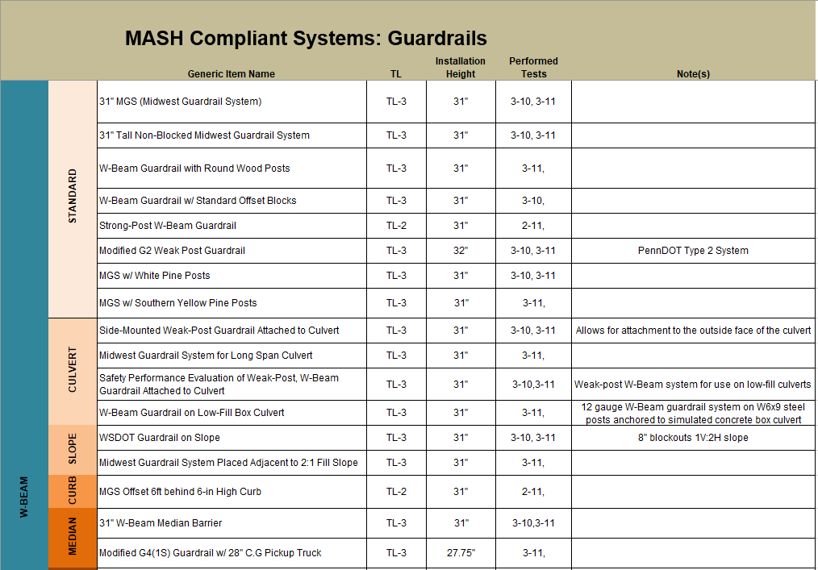

Slide 5
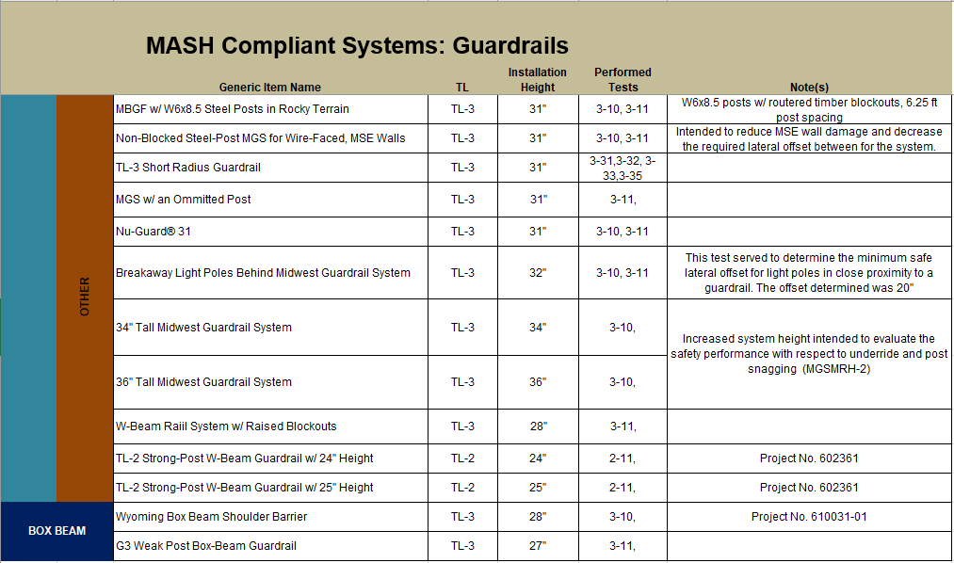

Slide 6
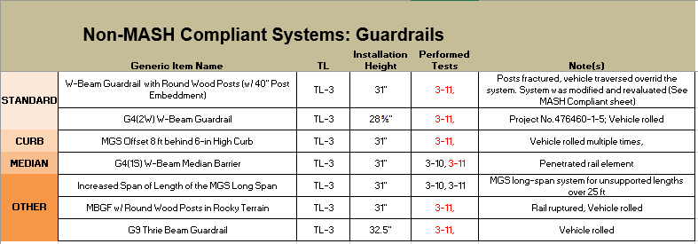

Slide 7
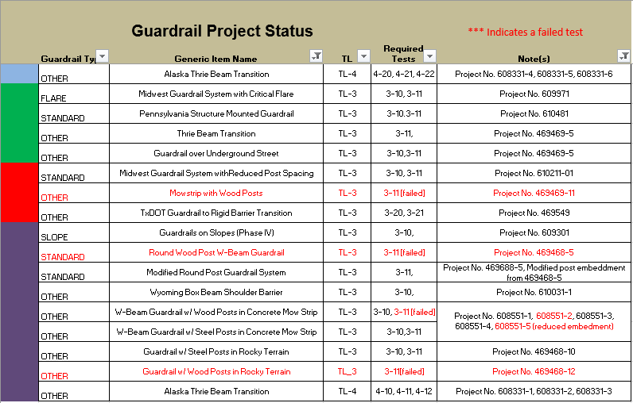
PENDING
SCHEDULED
WORKING
COMPLETE

Slide 8
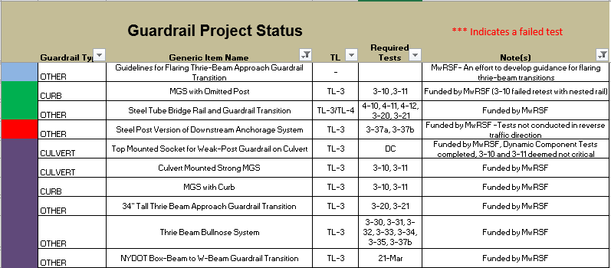
PENDING
SCHEDULED
WORKING
COMPLETE

Slide 9
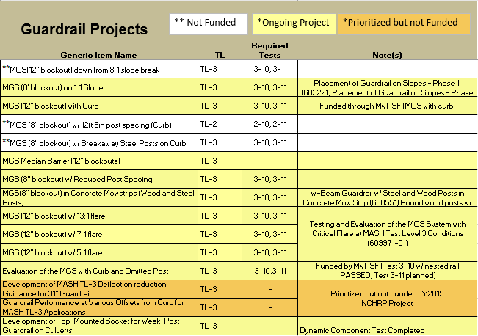

Slide 10
So far, regarding CIP

Slide 11
Cast In Place MASH Table
Link:

Slide 12
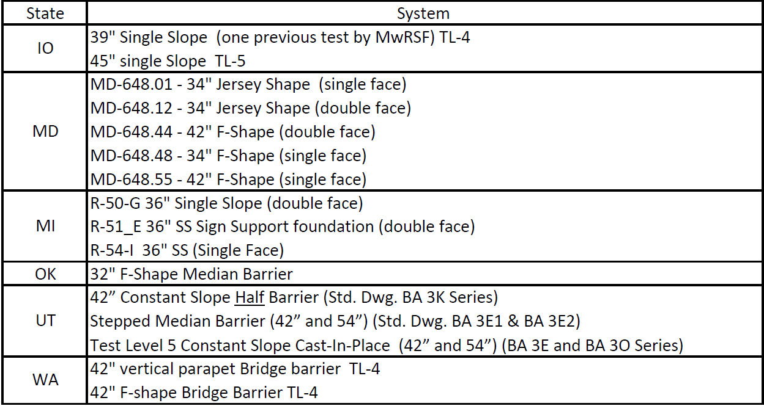
Members Cast In Place Testing Needs
LINK:

