Slide 1
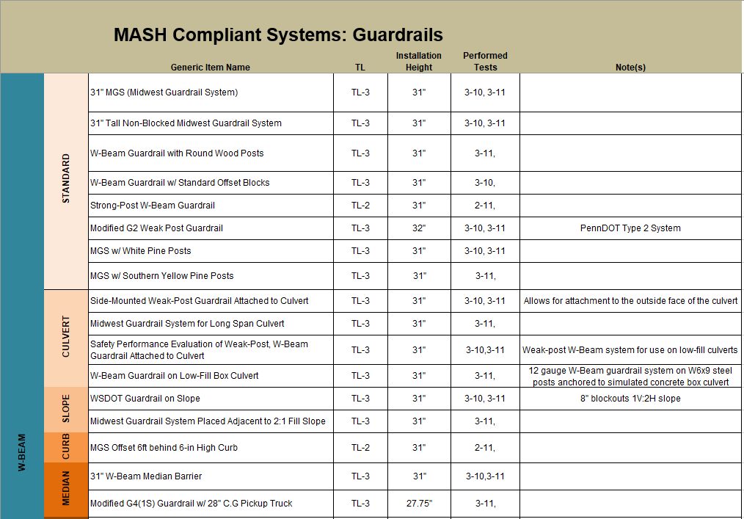

Slide 2
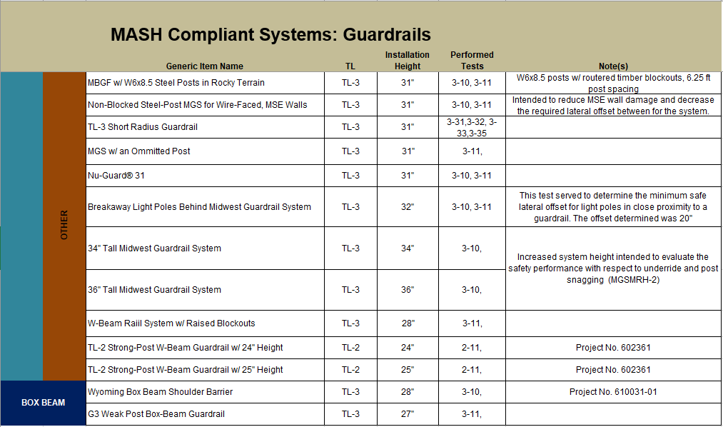

Slide 3
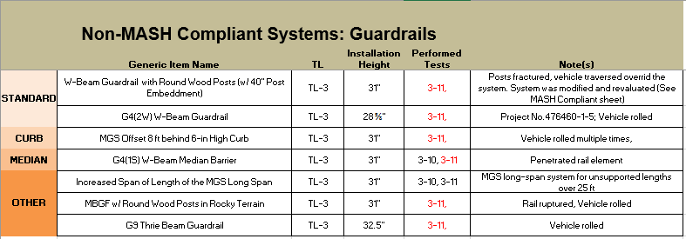

Slide 4
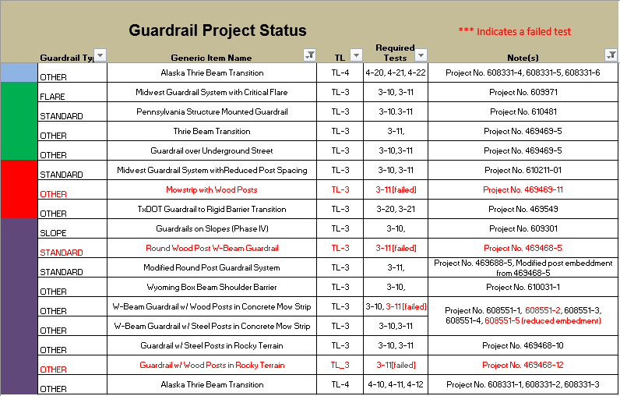
PENDING
SCHEDULED
WORKING
COMPLETE

Slide 5
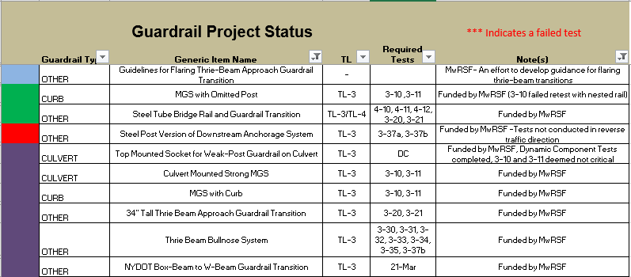
PENDING
SCHEDULED
WORKING
COMPLETE

Slide 6
