Slide 1
Wood Sign Supports
2019-01-BD
PS Developers: Scott Jollo, Jeff Jeffers, Rodney Wynn
Project Synopsis
Develop criteria for single and multiple wood post sign supports for small to medium sign sizes used for permanent and temporary installations. The project will review existing literature, determine applicable wood species and grades, determine installation details, and perform MASH crash testing.
Project Goal(s)
Identify and evaluate the crash performance of breakaway wood sign supports.
Project Background
Wood sign support 4”x4”, 4”x6”, 6”x6”, and 6”x8” posts have been successfully used for many years that include drilled weakening holes to promote controlled fracture on impact.
Recent MASH testing of single 4”x4” sign post and closely-spaced multiple 4”x4” sign posts failed due to penetration of the occupant compartment by the sign or post fragments. Evaluation of 4”x4” wood posts with different wood species and grades has not been performed and evaluation of large wood post sizes has not been performed.

Slide 2
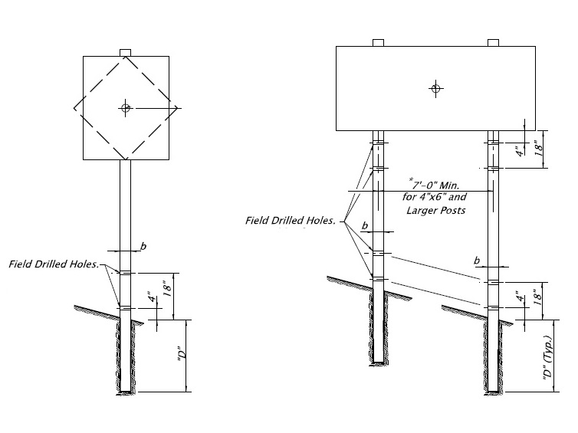
Wood Sign Supports
2019-01-BD
Wood Post Elevation

Slide 3
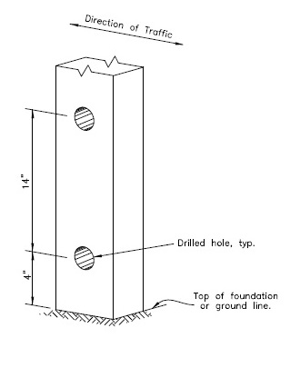
Wood Sign Supports
2019-01-BD
Wood Post Field Drilled Holes

Slide 4
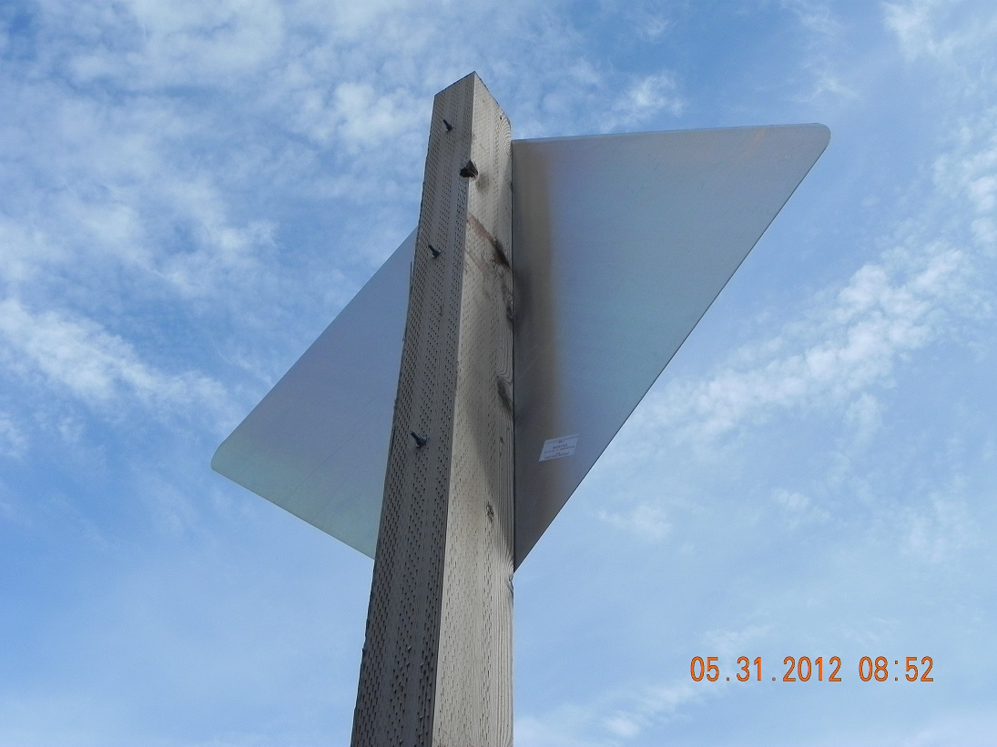
Wood Sign Supports
2019-01-BD
Wood Post Sign Attachment

Slide 5
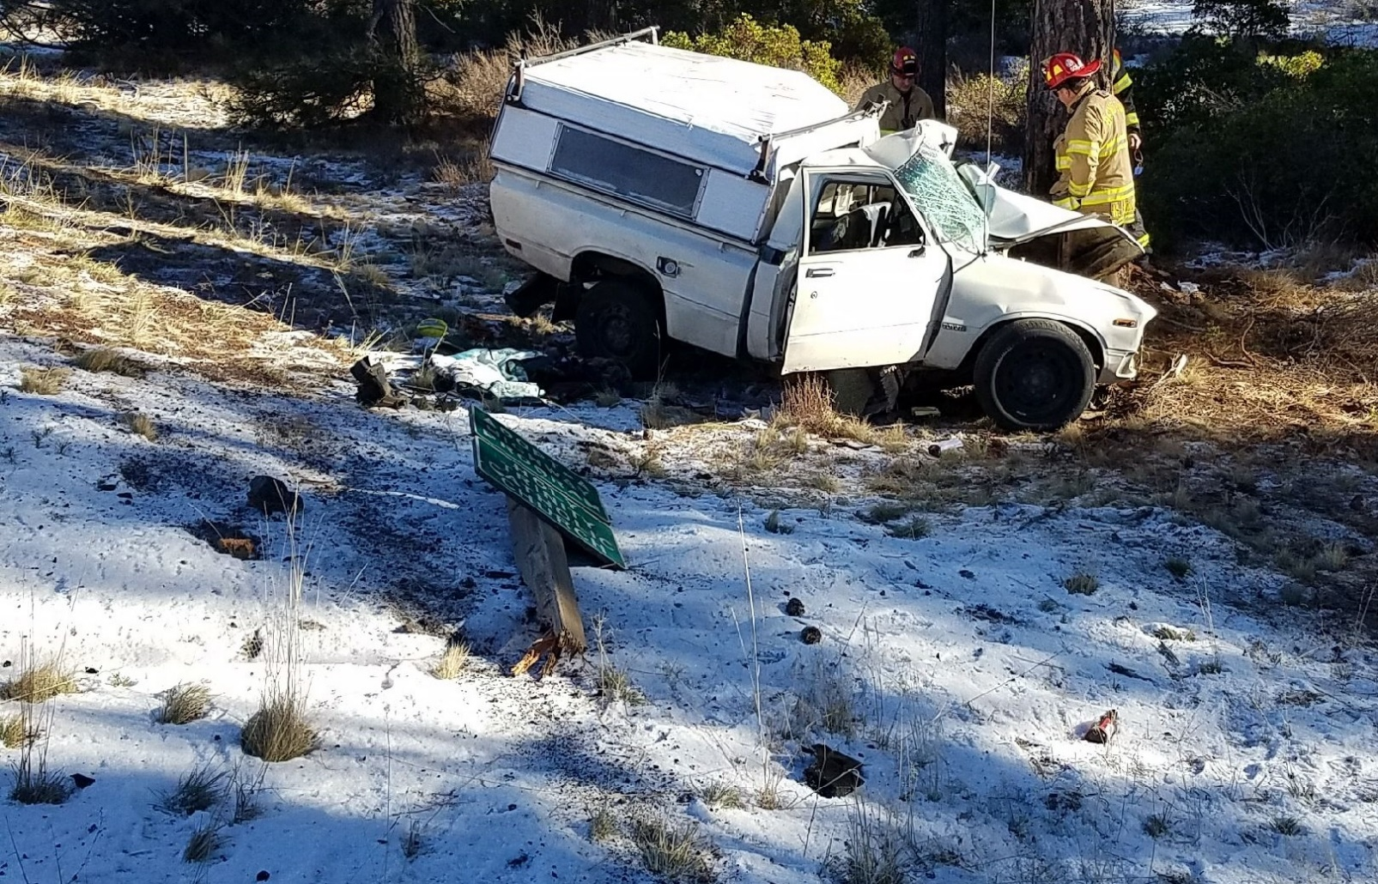
Wood Sign Supports
2019-01-BD
Wood Post Vehicle Impact

Slide 6
Wood Sign Supports
2019-01-BD
Proposed Work Plan
Literature review of previous crash testing and state standards.
Perform engineering analysis of wood post sizes, species, and weakening hole options
Conduct pendulum testing to evaluate different wood post options
Perform full-scale MASH crash testing on single and dual wood post sign systems.
Produce final report detailing literature review, engineering analysis, pendulum testing, and full-scale crash testing.
Deliverables
Summary table of successful results, including post dimension, drilled hole dimension/placement, wood species, wood grades, minimum embedment requirements, number of posts allowed in a 7-foot swath, min/max sign height.

Slide 7
Wood Sign Supports
2019-01-BD
Urgency and Expected Benefit
MASH implementation milestone for sign supports is December 31, 2019. To date, information is not available whether wood post sign supports are being evaluated by NCHRP 03-119.
Wood post material is a common, available material for sign supports. Maintenance crews can replace damaged wood sign posts with minimal engineering support. Cost of wood posts is competitive with other sign post options for small to medium-sized signs.
Funding
The estimated cost to complete the proposed project is $240,000.
Research Period
The estimated time to complete the proposed project is 18 months.

Slide 8
Steel Luminaire Supports
2019-02-BD
PS Developers: Erik Emerson, Scott Jollo, Ethan Peterson
Project Synopsis
Develop criteria for non-proprietary steel luminaire supports that satisfies MASH requirements. The project will review existing literature, determine arm and height configurations, determine installation details, perform computer simulations, and perform MASH crash testing.
Project Goals
Identify and evaluate the crash performance of breakaway steel luminaire supports.
Coordinate with researchers that are working on the NCHRP 03-119 project.
Project Background
Slip base and Frangible base luminaire supports have been successfully used across the country with a high level of safety. Changes in MASH for the roof crush criteria has raised concerns about whether or not the current maximum total weight of 1000 lbs is acceptable.
The current NCHRP 03-119 project is including luminaire breakaway supports in the research, but the extent of the luminaire breakaway supports investigation is not known.

Slide 9
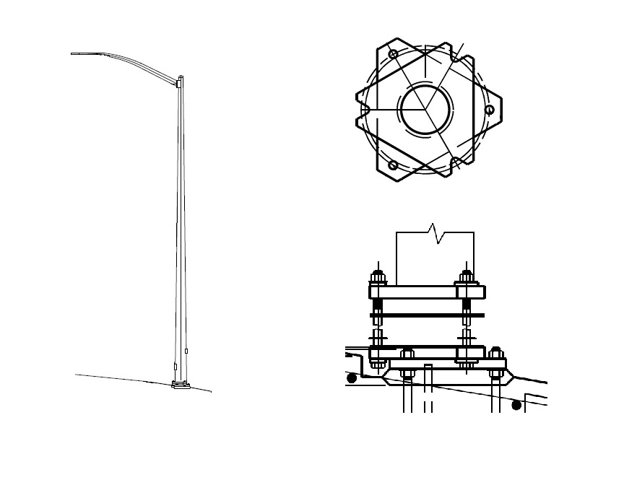
Steel Luminaire Supports
2019-02-BD
Luminaire Slip Base

Slide 10
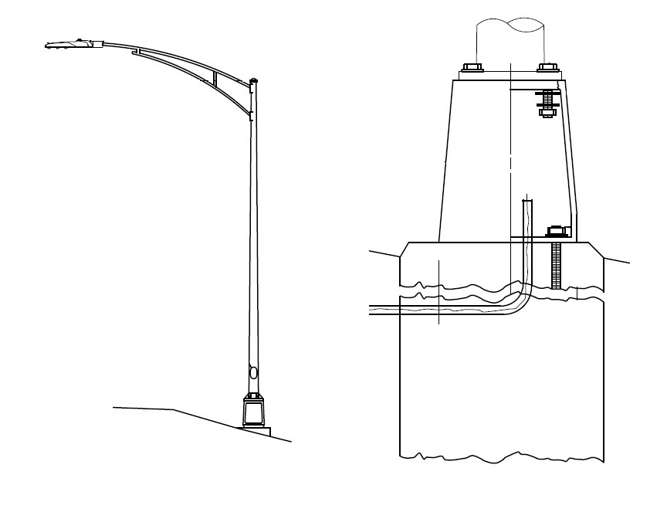
Steel Luminaire Supports
2019-02-BD
Luminaire Frangible Base

Slide 11
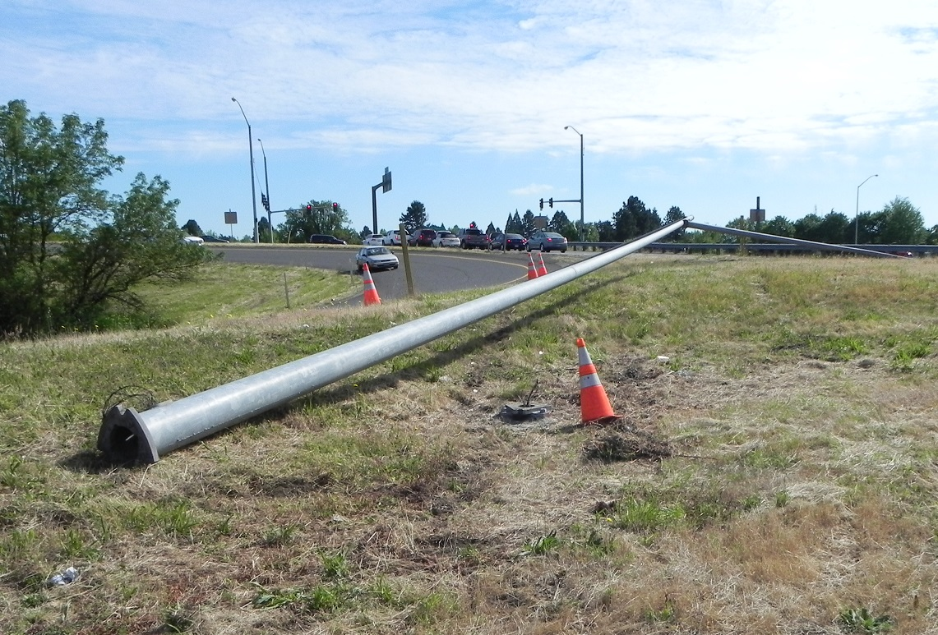
Steel Luminaire Supports
2019-02-BD
Luminaire Slip Base Vehicle Impact

Slide 12
Steel Luminaire Supports
2019-02-BD
Proposed Work Plan
Literature review of previous crash testing and state standards. Coordinate with NCHRP 03-119 project to determine extent of luminaire support evaluation.
Perform computer simulations to evaluate arm lengths, luminaire mounting heights, base type, pole sizes, and maximum weights.
Perform full-scale MASH crash testing on worst-case luminaire support configuration. The configuration used in full-scale crash testing will be selected based on simulation results.
Produce final report detailing literature review, computer simulations, and full-scale crash testing. Develop guidelines for luminaire support configurations
Deliverables
Summary table of results including breakaway base dimensions, ranges of arm lengths, range of luminaire mounting heights, base types, pole sizes, and maximum weights.

Slide 13
Steel Luminaire Supports
2019-02-BD
Urgency and Expected Benefit
MASH implementation milestone for luminaire supports is December 31, 2019.
Steel luminaire breakaway supports are very common and maintenance crews have had satisfactory historical performance.
The results of this research can move States towards MASH compliant breakaway luminaire supports.
Funding
The estimated cost to complete the proposed project is $120,000.
Research Period
The estimated time to complete the proposed project is 18 months.

Slide 14
Non-Proprietary Large Sign Supports
2019-03-BD
PS Developers: James Danila, and Joseph Sweat
Project Synopsis
DOT’s are using non-proprietary wood and steel-I-beam supports with slip bases to support large ground mounted guide signs and need assistance in determining if these designs may continue to be used and in evaluating if they will meet MASH testing requirements.
Project Goal(s)
Provide clarification to state DOT’s regarding the limits of the continued use of sign supports which meet NCHRP 350 after December 31st, 2019 and what analysis is needed to justify their continued use.
Determine if large sign supports of different shapes, materials and spacing can meet MASH test requirements. Specific evaluation of closely spaced supports (<6ft spacing).
Project Background
Previous MASH testing has been conducted on temporary large sign supports (Report 0-6782-1).
Ongoing Pooled Fund project evaluating large guide signs on flat terrain and slopes. This project is not currently evaluating closely spaced supports.

Slide 15
Non-Proprietary Large Sign Supports
2019-03-BD
Proposed Work Plan
Literature review of previous crash testing and state standards.
Evaluate various large sign supports of different shapes, materials and spacing for MASH compliance. Specific consideration will be given to closely spaced supports (<6ft spacing).
Perform full-scale MASH crash testing on large sign support system.
Produce final report detailing literature review, engineering analysis, and full-scale crash testing.
Deliverables
Provide clarification on limits of DOT’s to continue to use NCHRP 350 compliant non-proprietary steel-I-beam supports.
Provide analysis and any needed testing on the subject designs.

Slide 16
Non-Proprietary Large Sign Supports
2019-03-BD
Urgency and Expected Benefit
Based on guidance from FHWA all sign supports must meet MASH after December 31st, 2019. The inability to continue use of NCHRP 350 compliant supports will have significant adverse impacts to numerous let contracts and substantial cost to the DOT.
Funding
The estimated cost to complete the proposed project is $100,000.
Research Period
The estimated time to complete the proposed project is 12 months.

Slide 17
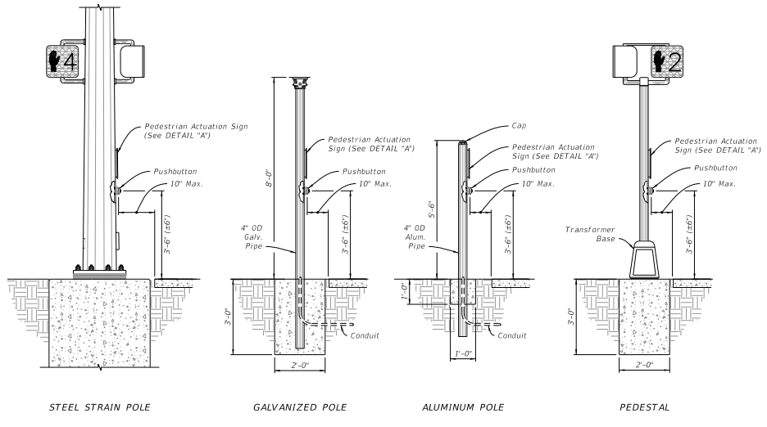
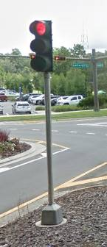
Crashworthy Pedestrian/Traffic Signals and Detector Assemblies
2019-04-BD
PS Developers: Derwood (FL)
Project Synopsis
MASH Crashworthiness evaluation of Pedestrian and Small Traffic Signals installed on Transformer Bases and Pedestrian Detector/Actuator Assemblies.
Project Goal(s)
Provide MASH Crashworthy designs of breakaway Pedestrian Signals/Actuators and Small Traffic Signals.
Project Background
Pedestrian Signals needed at intersections/pedestrian crossings where there is no other post or poles fore which to attach.
ADA Guidance recommends separated Pedestrian detector/actuators, which require separate posts.
Small traffic signals are often mounted to above transformer bases to have a breakaway system in locations such as medians and traffic islands.

Slide 18
Crashworthy Pedestrian/Traffic Signals and Detector Assemblies
2019-04-BD
Proposed Work Plan
Crash test worse-case assembly details based on information gathered from the member states and establish guidelines for acceptable mounting hardware (i.e., heights, size, and mass of signal heads).
Task 1. Information Gathering through Members Survey.
Develop design details. Conduct FEA simulations as design aid and vehicle impact behavior prediction.
Task 2. Component Testing.
Conduct component testing to investigate worse-case conditions.
Task 3. System Construction & Full-Scale Crash Testing.
Build /Purchase test articles. Conduct full-scale crash testing of worse case(s) (TL-3).
Task 4. Guidelines.
Define guidelines and summarize recommendations for implementation.
Deliverables
Guidelines (i.e., minimum maximum design parameters) for establishing MASH Compliant Pedestrian Signal Assemblies, Small Traffic Signal Supports, and Pedestrian Detector/Actuator Posts.

Slide 19
Crashworthy Pedestrian/Traffic Signals and Detector Assemblies
2019-04-BD
Urgency and Expected Benefit
Needed for MASH Implementation of Breakaway Devices. Provide MASH Compliant Pedestrian Signal and Detector/Actuator Assemblies, as well as MASH Compliant Small Signal Assemblies.
Funding: $120,000
Research Period : 1 year

Slide 20
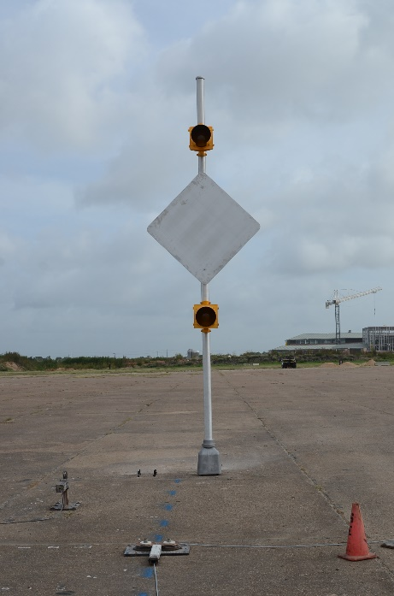
Crashworthy Enhanced Highway Sign Assemblies
2019-05-BD
PS Developers: Derwood Sheppard
Project Synopsis
MASH crashworthiness evaluation of various enhanced highway signing options (i.e., RRFB’s, Highlighted Signs, Flashing Beacons, Speed-Feedback Signs, etc.) installed on transformer bases.
Project Goal(s)
Evaluate MASH crashworthy designs of breakaway enhanced highway sign assemblies through full-scale crash testing.
Project Background
Previous MASH tests were run on a sign assembly with flashing beacons and solar panels by TTI. (TTI Report 0-6946-1 ; August 2017)

Slide 21
Crashworthy Enhanced Highway Sign Assemblies
2019-05-BD
Proposed Work Plan
Literature review of previous crash testing and state standards.
Determine worst-case assembly details for crash testing through engineering analysis.
Perform full-scale MASH crash testing on worst-case assembly system.
Produce final report detailing literature review, engineering analysis, and full-scale crash testing. Develop guidelines for acceptable mounting hardware.
Deliverables
Guidelines (i.e., minimum/maximum design parameters) for establishing MASH compliant enhanced highway assemblies.

Slide 22
Crashworthy Enhanced Highway Sign Assemblies
2019-05-BD
Urgency and Expected Benefit
Needed for MASH implementation of breakaway devices. Provide MASH compliant pedestrian enhanced highway assemblies.
Funding
The estimated cost to complete the proposed project is $150,000.
Research Period
The estimated time to complete the proposed project is 12 months.

Slide 23
MASH Compliance of Steel Goal Post Sign Supports
2019-38-BD
PS Developers: Ted Whitmore
Project Synopsis
The project will review existing literature, analyze current design and propose modifications, evaluate final design through computer simulations, and perform MASH crash testing.
Project Goal(s)
Evaluate crashworthiness of breakaway steel “goal post” type sign supports according to MASH TL-3. If MASH TL-3 compliance is unlikely, then evaluate according to MASH TL-2.
Evaluate design modification for omni-directional impacts.
Project Background
These support systems are typically used in relatively low speed, urban environments where available right of way is highly restricted and/or available sidewalk width for pedestrians would be too restricted by using a multiple support system.
Breakaway steel supports were previously approved under NCHRP Report 350. To date, no MASH crash testing has been performed on these types of sign support systems.

Slide 24
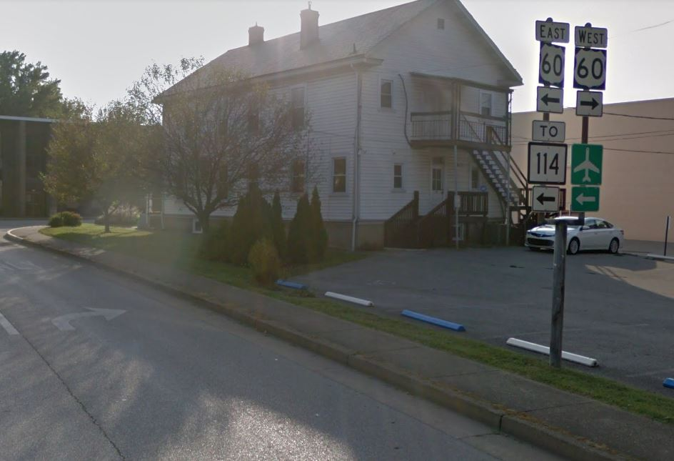
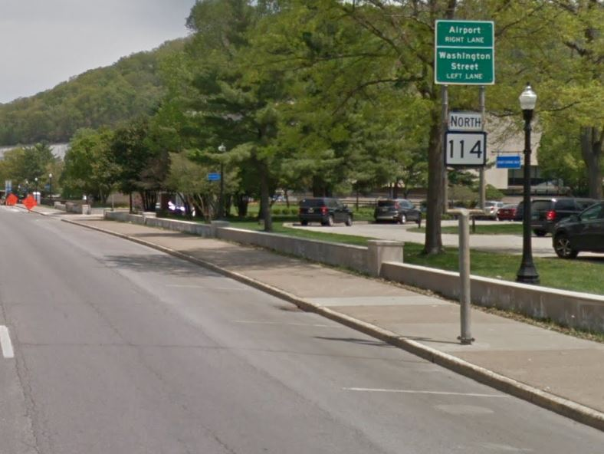
MASH Compliance of Steel Goal Post Sign Supports
2019-38-BD

Slide 25
MASH Compliance of Steel Goal Post Sign Supports
2019-38-BD
Proposed Work Plan
Literature review of previous crash testing and state standards.
Evaluate possible design modifications to steel goal post sign supports.
Perform computer simulations to evaluate potential MASH compliance.
Perform full-scale MASH crash testing.
Produce final report detailing literature review, engineering analysis, computer simulations and full-scale crash testing.
Deliverables
Guidelines (i.e., mounting height, sign attachments, etc.) for MASH compliant steel goal post sign supports.

Slide 26
MASH Compliance of Steel Goal Post Sign Supports
2019-38-BD
Urgency and Expected Benefit
Successful completion of this project will result in the availability of a non-proprietary support system for use typically in relatively low speed, urban environments where available right of way is highly restricted and/or available sidewalk width for pedestrians would be too restricted by using a multiple support system.
Funding
The estimated cost to complete the proposed project is $200,000.
Research Period
The estimated time to complete the proposed project is 18 months.

