Slide 1
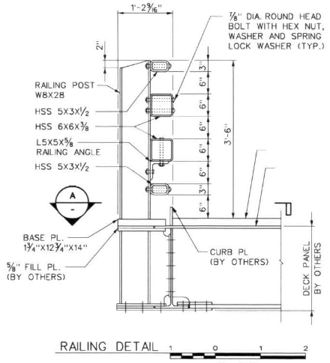
MASH TL-5 TBTA Bridge Railing Mounted on Traditional Concrete Deck
2019-22-BR
PS Developers Carlos Torres, P.E., MI
Project Synopsis
TBTA bridge railing was successfully crash tested under MASH TL-5 criteria, and an FHWA eligibility letter (B-274) was issued. However, this railing was tested on a composite bridge span, and transportation agencies may wish to it on a traditional concrete bridge deck
Project Goal(s)
Evaluate TBTA bridge railing mounted on a traditional concrete bridge deck. Establish design criteria for mounting the TBTA bridge railing on a traditional concrete deck. Determine if the TBTA bridge railing can be mounted on top of a concrete brush block
Project Background
TBTA bridge railing was testing to MASH TL-5 on an orthotropic steel deck
If an equivalent post to concrete connection can be designed, it will allow installation of the TBTA rail on concrete decks

Slide 2
MASH TL-5 TBTA Bridge Railing Mounted on Traditional Concrete Deck
2019-22-BR
Proposed Work Plan
Task 1: Post to Deck Connection Design
Design of the post attached to the concrete deck using adhesive or screw-in anchors
Meet capacity of the post-to-steel orthotropic deck connection used in TBTA crash testing
Task 2: Bogie Testing
Test and compare post-to-steel deck and post-to-concrete connections
Compare force-deflection responses to demonstrate that the two are equivalent
Deliverables
Final report
Engineering drawings

Slide 3
MASH TL-5 TBTA Bridge Railing Mounted on Traditional Concrete Deck
2019-22-BR
Urgency and Expected Benefit
Successful design will allow user agencies to use the TBTA bridge on concrete decks
Funding
Task 1 – Connection Design $20,000
Task 1 – Bogie Testing $20,000
TOTAL $40,000
Research Period
10 months

Slide 4
Development of a Thrie-Beam Retrofit for Upgrading Obsolete Bridge Railings
2019-23-BR
PS Developers
Carlos Torres, Michigan DOT; Derwood Sheppard, FLDOT, Alex Bardoe, MASSDOT, Alex Lim
Project Synopsis
Design and Test a new Thrie-Beam retrofit bridge rail closely spaced posts anchored to a 9-inch high concrete curb to meet MASH TL-3
Project Goal
A Thrie-Beam retrofit bridge rail that is MASH TL-3 compliant
Project Background
Interest nationally in this problem statement for MASH TL-3
Oregon DOT standard details to consider and use as follows.

Slide 5
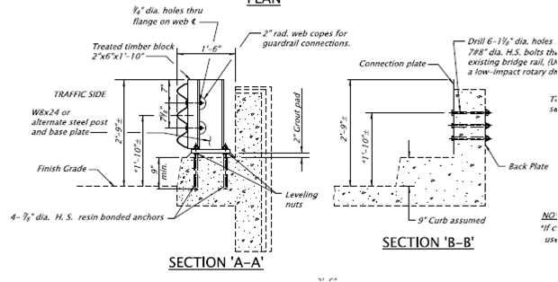
Development of a Thrie-Beam Retrofit for Upgrading Obsolete Bridge Railings
2019-23-BR
Proposed Oregon Design to consider:

Slide 6
Development of a Thrie-Beam Retrofit for Upgrading Obsolete Bridge Railings
2019-23-BR
Proposed Work Plan
1.) Task 1 - Literature Review – Look at systems that have already been tested.
2.) Task 2 – Engineering Design and detailing
3.) Task 3 – Construction of full scale test installation
4.) Task 4 – Full-scale crash testing – MASH Tests 3-10 & 3-11.Task 1: Literature
Deliverables
A report providing details of the new retrofit design, documentation of the crash test results, and the assessment of the performance of the new design according to MASH TL-3 specifications.

Slide 7
MASH TL-4 Crash Testing of Bicycle Railing on Constant Slope Parapet
2019-24-BR
PS Developers
Kevin Riechers, IDOT; Carlos Torres, MDOT; Kenneth Shannon, MTO
Project Synopsis
Evaluate and test a combination barrier system that consists of a bicycle railing mounted on top of a standard IDOT concrete parapet in accordance with MASH TL-4 criteria.
Project Goal
Evaluate the performance of a railing mounted on top of a standard IDOT constant slope parapet under MASH TL-4 criteria.
Project Background
There are a significant number of bridges that accommodate bicyclists.
The department utilizes a railing height of 54 inches as recommended in the early editions of the LRFD Bridge Design Specifications.
There is a need to develop a MASH TL-4 bridge rail to accommodate bicyclist and traffic safety.

Slide 8
MASH TL-4 Crash Testing of Bicycle Railing on Constant Slope Parapet
2019-24-BR
Proposed Work Plan
Task 1: Engineering Analysis and Drafting
Evaluate the railing design and make recommendations for modifications.
Develop full-scale test installation drawings of the combination barrier system for testing.
Task 2: Construction and Demolition
Task 3: Full-Scale Crash Testing and Reporting
Perform critical full-scale crash tests. (Budgeting for MASH Test 4-12)
Provide a final report documenting crash test results.
Provide a professional opinion for crash tests not conducted.
Deliverables
A report providing details of the combination barrier system, documentation of the evaluation, crash test results, and the assessment of the performance of the system according to MASH TL-4 specifications.

Slide 9
MASH TL-4 Crash Testing of Bicycle Railing on Constant Slope Parapet
2019-24-BR
Urgency and Expected Benefit
Benefit member states by implementing MASH TL-4 compliant barrier systems that accommodate bicyclists while providing higher safety for the motoring public and meet the most recent barrier testing criteria.
Funding
Total Estimated Cost = $250,000
Research Period
Work Schedule: (Estimated Project Duration = 10 months from initiation of the project)
Task 1 = 3 months
Task 2 = 3 months
Task 3 = 4 months

Slide 10
Resistance of Bolt-through Anchor to Repeated Impact Loading
2019-34-BR
PS Developer
Alex Lim (OR)
Project Synopsis
State transportation agencies need a bolt through connection bridge rail retrofit option to attach tested concrete rails to existing bridge decks for MASH TL-4 compliance.
Project Goal(s)
Provide an easy option to attach tested concrete rail to bridge deck as shown.
Provide a connection option when the resin bonded anchor does not work on thin existing decks with 3300psi concrete and poor reinforcing.
Design anchor bolts to avoid brittle failure.
Determine the load transfer to bolt connection.
Determine the limit of allowable bolt spacing at different locations along barrier to ensure load transfer to deck is achieved at any section.

Slide 11
Resistance of Bolt-through Anchor to Repeated Impact Loading
2019-34-BR
Project Background
Allow designers to design and attach concrete tested rails to concrete bridge decks.
Oftentimes, the use of resin bonded anchors is not an option for retrofits on thin (< 8-inch) existing deck with lower concrete strength and poor reinforcing.
Proposed Work Plan
Task 1: Engineering Analysis
Task 2: Construction and Demolition
Task 3: Testing and Reporting
Deliverables
A report providing details of the test installation, documentation of the evaluation, the results of the tests performed, and the assessment of the results.

Slide 12
Resistance of Bolt-through Anchor to Repeated Impact Loading
2019-34-BR
Urgency and Expected Benefit
Allow for designers to use resin bonded anchors to attach tested rails to thin (< 8-inch) existing concrete bridge decks with low concrete strength and poor reinforcing.
Funding
Total Estimated Cost = $230,000
Research Period
Work Schedule: (Estimated Project Duration = 10 months from initiation of the project)
Task 1 = 3 months
Task 2 = 3 months
Task 3 = 4 months

