Slide 1
MASH TL-4 Testing and Evaluation of Free-Standing F-shape Portable Concrete Barrier
2019-06-LCB
PS Developers
Christopher Henson, Oregon DOT; Nina Ertel, P.E, PennDOT.; Josh Palmer, Colorado DOT; Josh Keith, Colorado DOT
Project Synopsis
Evaluate and test a 42” tall, F-shape profile, pin-and-loop connection, free-standing PCB in accordance with MASH.
Project Goal
A Free-Standing Portable Concrete Barrier that is MASH TL-4 compliant
Project Background
A previous ODOT designed 42” PCB system met NCHRP Report 350 TL-4 criteria.
Under a PennDOT funded project, TTI is currently designing F-Shape precast barriers using a pin-and-loop connection keyed into asphalt to satisfy MASH TL-4 criteria.

Slide 2
MASH TL-4 Testing and Evaluation of Free-Standing F-shape Portable Concrete Barrier
2019-06-LCB
Proposed Work Plan
Task 1: Literature Review and Engineering Analysis
Evaluate current PCB designs
Determine critical PCB designs
Determine which crash tests are critical for determining MASH compliance
Task 2: Construction and Demolition
Task 3: Full-Scale Crash Testing and Reporting
Perform critical full-scale crash tests (budgeting for two crash tests)
Provide a final report documenting crash test results
Provide a professional opinion for other PCB designs
Deliverables
A report providing details of the PCB system, documentation of the evaluation, crash test results, and the assessment of the performance of the PCB according to MASH specifications.

Slide 3
MASH TL-4 Testing and Evaluation of Free-Standing F-shape Portable Concrete Barrier
2019-06-LCB
Urgency and Expected Benefit
Several states use PCB in a permanent installation.
The major advantage of PCB is that, when used on a paved shoulder, or paved median with no embedment, it can be easily removed to accommodate pavement overlays and then replaced without damage.
Funding
Total Estimated Cost = $245,000
Research Period
Work Schedule: (Estimated Project Duration = 10 months from initiation of the project)
Task 1 = 3 months
Task 2 = 3 months
Task 3 = 4 months

Slide 4
Shallowest Embedment or Footing for CIP Median Barrier at MASH TL-5
2019-08-LCB
PS Developers Jim Danila, MA
Project Synopsis
Develop a design for a minimum embedment depth in ACP and/or the minimum footing dimensions required for a TL-5 concrete median barrier.
Project Goal(s)
Through testing or engineering analysis, identify minimum embedment depth in ACP and/or footing depth required to satisfy MASH TL-5 testing on a concrete median barrier, including the minimum barrier length required
Project Background
MASH TL-5 single slope median barrier typically has a continuous shallow footing or deep end footings
These footings are sometime impractical due to buried utilities or bridge footings
TTI has recently performed work on high-containment barriers
MASH Test 4-12 with 40 ft long SSB keyed into 1-inch asphalt
MASH Test 4-12 with 70 ft long SSB keyed into 1-inch asphalt
TxDOT Project 0-6948, structurally independent foundations for 54-inch single slope barrier

Slide 5
Shallowest Embedment or Footing for CIP Median Barrier at MASH TL-5
2019-08-LCB
Proposed Work Plan
Task 1: Simulation Analysis
Develop model of barrier keyed into asphalt and perform MASH Test 5-12 impact simulations
Determine acceptable minimum barrier segment depth and length and final design for testing
Task 2: Construction of Test Installation
Task 3: Testing and Reporting
Perform MASH Test 5-12 with tractor-van trailer
Prepare Final Report
Deliverables
Final report
Engineering drawings

Slide 6
Shallowest Embedment or Footing for CIP Median Barrier at MASH TL-5
2019-08-LCB
Urgency and Expected Benefit
With the release of NCHRP Report 892, TL-5 pier protection is likely to be a more commonly used design component
Reducing or eliminating some or all of the footing required for a TL-5 concrete barrier design will have an immediate cost reduction benefit.
Funding
Task 1 – Simulation Analysis $35,000
Task 2 – Construction $78,000
Task 3 – Testing and Reporting $57,000
TOTAL $170,000
Research Period
12 months

Slide 7
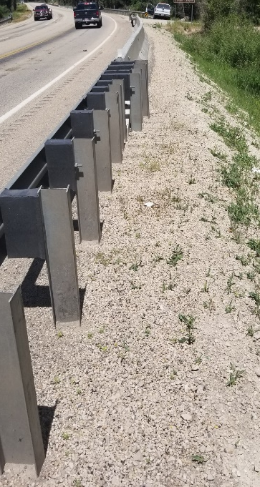
Guardrail to Anchored Portable Barrier Transition
2019-09-LCB
PS Developers Shawn Debenham, UT
Project Synopsis
PCBs in permanent applications require last three segments to be anchored before installing a crash cushion or w-beam
There are no MASH transition between w-beam or thrie-beam to anchored PCBs
Having a transition design would simplify the design and construction process
Project Goal(s)
Design a MASH transition between W-beam guardrail and tangent anchored PCB
Project Background
In mountainous areas, anchored barriers adjacent to 2:1 slope are frequently used
TTI developed an anchored barrier system under the pooled fund
MwRSF recently developed a transition from W-beam to free-standing PCB
Transition is needed for TTI’s anchored PCB to W-beam guardrail

Slide 8
Guardrail to Anchored Portable Barrier Transition
2019-09-LCB
Proposed Work Plan
Task 1: Conceptual Design
Develop various concepts of the transition and present to Tech Rep. for selection of one concept for further development through simulation and testing
Task 2: Simulation Analysis
Develop models of the selected transition concept and perform MASH impact simulations to evaluate design
Make small modifications to the design to improve its performance if needed
Task 3: Construction
Task 4: Testing and Reporting
Perform MASH Test 3-20 and Test 3-22 at the downstream end of the transition
Prepare Final Report
Deliverables
Final report
Engineering drawings

Slide 9
Guardrail to Anchored Portable Barrier Transition
2019-09-LCB
Urgency and Expected Benefit
One transition design to be used for anchored temporary concrete barrier and if possible use for bridge rails and cast-in-place concrete barriers
Funding
Task 1 – Conceptual Design $12,000
Task 1 – Simulation Analysis $40,000
Task 2 – Construction $35,000 (assuming PCBs from older projects will be used)
Task 3 – Testing and Reporting (assuming only downstream end will need testing)
Test 3-20 $40,000
Test 3-22 $45,000
TOTAL $172,000
Research Period
12 months

Slide 10
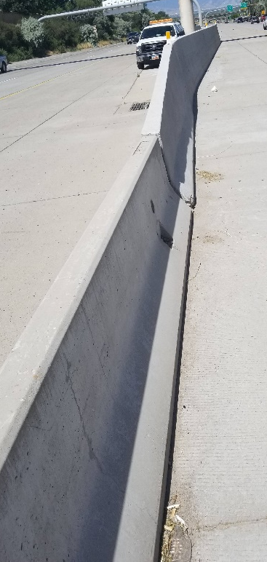
Transition from Pinned-Down to Rigid Barrier Median Application
2019-10-LCB
PS Developers Shawn Debenham, UT
Project Synopsis
Need transition from pinned-down PCB’s to rigid median barrier for temporary and permanent applications
Current transition from pinned-down to ridged barrier has been successfully tested for right shoulder applications only
Project Goal(s)
Modify the transition to extend its used for median applications
Project Background
Transition from pinned F-shape PCB to rigid single-slope barrier for both asphalt and concrete pavement was successfully tested to MASH criteria
However, these designs are for right shoulder applications only

Slide 11
Guardrail to Anchored Portable Barrier Transition
2019-10-LCB
Proposed Work Plan
Task 1: Transition Design
Previously developed roadside version of the transition design (from TTI projects 40516-34 and 405160-36) will be used as basis to develop a median transition design. This design effort will not include simulation
Additional testing is not needed as median version is not expected to deteriorate crash performance compared to the roadside version of the transition
Deliverables
Final report
Engineering drawings

Slide 12
Guardrail to Anchored Portable Barrier Transition
2019-10-LCB
Urgency and Expected Benefit
Development of a crashworthy transition from pinned-down anchored F-shape temporary concrete barrier to rigid single-slope barrier would provide states with a safe median barrier connection design
Funding
Task 1 – Conceptual Design $15,000
Research Period
5 months

Slide 13
Transition from W-Beam Guardrail to Concrete Barrier
2019-11-LCB
PS Developers
Hassan Raza, Mark Buckalew, Steve Walker, Carlos Torres
Project Synopsis
Develop and evaluate a MASH TL-3 compliant W-Beam transition to various types of concrete barriers using engineering analysis, simulation, and/or crash testing.
Project Goal(s)
A MASH TL-3 compliant W-beam transition to various types of concrete barriers.
Project Background
Many states use various types of concrete barriers as bridge railings.
Transitions from W-Beam guardrail to a concrete barrier have passed MASH criteria.
A W-Beam transition from a W-Beam guardrail to a concrete barrier has not been tested to MASH.

Slide 14
Transition from W-Beam Guardrail to Concrete Barrier
2019-11-LCB
Proposed Work Plan
Task 1: Literature Review and Engineering Analysis
Evaluate W-Beam transition designs
Determine critical W-Beam transition designs
Determine which crash tests are critical for determining MASH compliance
Task 2: Construction and Demolition
Task 3: Full-Scale Crash Testing and Reporting
Perform critical full-scale crash tests (budgeting for two crash tests)
Provide a final report documenting crash test results
Provide a professional opinion for other W-Beam transition designs
Deliverables
A report providing details of the transition, documentation of the evaluation, crash test results, and the assessment of the performance of the transition according to MASH TL-3 criteria.

Slide 15
Transition from W-Beam Guardrail to Concrete Barrier
2019-11-LCB
Urgency and Expected Benefit
Several states connect W-Beam guardrail to various concrete barriers.
MASH compliant transitions are urgently needed to meet MASH compliance dates.
Funding
Total Estimated Cost = $130,000
Research Period
Work Schedule: (Estimated Project Duration = 10 months from initiation of the project)
Task 1 = 3 months
Task 2 = 3 months
Task 3 = 4 months

Slide 16
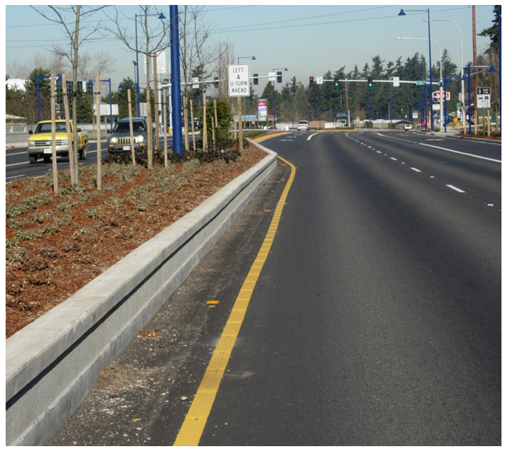
MASH TL-2 Compliant Permanent Concrete Low-Profile Barrier (Barrier Curb)
2019-12-LCB
PS Developers: Derwood (FL)
Project Synopsis
Develop a MASH TL-2 Compliant Permanent Concrete Low-Profile Barrier.
Project Goal(s)
Provide design details for a MASH TL-2 Compliant Permanent Concrete Low-Profile Barrier.
Project Background
From AASHTO RDG, 4th Edition 2011, Chapter 5:
Typically for urban environments
Typically range 18 in. to 20 in
Provide additional design options for site-specific applications
Improves sight distance; Option to tie in with adjacent surroundings
Example of existing low-profile concrete systems:
MASH TL-2 TxDOT PCB (20-inch, negative slope profile)
MASH TL-3 TxDOT PCB (26-inch, T-shaped profile)
NCHRP Report 350 TL-2 Florida system (18-inch)
NCHRP Report 350 TL-2 rough stone masonry guardwall (20-inch)
NCHRP Report 350 TL-2 bridge rail (20-inch)

Slide 17
MASH TL-2 Compliant Permanent Concrete Low-Profile Barrier (Barrier Curb)
2019-12-LCB
Proposed Work Plan
Design and Crash Test a LON segment of MASH TL-2 Compliant Permanent Concrete Barrier (Barrier Curb). The project should look to optimize the system while allowing for potential future asphalt overlays, but not exceed 24-inches of height to avoid sight distance issues.
Task 1. Design Detail Development and Finite Element Investigation..
Develop design details.
Conduct finite element simulation as design aid and vehicle impact behavior prediction.
Task 2. System Construction & Full-Scale Crash Testing.
Build test article.
Conduct full-scale crash testing (TL-2).
Task 3. Implementation.
Summarize implementation recommendations based on crash testing and engineering investigation.
Deliverables
MASH TL-2 Compliant Permanent Concrete Low-Profile Barrier.

Slide 18
MASH TL-2 Compliant Permanent Concrete Low-Profile Barrier (Barrier Curb)
2019-12-LCB
Urgency and Expected Benefit
A MASH Compliant design for permanent design is currently not available.
Benefits include:
Having a MASH option for urban areas where visibility of pedestrians, bicyclists, and businesses is paramount, in addition to providing sufficient stopping sight distance.
Provide a great crashworthy alternative for separated ped./bicycle facilities (i.e. Barrier Curb).
Aesthetically mitigate items like; trees, street furniture, parklets, etc. in context sensitive areas (i.e., urban areas with speeds between 35 and 45 MPH).
Funding: $180,000
Research Period : 1 year

Slide 19
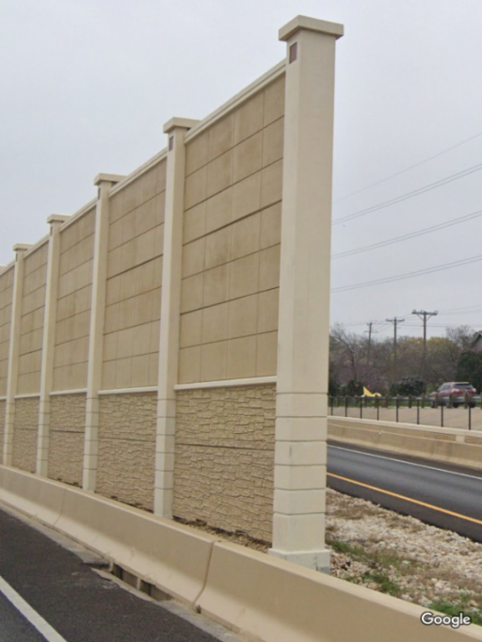
Vehicle Collision Forces on a Soundwall
2019-35-LCB
PS Developers
Project Synopsis
Use computer simulations to update the vehicle collision forces and heights of applications in AASHTO section. Also, to base loading on the height of the rail in front of the soundwall
Project Goal(s)
To Update Section 15.8.4 of the AASHTO LFRD Bridge Design Specifications
To Provide loading for objects within the Zone of Influence but behind the wall
Project Background
The AASHTO LFRD Bridge Design Specifications provides vehicle collision forces based on limited data and engineering judgement
If the rail is impacted prior to the beginning of the wall, the lean of the vehicle could create a lateral load instead of the transverse loads covered by the specification

Slide 20
Vehicle Collision Forces on a Soundwall
2019-35-LCB
Proposed Work Plan
Simulate updated TL-5 and TL-4 vehicle models into tested systems with a relatively tall barrier to build a confidence level (validation) of simulation model for heavy vehicles into soundwalls
Conduct literature review to define the state of practice for common soundwall configurations and installations details
Define critical configurations for evaluation
Conduct impact simulations of the selected configuration to determine the impact force
Process the impact force profile into a design table format
Deliverables
A report describing the process and the results of the project
A table describe loading profile for both vertical and longitudinal directions and the selected critical impact conditions
Equivalent static force of these profiles

Slide 21
Vehicle Collision Forces on a Soundwall
2019-35-LCB
Urgency and Expected Benefit
Expansion of highways and high speed roadways into more residential areas leads to more soundwall applications
Soundwalls exposed to vehicle impact loads that they cannot withstand.
Safety and labiality risk by having the soundwalls next to the driving public and the residential population
Benefit to user agencies to identify design load to ensure the integrity of the soundwalls
Funding
$89,559 estimated
Research Period
Expected to span over 12 months

