Slide 1
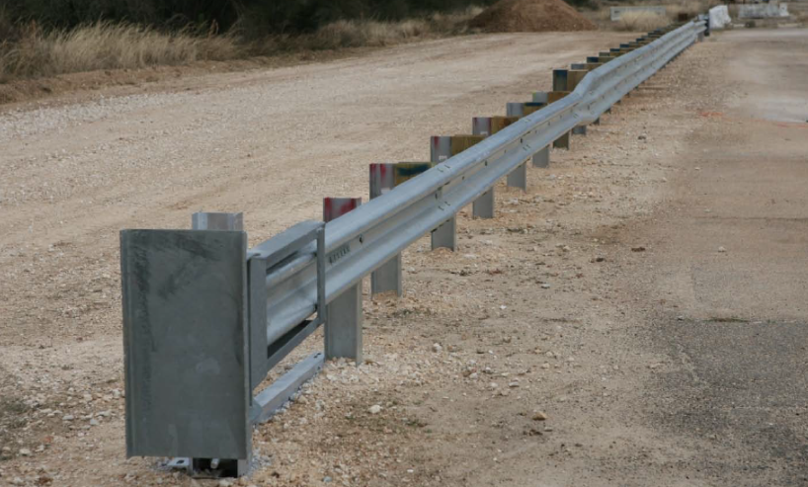
Design and Testing of a MASH TL-3 Thrie-Beam System for Roadside and Median Applications
2019-13-LSRB
PS Developers
Jim (MassDOT), Joe (WVDOT), Kurt (LADOTD), Filiberto (IDOT)
Project Synopsis
Develop and crash test a MASH TL-3 thrie-beam roadside and a median system
Develop transition from w-beam to thrie-beam through computer simulation
Project Goal(s)
Develop designs for a MASH TL-3 thrie-beam roadside system and a median system
MASH crash test the newly developed thrie-beam designs
Develop transition from w-beam to thrie-beam through computer simulation

Slide 2
Design and Testing of a MASH TL-3 Thrie-Beam System for Roadside and Median Applications
2019-13-LSRB
Project Background
G9 thrie-beam failed MASH testing
Need also exists for a transition and termination method
Crash testing for the transition will be balloted for prioritization next year because of budgetary concerns
Development of termination method will be balloted for prioritization next year because of budgetary concerns
Proposed Work Plan
Task 1: Literature and Engineering Review
Review previous literature and research
Preliminary analysis preparing for simulation
Task 2: Computer Modeling and Simulation
Develop roadside, median, and transition systems
Task 3: MASH Crash Testing
Crash test the roadside and median systems to MASH TL-3.
Task 4: Reporting
Complete the final technical report documenting all of the work completed in this project.

Slide 3
Design and Testing of a MASH TL-3 Thrie-Beam System for Roadside and Median Applications
2019-13-LSRB
Deliverables
MASH TL-3 crash tested designs for roadside and median thrie-beam barriers
Computer simulated design for a transition from w-beam to thrie-beam guardrail
Technical report documenting the project
Urgency and Expected Benefit
Limited available guardrail options for enhanced protection from hazards
Immediate benefit to safety by reducing impact severity and financially by having an alternative to concrete barrier.
Funding
$300,000
Research Period
18 months

Slide 4
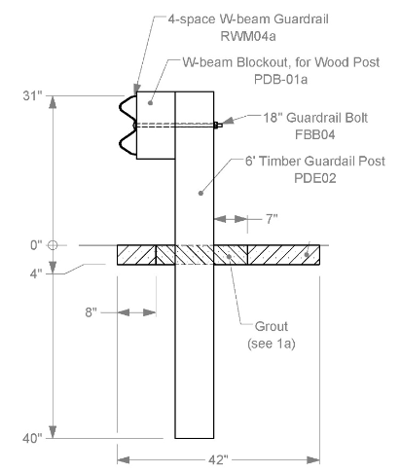
31” Rectangular Wood Post W-Beam Guardrail in Concrete Mow Strips
2019-15-LSRB
PS Developers Kurt Brauner, LA
Project Synopsis
Design wood-post guardrail installed in concrete mow strip with leave outs around posts that are backfilled with weaker material to allow the post to deflect on MASH TL-3 impacts
Project Goal(s)
Develop and analyze various options that will allow a wood post used in a concrete mow strip to perform properly when used as part of MASH TL-3 guardrail
Project Background
TTI performed MASH testing with wood-post mow-strip
Small car Test 3-10 passed with 40 inch post embedment
Pickup truck Test 3-11 failed with 40 inch embedment
Pickup truck Test 3-11 failed with 36 inch post embedment
Previous research by TTI under NCHRP Rep. 350 may be useful for this project.

Slide 5
31” Rectangular Wood Post W-Beam Guardrail in Concrete Mow Strips
2019-15-LSRB
Proposed Work Plan
Task 1: Design
Evaluate past testing to develop design changes with likelihood of success
Use past testing as guidance for the design changes
Task 2: Construction, Testing, & Reporting
Construct guardrail for testing
Perform MASH Test 3-11
It is expected that that Test 3-10 would not be needed due to changes being small and the previous successful Test 3-10 with 40-inch post embedment
Final Report
Deliverables
Final report
Engineering drawings

Slide 6
31” Rectangular Wood Post W-Beam Guardrail in Concrete Mow Strips
2019-15-LSRB
Urgency and Expected Benefit
Wood post guardrail is widely used in mow-strips based on past successful performance under NCHRP Report 350
Having a MASH approved system is essential and will have immediate implementation
Funding
Task 1 – Redesign $5,000
Task 2 – Construction, Testing, & Reporting $55,000
TOTAL $60,000
Research Period
6 months

Slide 7
BIB Terminal Variations in Foreslope/Backslope/Ditch Configurations
2019-17-LSRB
PS Developers: Jeff (AK); Christopher (OR), Josh (CO), Fil (IL)
Project Synopsis
Evaluate range of BIB ditch configurations (site variations from crash tested conditions), producing acceptable results under MASH conditions.
Project Goal(s)
Consider variations from crash tested configuration to establish:
• BIB terminal may be installed on foreslope flatter than 4:1;
• Flattest effective backslope; investigate whether there is a limit for backslope steepness;
• BIB terminal may be installed in flat-bottomed ditches;
• Design alterations from previous tested configuration, if any, when ditch configurations vary
Project Background
MASH crash test: 4:1 Foreslope/ 2:1 Backslope/ V-Ditch, TTI project 608431, tests 3-34, 3-35
Notes:
Flattest effective backslope; a threshold backslope for requiring area free of fixed objects behind the terminal; and investigate whether there is a limit for backslope steepness.
Ditch configurations vary: the foreslope is flatter than 4:1; foreslope of the ditch is wider than 6 feet; the backslope varies from 2:1; or the ditch is flat-bottomed

Slide 8
BIB Terminal Variations in Foreslope/Backslope/Ditch Configurations
2019-17-LSRB
Proposed Work Plan
Task 1. DOT Members Survey.
Identify common applicable ranges with respect to research parameters in use (and needed) by DOT Members (degree of backslope, type of ditch configuration, ditch width, rubrail /no rubrail)
Task 2. Engineering Analysis and Finite Element Investigation.
Conduct engineering analysis to identify most critical cases based on Task 1 results.
Conduct FE computer simulations to investigate critical cases for system crashworthiness.
Task 3. Recommendations.
Summarize recommendations based on engineering analysis (and FEA).
Deliverables
Acceptable limits for foreslope (flatter than 4:1), and backslope (range of variation from 2:1 and critical slope), offset to ditch bottom or width of foreslope, and width of flat-bottomed ditch.
Necessary changes to design for variations

Slide 9
BIB Terminal Variations in Foreslope/Backslope/Ditch Configurations
2019-17-LSRB
Urgency and Expected Benefit
MASH tests successfully completed (3-34, 3-35) for one site configuration. States have variable design standards for ditches and adapting the device for site variability would increase the number of locations this device could be installed.
BIB Terminal eliminates potential for terminal end strike. Because of the slopes involved, other issues need to be considered. If acceptable limits for site variability can be shown, wider installation may reduce risk to the traveling public.
Funding: $90,000
Research Period : 1 year

Slide 10
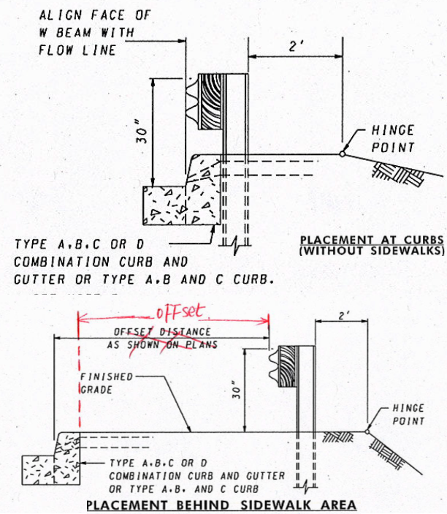
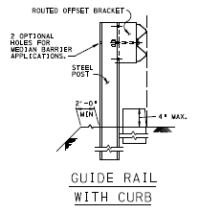
MASH TL-2 Evaluation and MASH determination of 8-inch vertical curb with MGS traffic barrier
2019-18-LSRB
PS Developers
Project Synopsis
Evaluate and potentially crash test a 8-inch tall vertical curb with MGS traffic barrier in accordance with MASH Test Level 2 (TL-2)
Project Goal(s)
To evaluate 8-inch vertical curb flush with MGS traffic barrier that is MASH TL-2 compliant
MDOT
Project Background
MDOT uses combination of curb and MGS guardrail with face of barrier rail flush with face of the curb + MGS guardrail with curb and sidewalk has barrier offset from curb (MD 605.31)
PennDOT uses 8 in. curb for roadways and 4 in. curb is used with traffic barrier. 4 in. curb often cannot be used on projects, and then 8 in. curb is allowed with stiffened traffic barrier(PennDOT Guide rail with curb detail)
PennDOT

Slide 11
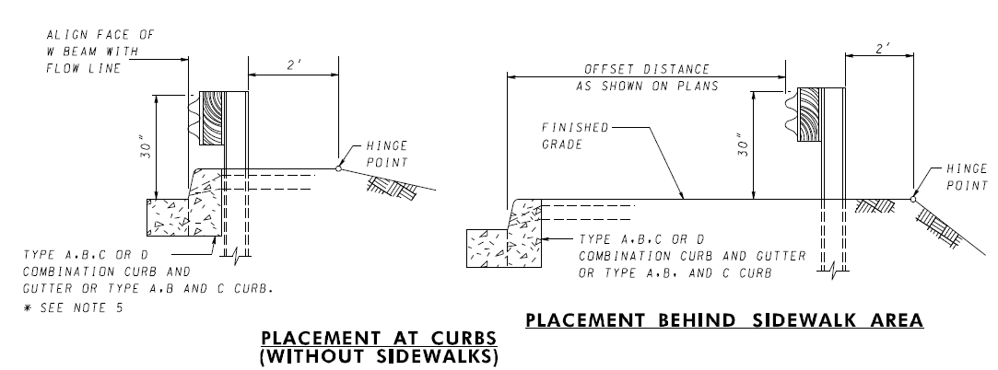
MASH TL-2 Evaluation and MASH determination of 8-inch vertical curb with MGS traffic barrier
2019-18-LSRB
Project Background
Type A – 8 inch
Type B – 6 inch
Type C – 3 inch
Type D – 6 inch

Slide 12
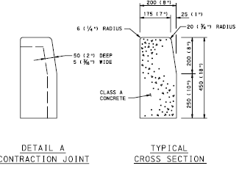
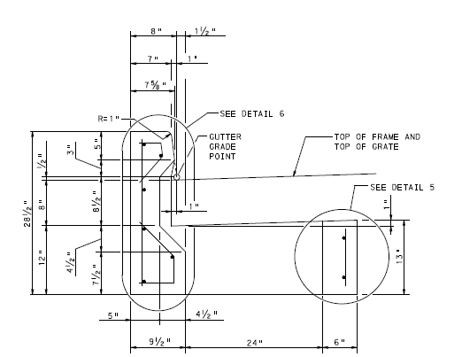
MASH TL-2 Evaluation and MASH determination of 8-inch vertical curb with MGS traffic barrier
2019-18-LSRB
Project Background
Standard is 8-inch vertical curb
Most existing curbs are 8-inches
Guiderail often installed at existing curbs
Standard inlet is 8-inch high
Curbed sections need inlets

Slide 13
MASH TL-2 Evaluation and MASH determination of 8-inch vertical curb with MGS traffic barrier
2019-18-LSRB
Project Background
Curb flush with w-beam
This often cannot be done on projects because:
The existing curb is 8-inch
8-inch curb needed for drainage and inlets
Then 8-inch curb is allowed with stiffened guardrail, i.e., close post spacing, which can cause conflicts with inlet boxes.

Slide 14
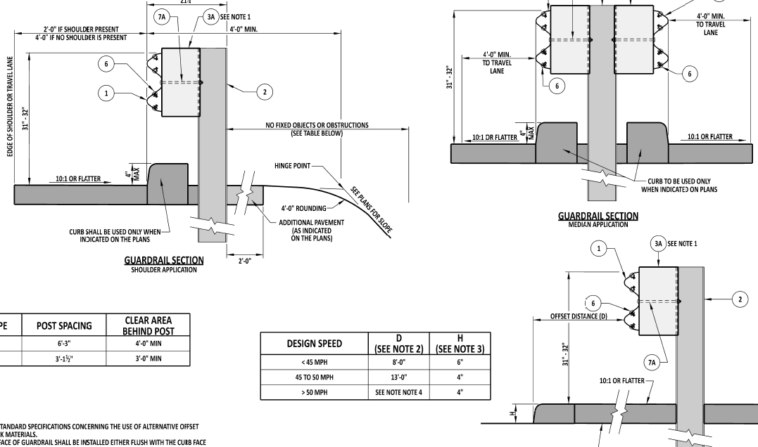
MASH TL-2 Evaluation and MASH determination of 8-inch vertical curb with MGS traffic barrier
2019-18-LSRB
Project Background
Note: 8-inch curb is sometimes used

Slide 15
MASH TL-2 Evaluation and MASH determination of 8-inch vertical curb with MGS traffic barrier
2019-18-LSRB
Proposed Work Plan
Build a confidence level (validation) of the simulation model of the guardrail with a curb by simulating MASH tested designs (e.g. ones conducted at the MwRSF)
Evaluate MGS traffic barrier installed along a 8-inch curb using LS-DYNA simulation for MASH TL-2 criteria
Evaluate and determined acceptable offset from face of curb, if barrier is pushed back
Identify the most critical successful configuration based on the simulation
Evaluate and perform MASH compliance via crash testing
Deliverables
Details of traffic barrier face flushed with face of 8-inch curb
Variation of barrier offset from curb documentation of the evaluation
Crash tests results and the assessment of the performance according to MASH Test Level 2 (or TL-2) specifications
Engineering opinion for MASH compliance for similar, less critical, designs

Slide 16
MASH TL-3 Thrie-Beam transition from 31" W-Beam guardrail to single slope CIP concrete barrier
2019-19-LSRB
PS Developers
Nina Ertel, P.E, PennDOT.; Joe Hall, WVDOT
Project Synopsis
Evaluate MASH TL-3 compliance of a Thrie-Beam transition from 31" W-Beam guardrail to single slope CIP concrete barriers.
Project Goal(s)
Determine MASH TL-3 compliance of a Thrie-Beam transition from 31" W-Beam guardrail to single slope CIP concrete barrier either with engineering opinion or crash testing.
Project Background
31” guiderail to F-shape and single slope CIP concrete barrier transition along the side of the road is a very common application.
There is already a MASH compliant thrie-beam to F-shape bridge barrier. However, the end of the bridge is modified where the thrie-beam connects.
Can this MASH compliant thrie beam transition be modified to connect to a F-shape for various heights and 42” high single slope CIP barrier without modifying the end?

Slide 17
MASH TL-3 Thrie-Beam transition from 31" W-Beam guardrail to single slope CIP concrete barrier
2019-19-LSRB
Proposed Work Plan
Task 1: Literature Review and Engineering Analysis
Evaluate current TL-3 Thrie-beam transition designs
Determine the critical transition design and evaluate the transition for TL-3 compliance
Evaluate and perform MASH compliance via engineering opinion, simulation and/or crash testing
Task 2: Construction and Demolition
Task 3: Full-Scale Crash Testing and Reporting
Perform critical full-scale crash tests (budgeting for two crash tests)
Provide a final report summarizing the details of the test installation, final drawings, and our finding and conclusions
Provide engineering opinion on any acceptable variations
Deliverables
A report providing an evaluation of MASH TL-3 compliance of a Thrie-Beam transition from 31" W-Beam guardrail to single slope CIP concrete barrier. Include engineering opinion for MASH compliance for similar, less critical designs from various states which were not crash tested.

Slide 18
MASH TL-3 Thrie-Beam transition from 31" W-Beam guardrail to single slope CIP concrete barrier
2019-19-LSRB
Urgency and Expected Benefit
Transitions between w-beam and CIP concrete barriers is a common application.
As new MASH compliant barriers are being adopted by DOT’s, new transitions are needed in order to implement the new concrete barriers for use.
Funding
Total Estimated Cost = $140,000
Note: Budgeting for two full-scale crash tests on either single slope or F-shape.
Research Period
Work Schedule: (Project Duration = 10 months from initiation of the project)
Task 1 = 3 months
Task 2 = 3 months
Task 3 = 4 months

Slide 19
Determination of the Length-of-Need for Guardrail without Anchorage Phase 2: MASH Crash Testing
2019-20-LSRB
PS Developers
Joe (WVDOT)
Project Synopsis
Continuation of Phase 1
Evaluate the length-of-need for guardrail without anchorage through crash testing
Project Goal(s)
Evaluate the unanchored guardrail system developed in Phase 1 through full-scale MASH crash testing
Project Background
Phase 1 prioritized in FY19
Phase 1 determines the LON through computer simulation
Phase 1 completes component testing to validate computer models
Phase 2 completed project with MASH crash testing

Slide 20
Design and Testing of a MASH TL-3 Thrie-Beam System for Roadside and Median Applications
2019-20-LSRB
Proposed Work Plan
Task 1: MASH Crash Testing
Crash test the guardrail system to MASH TL-3.
Deliverables
Minimum required length-of-need for a guardrail system without anchorage
Technical report documenting all of the work completed in this project
Urgency and Expected Benefit
Guidance is needed for safely installing guardrail systems before anchorage is installed
States will be able to safely protect errant motorists under this unanchored condition
Funding
$130,000
Research Period
9 months

Slide 21
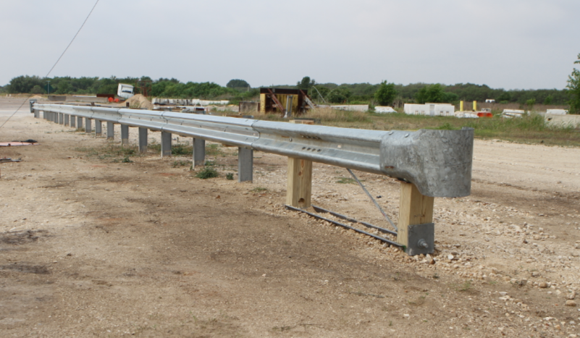
Steel Post Downstream End Anchor
2019-36-LSRB
PS Developers: Jeff (AK)
Project Synopsis
Evaluate design alternatives for Steel Post Downstream End Anchor for 31” w-beam guardrail and conduct crash testing under MASH 2016 conditions. Project will use analysis, simulation, as required, and conduct full-scale testing necessary to obtain an eligibility letter.
Project Goal(s)
Design and test a steel post downstream end anchor as an alternative to existing MASH 2016 compliant w-beam guardrail end anchors that use timber posts.
Project Background
Wood anchor posts have failed in testing. Need for material w/ consistent and reliable material properties.
BCT Timber posts in BCT Post Sleeves: maintenance issues.
Alternative: steel posts easier to maintain (?), more dependable than wood posts (?)
Steel posts (direct bury or in tubes) → easier replacement /maintenance, durability

Slide 22
Steel Post Downstream End Anchor
2019-36-LSRB
Proposed Work Plan
Task 1. Design Development & Finite Element Investigation.
Develop design system
Conduct finite element simulation as design aid and to investigate CIP for full-scale crash testing.
Task 2. Component Testing.
Develop appropriate component testing as design aid for the proposed system, and as preliminary component behavior investigation.
Task 3. System Construction & Full-Scale Crash Testing.
Build test article.
Conduct full-scale crash testing.
Deliverables
Provide a downstream end anchor design that relies on steel posts. Provide a crash test report and supporting materials sufficient for FHWA consideration of a MASH eligibility letter.

Slide 23
Steel Post Downstream End Anchor
2019-36-LSRB
Urgency and Expected Benefit
Failure of BCT timber posts in downstream end anchors suggests an alternative should be investigated. Maintaining tension in a w-beam barrier system is critical to guardrail performance and reducing road user risk to an acceptable level.
Improving ease of maintenance can reduce exposure of motorists to temporary work zones and equipment, and shorten the time maintenance personnel are exposed to traffic when working near open lanes of traffic.
Steel posts are less prone to rot, pests, or undetected structural weakness or damage than wood posts. Reducing use of wood posts where possible may provide immediate safety and service advantages.
Funding: $170,000
Research Period : 18 months

Slide 24
BIB Terminal Additional Crash Testing
2019-37-LSRB
PS Developers: Jeff (AK); Christopher (OR), Josh (CO), Fil (IL)
Project Synopsis
Conduct additional crash testing as required by FHWA, producing acceptable results under MASH conditions to qualify for an FHWA eligibility letter.
Project will use analysis, simulation, as required, and conduct required testing
Project Goal(s)
Conduct additional crash testing required by revision to MASH16. Additional crash testing is TBD.
Tests 3-34 and 3-35 were conducted successfully with the following BIB configuration: 4:1 Foreslope/ 2:1 Backslope/ V-Ditch.
Project Background
MASH 2016 crash tests 3-34 (car) and 3-35 (pickup) conducted successfully on 4:1 Foreslope/ 2:1 Backslope/ V-Ditch. Other tests identified in MASH16 were evaluated as “non-relevant” and were not conducted

Slide 25
BIB Terminal Additional Crash Testing
2019-37-LSRB
Proposed Work Plan
Task 1. Finite Element Investigation on the Newly Proposed Tests.
Conduct finite element simulation to investigate CIP for additional full-scale crash testing.
Task 2. System Construction & Full-Scale Crash Testing.
Build test article.
Conduct additional full-scale crash testing.
Task 3. Recommendations.
Summarize recommendations based on additional testing.
Deliverables
Crash test results (tests TBD) and supporting materials which, when presented in combination with the results and materials obtained under Test Report Number 608431-07-1&2, will be sufficient to request FHWA consideration for an eligibility letter.

Slide 26
BIB Terminal Additional Crash Testing
2019-37-LSRB
Urgency and Expected Benefit
MASH tests have been successfully completed (3-34, 3-35) which show that small cars do not snag with an elevated rail height and the system has strength to withstand pickup truck impact. At a future time, FHWA may require additional crash testing in order to issue an eligibility letter for installation on the NHS.
BIB Terminal eliminates the potential for terminal end strike. Completing additional testing required in order to obtain an FHWA eligibility letter will enable wider installation of this terminal across the NHS with the potential to reduce risk to the traveling public.
Funding: $100,000
Research Period : 1 year

Slide 27
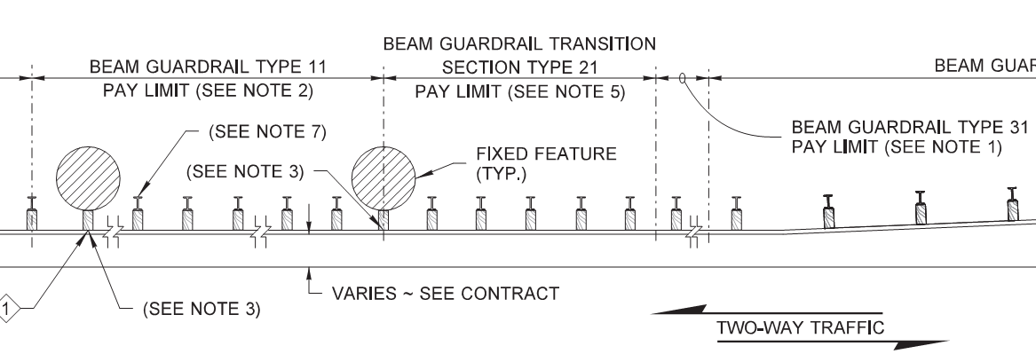
Design and Testing of a Thrie-beam System at a Fixed Object
2019-39-LSRB
PS Developers
John (WSDOT)
Project Synopsis
Develop and crash test a MASH TL-3 thrie-beam roadside system at a fixed object
System to have minimal deflection and “close to rigid” behavior
Cost effective alternative to concrete barrer
Project Goal(s)
Develop and crash test a MASH TL-3 thrie-beam roadside system for protecting errant motorists from a fixed object

Slide 28
Design and Testing of a Thrie-beam System at a Fixed Object
2019-39-LSRB
Project Background
WSDOT system for a nested thrie-beam with reduced post spacing shields fixed objects
Fixed object is in close proximity to roadway→ need for minimal deflection
Could provide a cost effective alternative to a concrete barrier
Proposed Work Plan
Task 1: Design Development
Review previous literature and research
Preliminary analysis
Computer simulation
Task 2: MASH Crash Testing
Crash test the roadside system to MASH TL-3.

Slide 29
Design and Testing of a Thrie-beam System at a Fixed Object
2019-39-LSRB
Deliverables
Design for a MASH compliant roadside thrie-beam barrier that provides a “close to rigid” condition
Technical report documenting the project
Urgency and Expected Benefit
Provides a cost effective alternative to concrete barriers when minimal deflection is needed
Funding
$
Research Period
months

Slide 30
31” W-beam Guardrail (Steel and Wood Post) in Asphalt Mow Strips
2019-40-LSRB
PS Developers Kurt Brauner, LA
Project Synopsis
There is a need to install the W-beam guardrail system in asphalt without having to construct a concrete mow-strip to control vegetation. Currently there is no design of the mow-strip for asphalt
Project Goal(s)
To develop and test an asphalt mow-strip that allows installation of wood post and steel post W-beam guardrails with posts installed directly in asphalt as opposed to a backfilled low-strength grout. Testing would be needed for MASH TL-3 for both systems
Project Background
Need MASH system for installing the wood & steel post guardrail in asphalt, without a concrete mow-strip
Previous MASH Tests 3-10 and 3-11 were successful on steel post W-beam guardrail in concrete mow strip
This design was unsuccessful for wood-post W-beam. It passed MASH Test 3-10, but failed Test 3-11

Slide 31
31” Rectangular Wood Post W-Beam Guardrail in Concrete Mow Strips
2019-40-LSRB
Proposed Work Plan
Task 1: Bogie Testing
Perform impact tests of posts installed in various thicknesses of asphalt and compare the force deflection behavior to posts directly installed in soil
Select designs for the full-scale system
Testing to be performed for both wood and steel posts
Task 2: Construction
Construct and repair test installations of wood-post W-beam guardrail and steel post W-beam guardrail
Task 3: Testing and Reporting
Perform MASH Test 3-10 and Test 3-11 for both steel post and wood post guardrail systems
Prepare final report
Deliverables
Final report
Engineering drawings

Slide 32
31” Rectangular Wood Post W-Beam Guardrail in Concrete Mow Strips
2019-40-LSRB
Urgency and Expected Benefit
Successful designs will allow agencies to install the W-beam guardrail system in asphalt without having to construct a concrete mow-strip to control vegetation. Currently there is no design of the mow-strip for asphalt. If successful, this design will see immediate implementation
Funding
Task 1 – Bogie Testing $45,000
Task 2 – Construction $55,000 (2 installations, 2 repairs)
Task 3 – Testing and Reporting
Test 3-10 x 2 $80,000
Test 3-11 x 2 $90,000
TOTAL $251,000
Research Period
12 months

