Slide 1
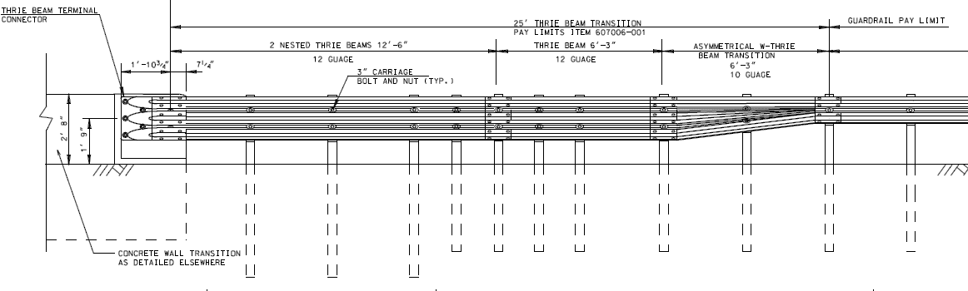
Shorter TL-3 MASH W-Beam Transition
Purpose
Investigate the crashworthiness of shorter W-beam to parapet transition system under MASH TL-3 criteria.
Status
Performing engineering review of available transition systems and their design variables.
Next
Parametric analysis/simulation to provide the CIP for full-scale crash test,
Full-scale crash test (Test 3-21).
Anticipated Completion Date:
July 2020
transition system

Slide 2
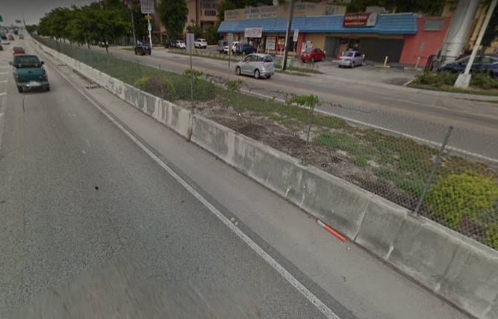
MASH Test Level 4 Testing and Evaluation of a Concrete Median Barrier with Fence Mounted on Top
Purpose
Investigate the crashworthiness of 36-in tall concrete single slope median barrier with chain link fence mounted on top under MASH16 TL4 criteria.
Status
Project started August 2019
Work Plan
Define details for chain link fence attached on top of barrier
Full-scale crash tests (Tests 4-11 and 4-12)
Anticipated Completion Date:
Fall 2020
Needs to be a Median application

Slide 3
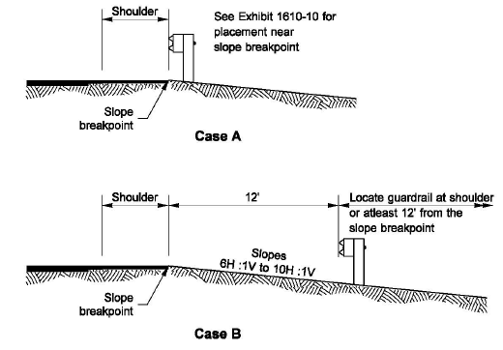
MASH Test Level 3 Testing of Guardrail on 6H:1V slope
Purpose
Determine appropriate offset distance from the slope break point of a 6H:1V slope to face of rail for an MGS guardrail system under MASH TL-3 Test Condition
Status
Project started May 2019
Work Plan
Vehicular trajectory analyses to find the profile of the bumper corner
Impact simulations to determine the critical placement location
Full-scale crash tests (Tests 3-11 and 3-10)
Guidance for Placement on 6H:1V slope
Anticipated Completion Date:
August 2020
WSDOT Design Manual
Notes:
MASH Test Level 3 Testing of Guardrail on 6 to 1 slope project has started
Purpose of the project is to determine appropriate offset distance from the slope break point of a 6 to1 slope to face of rail for a MGS guardrail system to meet MASH TL-3 criteria
AASHTO – Guardrail installed on the shoulder, should installed with the 2 ft distance from the back edge of the guardrail post to the slope breakpoint.
WSDOT -Limits to the near slope breakpoint or the minimum offset of 12 ft.
However, in many mountainous areas or in locations with tight environmental controls, site restriction might dictate the need for steeper slopes, or placement closer to the slope break point.
Guardrail on 8:1 slope with 5ft offset was tested to meet NCHRP 350TL-3 criteria (MwRSF) – barely prevent the pickup truck form overriding it.
Case A – guardrail on 1:1 and 2:1 slope was tested to meet MASH TL3 criteria (TTI)
Project has started on May 2019
To achieve the purpose,
1. Trajectory and Impact simulation will be conducted to find the profile of the bumper corner and with the profile, the most critical location for a guardrail will be determined.
2. Full-scale crash tests (Tests 3-11 and 3-10) will be conducted for the most critical case.
The anticipated completion date is August 2020.

Slide 4
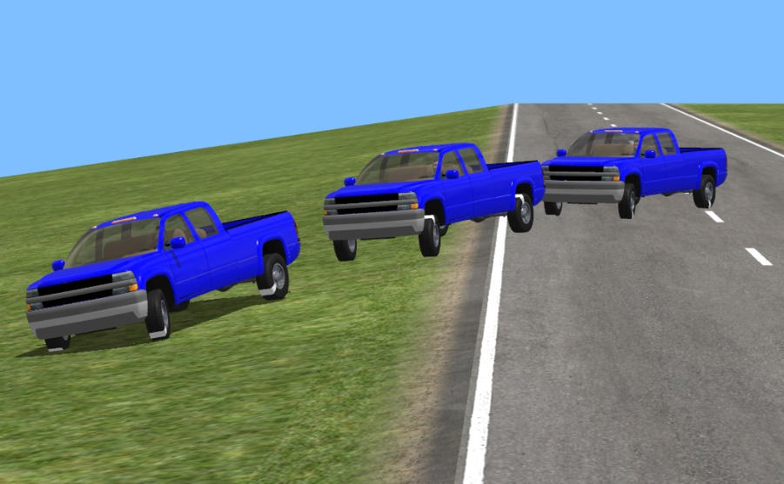
MASH Test Level 3 Testing of Guardrail on 6H:1V slope
Trajectory and Impact simulation to find the profile of the bumper corner
offset
1V
6H
Notes:
Trajectory and Impact simulation will be conducted to find the profile of the bumper corner
The outputs taken from these simulations included graphical plots of vehicle bumper height with respect to local terrain along the slope
With the profile, the most critical location (or offser) for a guardrail will be determined.

Slide 5
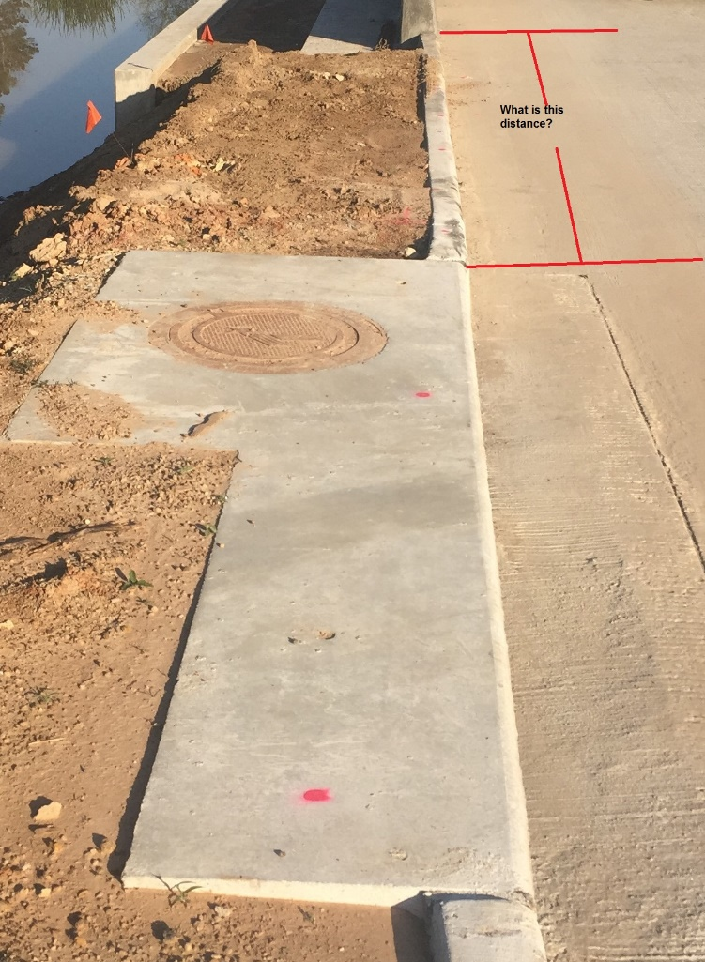
Accommodating Inlets with Transitions
Develop a transition design to be evaluated under MASH TL-3 test conditions
Hydraulic inlets configurations to be accommodated in the design

Slide 6
Accommodating Inlets with Transitions
Proposal being prepared for the following research activities.
Polling State DOT’s with these inlets configurations
Perform nonlinear finite element analyses
Perform MASH TL 3 transition test for the 2270P test vehicle (Phase I)

Slide 7
LON for Guardrail without Anchorage: Phase 1
Purpose
Use computer simulation to determine length-of-need for guardrail without anchorage
Complete component testing for validation of computer simulation
Phase II will complete crash testing
Status
Has not started yet; processing at WSDOT
Phase II balloted for prioritization during this meeting

Slide 8
Bi-Lateral Tasks
Impact Performance Evaluation of Modified Minnesota Swing-Away Mailbox Support to MASH (Minnesota);
Analysis and Testing of Florida Department of Transportation Barrier Systems for MASH Compliance (Florida);
MASH Implementation Technical Support for WSDOT (Washington);
Evaluation of W-Beam Guardrail Terminal Post in Sleeve (Alaska);
MASH Full-Scale Crash Testing of the Transition from the MGS Weak Post System to the Strong Post MGS System (Connecticut);
MASH Full-Scale Crash Testing and Evaluation of the Merritt Parkway Guide Rail (Connecticut);
MASH Testing of Single Slope and F-Shape Barriers with Drainage Scuppers (Washington)

