Slide 1
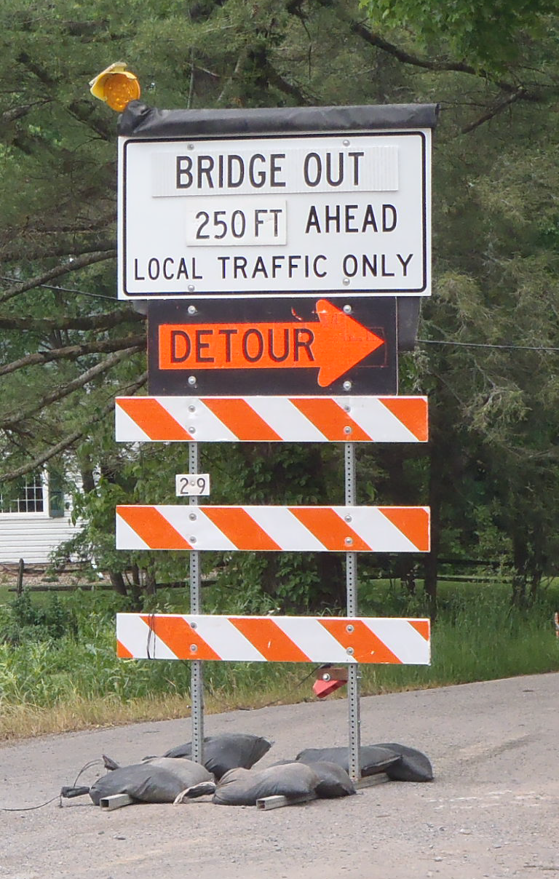
Testing Type III Barricades with Panels and Mounted Sign on Top
2019-26-WZ
PS Developers
Brian (PennDOT), Steve (WSDOT), Hassan (PennDOT), Ken (MnDOT), Filiberto (IDOT)
Project Synopsis
Type III barricades are required to be tested with attachments
Signs and panels are often mounted on Type III barricades
Need to develop a crashworthy Type III barricade with signs/panels
Project Goal(s)
Develop designs for a MASH compliant Type III barricade with panels or signs
Test critical design or designs to allow for other designs to be compliant

Slide 2
Testing Type III Barricades with Panels and Mounted Sign on Top
2019-26-WZ
Project Background
Type III barricades are often placed at road closures or as advance warning for TTC
Signs are often mounted to Type III barricades for portability
Currently available designs are mostly proprietary
Concerns with the varying materials (metal, plastic, wood, etc.) for crashworthiness and durability
Approaching the Implementation Deadline at the end of 2019
Proposed Work Plan
Task 1: Engineering Review
Review current standards of Roadside Safety Pooled Fund
Develop critical design or designs to be tested
Task 2: MASH Crash Testing
Crash test the design(s) to MASH TL-3.

Slide 3
Testing Type III Barricades with Panels and Mounted Sign on Top
2019-26-WZ
Deliverables
MASH compliant Type III barricades with mounted signs or panels
Recommendations for future research if designs do not meet MASH criteria
Technical report documenting the project
Urgency and Expected Benefit
Allow states to provide consistency in the work zone environment for drivers familiar with previous NCHRP 350 signs and barricades
Increases availability by providing a non-proprietary alternative for states to use
Funding
$175,000
Research Period
12 months

Slide 4
Testing of category two sign and barricade systems and ballast guidelines
2019-28-WZ
PS Developers
Chris Brookes, Work Zone Delivery Engineer
Project Synopsis
Evaluate category two sign and barricade systems to determine acceptable ballast practices.
Project Goal(s)
Testing of category two sign and barricade systems to determine acceptable ballast practices.

Slide 5
Testing of category two sign and barricade systems and ballast guidelines
2019-28-WZ
Project Background
Most state DOT use temporary signs for shorter durations projects (under 14 days in Michigan) where signs are not driven into the ground, or projects where the closure is placed and removed daily.
These signs and barricades require ballast to be utilized. Under NCHRP 350 Sand bags were allowed to be utilized.
The acceptable number and size of the sand bags needs to be detailed out under MASH to allow this everyday practice to be utilized.
Proposed Work Plan
Task 1: Literature Review and Engineering Analysis
Task 2: Construction and Demolition
Task 3: Full-Scale Crash Testing and Reporting (budgeting for four crash tests)

Slide 6
Testing of category two sign and barricade systems and ballast guidelines
2019-28-WZ
Deliverables
A report providing details of the category two sign and barricade systems ballast guidelines.
Urgency and Expected Benefit
To be able to continue using daily lane closure and place signs on paved surfaces, DOTs and contractors must know the correct and safe method for ballasting signs.
Funding
Total Estimated Cost = $105,000
Research Period
Work Schedule: (Project Duration = 10 months from initiation of the project)
Task 1 = 3 months
Task 2 = 3 months
Task 3 = 4 months

Slide 7
Portable Sign Supports for Aluminum Signs with Variation on Mounting Height
2019-29-WZ
PS Developers
Shawn Debenham, Justin Wilstead, Brian Crossley, Ken Johnson
Project Synopsis
There is a need to place temporary signs within channelizing devices so they are visible for the traveling public.
MASH testing will be conducted to aide in the development of a crashworthy sign stand with a minimum mounting height of 3’ for temporary applications.
Project Goal(s)
Develop a design for a sign stand for rigid signs that can be placed within channelizing devices at a mounting height of 3’ or greater.
Sign size needs to range from 2’ x 2’ to 4’ x 4’.

Slide 8
Portable Sign Supports for Aluminum Signs with Variation on Mounting Height
2019-29-WZ
Project Background
Signs placed among channelizing devices in work zones can be visually blocked.
There is not a tested sign stand that can hold a rigid (aluminum) sign at a height necessary to be placed among channelizing devices (currently only roll-up signs are in use).
A sign stand that can place the sign above these devices is needed to provide appropriate sight distance and decision time.
Proposed Work Plan
Task 1: Literature Review and Engineering Analysis
Task 2: Construction and Demolition
Task 3: MASH TL-3 Full-Scale Crash Testing and Reporting
Deliverables
Summary report to document research effort, including literature review, CAD details, crash testing, and recommendations for further research.

Slide 9
Portable Sign Supports for Aluminum Signs with Variation on Mounting Height
2019-29-WZ
Urgency and Expected Benefit
Successful MASH evaluation of a temporary sign stand will improve safety in work zones and allow for the installation of signs among channelizing devices that can be seen with adequate time for decision making.
Funding
Total Estimated Cost = $115,000
Note: Budgeting for four (4) full-scale crash tests
Research Period
Work Schedule: (Estimated Project Duration = 10 months from initiation of the project)
Task 1 = 3 months
Task 2 = 3 months
Task 3 = 4 months

Slide 10
ITS Sensor Attachments for Smart Work Zones
2019-30-WZ
PS Developers: Chris Brookes, Ken Johnson
Project Synopsis
The project will review existing literature, survey state use of ITS sensors for work zone applications, crash test a worst-case application with attachment location, weight, and size, and provide final guidance.
Project Goals
Evaluate ITS sensors attached to work zone systems for MASH compliance.
Provide guidance for weight, size, and mounting location of sensor attachments.
Project Background
Rear end crashes are the leading cause of work zone fatalities on the nations roadways. ITS sensors are a major part of reducing fatalities in work zones. Under NCHRP 350 these devices were often placed on trailers and categorized as Category 4 devices, which didn’t require testing based upon the net benefit these devices provided to the motoring public. Currently, no MASH testing has been conducted on these types of devices.

Slide 11
ITS Sensor Attachments for Smart Work Zones
2019-30-WZ
Proposed Work Plan
Literature review of previous crash testing and state standards for ITS sensor attachments.
Perform full-scale MASH crash testing on worst-case sensor attachment. The critical sensor weight, size, and mounting location will be determined through engineering analysis.
Produce final report detailing literature review, engineering analysis, and full-scale crash testing. Develop guidelines for sensor attachments.
Deliverables
Final report detailing test results, MASH performance evaluation summary and ITS sensor attachment guidelines. The guidance would comprise of sensor size, weight, and mounting location.

Slide 12
ITS Sensor Attachments for Smart Work Zones
2019-30-WZ
Urgency and Expected Benefit
MASH compliant ITS sensor use with work zone systems. Reduced fatalities in work zones.
Funding
The estimated cost to complete the proposed project is $110,000.
Research Period
The estimated time to complete the proposed project is 12 months.

Slide 13
Generic Sign Cover for Variable Signs
2019-31-WZ
PS Developer
Chris Brookes
Project Goal
Testing of Sign Covers for temporary and permanent signs.
Project Background
The configuration of the work zone will change during the project either by open or closing lanes and the permanent and temporary signing is required to be modified.
A common approach has been to cover signs with an old plywood sign with the back side facing outward and two hooks at the top.
This method allows for reduced worker exposure as removing and placing these signs potentially daily is not practical and presents issue for worker and motorist safety.

Slide 14
Generic Sign Cover for Variable Signs
2019-31-WZ
Proposed Work Plan
Task 1: Literature Review and Engineering Analysis
Task 2: Construction and Demolition
Task 3: MASH TL-3 Full-Scale Crash Testing and Reporting
Deliverables
Summary report to document research effort, including literature review, CAD details, crash testing, and recommendations for further research.

Slide 15
Generic Sign Cover for Variable Signs
2019-31-WZ
Urgency and Expected Benefit
There are limitations on using soft covers due to the manufactures warranty of sign sheeting (some up to 15 years on permanent signs). Due to this, an approved and tested method needs to be evaluated.
Funding
Total Estimated Cost = $105,000
Note: Budgeting for four (4) full-scale crash tests
Research Period
Work Schedule: (Estimated Project Duration = 10 months from initiation of the project)
Task 1 = 3 months
Task 2 = 3 months
Task 3 = 4 months

Slide 16
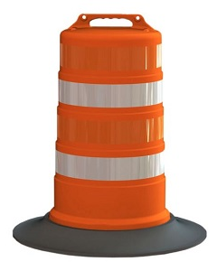
Effect of Commonly used Accessories Crashworthiness of Work Zone Category 1 and Category 2 Devices under MASH Testing.
2019-32-WZ
PS Developers
Filiberto (IDOT)
Project Synopsis
No MASH guidance on crashworthiness of accessories mounted on Category 1 devices
Develop guidance for Category 1 devices with mounted accessories through crash testing
Crash test Category 2 devices (Type I or Type II barricades) with mounted accessories
Project Goal(s)
Develop guidance regarding the crashworthiness of accessories mounted on Category 1 devices
Crash test Category 2 devices (Type I or Type II barricades) with mounted accessories

Slide 17
Effect of Commonly used Accessories Crashworthiness of Work Zone Category 1 Devices under MASH Testing.
2019-32-WZ
Project Background
NCHRP Report 350 testing completed on Category 1 devices with accessories
Category 1 devices are currently self-certified, but no guidance regarding accessories
Category 2 devices are required to be crash tested with mounted accessories
Proposed Work Plan
Task 1: Engineering Review
Review currently available Category 1 and Category 2 devices (Type I and Type II barricades) and typical accessories
Determine crash testing plan
Task 2: MASH Crash Testing
Crash test the Category 1 and Category 2 devices (Type I and Type II barricades) with accessories to MASH TL-3

Slide 18
Effect of Commonly used Accessories Crashworthiness of Work Zone Category 1 Devices under MASH Testing.
2019-32-WZ
Deliverables
Guidance on attaching accessories to Category 1 devices
Non-proprietary crash tested designs for Type I and Type II barricades with mounted accessories
Technical report documenting the project
Urgency and Expected Benefit
Provide states with guidance for mounting accessories on Category 1 devices
Provide states with non-proprietary designs for Type I and Type II barricades with mounted accessories
Funding & Research Period
$130,000
12 months

Slide 19
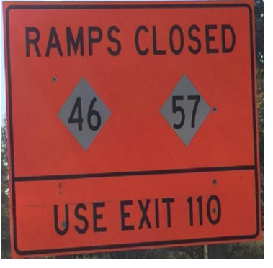
MASH TL-3 Evaluation of Global Warning Sign
2019-33-WZ
PS Developers: Chris Brookes, Ken Johnson, Filiberto Sotelo
Project Synopsis
The project will review existing literature and state standards, perform MASH crash testing, and provide final guidance.
Project Goal(s)
Evaluate work zone warning signs for MASH compliance.
Provide guidance for acceptable mounting height and sign size.
Project Background
Most state DOT place global informational signs in place during longer term construction projects to help promote awareness and increase the percentage of traffic detoured. These signs can range in size and shape and under NCHRP 350 each size and layout was not specifically tested.
Previous MASH testing has been conducted on a few work zone sign systems.

Slide 20
MASH TL-3 Evaluation of Global Warning Sign
2019-33-WZ
Proposed Work Plan
Literature review of previous crash testing and state standards for work zone warning signs.
Perform full-scale MASH crash testing on worst-case sign size and mounting height.
Produce final report detailing literature review, and full-scale crash testing. Develop guidelines for acceptable mounting height and sign size
Deliverables
Final report detailing test results, MASH performance evaluation summary, and work zone warning sign size guidelines.

Slide 21
MASH TL-3 Evaluation of Global Warning Sign
2019-33-WZ
Urgency and Expected Benefit
Continued use of work zone signs for DOTs, which are MASH compliant.
Funding
The estimated cost to complete the proposed project is $115,000.
Research Period
The estimated time to complete the proposed project is 12 months.

