Slide 1
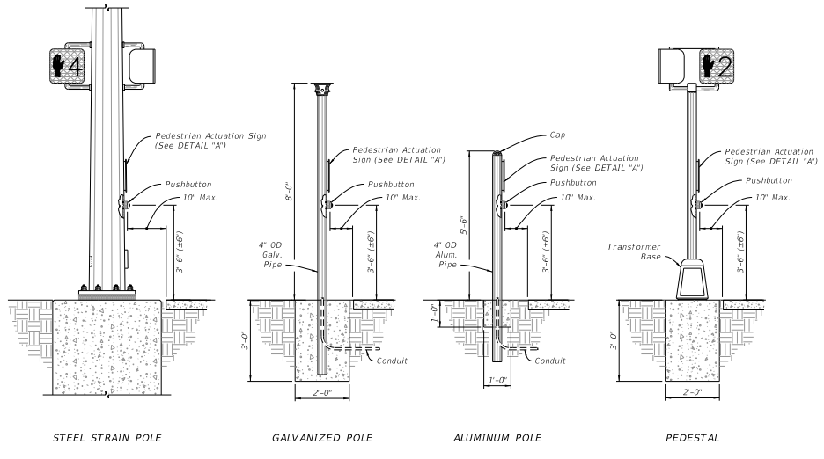
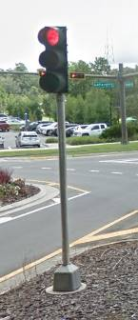
Crashworthy Pedestrian/Traffic Signals and Detector Assemblies
2019-04-BD
PS Developers: Derwood (FL)
Project Synopsis
MASH Crashworthiness evaluation of Pedestrian and Small Traffic Signals installed on Transformer Bases and Pedestrian Detector/Actuator Assemblies.
Project Goal(s)
Provide MASH Crashworthy designs of breakaway Pedestrian Signals/Actuators and Small Traffic Signals.
Project Background
Pedestrian Signals needed at intersections/pedestrian crossings where there is no other post or poles fore which to attach.
ADA Guidance recommends separated Pedestrian detector/actuators, which require separate posts.
Small traffic signals are often mounted to above transformer bases to have a breakaway system in locations such as medians and traffic islands.

Slide 2
Crashworthy Pedestrian/Traffic Signals and Detector Assemblies
2019-04-BD
Proposed Work Plan
Crash test worse-case assembly details based on information gathered from the member states and establish guidelines for acceptable mounting hardware (i.e., heights, size, and mass of signal heads).
Task 1. Information Gathering through Members Survey.
Develop design details. Conduct FEA simulations as design aid and vehicle impact behavior prediction.
Task 2. Component Testing.
Conduct component testing to investigate worse-case conditions.
Task 3. System Construction & Full-Scale Crash Testing.
Build /Purchase test articles. Conduct full-scale crash testing of worse case(s) (TL-3).
Task 4. Guidelines.
Define guidelines and summarize recommendations for implementation.
Deliverables
Guidelines (i.e., minimum maximum design parameters) for establishing MASH Compliant Pedestrian Signal Assemblies, Small Traffic Signal Supports, and Pedestrian Detector/Actuator Posts.

Slide 3
Crashworthy Pedestrian/Traffic Signals and Detector Assemblies
2019-04-BD
Urgency and Expected Benefit
Needed for MASH Implementation of Breakaway Devices. Provide MASH Compliant Pedestrian Signal and Detector/Actuator Assemblies, as well as MASH Compliant Small Signal Assemblies.
Funding: $180,000
Research Period : 1 year

