Slide 1
Portable sign supports for aluminum signs with variation on mounting height
2019-29-WZ
PS Developer(s)
Shawn Debenham (UT), Justin Wilstead (UT), Brian Crossley (PA), Michelle Moser (MN)
Project Synopsis
There is a need to place temporary signs within channelizing devices so they are visible for the traveling public. This requires a minimum sign height of 5 ft measured from the top of pavement to the bottom of the sign. MASH testing will be conducted to aide in the development of a crashworthy sign stand for temporary applications.
Project Goal(s)
Develop a design for a sign stand for rigid signs that can be placed within channelizing devices at a mounting height of 5’ or greater (7’ is preferred). Sign size needs to range from 2’ x 2’ (4 square feet) to 4’ x 4’ (16 square feet).

Slide 2
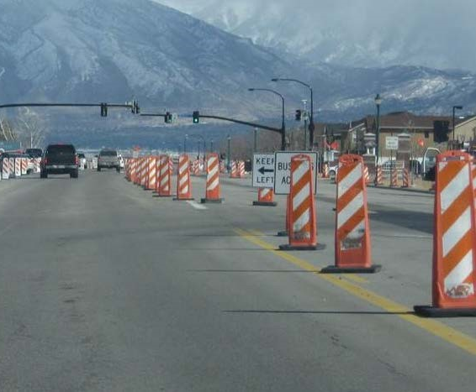
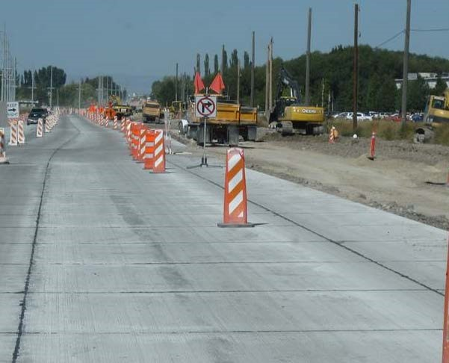
Portable sign supports for aluminum signs with variation on mounting height
2019-29-WZ
Project Background
In work zones, when signs are placed among channelizing devices, they can be visually blocked. Currently, there isn’t a tested non-proprietary sign stand that can hold a rigid (aluminum) sign at a height necessary to be placed among channelizing devices, only roll-up signs. A sign stand that can place the sign above these devices is needed to provide appropriate sight distance and decision time.
Improper placement
Proper placement

Slide 3
Portable sign supports for aluminum signs with variation on mounting height
2019-29-WZ
Proposed Work Plan
Task 1: Literature Review
Task 2: Simulation and Engineering Analysis
Task 3: Construction and Demolition
Task 4: Full-Scale Crash Testing and Reporting
Deliverables
Compile summary report to document research effort, including literature review, CAD details, crash testing, and recommendations for further research in the event of the system failing testing criteria.
Urgency and Expected Benefit
Successful MASH evaluation of a temporary sign stand will improve safety in work zones and allow for the installation of signs among channelizing devices that can be seen with adequate time for decision making.

Slide 4
Portable sign supports for aluminum signs with variation on mounting height
2019-29-WZ
Funding
Total Estimated Cost = $130,000
Research Period
Work Schedule: (Project Duration = 12 months from initiation of the project)
Task 1 = 2 months
Task 2 = 3 months
Task 3 = 3 months
Task 4 = 4 months

