Slide 1
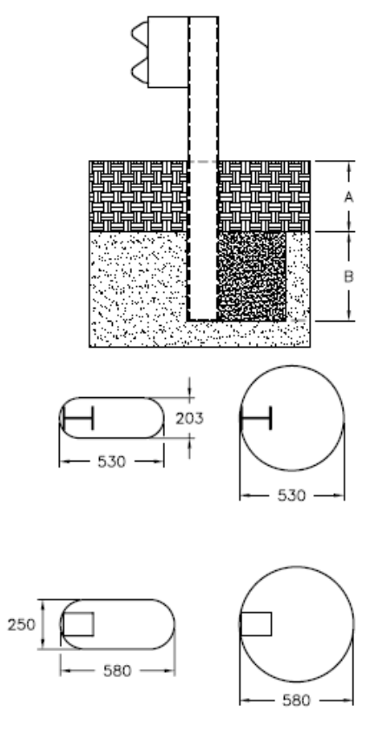
Determine MASH Compliance of Placing Guide Rail in Rock
2020-02-LSRB
PS Developers PF Tech. Rep. TBA (Presenting: Nauman Sheikh, TTI)
Project Synopsis
Update the current RDG guideline for guardrail post installation in rock using the MASH testing criteria
Project Goal(s)
Update current guardrail in rock guidance using recent and new MASH crash testing.
Project Background
Current RDG guidance for guardrail post installation in rock is based on NCHRP Report 350 testing
Testing was performed with steel post guardrail
Slightly larger holes were recommended for wood post guardrail
MASH evaluation/update of the guideline is needed
8”
20”
20”
9.8”
22.8”
22.8”

Slide 2
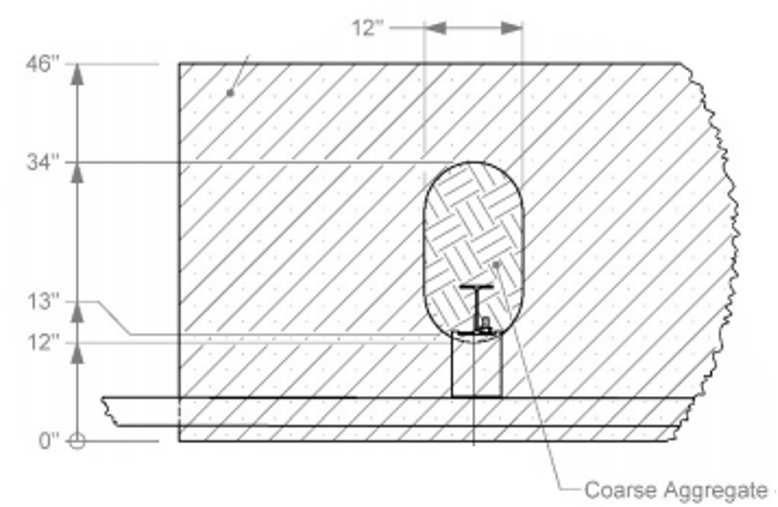
Determine MASH Compliance of Placing Guide Rail in Rock
2020-02-LSRB
Project Background
TTI/TxDOT tested round wood post in rock with oval and round holes – both failed MASH
TTI/TxDOT tested steel post guardrail in larger oval holes – passed MASH
Contractors seem to prefer a single round hole over coring two holes to make oval
If slightly larger hole is acceptable, the steel post system doesn't need to be tested for MASH
Evaluation and test is needed for rectangular wood post in rock using MASH criteria

Slide 3
Determine MASH Compliance of Placing Guide Rail in Rock
2020-02-LSRB
Proposed Work Plan
Task 1: Past Testing Review & Wood Post System Design
Evaluate past testing to develop design for the rectangular wood post guardrail in simulated rock
Get concept design approved from Tech. Rep. prior to testing
Task 2: Construction
Construct wood-post guardrail in simulated concrete rock for testing
Task 3: Crash Testing, Guideline, & Final Report
Perform MASH Test 3-10 and 3-11
Use results of the new and past testing to recommend update to guideline
Final Report
Deliverables
Final report including the guideline and system drawings

Slide 4
Determine MASH Compliance of Placing Guide Rail in Rock
2020-02-LSRB
Urgency and Expected Benefit
Wood post guardrail is widely used and when rock is encountered, a MASH compliant guidance is needed for proper installation.
The guidance will be a recommended update to the RDG’s current guidance for both steel and wood post systems
Funding
Total Cost Estimate = $145,503
Task 1 - $13,218
Task 2 - $45,957 (includes repairs for retesting and demolition & disposal after project)
Task 3 - $86,328 (Test 3-11 and Test 3-10)
Research Period
12 months

