Slide 1
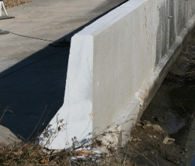
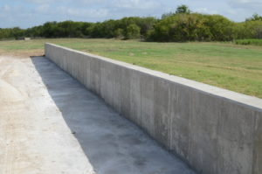
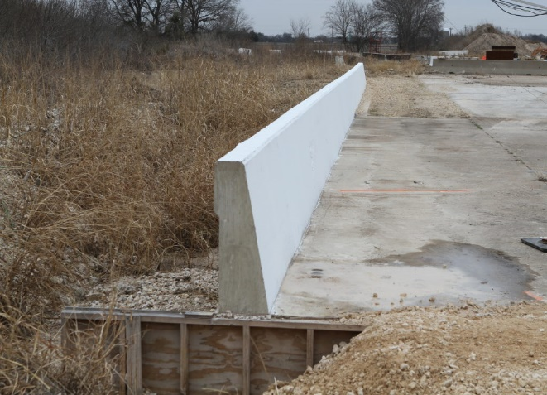
Attaching MASH-compliant transitions to rigid concrete barriers other than the tested barrier
2020-03-LCB
PS Developers: Steve (AL), Carlos (MI), Jeff (AK); Nina (PA), Joe (WV)
Project Synopsis
Evaluate and develop guidelines for attaching MASH thrie beam transitions to concrete barriers other than the originally tested barriers, prioritized by state type and usage.
Project Goal(s)
Develop design guidance for attaching MASH-compliant thrie beam transitions and concrete barrier that have not been tested together.
Project Background
TL4 and TL3 tested barrier Including: 32” or 42” F-shape, Single Slope, Vertical Wall, NJ shape
Notes:
Flattest effective backslope; a threshold backslope for requiring area free of fixed objects behind the terminal; and investigate whether there is a limit for backslope steepness.
Ditch configurations vary: the foreslope is flatter than 4:1; foreslope of the ditch is wider than 6 feet; the backslope varies from 2:1; or the ditch is flat-bottomed

Slide 2
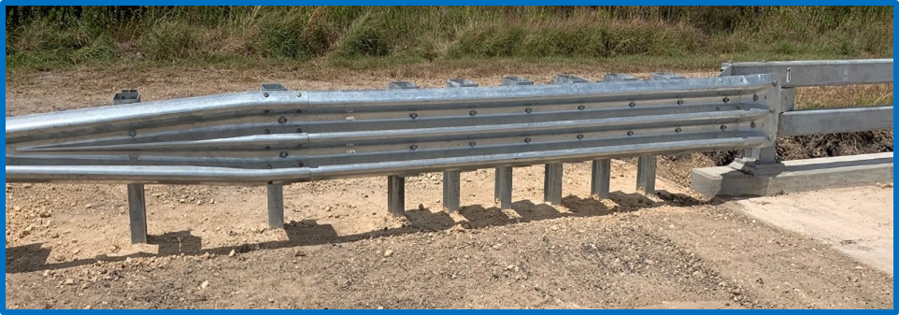
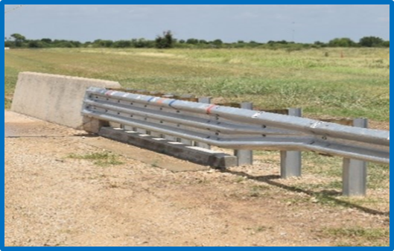
Attaching MASH-compliant transitions to rigid concrete barriers other than the tested barrier
2020-03-LCB
Project Background (continued)
Multiple TL3 MASH-tested transitions are shown effective with a specific barrier, including: TxDOT GF(31)TR 31-in transition, Alaska’s 34-3/4” transition, and MwRSF’s 34-in transition.
Project Background
Notes:
Flattest effective backslope; a threshold backslope for requiring area free of fixed objects behind the terminal; and investigate whether there is a limit for backslope steepness.
Ditch configurations vary: the foreslope is flatter than 4:1; foreslope of the ditch is wider than 6 feet; the backslope varies from 2:1; or the ditch is flat-bottomed

Slide 3
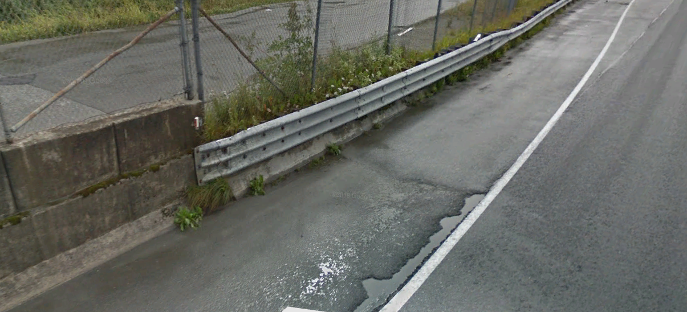
Attaching MASH-compliant transitions to rigid concrete barriers other than the tested barrier
2020-03-LCB
Project Background (continued)
Project Background
Notes:
Flattest effective backslope; a threshold backslope for requiring area free of fixed objects behind the terminal; and investigate whether there is a limit for backslope steepness.
Ditch configurations vary: the foreslope is flatter than 4:1; foreslope of the ditch is wider than 6 feet; the backslope varies from 2:1; or the ditch is flat-bottomed

Slide 4
Attaching MASH-compliant transitions to rigid concrete barriers other than the tested barrier
2020-03-LCB
Proposed Work Plan
Task 1. Literature Review and Engineering Analysis.
Evaluate thrie beam transitions and barrier designs (i.e., vertical wall, F-Shape, Single Slope, etc…) commonly used by states, which represent critical conditions for analysis and simulation
Determine critical transition design (at TL-3, since TL-4 transition has not yet been developed)
Evaluate what is necessary for MASH determination (e.g. professional opinion, simulation)
Task 2. Engineering Analysis, Simulation
Prioritization of systems to work on will depend on the outcomes from Task 1.
For each prioritized system, conduct the computer simulation to investigate the crashworthiness of the base-line design.
For each prioritized, conduct computer simulations parametrically to replicate the real world installations by varying a single parameter each time
TTI team anticipates that the total number of combinations that will be investigated by computer simulation could be 5-10.
Task 3. Report and Guidelines
Describing the transition(s) considered and included in the analysis, results of engineering analysis and computer simulations

Slide 5
Attaching MASH-compliant transitions to rigid concrete barriers other than the tested barrier
2020-03-LCB
Deliverables
A report and a standalone guidance document.
Report should determine whether other MASH-compliant transitions can be treated in the same manner as the analyzed transition(s).
Guidance Document providing design solutions to connect MASH tested thrie beam transitions rigid barriers of different material, slope, or snagging potential than the tested rigid barrier.
Design solutions and guidance may include or address:
tapering toe of barrier;
slope variations and connecting options (tapered block, direct attachment);
curbs;
barrier termination options;
limits on connection to embedded or pre-cast barrier versus cast-in-place barrier.

Slide 6
Attaching MASH-compliant transitions to rigid concrete barriers other than the tested barrier
2020-03-LCB
Urgency and Expected Benefit
Rather than test many transitions for unique applications, we should seek broader application of proven transitions.
If guidance can be developed, then we will have greater flexibility when selecting transition-barrier combinations.
Guidelines are needed for connecting existing MASH transitions and rigid barriers other than those tested.
Guidelines will reduce development cost of multiple options, and give states flexibility by adapting tested transitions to various needs on the highway system.
Funding: $90,000
Research Period : 12 months

