Slide 1
MASH Implementation Pooled Fund Technical Advisory Committee
Approval of budget updates FFY2022 program
New Solicitation
TTI report and update
January 19, 2022 12:00pm Central Time

Slide 2
MASH Implementation Pooled Fund
FFY 2022 Budget Update

Slide 3
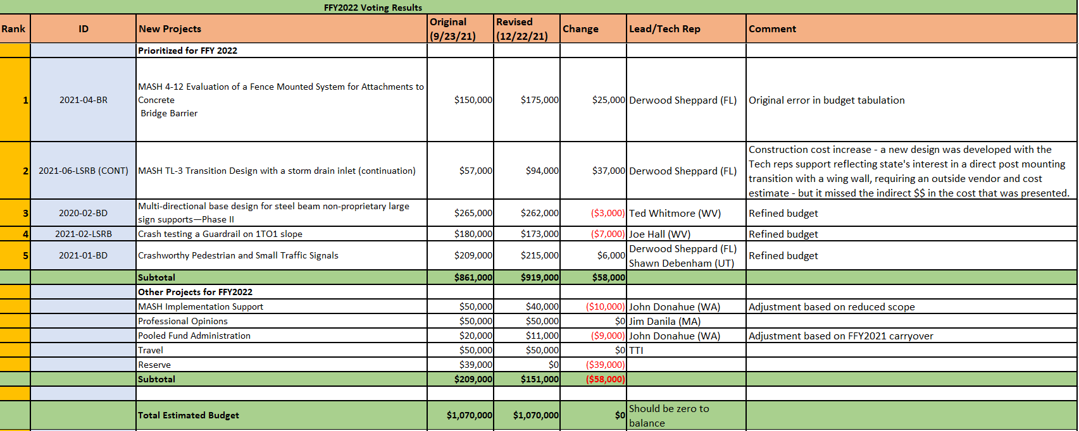

Slide 4
MASH Implementation Pooled Fund
Approval:
2021 – 06 - LSRB TL-3 Transition with Storm Drain Inlet
Task Order Budget Increase $37,000
Concurrence:
Pre-Task Order project adjustments FFY2022
FFY 2022 Budget Update

Slide 5
MASH Implementation Pooled Fund
New Solicitation Proposal for 2023-2028

Slide 6
Study Focus
Road to Zero
The goal is zero deaths and serious injuries
Not a single death is acceptable
Recent Trends / Roadway Departures
Increased highway fatalities
45% are roadway departures
An FHWA critical focus area (greatest potential to reduce fatalities)
RwD is a part of all state Strategic Highway Safety Plans (SHSPs)
Safety devices are central to building a strategy towards zero deaths

Slide 7
Study Focus
“Advancing life-saving technology in vehicles and infrastructure”
National Safety Council’s Road to Zero Coalition
Technology is not just about what’s in the vehicle
State DOT’s . . .
Are central to SHSP implementation
Are responsible for responding to roadside safety issues and needs
Many common issues benefit from using the pooled fund approach
Smart strategy for states’ to respond road to zero initiatives
Provide maximum cost effective impact / Optimize all resources
Provide necessary collaborative activities

Slide 8
Study Objective
To assist agencies in achieving their RwD-related SHSP goals
To develop, evaluate and deploy life-saving roadside safety devices and countermeasures
To support MASH implementation in hardware categories that have lagged due to design, performance challenges and issues.
To include special barrier applications, sign supports, work zone traffic control devices, luminaire poles, etc.
All in accordance with AASHTO and FHWA adopted standards such as MASH
Pooled fund activities will directly support and impact state efforts to achieve Target Zero addressing the need to reduce frequency / severity of roadway departure crashes
Note that FHWA Roadway Departure Focus States may particularly benefit

Slide 9
Proposed Scope of Work
Design, analyze, test, and evaluate crashworthy roadside safety devices
Develop guidelines for the use, selection, and placement of these devices
Evaluate and test bridge rails, guardrails, transitions, median barriers, portable concrete barriers, end treatments, crash cushions, culverts, breakaway support structures (e.g., sign supports, luminaire supports, mailboxes), and work zone traffic control devices
Evaluate influence of roadside features such as driveways, slopes, ditches, shoulders, medians, and curbs on vehicle collision performance
Work starts each year with identification, description, selection, and prioritization of research issues

Slide 10
Proposed Scope of Work
A technical committee made up of participating states will guide the research
identify common research needs
select and prioritize projects for funding
oversee research and testing
convene on an annual basis unless emerging issues require interim decisions.

Slide 11
Study Organization
WSDOT will serve as the chair of the technical committee
An agreement with Texas Transportation Institute (TTI) will guide the work
The agreement will include a reduced overhead rate (35%) for all projects under the pooled fund project
NEW – participating states must commit $65,000 for three to five years to participate in the pooled fund project
Pooled fund starts in FFY2023 (October 1, 2022)
Fall 2022 technical committee meeting will determine priorities for work in FFY2023
Money committed to the current fund (TPF 5(343)) for FFY2023 and later will be transferred to the new account

Slide 12
Questions and Discussion
MASH Implementation Pooled Fund
New Solicitation Proposal for 2023-2028

Slide 13
MASH Implementation Pooled Fund
TTI Report and Update

