Slide 1
TPF 5(501) Roadside Safety Pooled Fund – Phase 3
Mid year Meeting
March, 2023

Slide 2
Pooled Fund Leadership
Tim Moeckel, WSDOT
Mustafa Mohamedali, WSDOT
Roger Bligh, TTI
Nauman Sheikh, TTI
Lance Bullard, TTI
Ariel Sheil, TTI

Slide 3
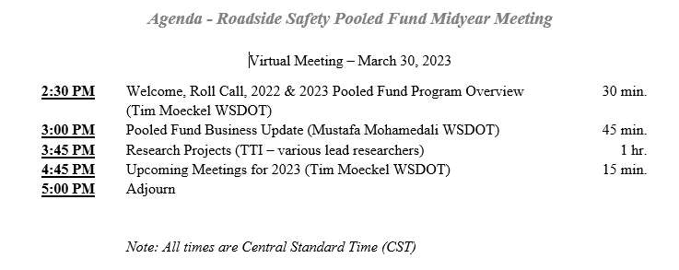
Agenda

Slide 4
Roll Call
Name
Organization
Position
How long have you been involved with the Roadside Safety Pooled Fund

Slide 5
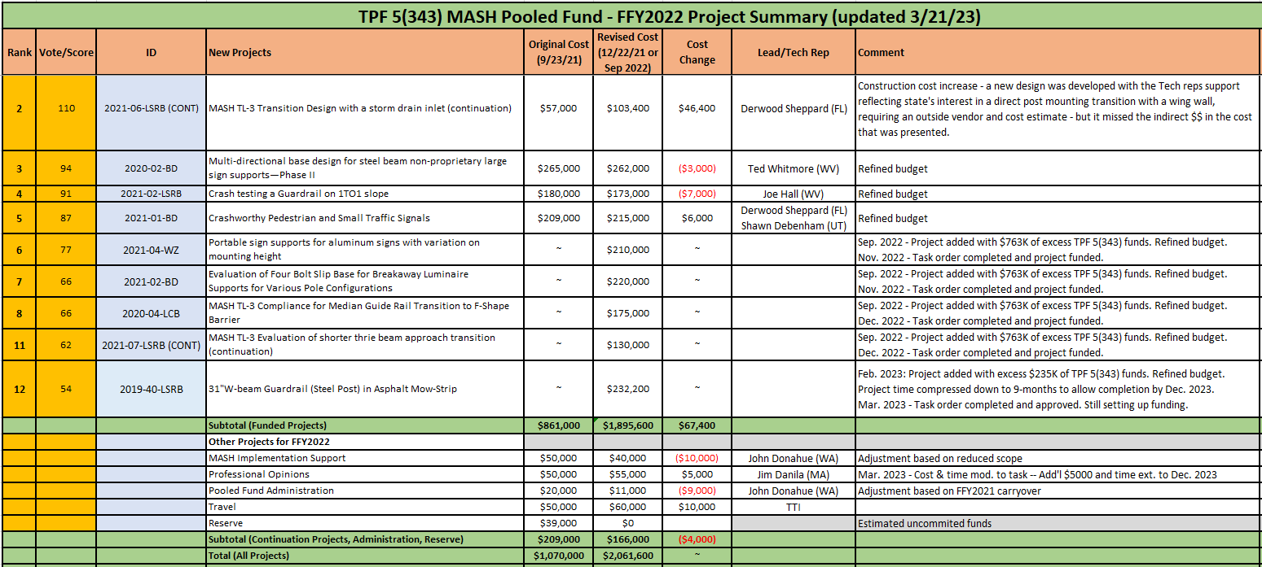
TPF 5(343) 2022 Research Program

Slide 6
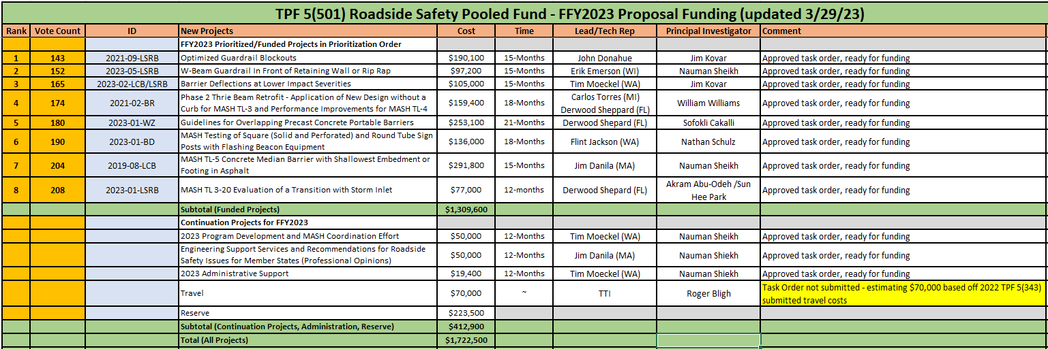
TPF 5(501) 2023 Research Program

Slide 7
TPF 5(501) State Commitment and Obligations Status
28 Total Pooled Fund Member States
State Commitments for this year’s 2023 program
26 states posted commitments on the Pooled Fund Website
2 states with verbal commitments
State Obligations & Transfer of Funds for this year’s 2023 program
13 States have completed the obligation & transfer of funds
15 States have not completed the obligation & transfer of funds

Slide 8
Notes:
That ends the first part of the meeting so I’ll turn things over to Mustafa for the Pooled Fund Business Update. Thanks!

Slide 9
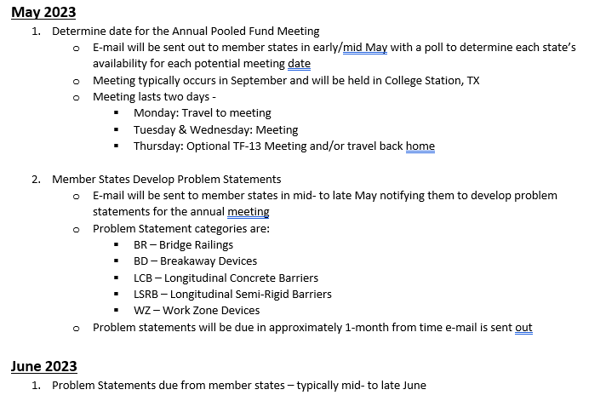
TPF 5(501) Calendar of Upcoming Events

Slide 10
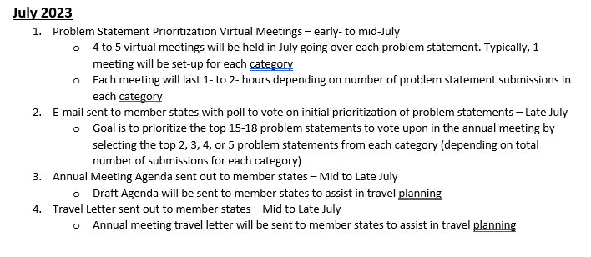
TPF 5(501) Calendar of Upcoming Events

Slide 11
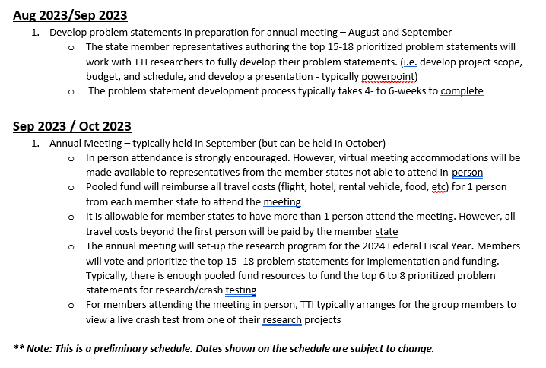
TPF 5(501) Calendar of Upcoming Events

Slide 12

GOODBYE JOHN AND CHIARA!!!!!

Slide 13


