Slide 1
MASH TL-4 Testing and Evaluation of Free-Standing F-shape PCB
2019-06-LCB
PS Developers
Christopher Henson, Oregon DOT; Nina Ertel, P.E, PennDOT; Andrew Pott, Colorado DOT

Slide 2
MASH TL-4 Testing and Evaluation of Free-Standing F-shape PCB
2019-06-LCB
Project Synopsis
  Design and test a 42” tall, F-shape profile, pin-and-loop connection, free-standing PCB in accordance with MASH Test Level 4
Project Goal
  Develop a 42”tall F-shape Free-Standing PCB that is MASH TL-4 compliant
Project Background
  A previous ODOT designed 42” PCB system met NCHRP Report 350 TL-4 criteria
  A similar barrier is not available for MASH TL-4
  Ideally a single barrier design that can be used for free-standing and pinning is preferred. This project is to focus on free-standing TL-4 barrier

Slide 3
MASH TL-4 Testing and Evaluation of Free-Standing F-shape PCB
2019-06-LCB

Slide 4
MASH TL-4 Testing and Evaluation of Free-Standing F-shape PCB
2019-06-LCB

Slide 5
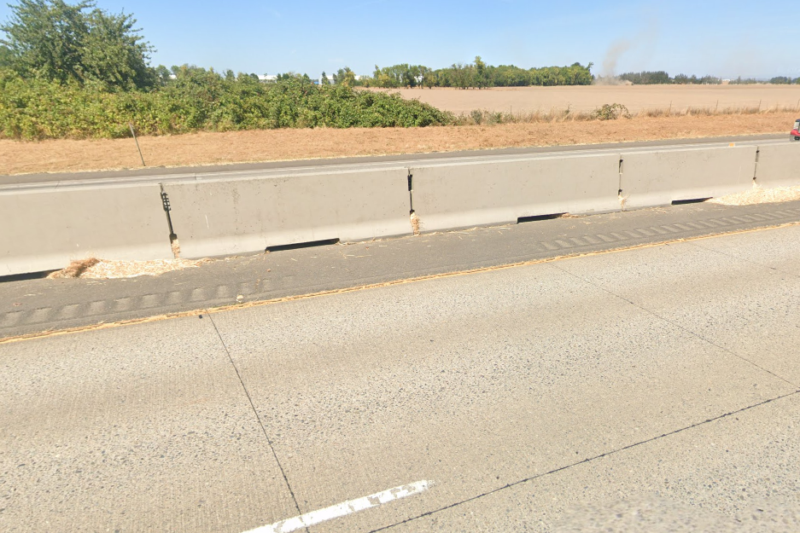
MASH TL-4 Testing and Evaluation of Free-Standing F-shape PCB
2019-06-LCB

Slide 6
MASH TL-4 Testing and Evaluation of Free-Standing F-shape PCB
2019-06-LCB
Proposed Work Plan
Task 1: Conceptual Design
  Develop initial barrier design concept based on review of existing MASH systems taller than 32-inch heights and/or TL-4.
  Seek approval of the concept
Task 2: Simulation Analysis & Detailed Design
  Develop FE model and perform impact simulations using MASH Test 4-12 testing conditions
  Modify and improve design based on simulation results
  Develop reinforcement details and barrier design for constructing testing prototype
Task 3: Construction & Demolition
Task 4: Crash Testing and Reporting
  Perform MASH Test 4-12 (small car and pickup tests not critical and will not be performed)
  Provide a final report documenting crash test results
Deliverables
Detailed report with the new PCB design and crash testing results

Slide 7
MASH TL-4 Testing and Evaluation of Free-Standing F-shape PCB
2019-06-LCB
Urgency and Expected Benefit
  Several states use PCB and currently there are no PCBs with pin-and-loop connections for MASH TL-4
Funding
  Total Estimated Cost = $215,000
Research Period
  12 months from initiation of the project

