Slide 1
Assessment of Bike Pedestrian Railing Attached to Crash Worthy Barriers – Phase I
Patrick O’Neill (WsDOT)
2023-03-BR

Slide 2
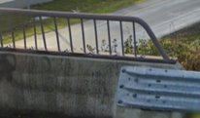
Project Goal(s)
Test or justify the use of steel or aluminum rails for bike pedestrian concerns not adversely affecting the crashworthiness of the barriers or system response. The addition of the pedestrian rail could improve the crashworthiness of the barrier and this will be considered for the barrier selected for this project.​
Provide recommendations for various configurations and test levels using the standard details provided by WSDOT in the Project Background below. TTI will evaluate two Bicycle Pedestrian rail systems part of this project. One design will involve a 1’-6” high pedestrian rail on a 36” single slope barrier (54” total height WSDOT Design). The other design will be one selected from a survey of the member states in the pooled fund (two designs total).

Slide 3
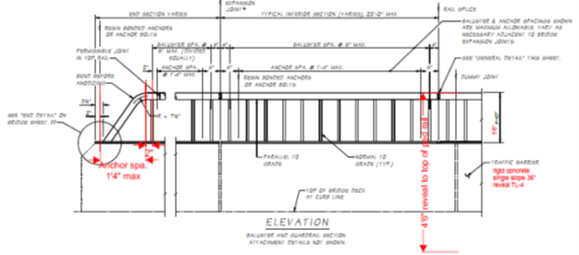
Project Background
WSDOT has been using a Bike Pedestrian Rail (BP-rail) either in a 12” or a 22” configuration for multiple years with the same or similar detailing. They built them out of either aluminum or steel, the basic structures are the same, and the detailing changes are associated with the availability of parts, welding, etc. ​

Slide 4
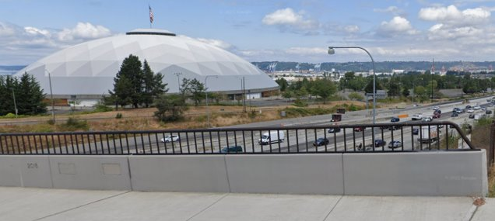
Project Background
Trailing End

Slide 5
Proposed Work Plan
Task 1 – Literature Review and State Survey ​
The research team reviews previous relevant research projects and sends out a survey to identify the common practice in the DOTs and prioritize selected systems/variations to be evaluated.​
Task 2 – Engineering Evaluation of Selected Systems (2)​
The research team will use a combination of approaches including engineering design and computer simulation to evaluate the prioritized two (2) systems. Designs developed for this project will meet the requirements of the LRFD Section 13 Specifications for Pedestrian railings. The research team provides recommendations for the systems/configurations that need to be evaluated through crash testing. This budget includes the design and evaluation of two systems. Computer simulations in this task will involve MASH 4-12 Specifications only. Simulations involving the small car (MASH 4-10) or the pickup truck (MASH 4-11) are not included in this workplan or budget.

Slide 6
Proposed Work Plan
Task 3 – Reporting​
The research team will document the effort on the evaluation of the systems/configurations and will provide recommendations.​​
Deliverables ​
Recommendation on suitability of tested details, further testing if warranted or needed, and statement on ranges of applicability

Slide 7
Urgency, Benefit, and Budget
Urgency and Expected Benefit​
This is currently common practice in Washington, any issues with current detailing or conversely validation of existing details would be iterated through the system. A valid passing system can lend credence to acceptability of ranges of heights and test levels, not to exceed the maximum passing configuration.​
​
Estimated Budget​
$106,350​
​
Estimated Research Period ​
12 months

