Slide 1
2023-03-LSRB Placement of Underground Obstruction by Posts
“How close is to close?”
Erik Emerson

Slide 2
Here is the problem
Posts need room to rotate.
Review research into placement of posts in rock and mow strips.
Sometimes people don’t pay attention to where post are and where other “stuff” is.
Usually, these problem are not found until late in construction.

Slide 3
Here is a project plan sheet

Slide 4
Here is the information I got from construction staff.

Slide 5
Erik starts asking question…
Is it the manhole cover that is in conflict or the manhole?
Project Manager : I don’t know?
How close would the post be to the conflict?
Project Manager: I don’t know?
How much embedment do you have?
Project Manager: I don’t know?
When do you need to have an answer by?
Project Manager: “We want to open to traffic next week.”

Slide 6
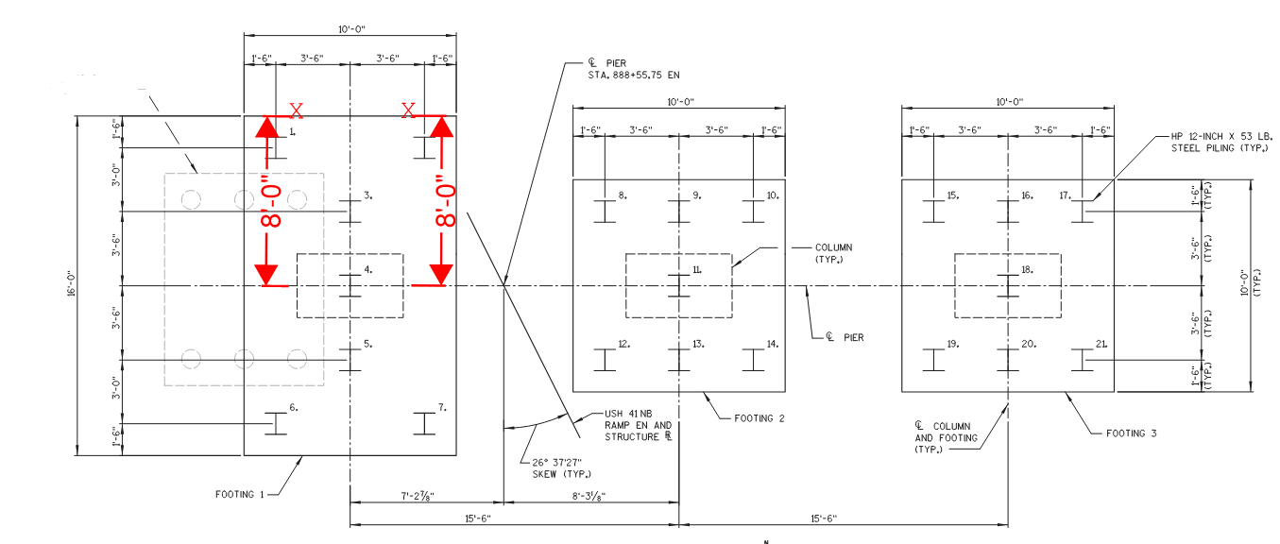
How about this project?
Post location

Slide 7
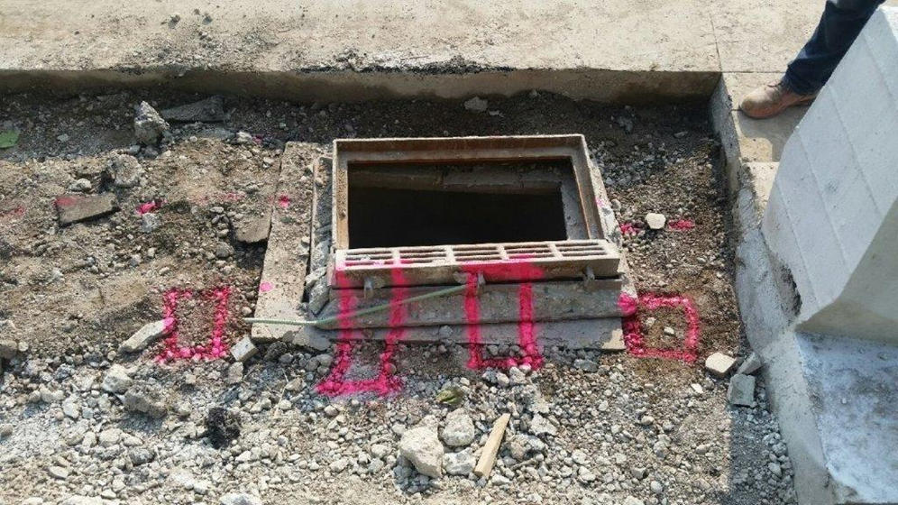
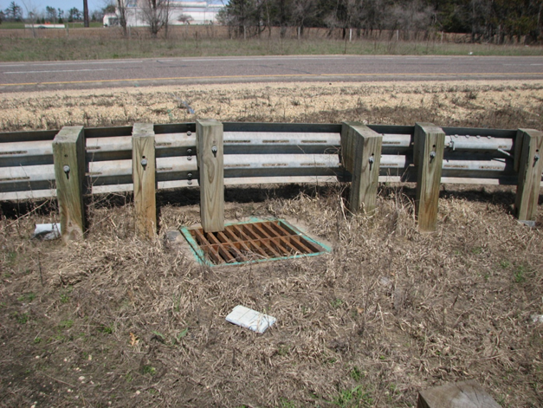
How much room does a post need for post rotation?

Slide 8
Here is the problem
We need to understand how close other object can be before they interfere with post rotation.
We need to understand what happens when post are too close to utilities?
Post will work but fiber optic is destroyed.
This may cause a partial closure of the road to repair the fiber optic.

Slide 9
2023-03-LSRB: Placement of Underground Obstruction by Posts
Goals
Determine how close an object can be placed to a guardrail post without interfering with post operation
Investigate any difference depending on which side of the post the underground obstruction (impact side, backside, left, right)
Investigate effect of elevation of underground obstruction on post response
100’

Slide 10
2023-03-LSRB: Placement of Underground Obstruction by Posts
Task Plan
Task 1 – Literature Review to identify followings:
Currently used posts, existing posts, and/or previously tested posts that closely placed underground obstructions, and obstruction types
Task 2 – Computer modeling of different underground obstruction
Conduct soil and guardrail post model calibration
Based on data from Task 1, develop computer simulation models for different configuration of posts and underground obstructions such as circular and flat obstructions
Find critical cases: combinations of a post and an obstruction / side of post impacting the obstructions / distance between post and obstruction
Task 3 – Conduct bogie tests on critical cases based on the recommendation ofTask 2
Task 4 – Calibrated simulations
Calibrate and upgrade the computer simulation models using bogie test results
Find a range of offsets from the post faces to the obstruction to eliminate effect on a beam guard operation.

Slide 11
2023-03-LSRB: Placement of Underground Obstruction by Posts
Deliverables
Final report
Placement guideline including a range of offsets from difference post faces to underground obstruction that will not interfere with beam guard operation, and approximate force imparted at a given distance from post.
Benefit
States will have a better understanding of how close underground obstructions can be to a post. States can provide information to a utility what forces will be imparted to their equipment at a given offset.
Estimated Cost
Total Estimated Cost = $211,791​
Total Estimated Time = 12 Months

