Slide 1
Desing and Testing of New Anchored PCB System
Supplemental Project - Caltrans
By
Nauman Sheikh, P.E. (TTI)
Bob Meline, P.E. (Caltrans)

Slide 2
Background
Caltrans NJ profile restrained Type-K PCB does not meet MASH TL-3 criteria
  Desire to change over to F-shape profile
  Use Oregon/TTI connection and barrier detail because of its history of good performance and low deflections in testing
Current TTI/Pooled Fund F-shape PCB uses inclined pins, which are less desirable for installation in asphalt
Caltrans wanted to use vertical pins

Slide 3
Research Objectives
Develop an F-shape PCB system using the Oregon/TTI barrier design that can be use as:
  Roadside barrier - anchored on asphalt
  Median barrier - anchored on asphalt
  Roadside barrier - anchored on concrete
  Median barrier - anchored on concrete with shallower anchor bolts (can also be a roadside barrier)
Several barrier design features were needed
  Reinforced segment toe areas
  Strengthened anchor pin/bolt holes
  Lifting holes
  Drainage scuppers

Slide 4
Research Approach
Developed barrier design details
Developed FE model of the barrier system and performed impact simulations
Refined the design
Constructed test installations
Performed four MASH Test 3-11, one for each configuration

Slide 5
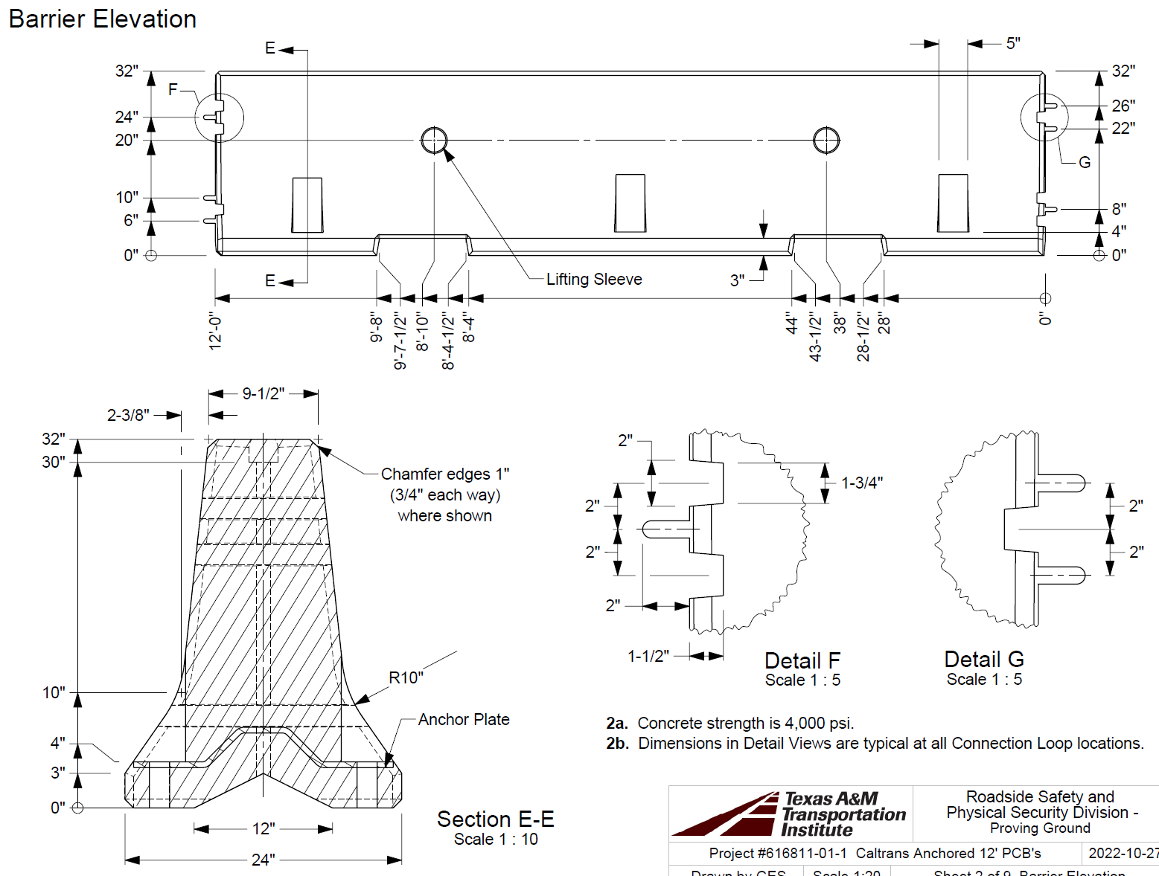
Barrier Details
12-ft F-shape
Pin-and-loop connections (same as Oregon/TTI design)
Lifting sleeves
3” tall drainage scuppers
3 holes for anchor pins/bolts on each side

Slide 6
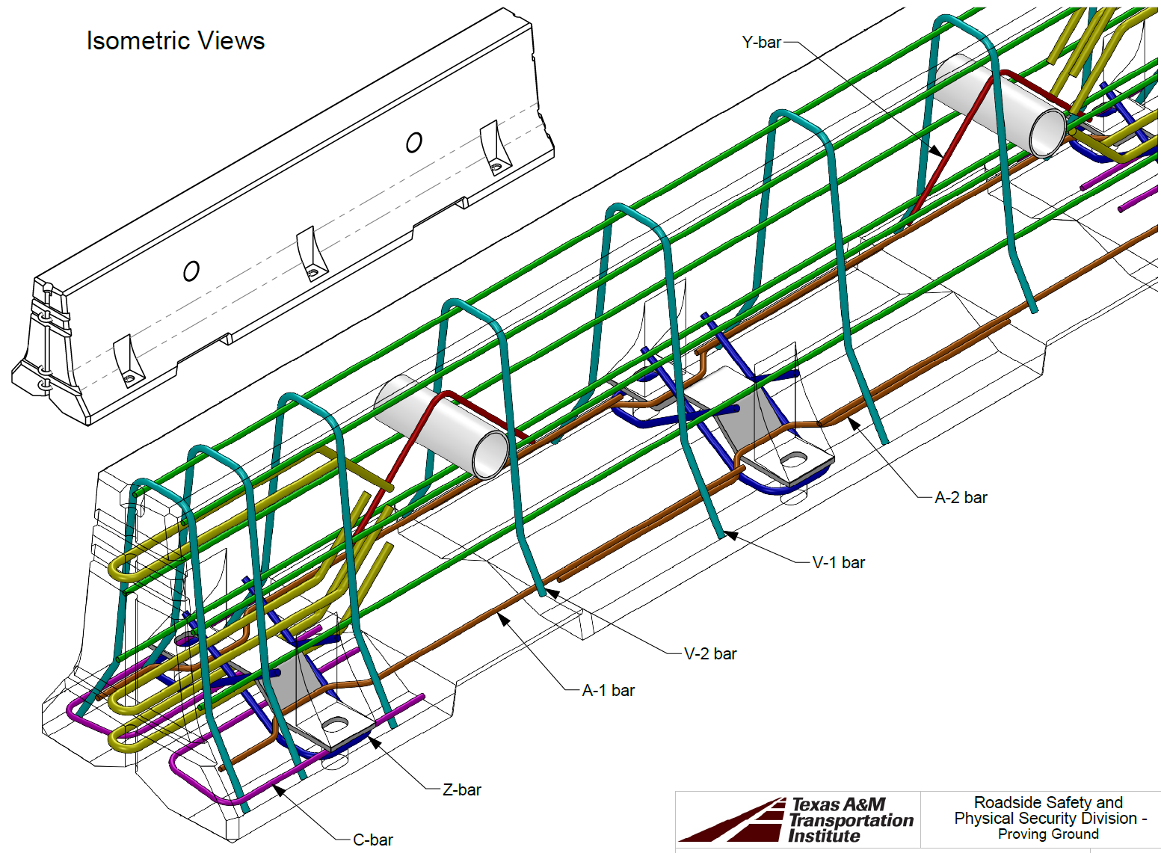
Barrier Details
Toe reinforcement (C-bar)
Anchor bolt/pin slot reinforcement (Z-bar and slotted plate)
Lifting holes

Slide 7
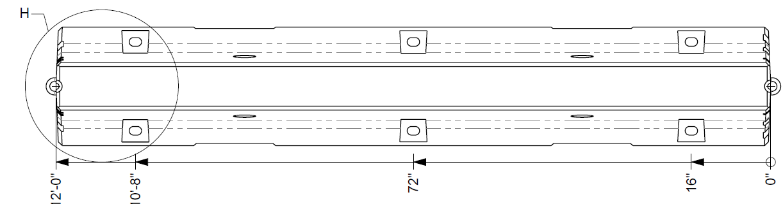
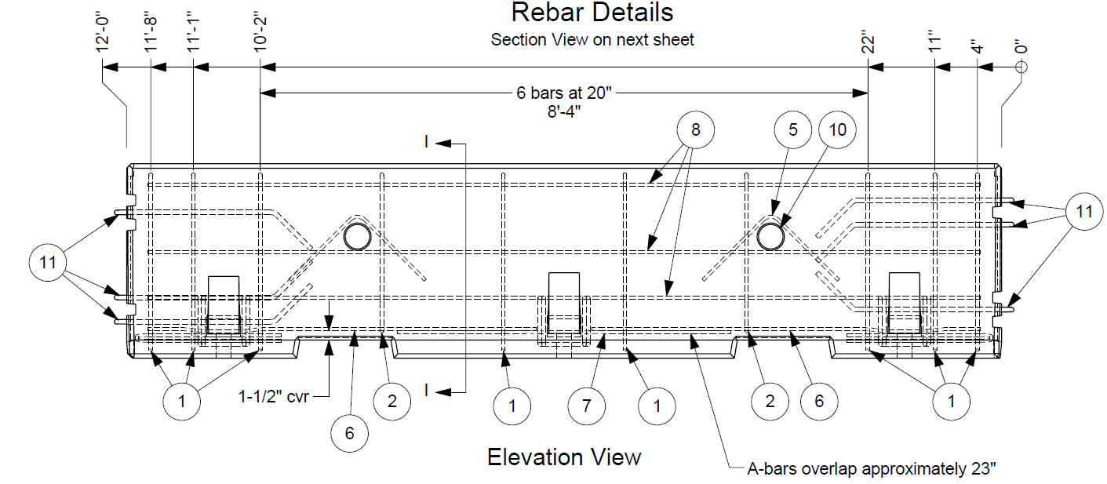
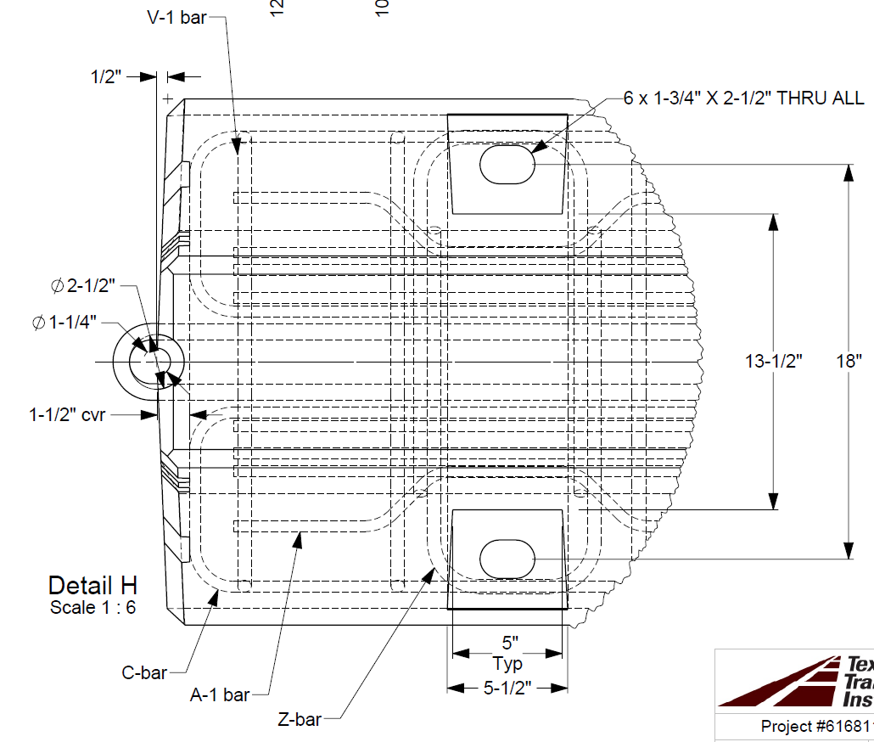
Barrier Details
Reinforcement details

Slide 8
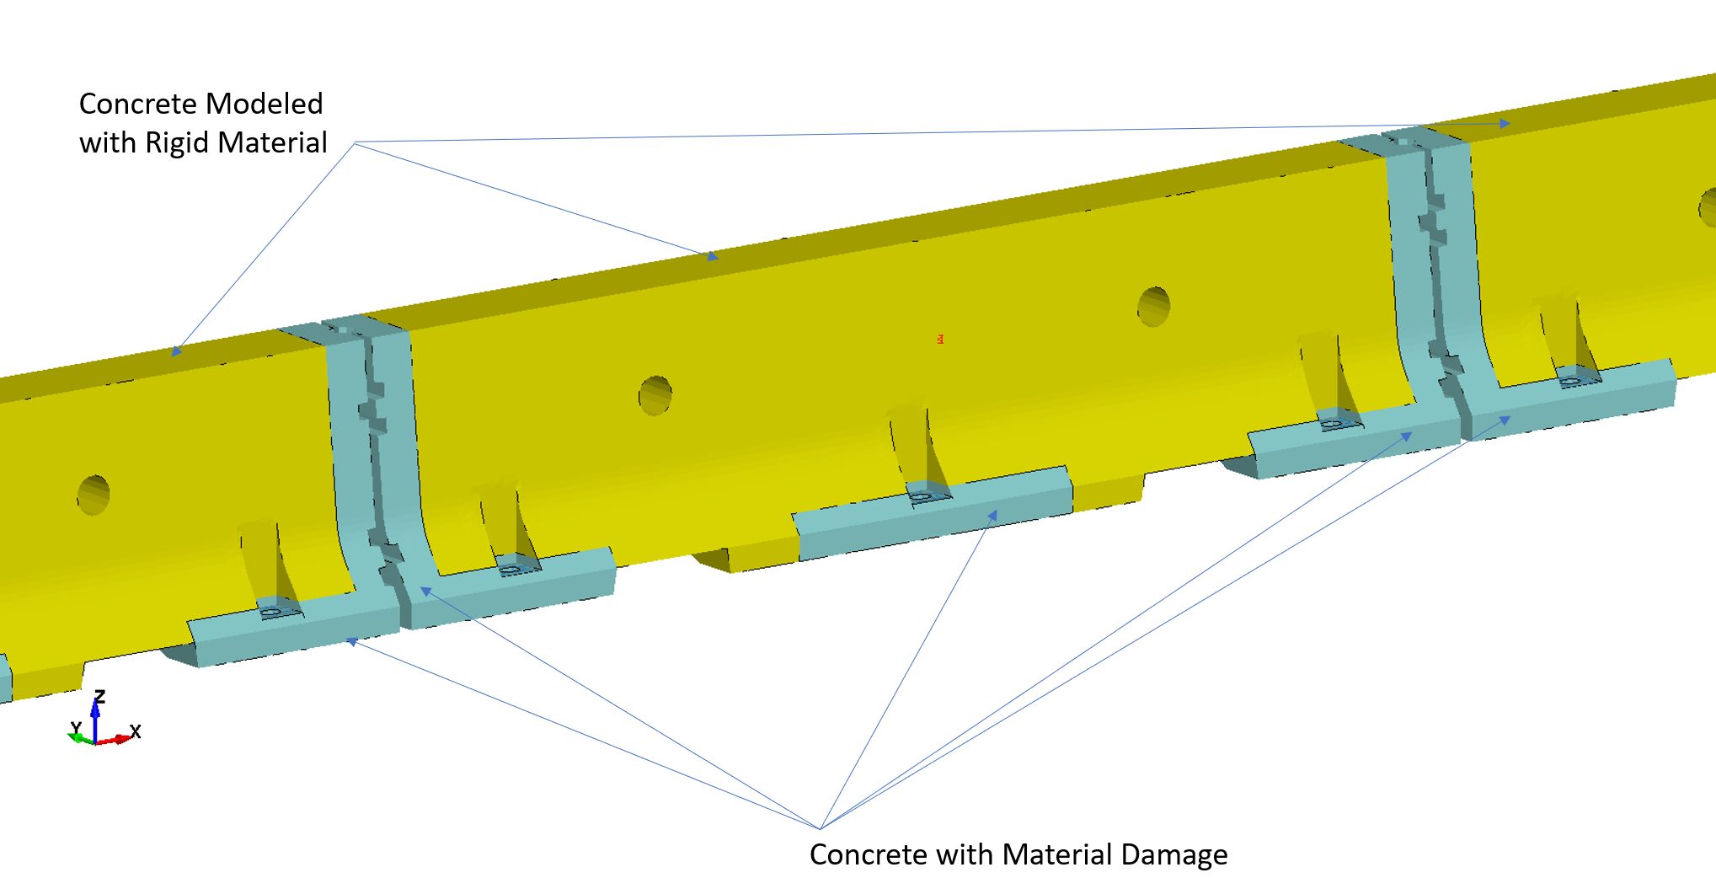
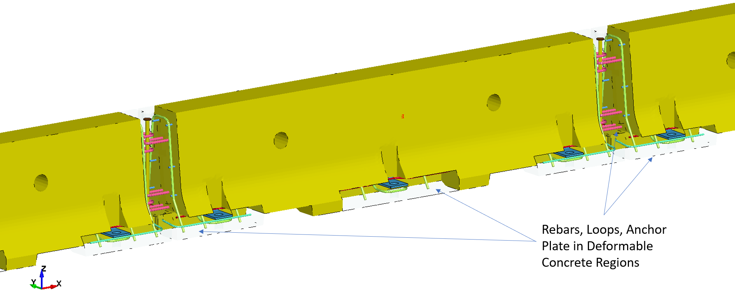
Simulation Analysis
Barrier Segment Model

Slide 9
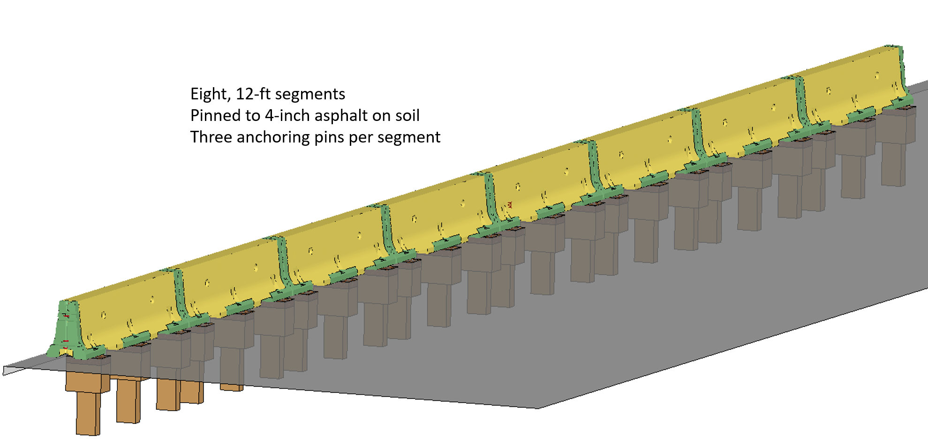
Simulation Analysis
Anchored on Asphalt, Roadside Configuration, Pins on Impact Side

Slide 10
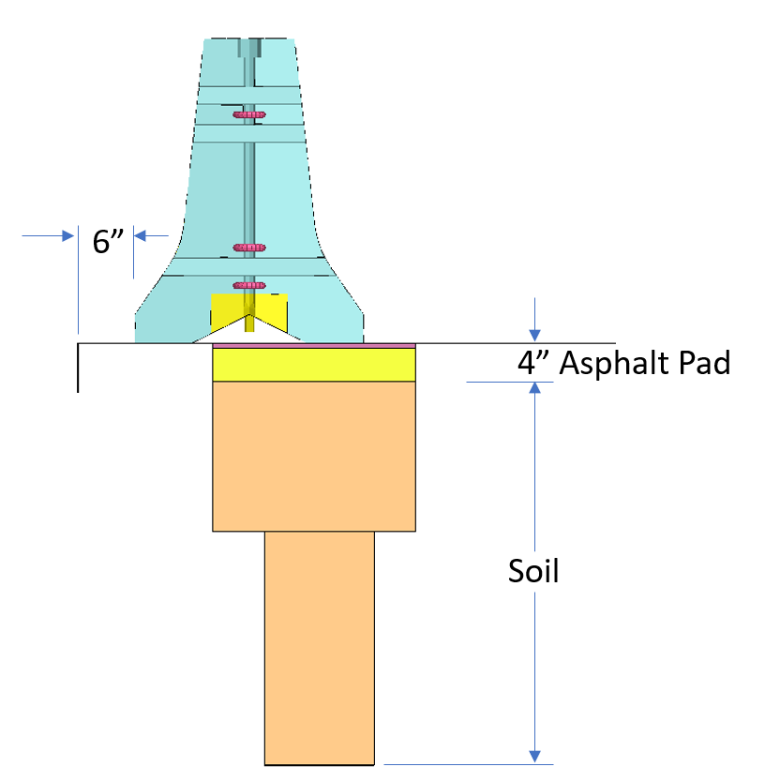
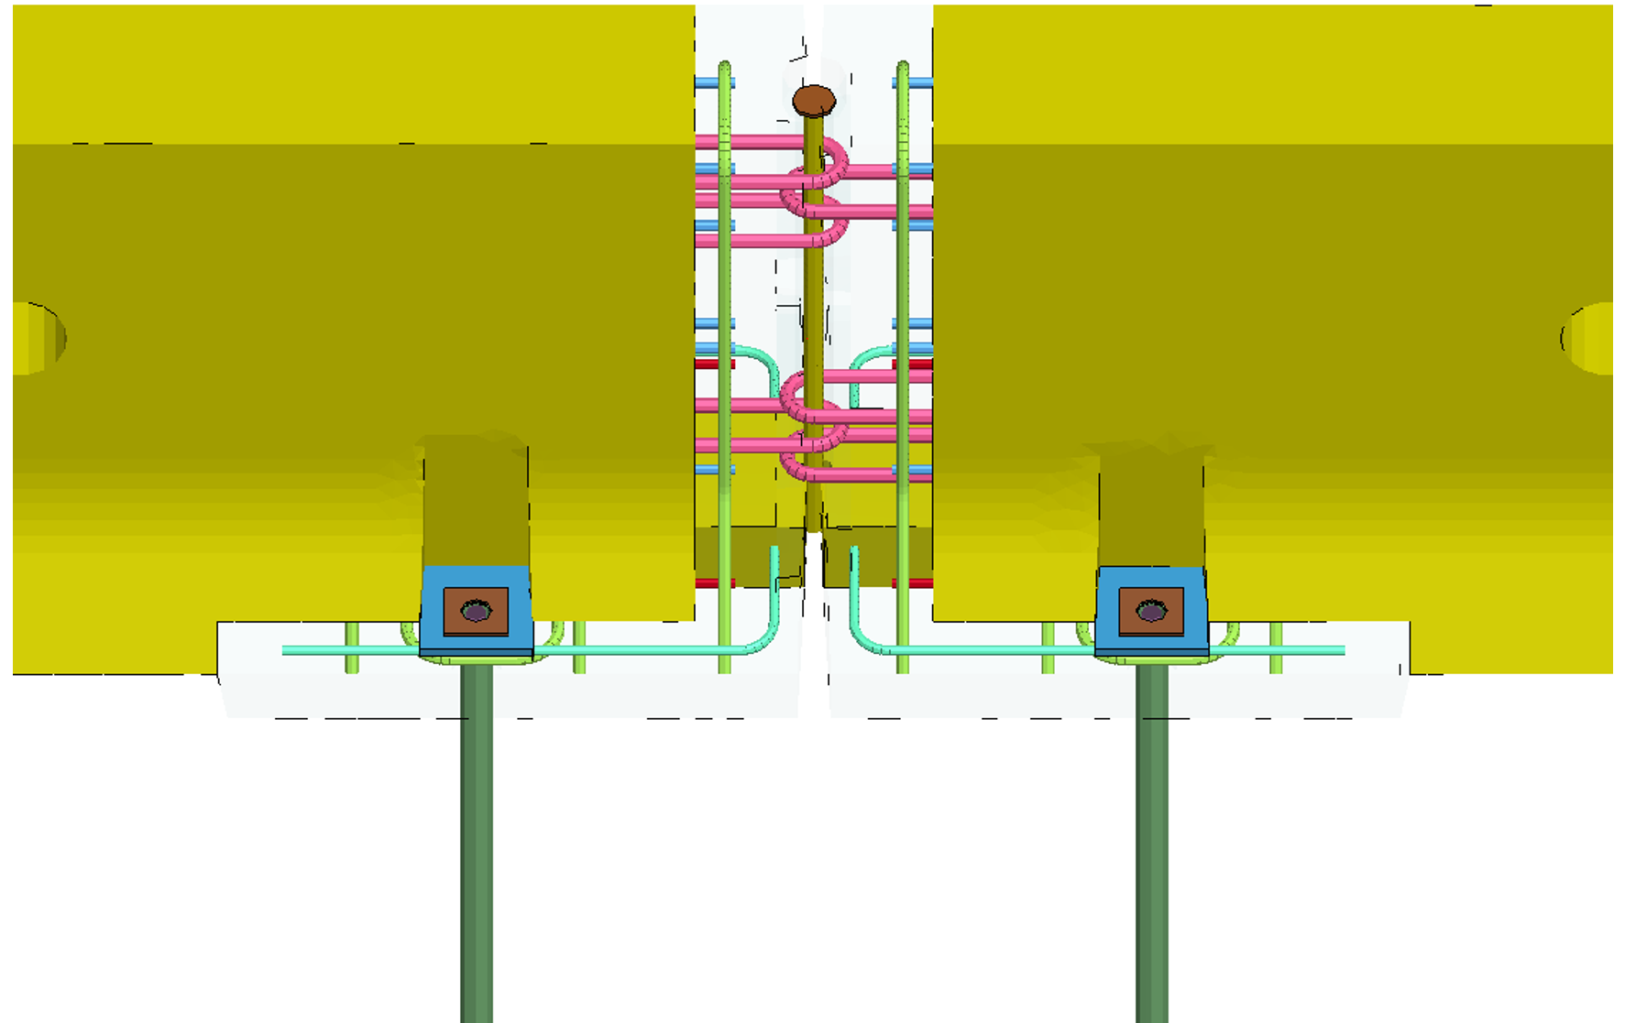
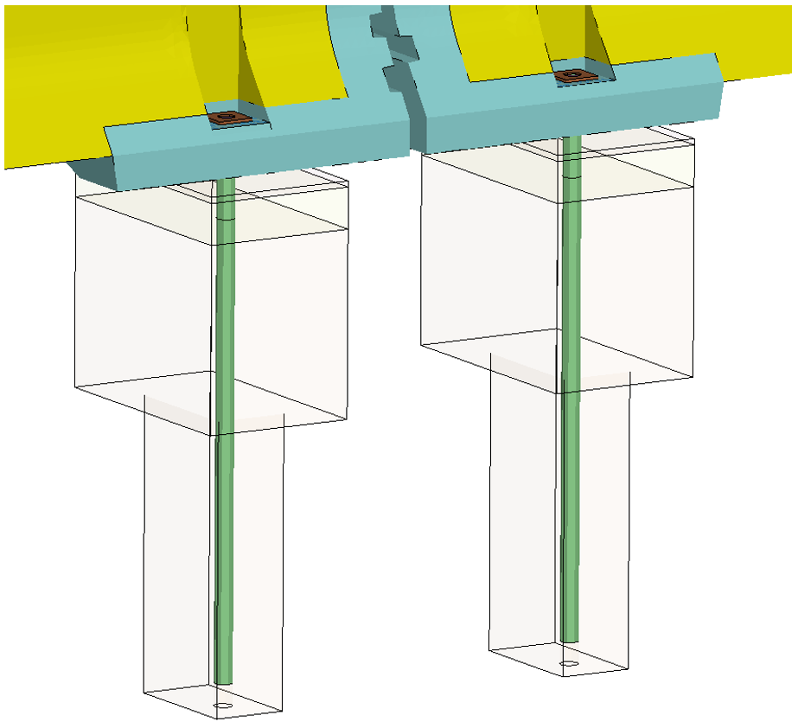
Simulation Analysis
Anchored on Asphalt, Roadside Configuration, Pins on Impact Side

Slide 11
Simulation Analysis
Anchored on Asphalt, Roadside Configuration, Pins on Impact Side
*Video Removed for size*

Slide 12
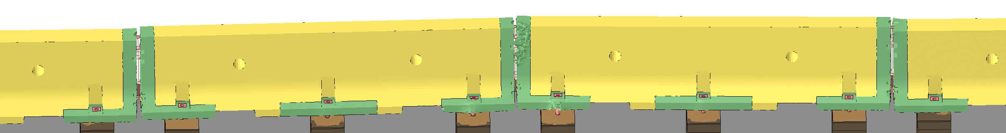
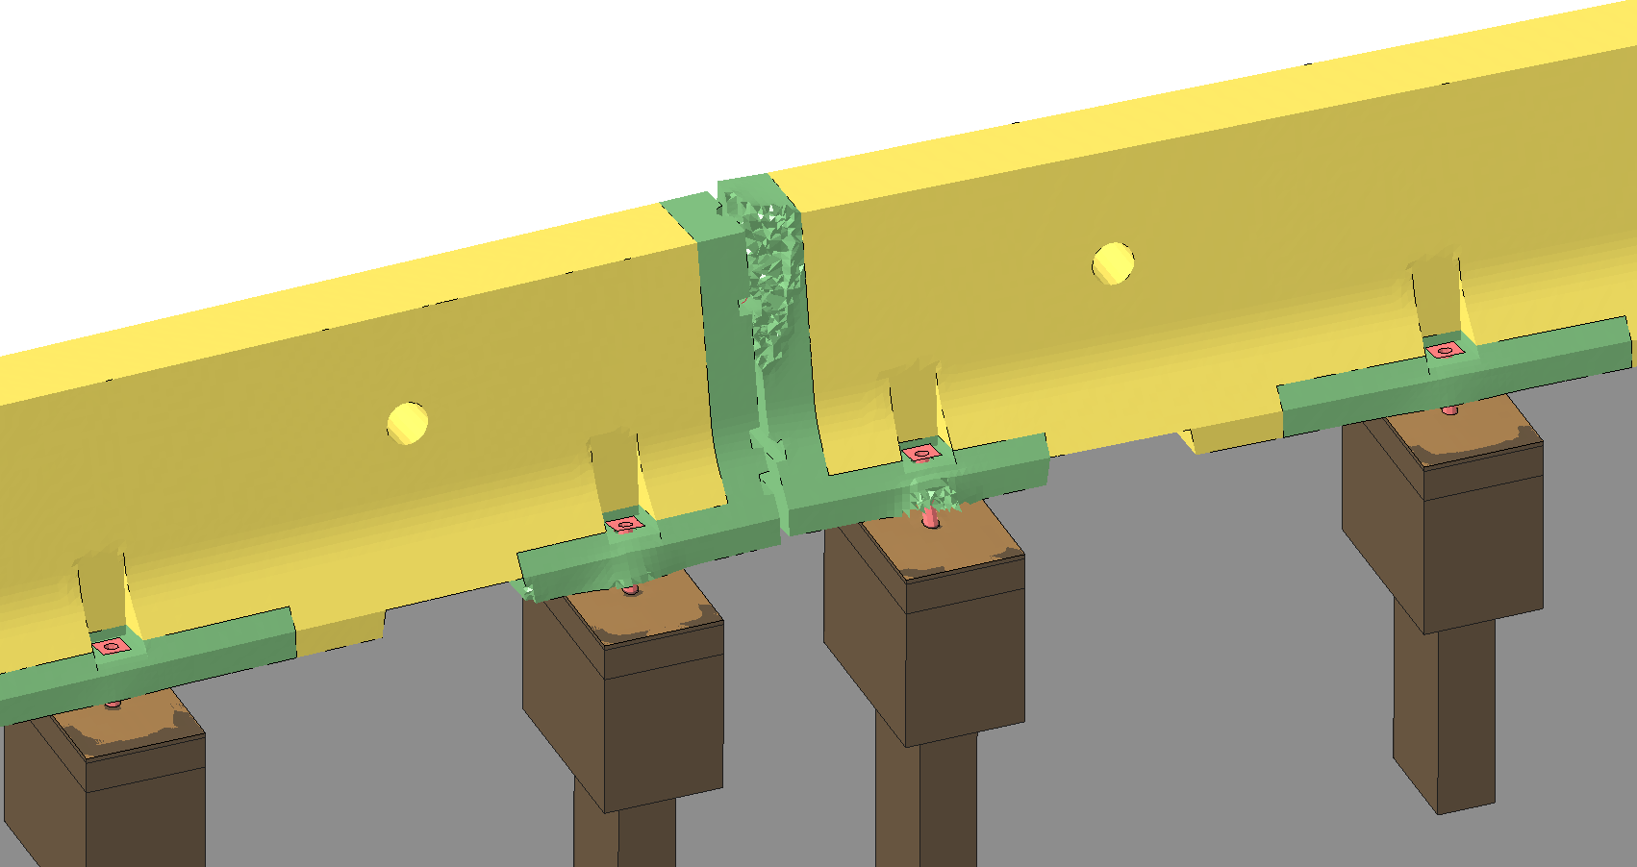
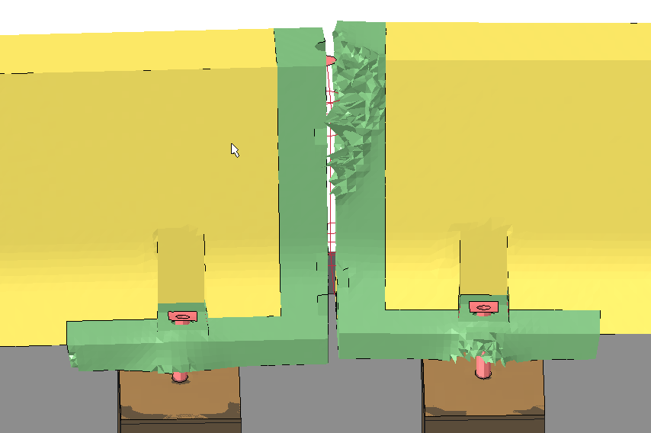
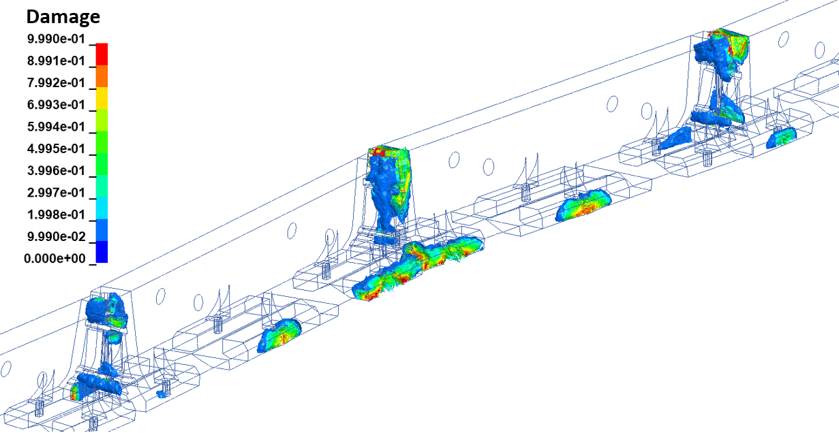
Simulation Analysis
Anchored on Asphalt, Roadside Configuration, Pins on Impact Side
Barrier Damage & Deflection

Slide 13
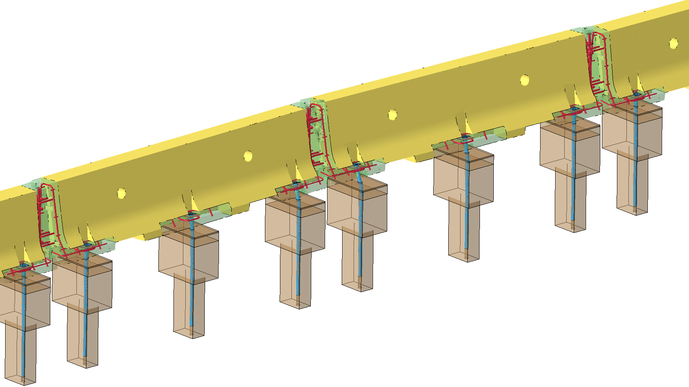
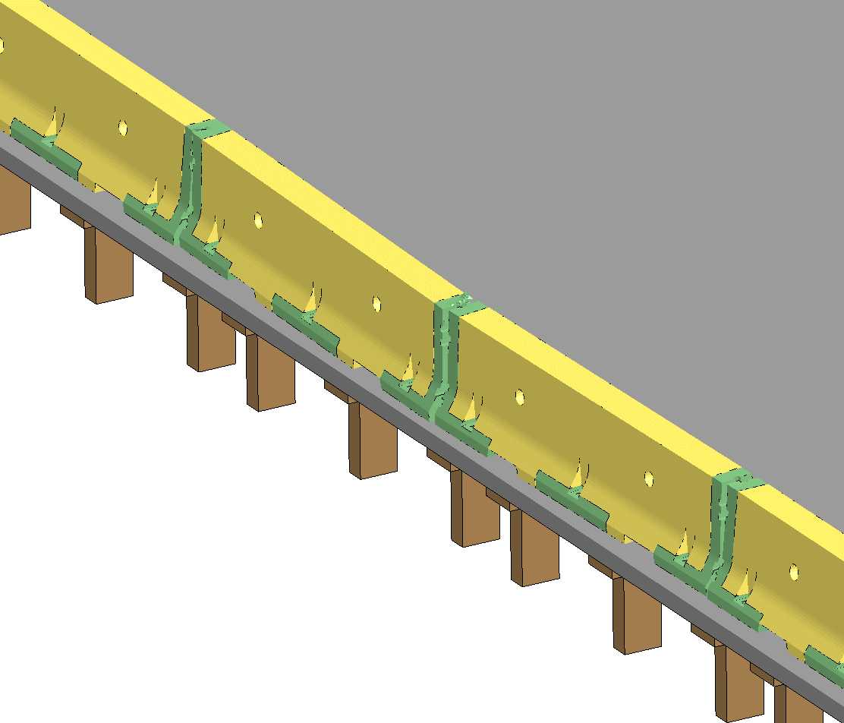
Simulation Analysis
Anchored on Asphalt, Roadside Configuration, Pins on Impact Side
Barrier Damage & Deflection
 | Test 3-11 | Test 3-10
Permanent Deflection (in) | 6 | 1.8
Max. Dynamic Deflection (in) | 8.1 | 4.4
Overhang from Pavement Edge (in) | None | None

Slide 14
Simulation Analysis
Simulation analyses were performed for other configurations
  Anchored on Asphalt, Roadside Configuration, 3 Pins on Impact Side
    Simulation of Test 3-11
    Simulation of Test 3-10
  Anchored on Asphalt, Median Configuration, 4 pins (1 on each corner)
    Simulation of Test 3-11
  Anchored on Concrete with epoxy anchor constraints on impact side
    Simulation of Test 3-11
All simulation results indicated design would pass MASH
Full-scale crash testing was recommeded

Slide 15
Crash Testing
Pinned to Asphalt as Roadside Barrier
Pinned on traffic side only
3 pins per 12-ft segment
36-inch long pins
4-inch thick asphalt
6-inch offset from vertical cut

Slide 16
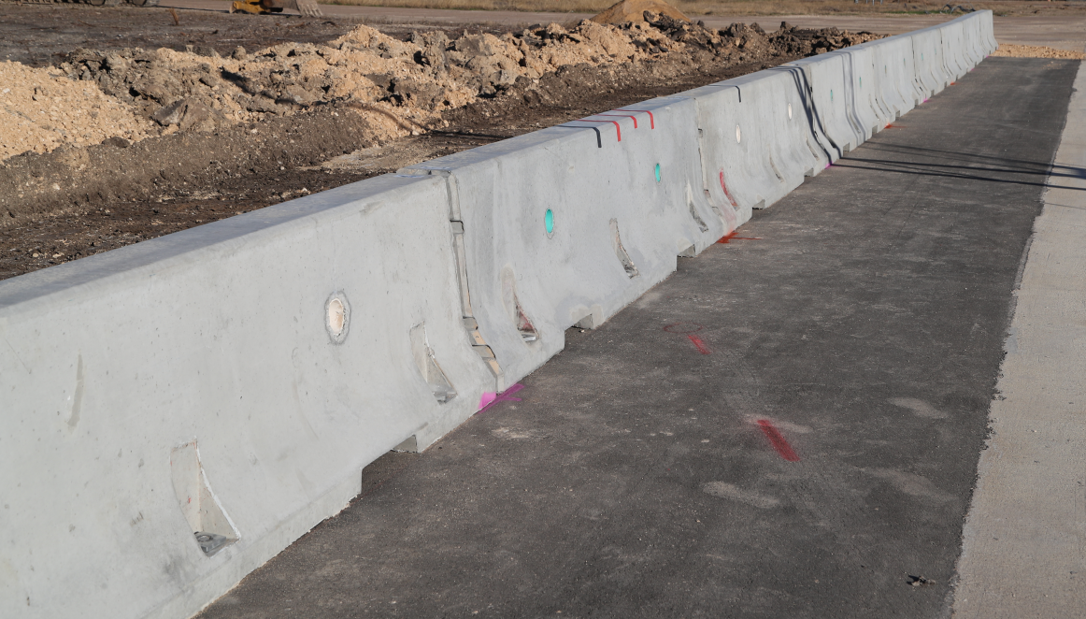
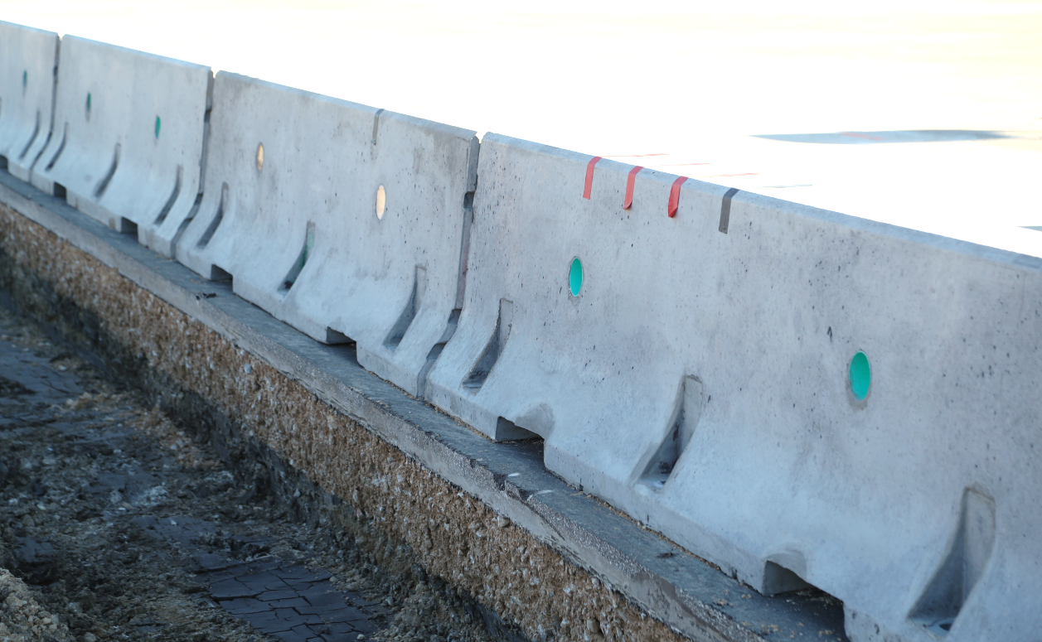
Crash Testing
Pinned to Asphalt as Roadside Barrier

Slide 17
Crash Testing
Pinned to Asphalt as Roadside Barrier
*video removed for size*

Slide 18
Crash Testing
Pinned to Asphalt as Roadside Barrier
*Video removed for size*

Slide 19
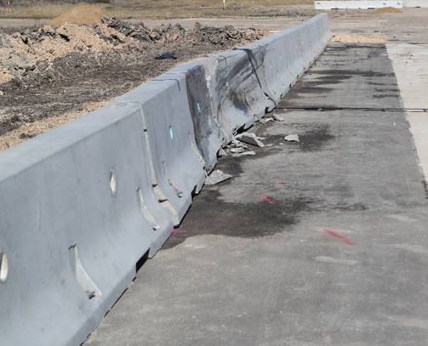
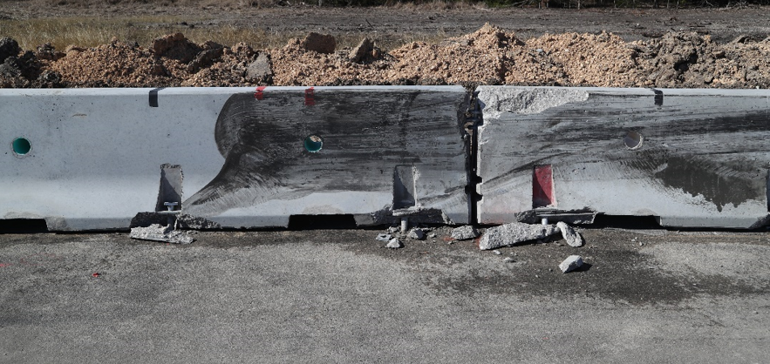
Crash Testing
Pinned to Asphalt as Roadside Barrier
TEST ARTICLE DEFLECTIONS
Dynamic (inches) | 10.1
Permanent (inches) | 5
Working Width / Height (inches) | 30.5 / 59.6

Slide 20
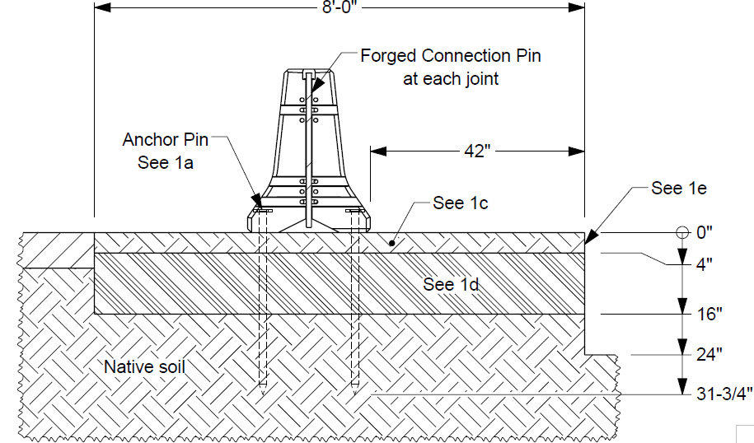
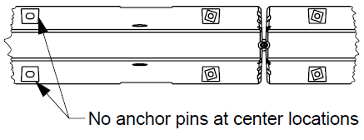
Crash Testing
Pinned to Asphalt as Median Barrier
Pinned on both sides
4 pins per 12-ft segment
  1 each corner
36-inch long pins
4-inch thick asphalt

Slide 21
Crash Testing
Pinned to Asphalt as Median Barrier
*video removed for size*

Slide 22
Crash Testing
Pinned to Asphalt as Median Barrier
*video removed for size*

Slide 23
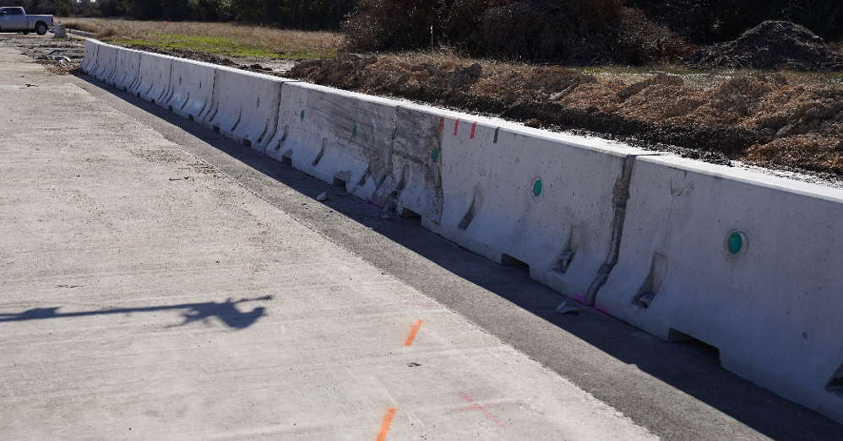
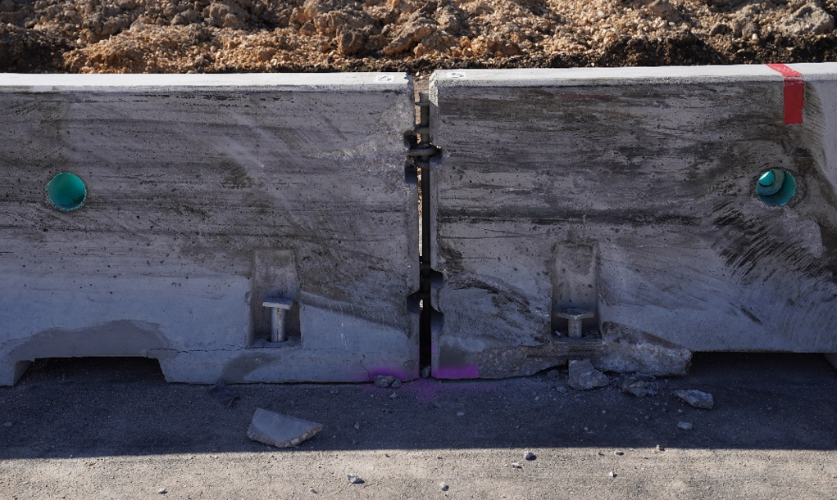
Crash Testing
Pinned to Asphalt as Median Barrier
TEST ARTICLE DEFLECTIONS
Dynamic (inches) | 7.2
Permanent (inches) | 0.75
Working Width / Height (inches) | 30.3 / 67.3

Slide 24
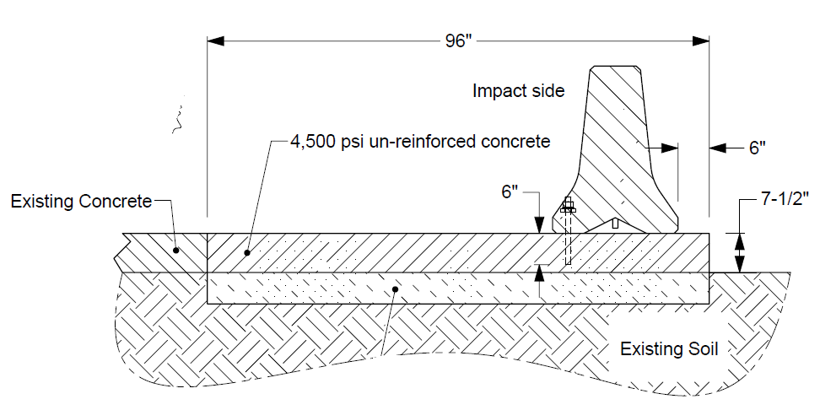
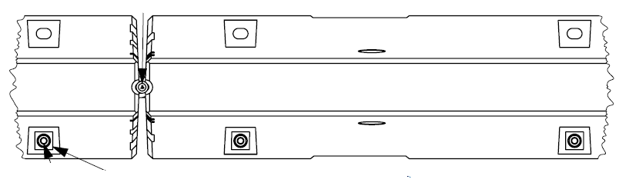
Crash Testing
Pinned to Concrete as Roadside Barrier
Epoxy anchor bolts on traffic side
3 anchors bolts per 12-ft segment
6-inch anchor embedment
6-inch offset from edge

Slide 25
Crash Testing
Pinned to Concrete as Roadside Barrier
*video removed for size*

Slide 26
Crash Testing
Pinned to Concrete as Roadside Barrier
*video removed for size*

Slide 27
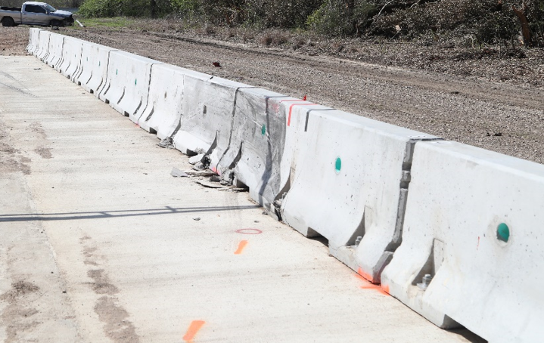
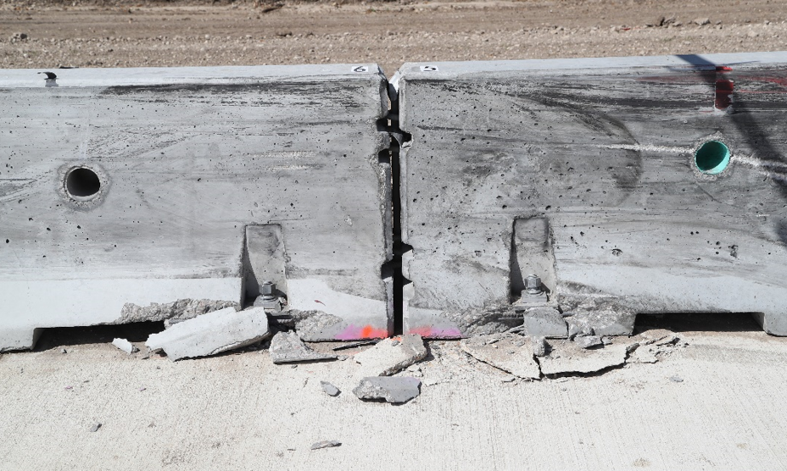
Crash Testing
Pinned to Concrete as Roadside Barrier
TEST ARTICLE DEFLECTIONS
Dynamic (inches) | 3.9
Permanent (inches) | 2.5
Working Width / Height (inches) | 27.6 / 3.0

Slide 28
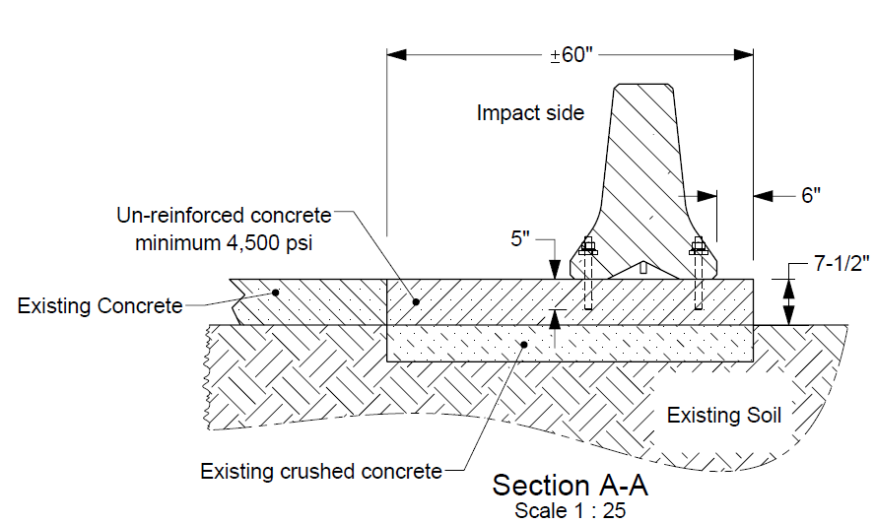
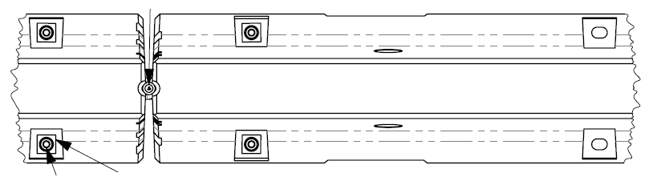
Crash Testing
Pinned to Concrete with Reduced Anchor Embedment (Roadside or Median)
Epoxy anchor bolts four corner
4 anchors bolts per 12-ft segment
5-inch anchor embedment
6-inch offset from edge

Slide 29
Crash Testing
Pinned to Concrete with Reduced Anchor Embedment (Roadside or Median)
*video removed for size*

Slide 30
Crash Testing
Pinned to Concrete with Reduced Anchor Embedment (Roadside or Median)
*video removed for size*

Slide 31
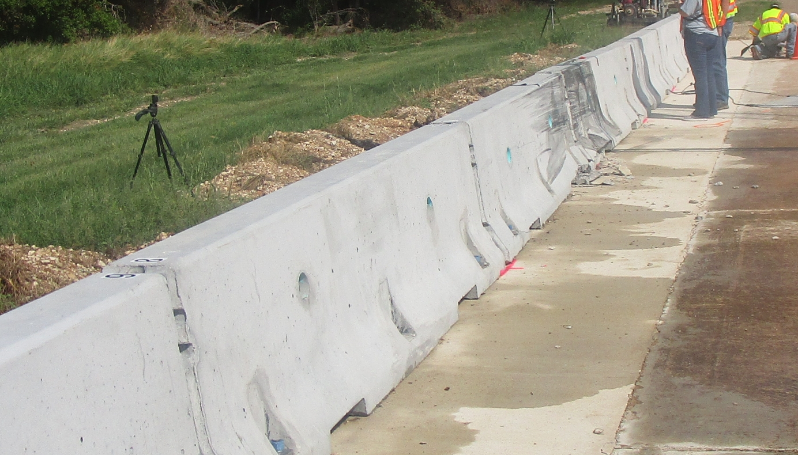
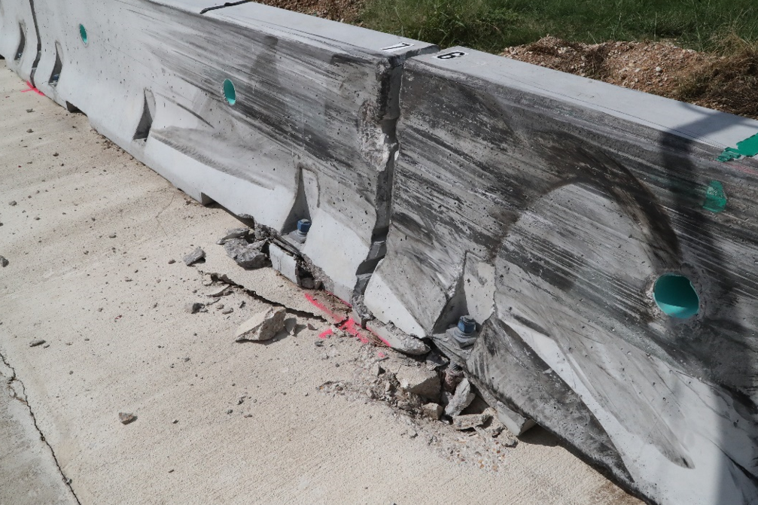
Crash Testing
Pinned to Concrete with Reduced Anchor Embedment (Roadside or Median)
TEST ARTICLE DEFLECTIONS
Dynamic (inches) | 10.1
Permanent (inches) | 5
Working Width / Height (inches) | 30.5 / 59.6

Slide 32
Conclusions
All four MASH Test 3-11 passed
The new PCB system is ready for use as:
  Median barrier on asphalt and concrete
  Roadside barrier on asphalt and concrete
Caltrans intends to do further research in developing transitions to rigid and free-standing barrier
  Looking for collaborating states
 | Max. Dynamic Deflection (in) | Permanent Deflection (in)
On asphalt as roadside barrier | 10.1 | 5.0
On asphalt as median barrier | 7.2 | 0.75
On concrete as roadside barrier | 3.9 | 2.5
On concrete with reduced anchor embedment | 10.1 | 5.0

