Slide 1
Fall Protection Fence Behind Long-Span Guardrail
Supplemental Project - WSDOT
By
Nauman Sheikh, P.E.

Slide 2
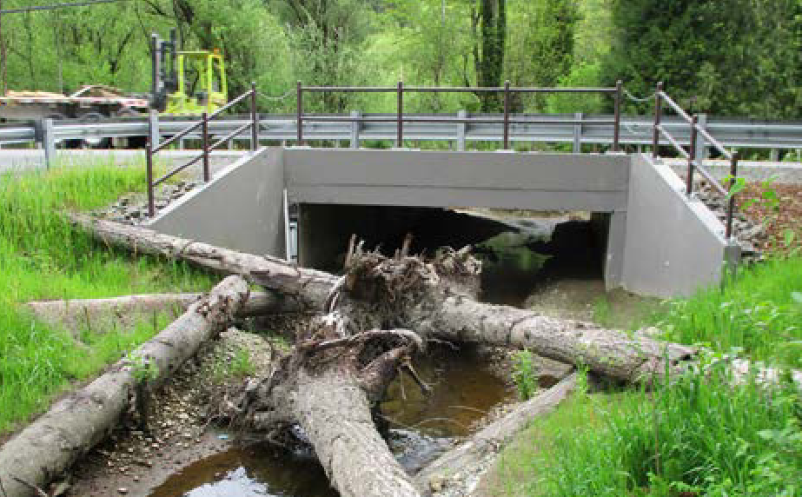
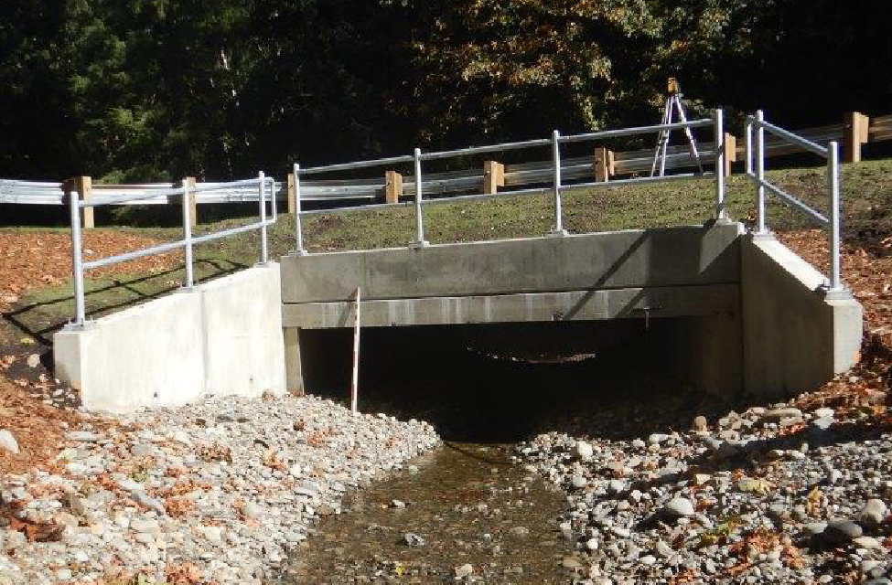
Background
Washington has fish passages crossing state highways
Culverts are used to allow the fish to pass
Longspan guardrail is used on the road when full guardrail post embedment cannot be achieved
  Unsupported span up to 25’
Maintenance workers and pedestrians work/walk behind the long-span guardrail, which could be a fall hazard
Photos Source: WSDOT Fish Passage Performance Report. June 30, 2021

Slide 3
Background
WSDOT wanted to install a fall-protection fence behind the guardrail
  Fence could negatively influence guardrail performance
  Possible negative impact on vehicle occupant safety
Needed to determine a design with suitable offset from the guardrail so the system remains MASH compliant

Slide 4
Research Approach
Developed FE model of the long-span guardrail system
  Validated model using past MASH Test 3-11
  Added model of fall-protection fence
Performed MAST TL-3 impact simulations to determine
  Long-span guardrail’s performance with fence
  Suitable offset for fence
  Critical impact points for testing
Performed MASH Test 3-10 and 3-11

Slide 5
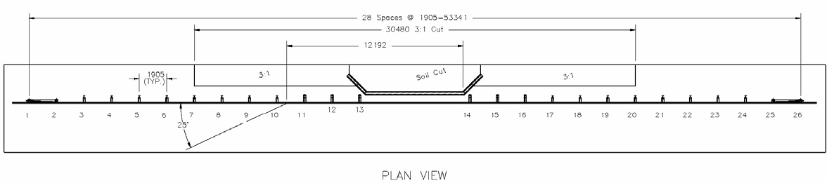
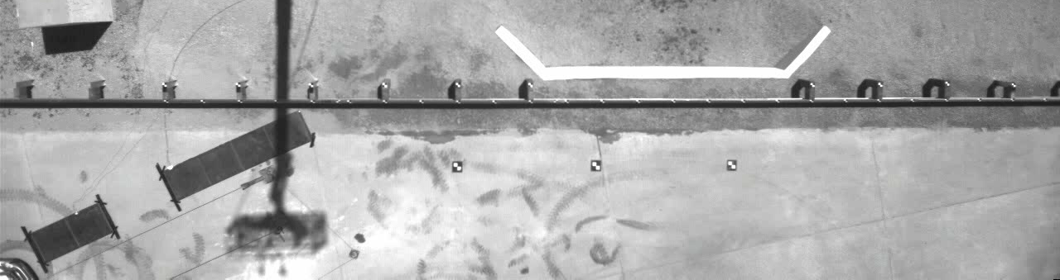
FE Modeling
Used MwRSF Test LSC-2 of long-span guardrail system for validation
25-ft unsupported span
Surrogate culvert
Only Test 3-11 was performed

Slide 6
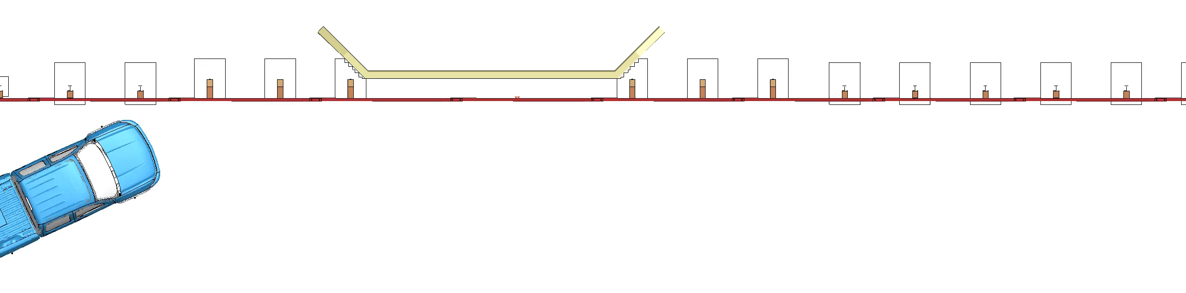
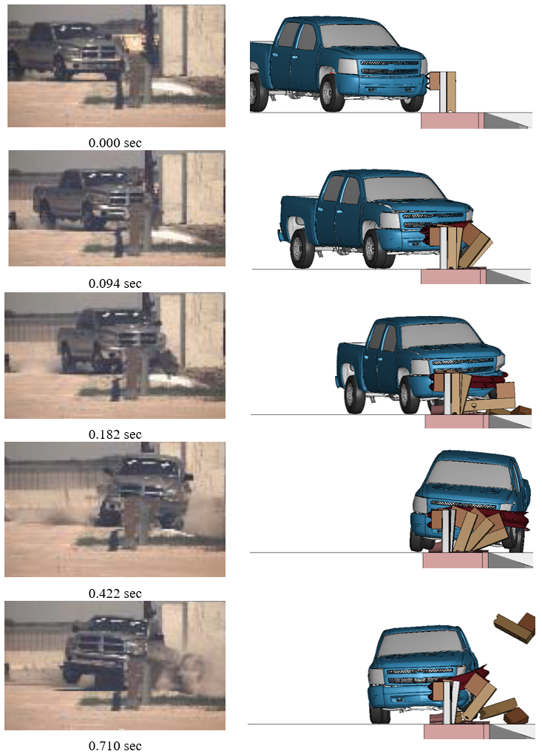
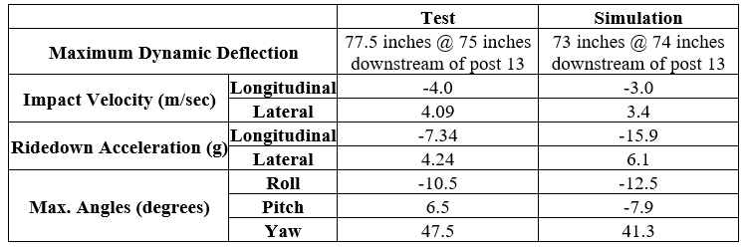
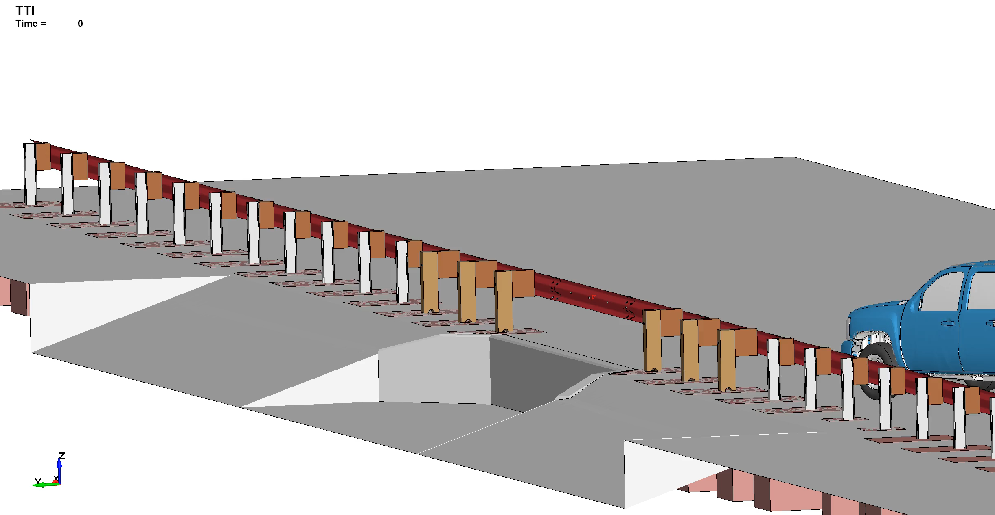
FE Modeling
Sufficient validation was achieved for using the model further with fence

Slide 7
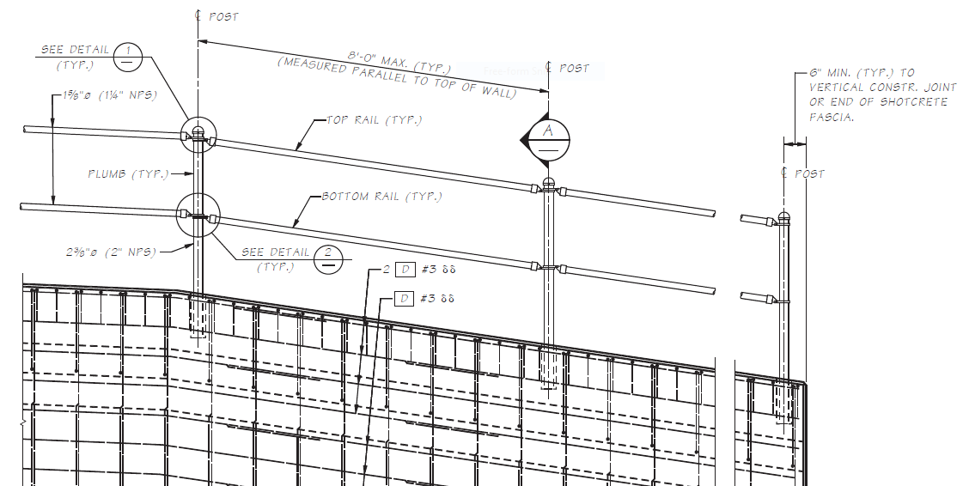
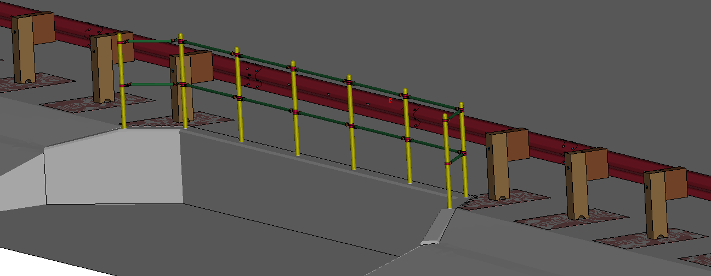
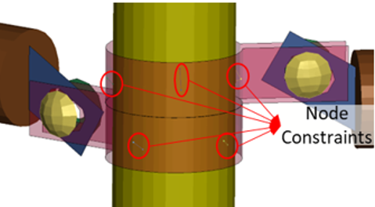
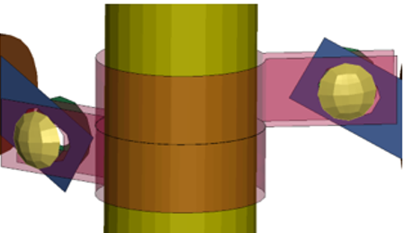
FE Modeling
Model of Long-Span Guardrail with Fall-Protection Fence
Fence installed into pre-cast holes in culvert wall
No offset between edge of wall and back of the wood posts
Pipe fittings/connections were modeled as constrained connections and friction-only connections to evaluate a range of performance

Slide 8
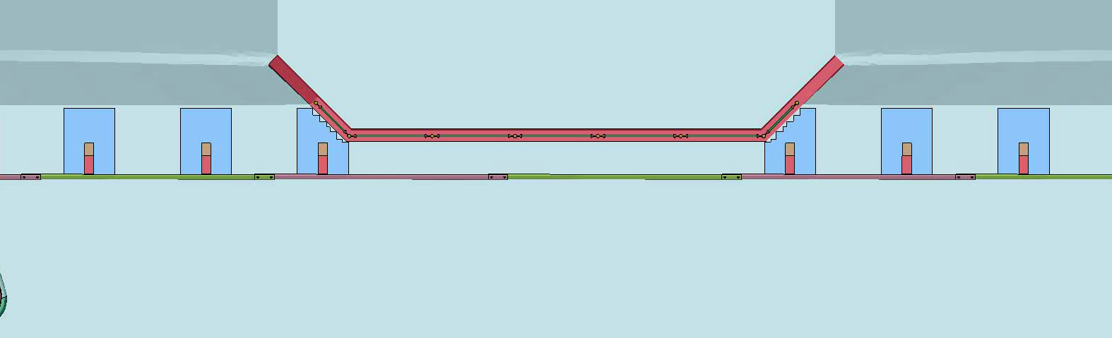
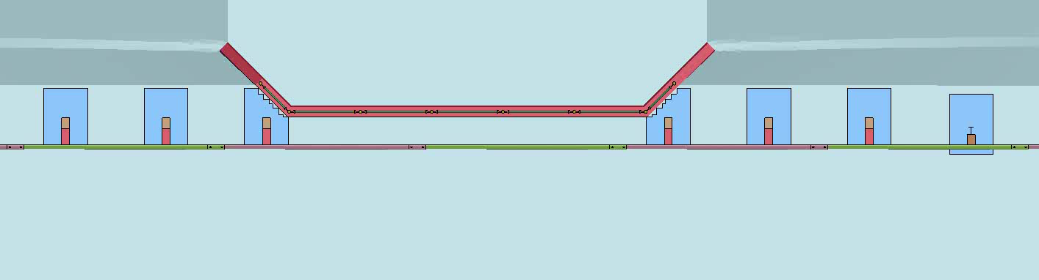
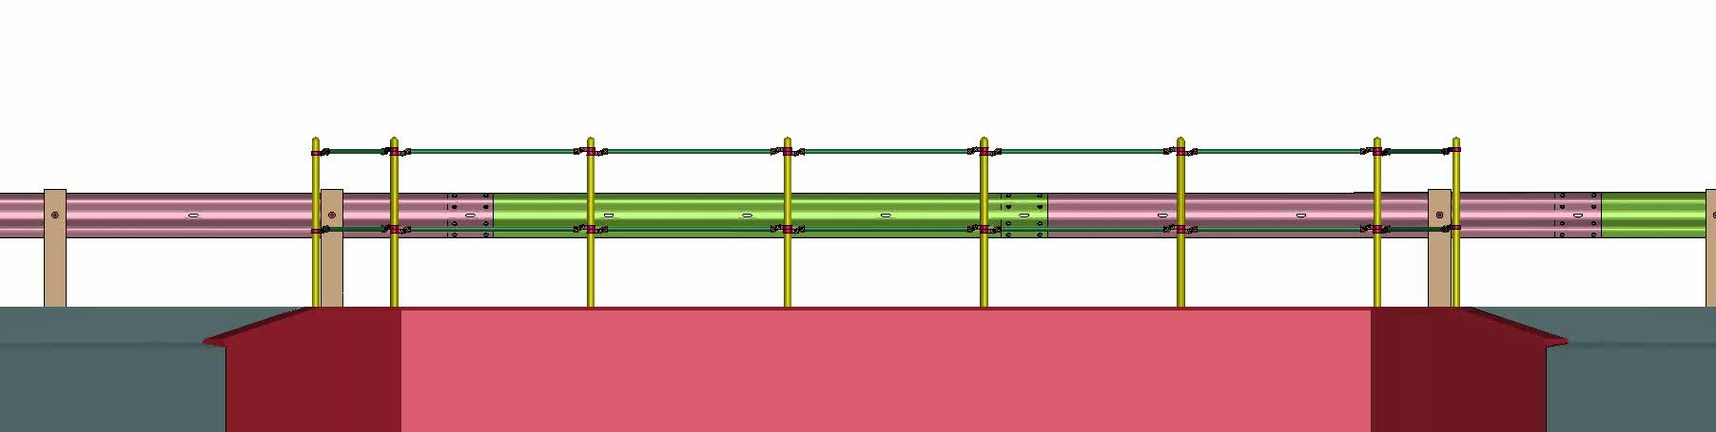
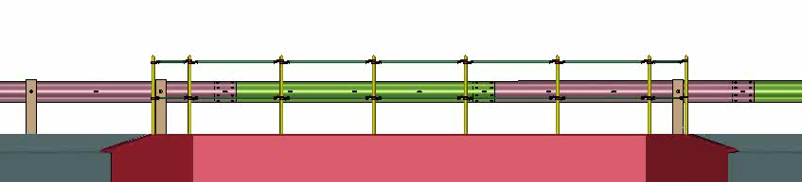
Simulation Results
Test 3-11 Simulations Results
Without Constraints
With Constraints
Dynamic Deflection = 55.0 in.
Permanent Deflection = 49.3 in
Dynamic Deflection = 68.2 in.
Permanent Deflection = 38.8 in.
Passed MASH Criteria

Slide 9
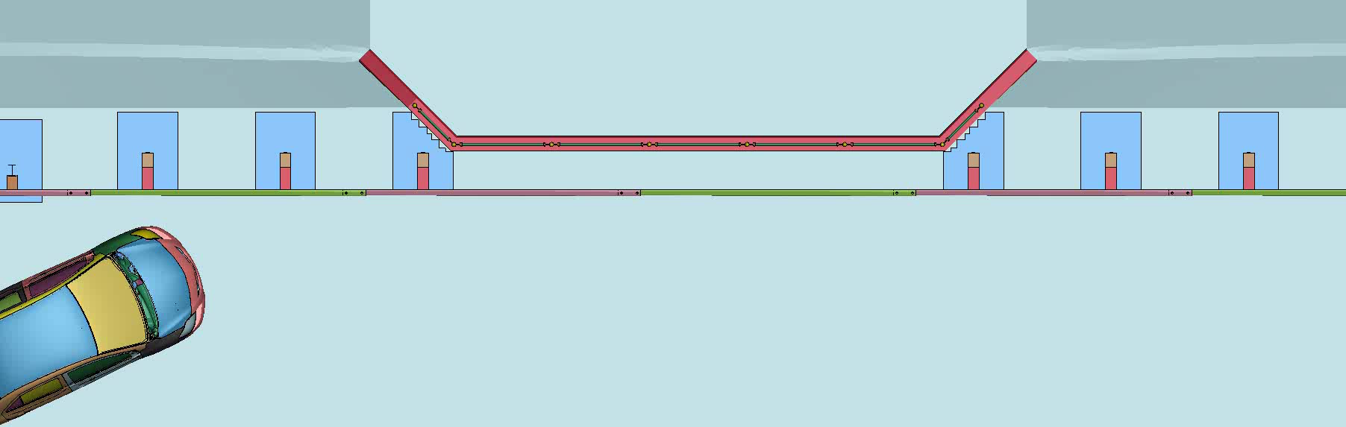
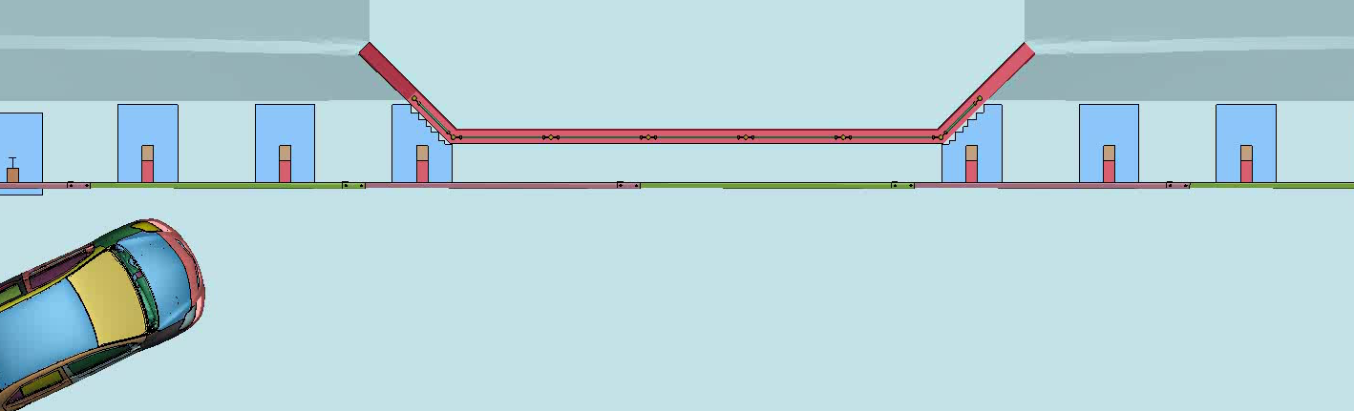
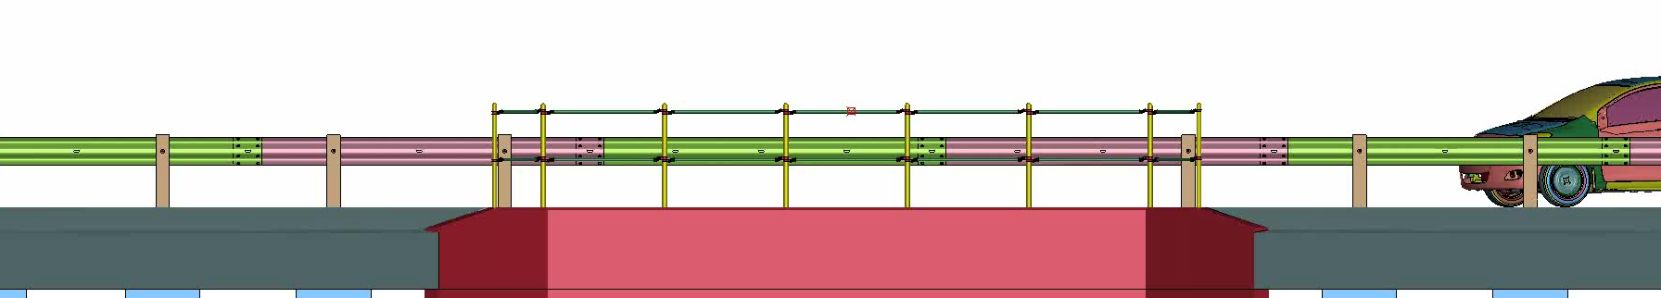
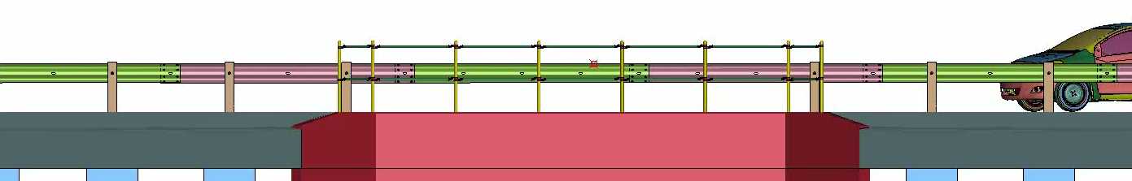
Simulation Results
Test 3-10 Simulations Results
Without Constraints
With Constraints
Dynamic Deflection = 56.8 in.
Permanent Deflection = 27.4 in
Dynamic Deflection = 54.7 in.
Permanent Deflection = 29.1 in.
Passed MASH Criteria

Slide 10
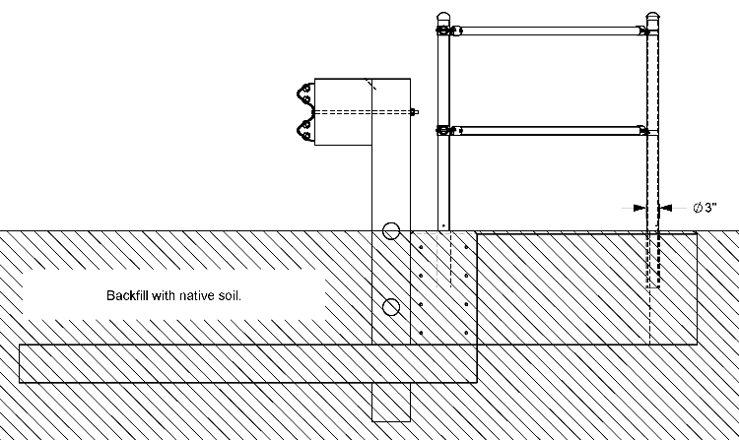
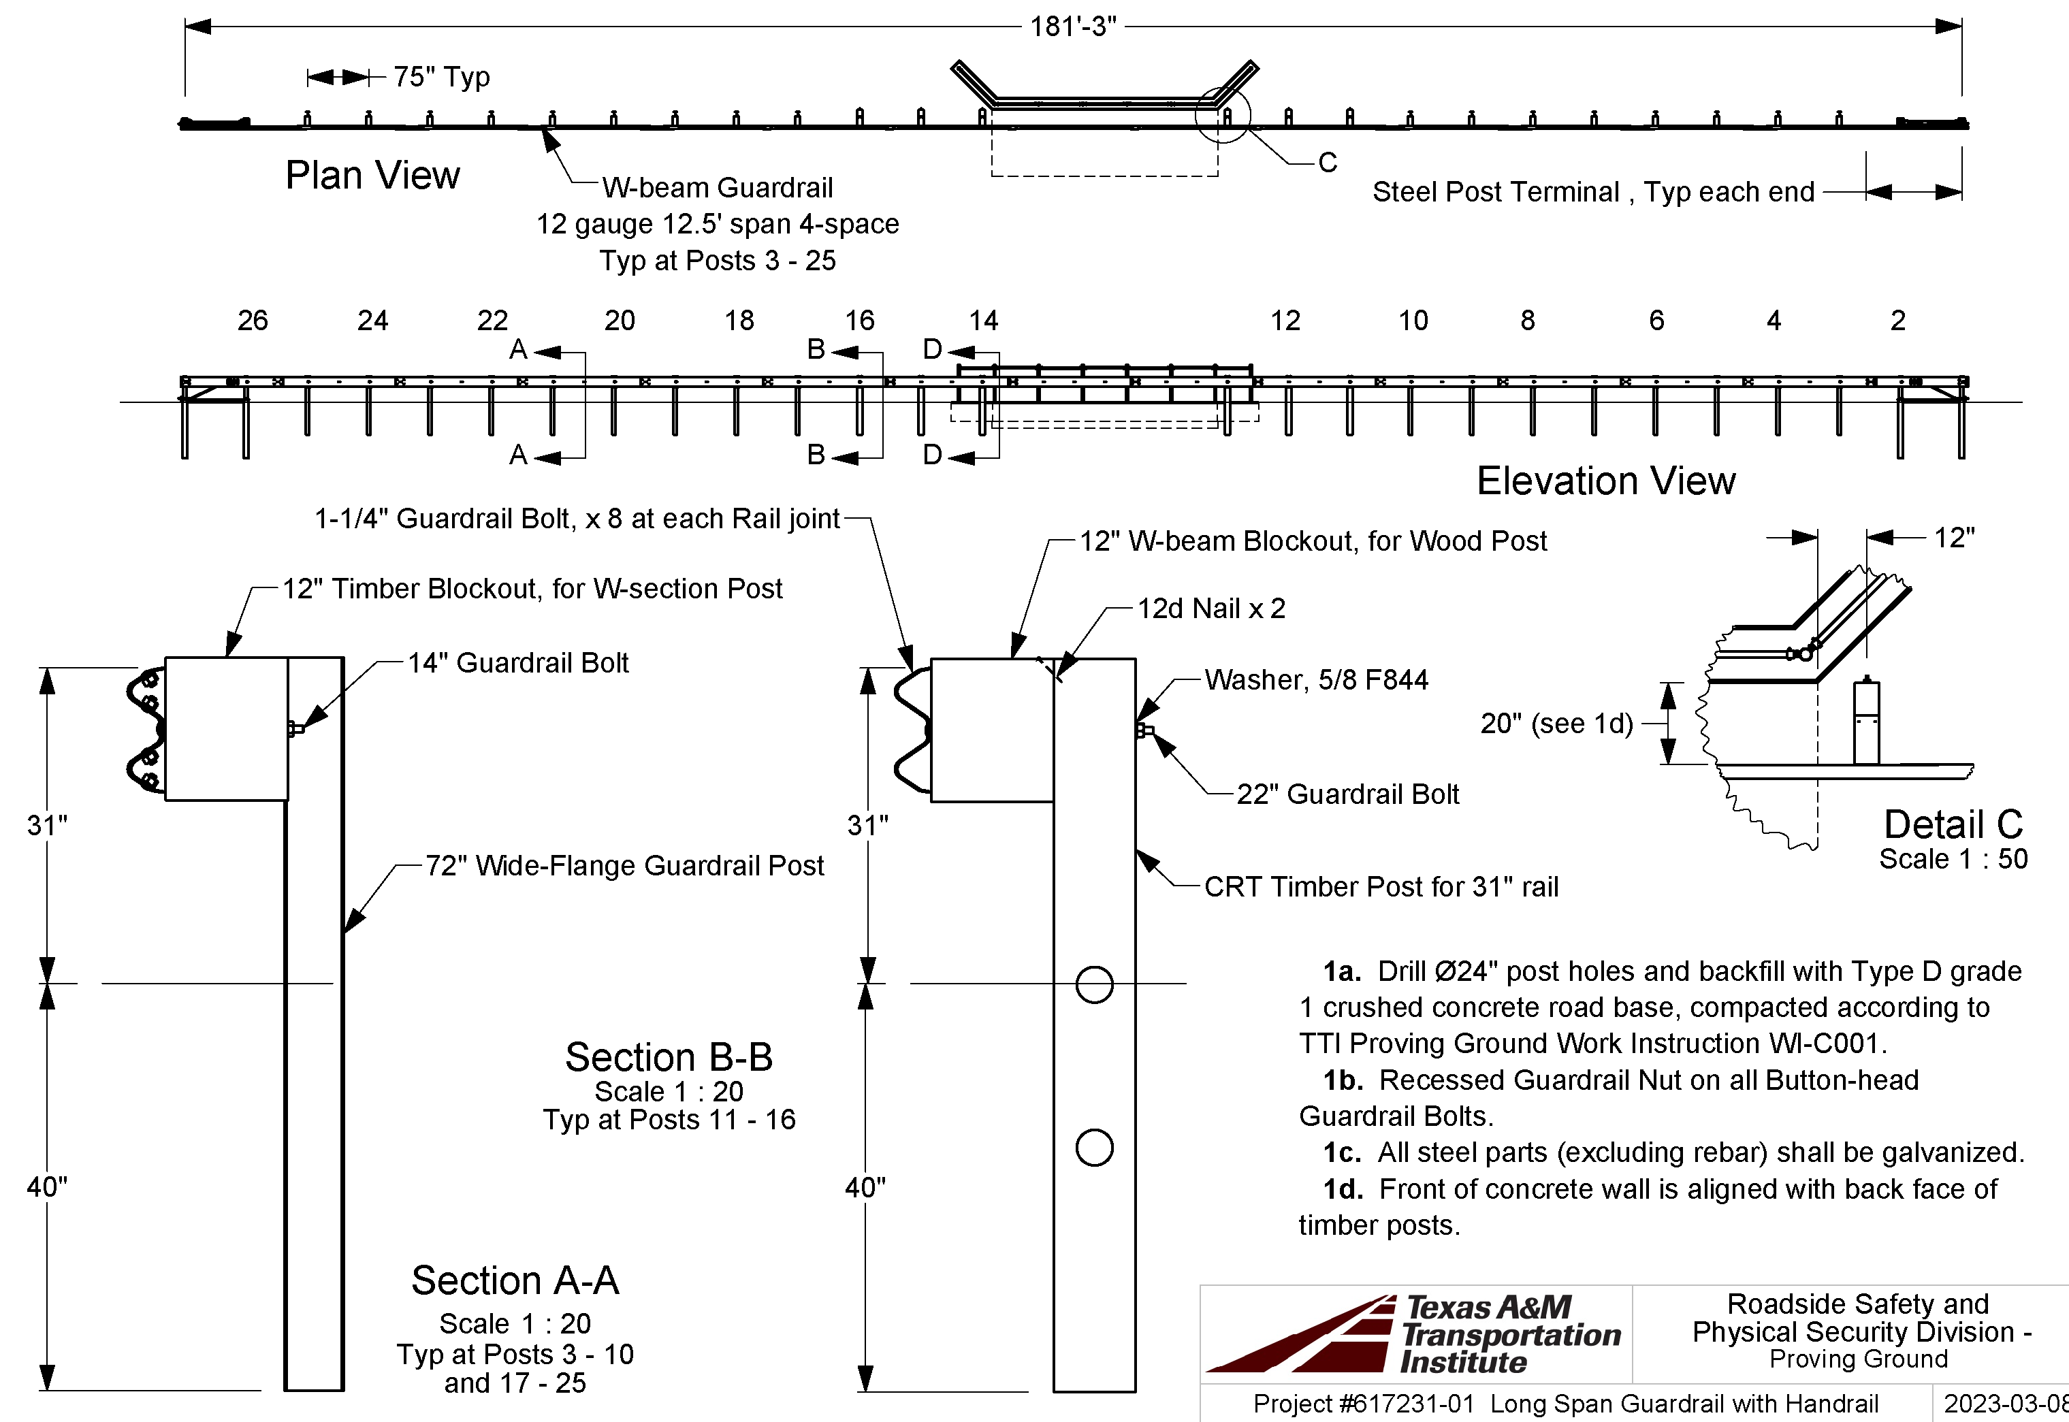
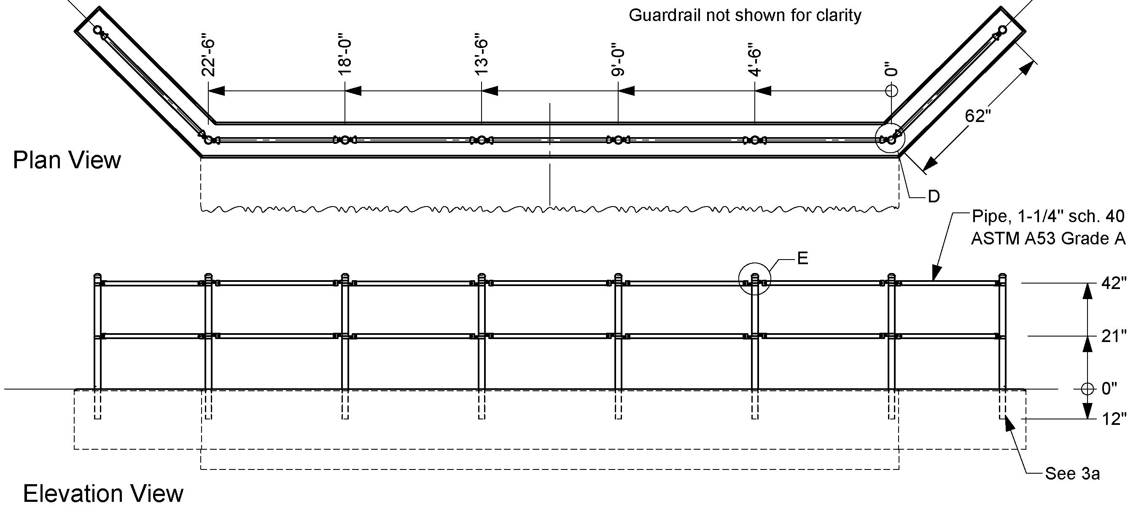
Test Installation

Slide 11
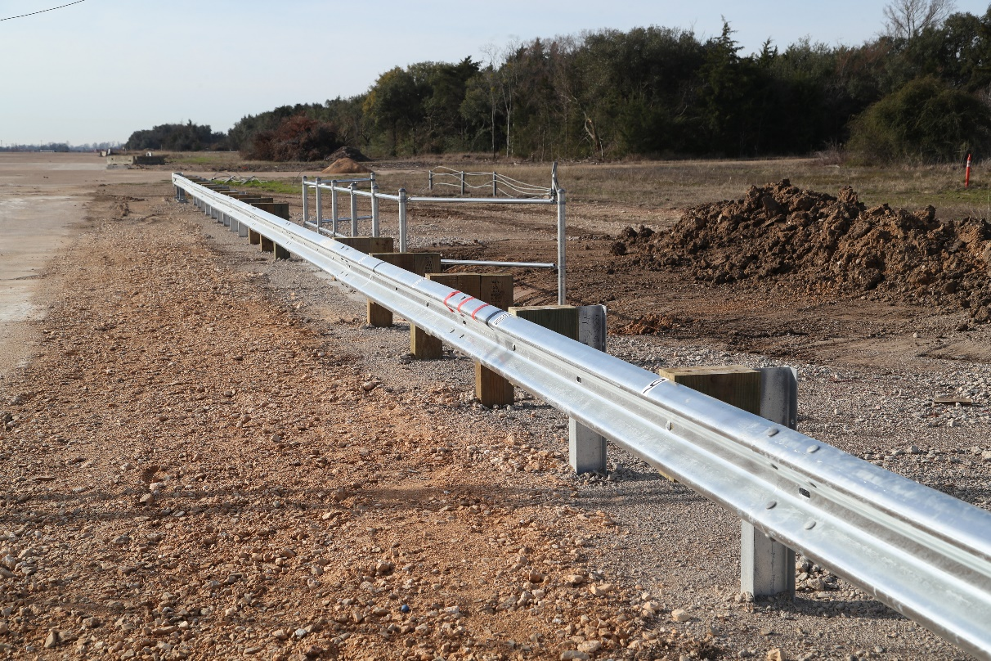
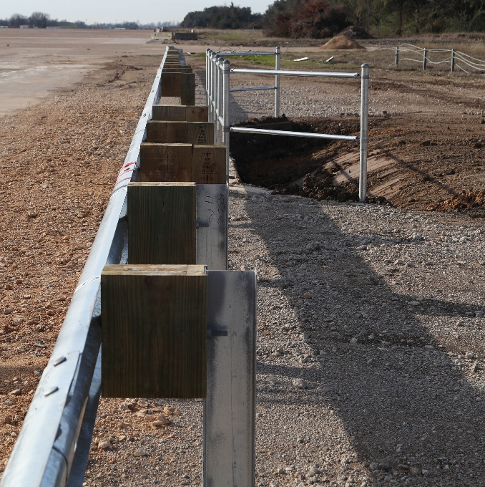
Test Installation

Slide 12
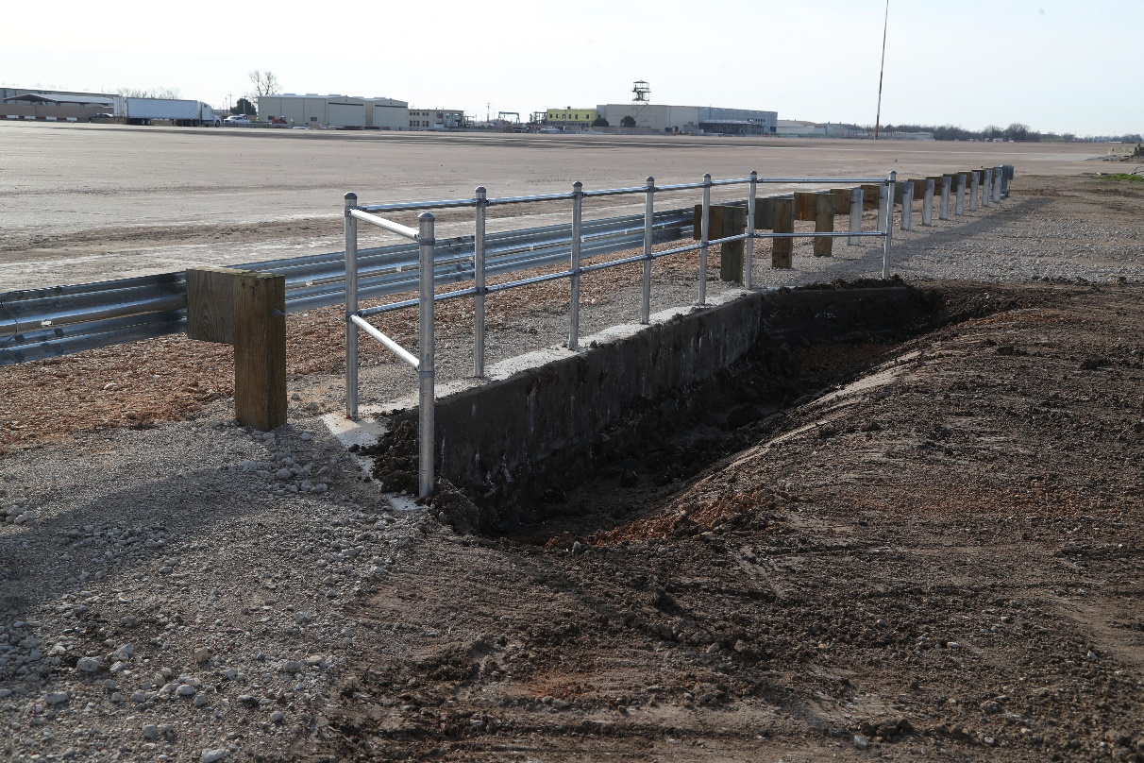
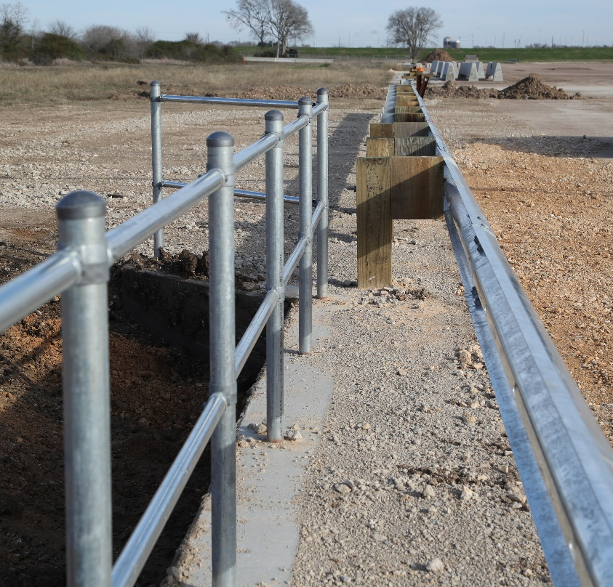
Test Installation

Slide 13
Test 3-10
*video removed for size*

Slide 14
Test 3-10
*video removed for size*

Slide 15
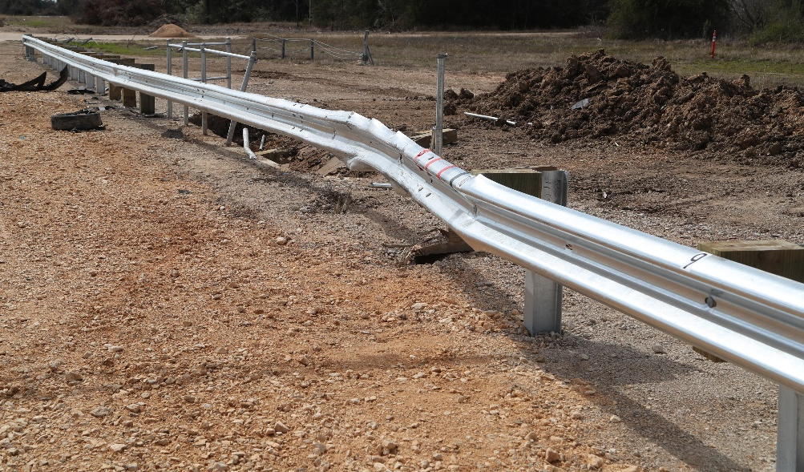
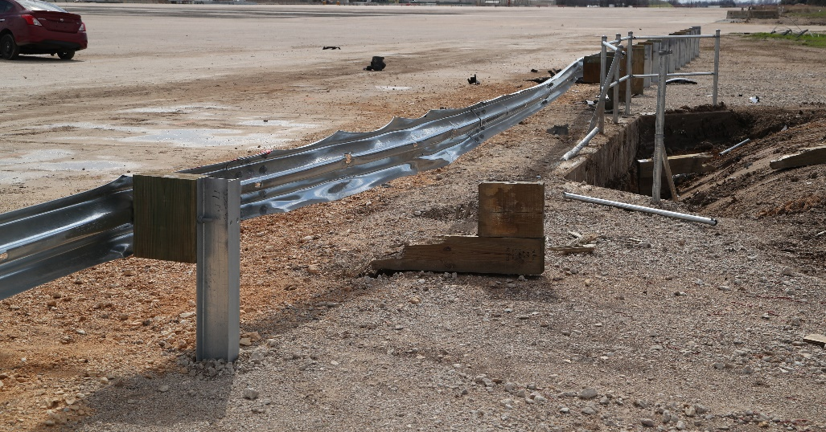
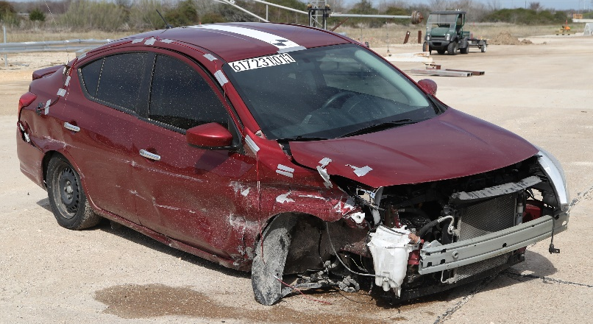
Test 3-10 Results
PASSED MASH TEST 3-10
Dynamic Deflection (inches) | 38.2
Permanent Deflection (inches) | 18.88
Working Width / Height (inches) | 46.2 / 16

Slide 16
Test 3-11
*video removed for size*

Slide 17
Test 3-11
*video removed for size*

Slide 18
Test 3-11
*video removed for size*

Slide 19
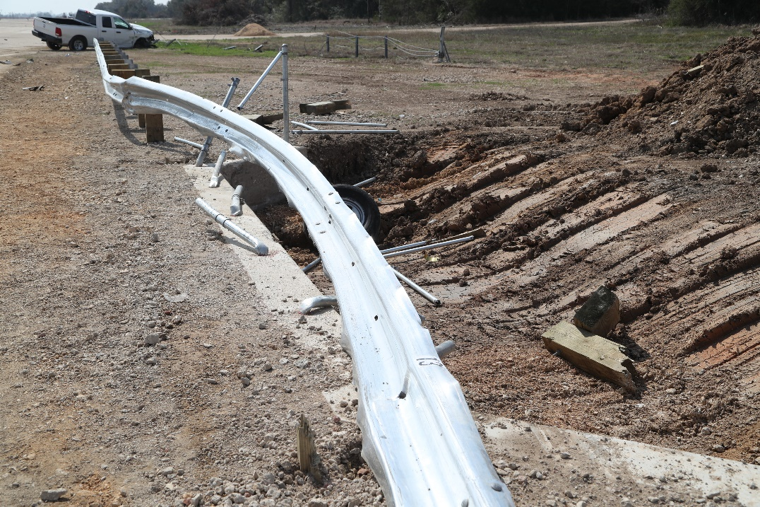
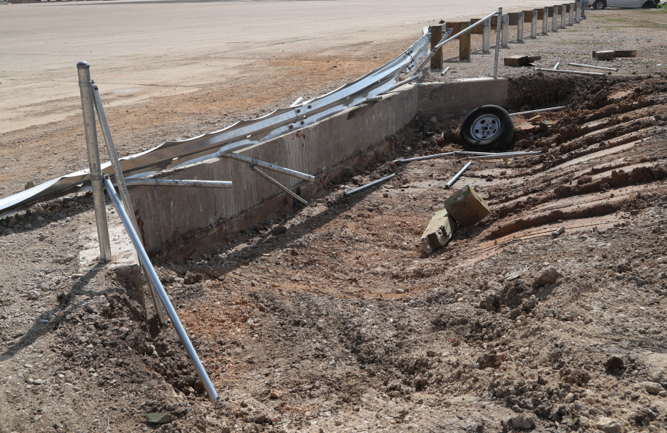
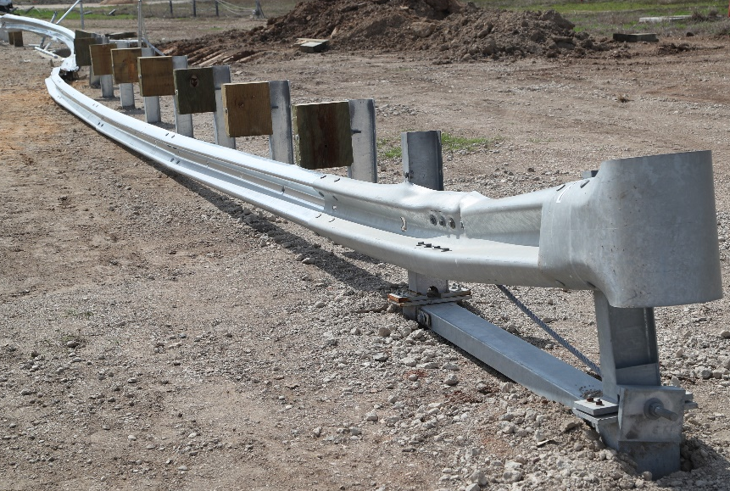
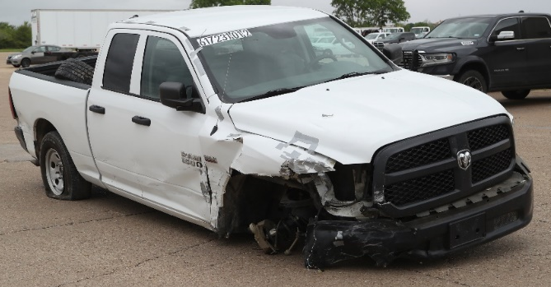
Test 3-11 Results
PASSED MASH TEST 3-11
Dynamic Deflection (inches) | 64.9
Permanent Deflection (inches) | 48
Working Width / Height (inches) | 72.3 / 59.4

Slide 20
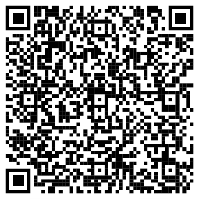
Conclusions
Long-Span Guardrail with Fall-Protection Fence behind it passed MASH TL-3
No offset needed between edge of the culvert wall and back of the post
System is ready for implementation
Final Report posted on roadsidepooledfund.org

