Slide 1
2024-01-BR: Bridge Rail End Treatments Guidance for Constrained Sites
October 2023, Annual Meeting
PS Developer: Mary McRae, Sara Manning, Mike Hills, ADOT Ali Hangul, TDOT
Ted Whitmore, WVDOT

Slide 2
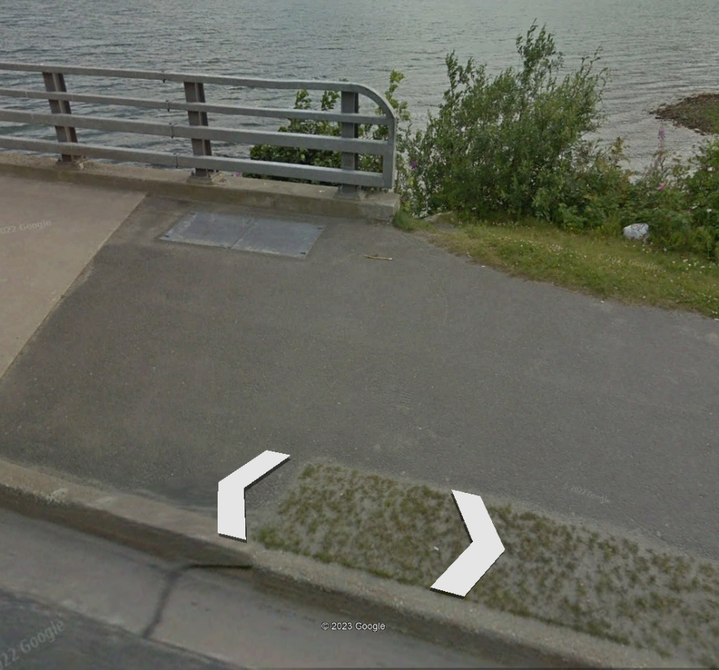
2024-01-BR: Bridge Rail End Treatments Guidance for Constrained Sites
Background
Thousands of places where MASH compliant transition rail and end treatment won’t fit
No guidance document
Time and resources dedicated to places with low speeds, low volumes
These locations are not necessarily high-speed or high-volume.
An effort is needed to optimize the allocation of resources to maximize the safety benefit of using specialty hardware.

Slide 3
2024-01-BR: Bridge Rail End Treatments Guidance for Constrained Sites
Synopsis
Due to the site constraints, the installation of existing MASH-compliant transition rail and end treatment systems at bridge railing ends could not be installed.
Many of these sites have low-speed and low-volume traffic and/or sidewalks.
Practitioners must decide whether to do without any protection or install an untested system.
This project will provide
Procedure to assist practitioners in determining whether a “do nothing” approach is sufficient.
A short, simple, non-proprietary end treatment or attenuator that directly connects to the bridge rail end.
A simple, short attenuator might provide some safety benefit to sites when a MASH attenuator does not fit

Slide 4
2024-01-BR: Bridge Rail End Treatments Guidance for Constrained Sites
Task Plan
Task 1 – Literature review
RDG, NHTSA, IIHS-HLDI, NCHRP reports such as Report 334 , and DOT standard plans.
Task 2 – Outreach to identify and categorize factors (via survey or other means)
Identify and categorize high priority situations. e.g., layout, geometry, ADT, exposure, or other pertinent features.
Task 3 – Analysis using analytical tools (e.g., RSAP)
Identify the key factors that would trigger some level of attenuation, even lacking an approved MASH device that would fit under various constraints.
?

Slide 5
2024-01-BR: Bridge Rail End Treatments Guidance for Constrained Sites
Task Plan (cont.)
Task 4 – Attenuator model and simulation (non-linear analysis)
Develop a simple, non-proprietary bridge end attenuator for at least some targeted situations.
Task 5 – Deliverables
Bridge Rail End Treatment Guidance for Constrained Bridge End Sites
Non propriety low-speed attenuator design
Simple and economical
Reduced risk to errant vehicles
Easy to replace and reduce damage (if any) to the bridge rail end

Slide 6
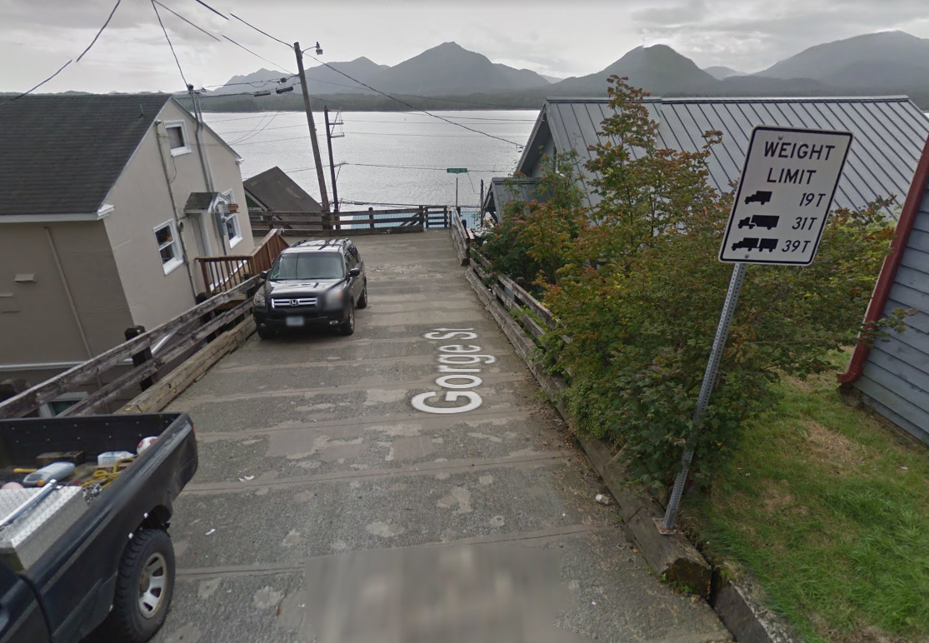
2024-01-BR: Bridge Rail End Treatments Guidance for Constrained Sites
Goals
Develop guidance for bridge end attenuation at sites constrained by physical context.
Speed, Volume, Geometry, and etc.
Model and simulate short, non-proprietary end treatment
Develop an attenuator-style end treatment for applications where transition rails are prohibited due to length or installation impediment

Slide 7
2024-01-BR: Bridge Rail End Treatments Guidance for Constrained Sites
Benefit
Provide enhanced safety of the roadway features via procedure similar to a Decision Tree to define the need for treatment based on speed, site geometry and traffic volume
The implementation of this project will help state DOT’s optimize their resources given the planned simplicity of the attenuator to be developed during the execution of this project.
Reduce repair cost . Use a better tool than just a simple rigid object. Envisioned a crushable attenuator made of steel (non-propriety)
Estimated Cost and Duration
$153,901
15 months

