Slide 1
2024-01-LSRB: MASH TL-3 Compliant Thrie -beam Guardrail System for Vehicle and Pedestrian Safety—Phase I
October 2023, Annual Meeting
PS Developer: Ali Hangul, MS, PE, TDOT

Slide 2
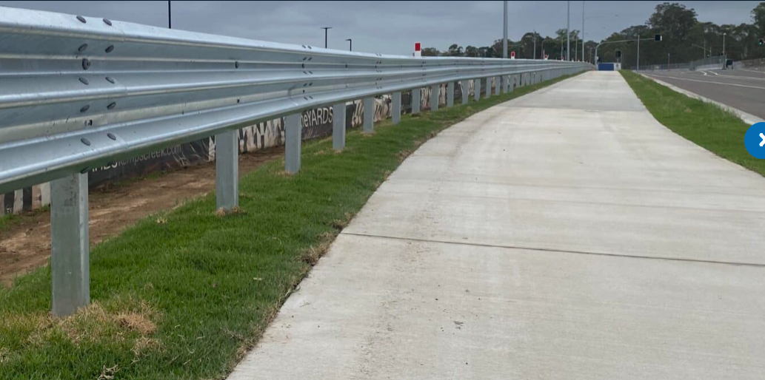
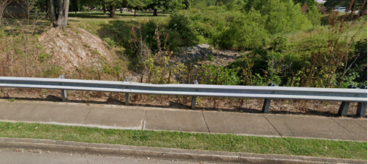
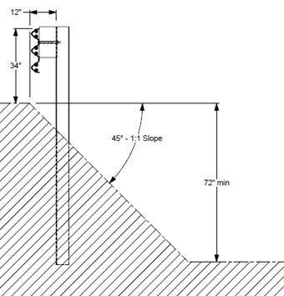
2024-01-LSRB: MASH TL-3 Compliant Thrie -beam Guardrail System for Vehicle and Pedestrian Safety—Phase I
Background
Existing W-beam guardrail system requires to be revaluated to offer a fall protection for pedestrians while continue serve for the vehicles.
Locations often maintains a ditch section offering non traversable clear zone behind the sidewalk also drop-off height enough, so it warrants for pedestrian safety rail.
In earlier pool fund project, a thrie-beam guardrail system with 34-inch height at 1:1 slope has been evaluated and successfully passed MASH TL-3 evaluation.
Notes:
During the development of rehabilitation/reconstruction of roadway projects (widening, multimodal accommodation) for an existing W-beam guardrail system located in urban or suburban context requires to be revaluated to offer a fall protection for pedestrians using the new sidewalk in addition to continue serve for the vehicles. Locations often maintains a ditch section offering non traversable clear zone behind the new sidewalk also drop-off height enough, so it warrants for pedestrian safety rail.

Slide 3
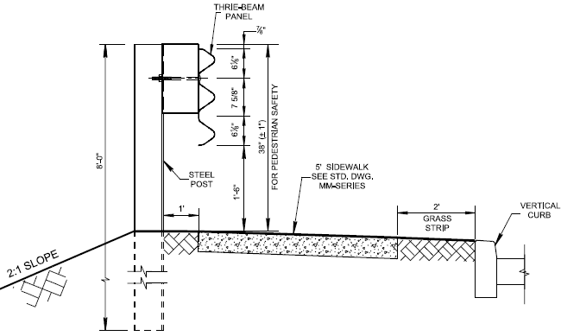
2024-01-LSRB: MASH TL-3 Compliant Thrie -beam Guardrail System for Vehicle and Pedestrian Safety—Phase I
Synopsis
Raising the conventional thrie-beam system by 3 inches to meet the min. rail height requirement (37-inch with ± 1 inch construction tolerance) to serve pedestrians as well as re-direct an errand vehicle.
Proposed design may improve the performance of the existing thrie-beam system placed near the curb and cutter section.
100’
Notes:
To offer a low-cost solution, TDOT is proposing to raise the conventional thrie-beam system by 3 inches to meet the minimum of 36-inch height (37-inch with ± 1 inch construction tolerance) rail height requirement to serve pedestrians while offering re-directive capacity for an errand vehicle. Practice may also improve the performance of the existing thrie-beam system placed near the curb and cutter section. While the modification is minimal, the raised thrie-beam design needs to be evaluated for MASH crashworthiness
Based on the experiences gained by this project, a thrie-beam at 37-inch height system placed along with sidewalk and/or curb and gutter roadway section could offer an effective performance as a combined system serving as a pedestrian safety rail and a vehicle guardrail rail applicable MASH TL-3 compliant system. Therefore, developing and evaluating such systems would provide several benefits in terms of safety, cost-effective, and constructability. To be an applicable MASH TL-3 compliant system, the system should be evaluated under MASH TL-3 evaluation criteria and pass full-scale LON and transition tests.

Slide 4
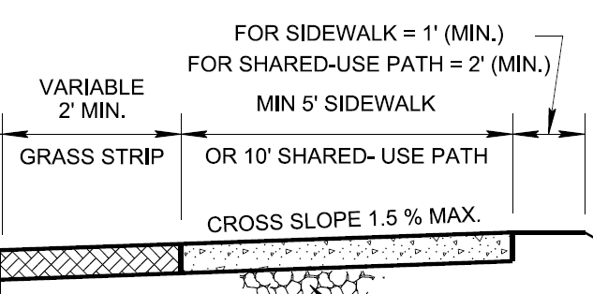
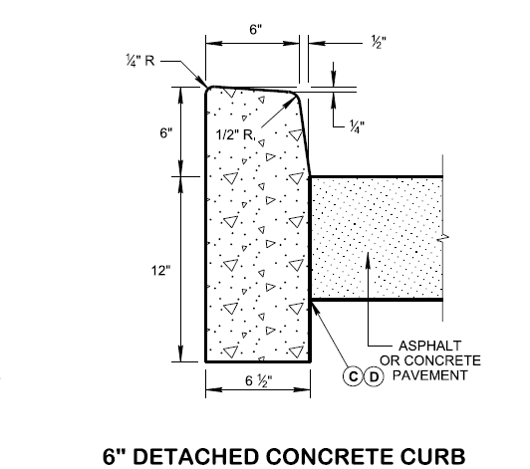
2024-01-LSRB: MASH TL-3 Compliant Thrie -beam Guardrail System for Vehicle and Pedestrian Safety—Phase I
100 ft Thrie-beam section with sidewalk
2:1 slope ditch behind post with 58-inch deep and 100 ft wide

Slide 5
2024-01-LSRB: MASH TL-3 Compliant Thrie -beam Guardrail System for Vehicle and Pedestrian Safety—Phase I
Task Plan
Task 1 – Literature Review
Review MASH compliant thrie-beam systems installed along with curb and/or sidewalk.
Review NCHRP 22-39
Review standard guidelines for pedestrian rail design.
Task 2 – Develop a design detail and perform LS-DYNA simulation
Modify and improve system designed by TDOT to meet design standards.
Develop FE model for the thrie-beam system.
Evaluate the system and determine CIP under MASH TL-3 criteria using LS-DYNA.
Task 3 – Conduct full-scale MASH Test 3-11 on the thrie-beam system
Design and conduct full-scale MASH Test 3-11 to determined LON and evaluate the system.

Slide 6
2024-01-LSRB: MASH TL-3 Compliant Thrie -beam Guardrail System for Vehicle and Pedestrian Safety—Phase I
Objectives
Develop a design detail and simulation model to validate the concept.
Evaluate 37-inch thrie-beam guardrail system under MASH Test 3-11.
Benefits
The results of the project would provide member states with a MASH TL-3 compliant thrie-beam guardrail system for vehicle and pedestrian safety in suburban context.
Estimated Cost and Duration
$189,671
18 months
Notes:
Develop a design detail and simulation model to validate the concept.
Evaluate 37-inch thrie-beam guardrail system under MASH Test 3-11.
Upon successful outcome, further test to evaluate the performance of the eccentric height transition section may be required.

