Slide 1
White Paper on national availability of MASH Approved trailer mounted equipment (Category IV devices)
October 2023, Annual Meeting
PS Developer: Brian Crossley, Pennsylvania DOT

Slide 2
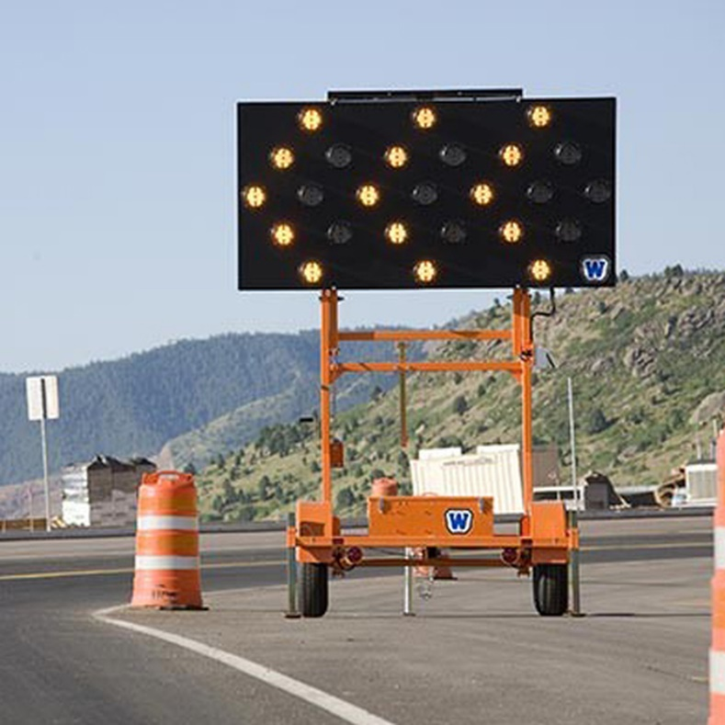
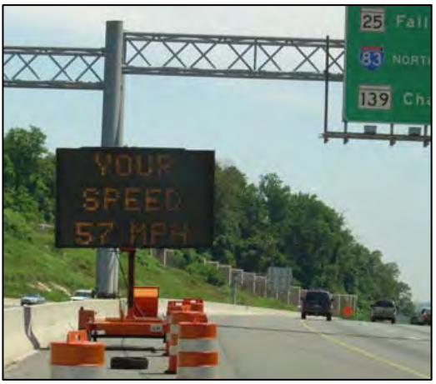
White Paper on national availability of MASH Approved trailer mounted equipment (Category IV devices)
Background
Having a suitable inventory of MASH approved trailer mounted equipment (Work-Zone Category IV) with accessories has been challenging for State DOTs.
Limited amount of current available MASH approved devices.
State DOTs are forced to continue to allow the use of old and new non-MASH approved devices to effectively meet the TTC needs of day-to-day operations.
While state DOTs will revisit sunset dates as time moves on, the availability of crashworthy Category 4 devices is of great concern to the state DOTs.
Many different configurations for the trailer mounted equipment with no knowledge of crashworthiness.

Slide 3
White Paper on national availability of MASH Approved trailer mounted equipment (Category IV devices)
Synopsis
For planning and resource purposes, a survey should be conducted nationally to see how many manufactured devices (Portable Message Boards, Arrow Boards, Portable signals, etc.) have been successfully tested to MASH standards.
Objectives
Review if a suitable inventory of MASH approved trailer mounted equipment (Work-Zone Category IV) with accessories are available.
Perform a national survey to see how many manufactured devices (Portable Message Boards, Arrow Boards, Portable signals, etc.) have been successfully tested to MASH standards.
Provide a final report for State DOT’s to understand gaps in available equipment, allow time to react and revise policy, and encourage business partners to pursue appropriate MASH testing to support business needs.

Slide 4
White Paper on national availability of MASH Approved trailer mounted equipment (Category IV devices)
Task plan
Task 1: Literature review
Review previously conducted research (FHWA letters)
Review NCHRP 350 compliant devices
Task 2: Data Collection
Survey with manufacturer
Current design parameters (samples)
MASH tested product or similar devices
Survey with DOTs
Usage of devices
Compile any available crash test result
Task 3: Deliverables
Recommend testing condition to evaluate the devices from MASH test matrix
Address recommendations in report

Slide 5
White Paper on national availability of MASH Approved trailer mounted equipment (Category IV devices)
Benefits
This approach will assist states with understanding gaps in available equipment, allow time to react and revise policy, and encourage business partners to pursue appropriate MASH testing to support business needs.
It may be beneficial if the pooled fund group could come up with some initial scoping or a study to provide a report on the current inventory of MASH Approved of trailer mounted equipment (aka Category 4 devices).
Allow for state DOTs to continue a consistent work zone environment for road users as there will be familiarity to the road user with existing and new trailer mounted work zone devices.
Provide for better availability of crashworthy trailer-mounted devices thus allowing for greater production by multiple manufacturers.
Estimated Cost and Duration
9 months
$26,992

