Slide 1
2024-02-BD Evaluation of Triangular Slip Base for Breakaway Luminaire Supports
Scott Jollo, P.E.
Oregon DOT
scott.u.jollo@odot.oregon.gov

Slide 2
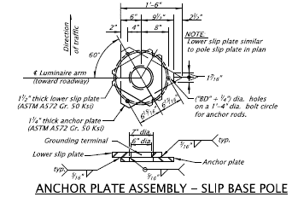
Project Goal
The goal of this research is to evaluate the MASH TL-3 impact performance of luminaire supports with a non-proprietary triangular, three-bolt slip base system.
Triangular slip plate Assembly

Slide 3
Background
Limited Full-scale experience of luminaire poles with MASH criteria
Ongoing tests of frangible cast aluminum transformer style bases
Roadside Safety Pooled Fund investigating MASH performance of a 4-bolt slip base assembly
3-bolt triangular slip base system are used by some states
Research is needed to determine if the 3-bolt triangular base systems comply with MASH criteria
Computer models with the 4-bolt slip base may be used with the 3-bolt slip bases.

Slide 24
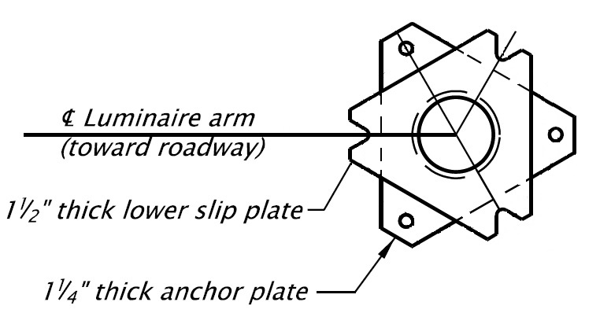
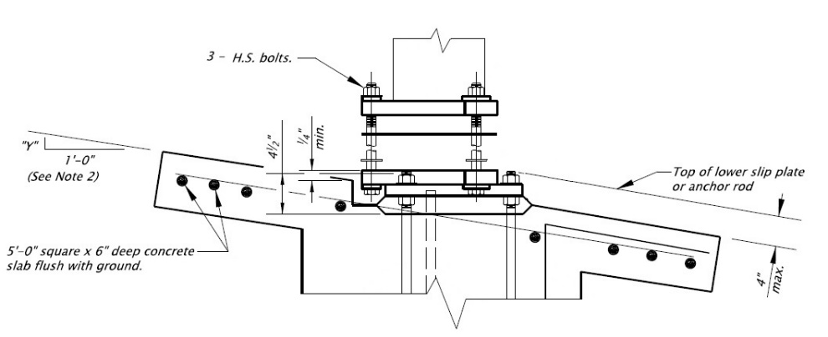
Supply of Luminaire Breakaway Bases
The 3-bolt breakaway base is non-proprietary
Uses standard galvanized steel plates
Uses standard high strength fasteners and anchor rods
Can be manufactured by many support manufacturers
Design can be maintained under the direction of the DOT

Slide 25
Supply of Luminaire Breakaway Bases
Frangible Base
Cast Aluminum box between concrete foundation and pole base
Akron manufacturers the frangible base
Steel and aluminum pole vendors in this market buy from Akron
Primarily used by a large majority of entities east of the Mississippi River
Infrastructure Bill spending opportunities
Heavy demand from State projects has caused a backlog with lead times in the range of 10-12 months.

Slide 27
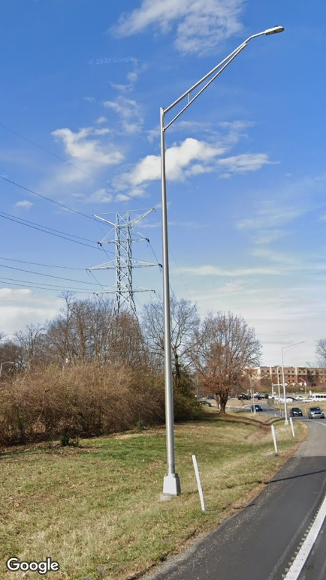
Supply of Luminaire Breakaway Bases

Slide 28
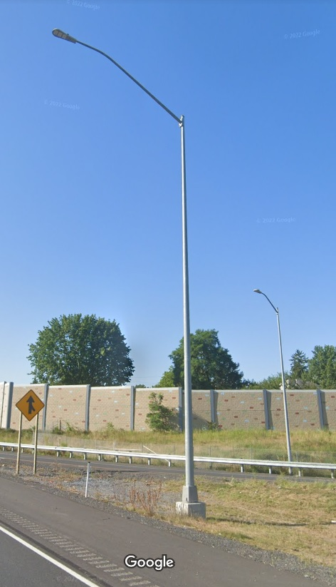
Supply of Luminaire Breakaway Bases

Slide 29
Proposed Work Plan – Task 1
Task 1: Literature Review and State Survey
Review previous and ongoing research to determine critical luminaire pole configurations that have met MASH requirements with other base types.
A survey will be distributed to the Roadside Safety Pooled Fund members to identify triangular base details used for 3-bolt triangular base luminaire poles.

Slide 30
Proposed Work Plan – Task 2
Task 2: Engineering Analysis
Task 1 data used to determine critical configurations of luminaire poles with 3-bolt triangular bases likely to meet MASH criteria.
Computer simulations may be used to help determine luminaire pole configurations recommended for full scale crash testing.

Slide 31
Proposed Work Plan – Task 3
Task 3: Full-scale Crash Testing
Evaluate a critical configuration of a luminaire pole with 3-bolt triangular slip base according to MASH criteria.
Testing may be limited to only MASH Test 3-60 if the pole configuration has been successfully crash tested with another base type.

Slide 32
Deliverables
Final Report to document research effort
Literature review
Computer simulations
Crash Testing
Recommendations for further research
Based on system failing MASH testing criteria

Slide 33
Urgency and Expected Benefit
3-bolt triangular base luminaire supports are used by states and there is a need to assess MASH compliance
The research will provide information about the continued use of 3-bolt slip base designs in state standards

Slide 34
Funding and Research Period
Estimated project cost = $165,000
Research Period of 18 months

Slide 35
Developer of Problem Statement
Name: Scott Jollo, Oregon DOT
Email: scott.u.jollo@odot.oregon.gov
Phone: 503.510.2204

