Slide 1
2024-02-LCB Foundation criteria and slope design guidance for Structurally Independent Concrete Barrier
Khamsai Yang

Slide 2
2024-02-LCB Foundation criteria and slope design guidance for Structurally Independent Concrete Barrier
Need
Foundation criteria and slope design guidance for previously tested structural independent barrier for other use cases.
Notes:
- Discuss the three bullet points and their sub-points.

Slide 3
2024-02-LCB Foundation criteria and slope design guidance for Structurally Independent Concrete Barrier
Prior Research
TxDOT Project 0-6968: Development of Structurally Independent Foundations for 36-inch Tall Single Slope Traffic Rail (SSTR) for MASH TL-4
36-in tall single slope attached to 12-in thick × 60-in wide moment slab
20-ft segment length

Slide 4
2024-02-LCB Foundation criteria and slope design guidance for Structurally Independent Concrete Barrier
Notes:
No measurable dynamic deflection.

Slide 5
2024-02-LCB Foundation criteria and slope design guidance for Structurally Independent Concrete Barrier
Proposed Work Plan
Background research on available testing data and other research including survey states for practices and needs.
Finite element analysis to identify critical configurations and relationships between barrier, soil parameters, and slope design.
Guidance Development. Prepare table or equation-based guidance for TL-4 moment slab and beam foundation concrete barriers.
Identify possible future critical crash testing.

Slide 6
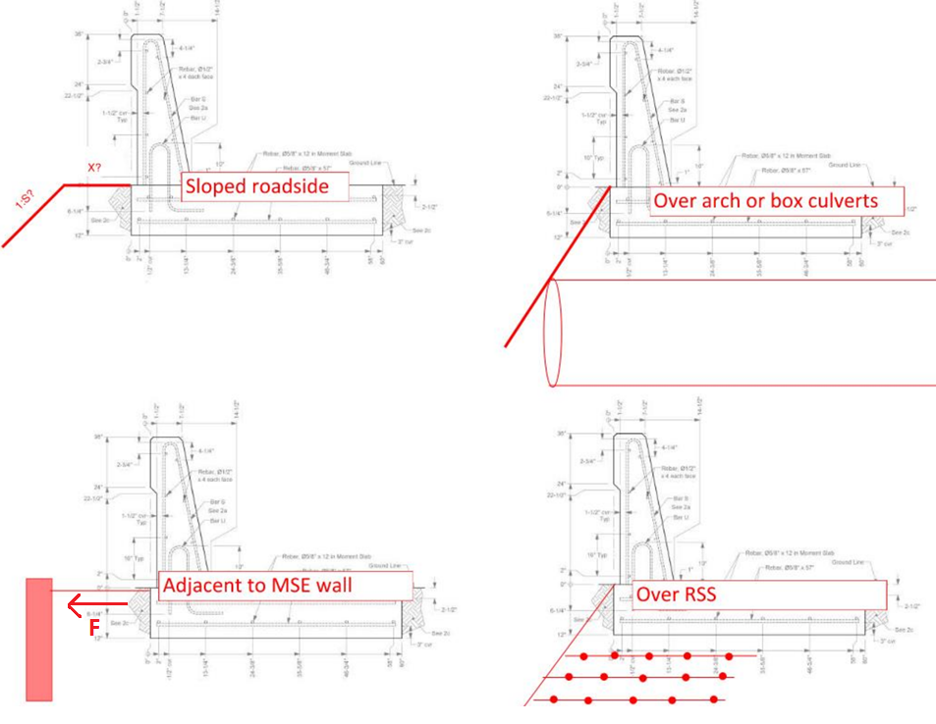
Length of barrier?
Width of slab?
Notes:
- Discuss the four situations.
3 of the 4 can be model similarly
MSE wall approach will focus on force against wall or wall cap
Guidance will also include length of barrier and slab width

Slide 7
2024-02-LCB Foundation criteria and slope design guidance for Structurally Independent Concrete Barrier
Moment Slab and Concrete Beam
Total Cost Estimate
$142,068
Notes:
Two shapes considered for analysis
Open for discussion if there’s interest to eliminate the concrete beam option.

