Slide 1
Half Post Spacing / Quarter Post Spacing in Combination with Curb MASH TL-3 (and/or TL-1 & 2)
Developer of Problem Statement: Nina Ertel, P.E., PennDOT
Presented by: James A. Borino, Jr., P.E., PennDOT

Slide 2
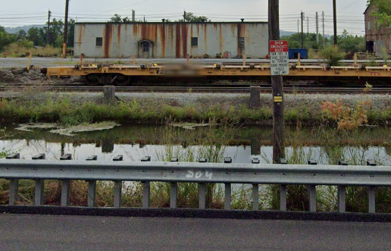
System to be Evaluated and Tested
Half Post Spacing / Quarter Post Spacing
in Combination with Curb
Previous research on MGS with curb (max 6”)
Previous research on reduced post spacing
This research will use this previous research
Goal:
MASH Compliance, TL-3
If project resources allow, simulations would evaluate deflections at lower speeds, i.e., 45mph (TL-2) and/or 25 mph(TL-1)

Slide 3
Why is this Needed?
Sometimes there are trees, utility poles and other hazards right behind a curb.
Then a reduced post spacing guide rail system is needed to reduce deflection.
Need to determine MASH compliance of this combination.
Additionally, if deflections are known at lower speeds, then some reduced post spacings could be avoided on low-speed roadways.

Slide 4
Proposed Work Plan
Literature Review
Engineering and Analysis Simulation
Crash Testing
Documentation/Reporting

Slide 5
Costs
Total Estimated Cost = $216,000
Total Estimated Time = 15 months

