Slide 1
2024-03-BD
Evaluation of Multi-Post Large Sign Supports with Slip Base and Slip Hinge
Scott Jollo, P.E.
Oregon DOT
scott.u.jollo@odot.oregon.gov

Slide 2
Project Goal
Investigate MASH compliance of multi-support breakaway sign support systems that incorporate both a four-bolt slip base mechanism and a slip hinge rather than fuse plate below the sign panel.
The slip hinge may provide more consistent activation than the fuse plate and does not rely on mechanical properties of the plate, which can vary significantly.

Slide 3
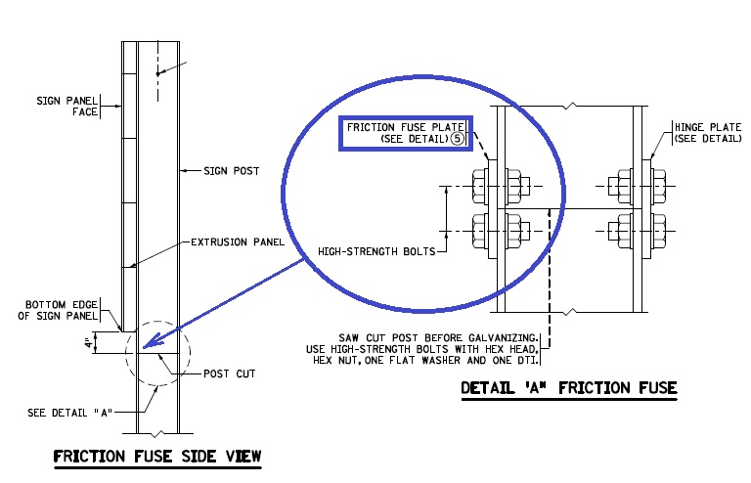
Background – Fuse Plate

Slide 4
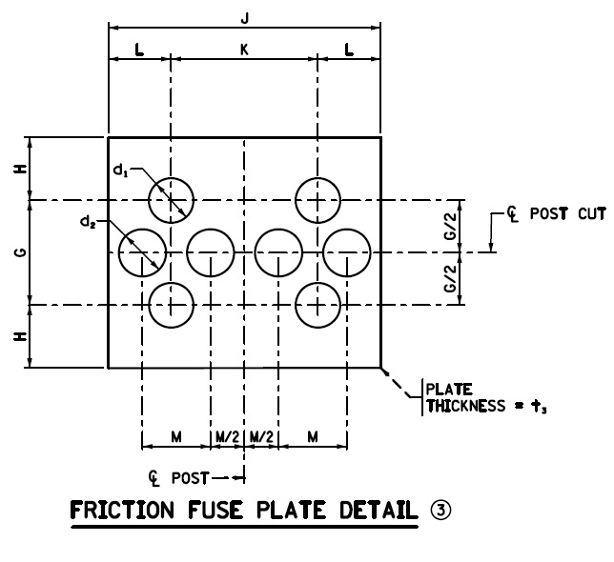
Background – Fuse Plate

Slide 5
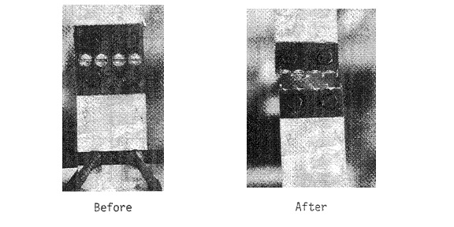
Background – Fuse Plate

Slide 6
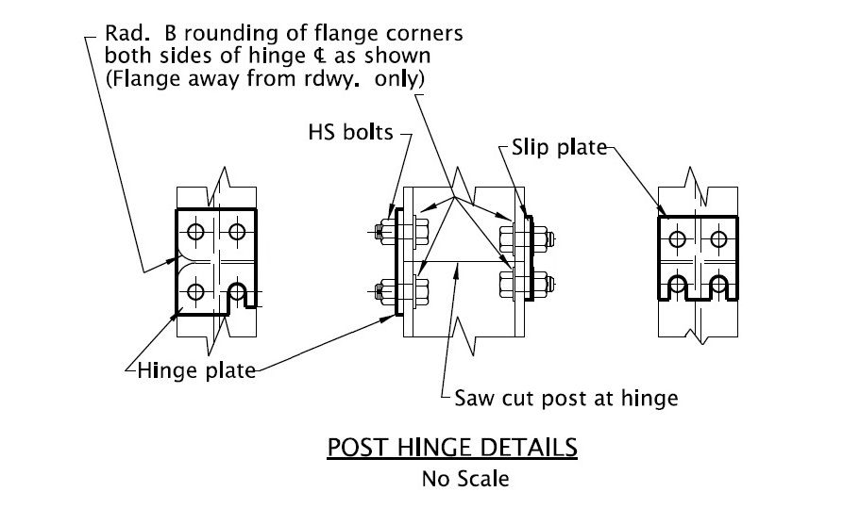
Background – Slip Hinge

Slide 7
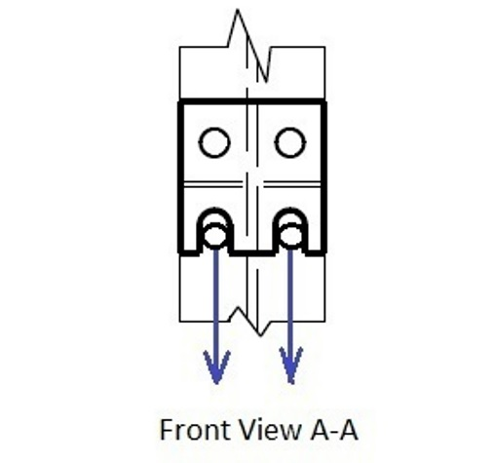
Background – Slip Hinge

Slide 8
Background
Full-scale testing experience of large guide sign systems in accordance with MASH criteria is limited.
Testing to date has been performed on systems that incorporate a fuse plate below the sign panel to permit rotation of the impacted post relative to the sign assembly. In some tests, the fuse plate has not ruptured and activated a hinge mechanism as intended.

Slide 9
Background
Other types of hinge mechanisms are used by some states. For example, Oregon DOT has had good field experience with a slip-style hinge mechanism. The slip hinge functions similarly to a slip base system.
A clamping force is provided through the tension developed in the slip bolts when they are tightened. Such a system may provide more consistent and reliable activation compared to fuse plates.

Slide 10
Background
Testing has also shown that the sign assembly can be damaged and require extensive and expensive repair if the impacted lower portion of the support post remains hinged to the upper portion of the support post.
If the hinge connection between the upper and lower portions of the support post can be designed to readily disengage, the level of repair may be significantly reduced. A slip hinge design may offer such an advantage.

Slide 11
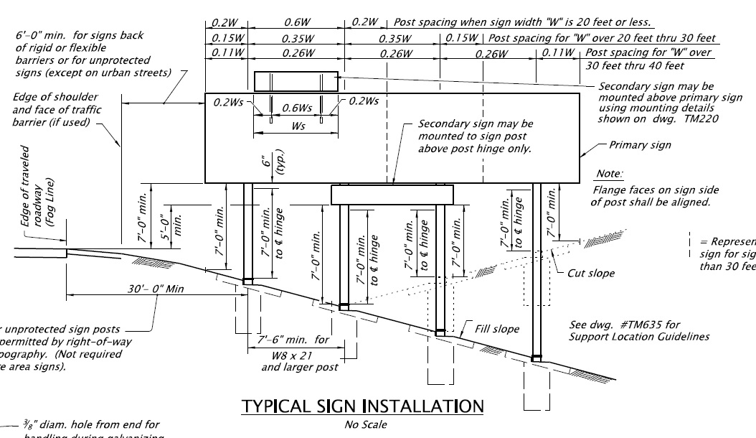

Slide 12
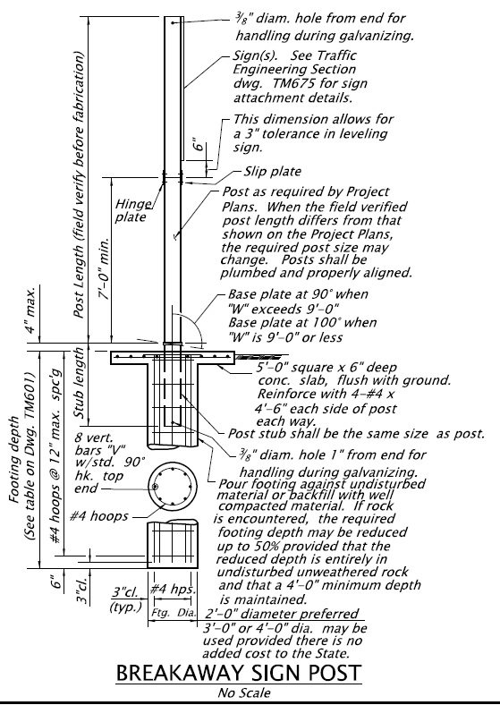

Slide 13
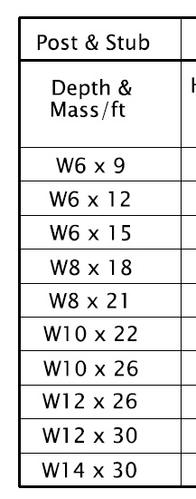

Slide 14
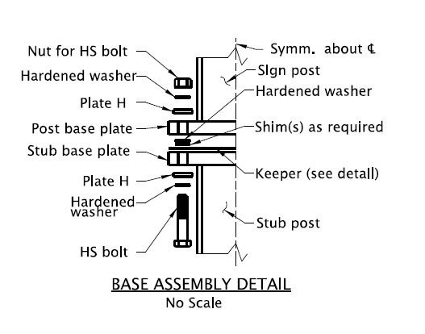

Slide 15
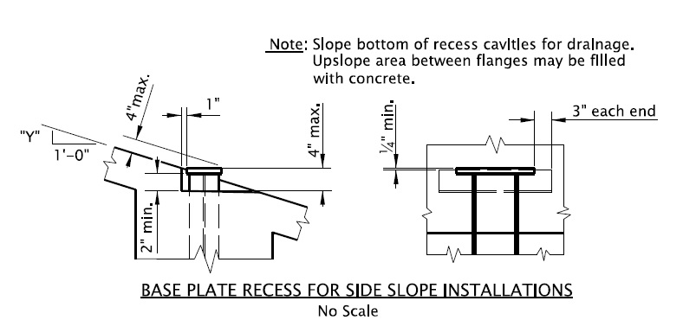

Slide 16
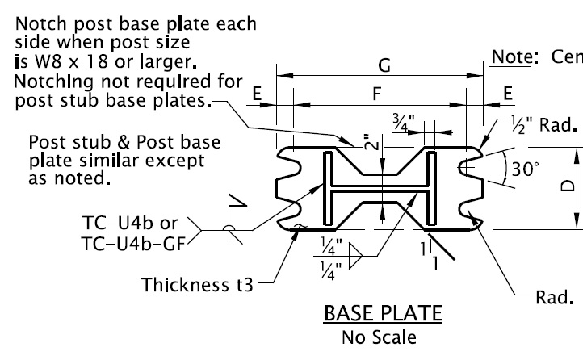

Slide 17
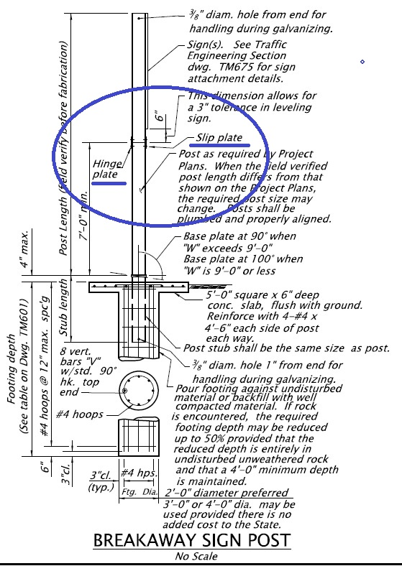

Slide 19
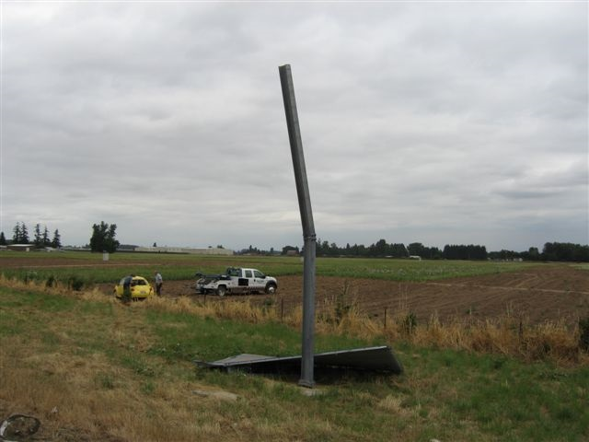

Slide 20


Slide 21
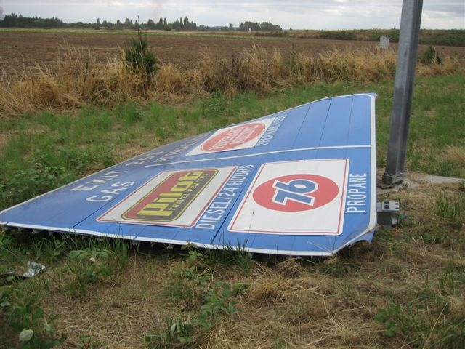

Slide 22
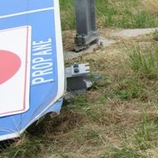

Slide 23
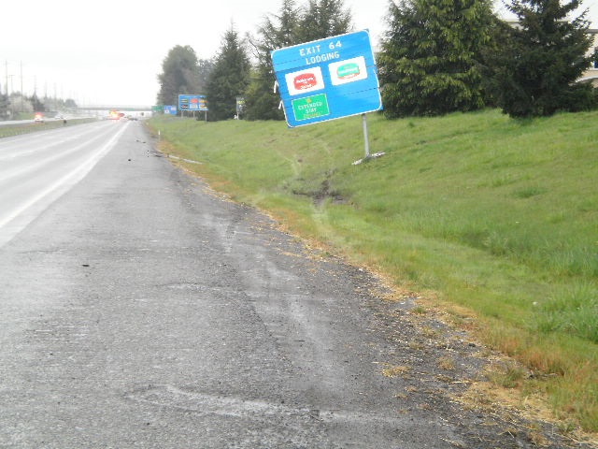

Slide 24
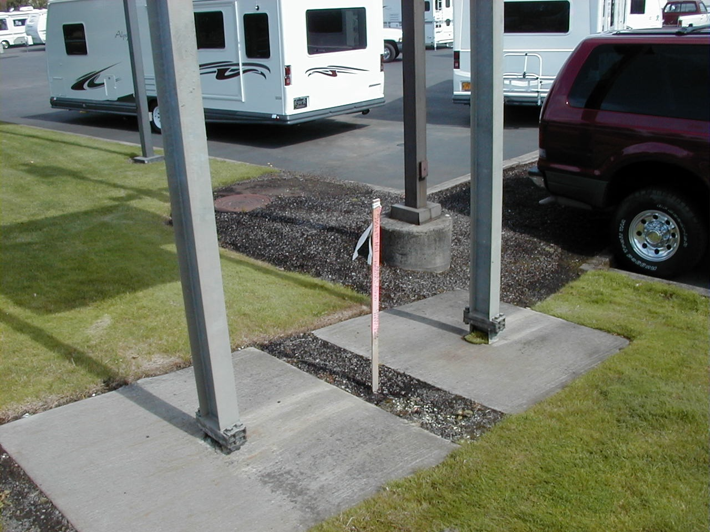

Slide 25
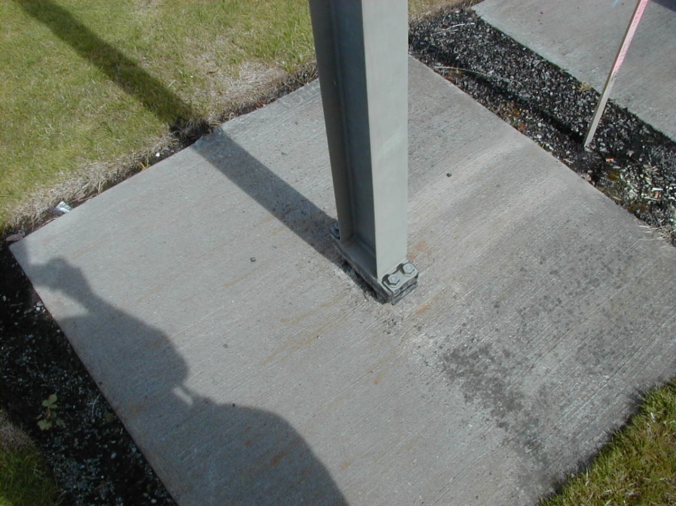

Slide 26
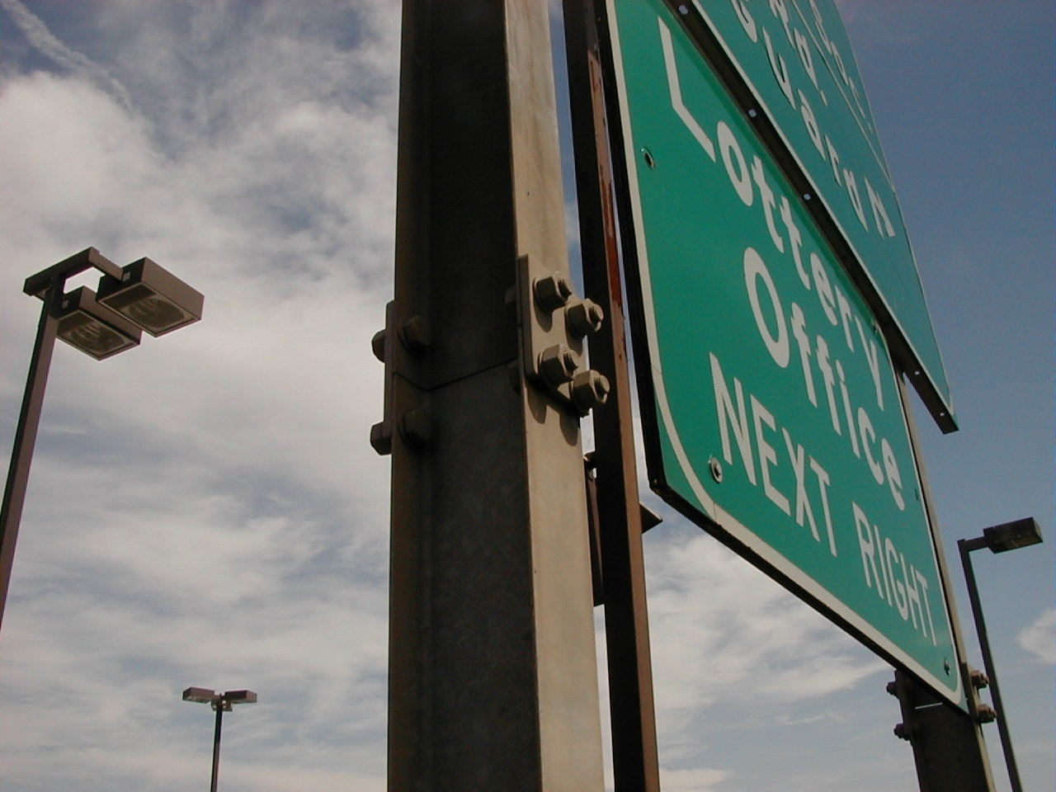

Slide 27
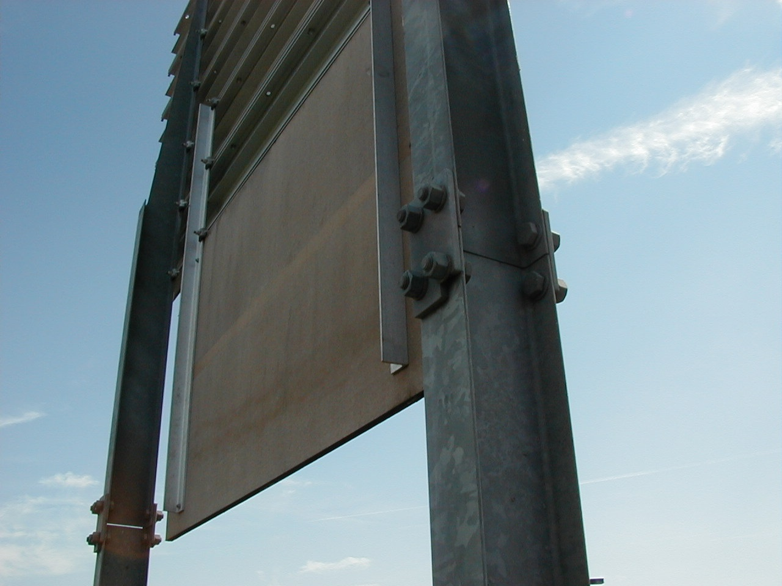

Slide 28
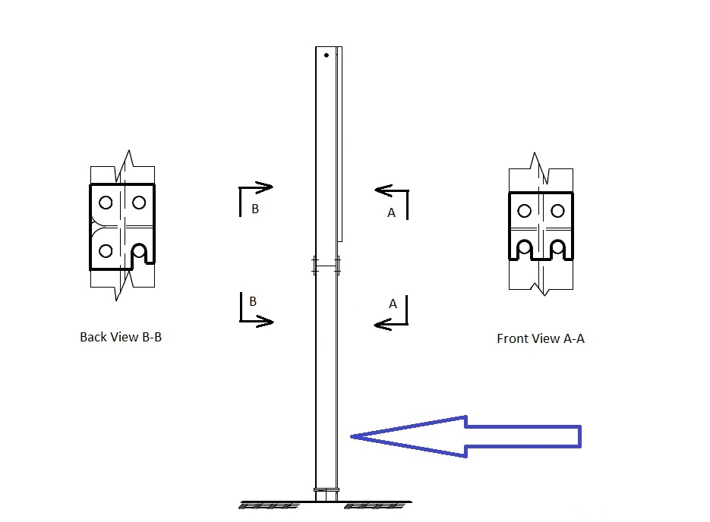

Slide 29


Slide 30
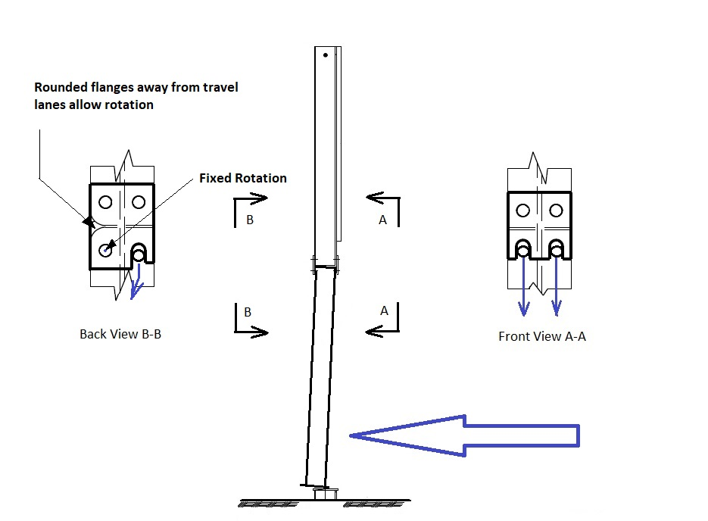

Slide 31
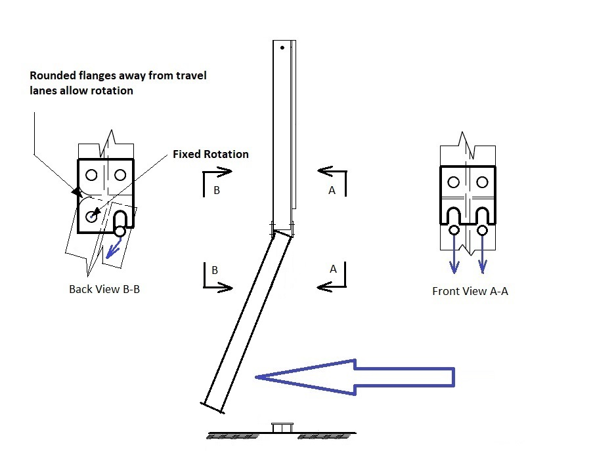

Slide 33
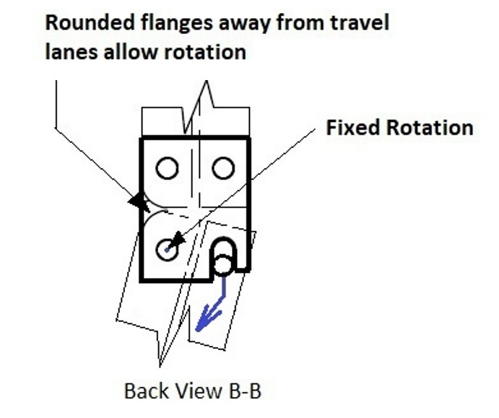

Slide 34
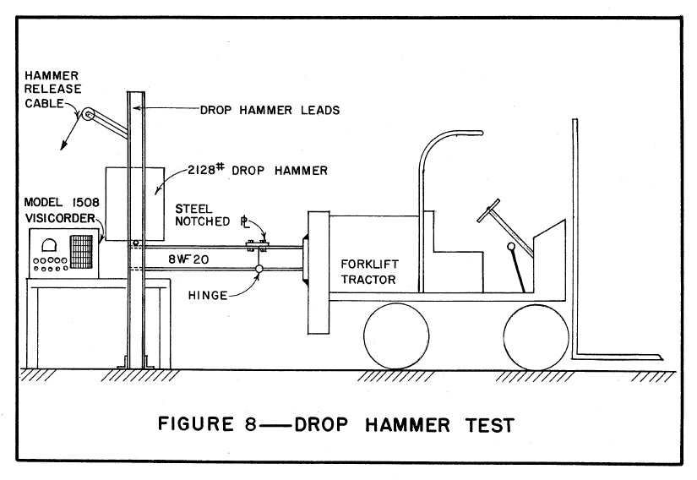

Slide 35
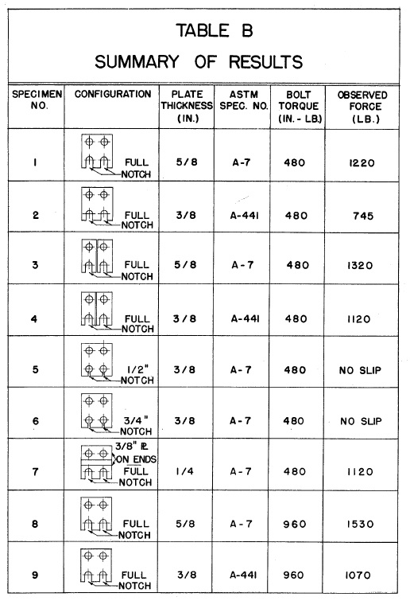

Slide 36
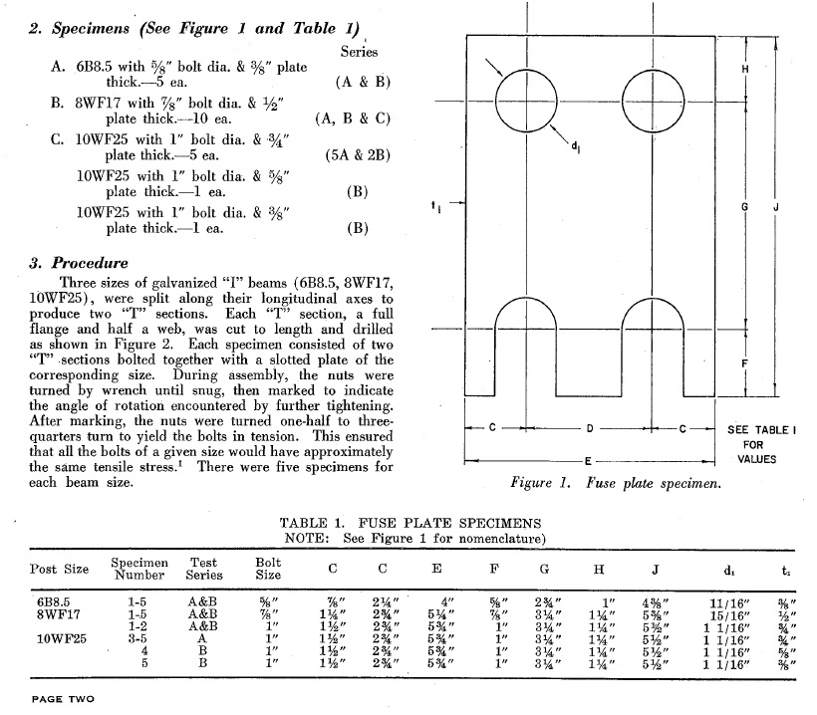

Slide 37
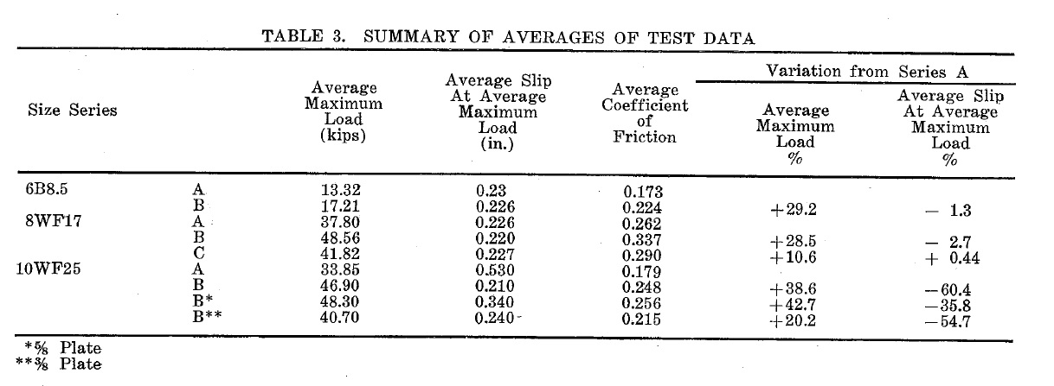
Hinge Testing

Slide 38
Proposed Work Plan – Task 1
Task 1: Literature Review and State Survey
  The research team will review previous and ongoing research projects to determine multi-post sign support systems that have met MASH requirements with various base and hinge types.
  A survey instrument will be distributed to the Roadside Safety Pooled Fund members to identify the characteristics of their multi-post sign support systems.

Slide 39
Proposed Work Plan – Task 2
Task 2: Engineering Analysis
  The research team will the data obtained in Task 1 to determine features and critical configurations of the multi-post sign support systems to evaluate through this research.
    features might include extruded aluminum sign panels
    W-section posts
    4-bolt slip base
    The hinge design may vary as a focal point of the research effort.
  The analysis will result in recommendations for full-scale crash testing.

Slide 40
Proposed Work Plan – Task 3
Task 3: Full-scale Crash Testing
  The research team will evaluate two critical configurations of multi-post sign support systems according to MASH criteria.
  Critical tests will be identified and performed to evaluate the impact performance of the selected configurations.
  The results will be used to evaluate MASH compliance and assess performance differences between slip hinge and fuse plate hinge designs.

Slide 41
Deliverables
Final Report to document research effort
  Literature review
  Computer simulations
  Crash Testing
  Performance differences observed between slip hinge and fuse plate hinge designs
  Recommendations for further research
    Based on system failing MASH testing criteria

Slide 42
Urgency and Expected Benefit
This project will assess MASH compliance and overall impact performance of multi-post sign support systems with slip hinge mechanisms.
The slip hinges may activate more consistently and result in less damage to the sign support system than fuse plate hinges.
If this is verified through research, it can provide states with a cost-effective option for multi-post sign support systems.

Slide 43
Funding and Research Period
Estimated project cost = $215,000
Research Period of 18 months

Slide 44
Developer of Problem Statement
Name: Scott Jollo, Oregon DOT
Email: scott.u.jollo@odot.oregon.gov
Phone: 503.510.2204

