Slide 1
Half Post Spacing / Quarter Post Spacing and in Combination with No Soil Backup, TL-3 (and/or TL-1 & 2)
Developer of Problem Statement: Nina Ertel, P.E., PennDOT
Presented by: James A. Borino, Jr., P.E., PennDOT

Slide 2
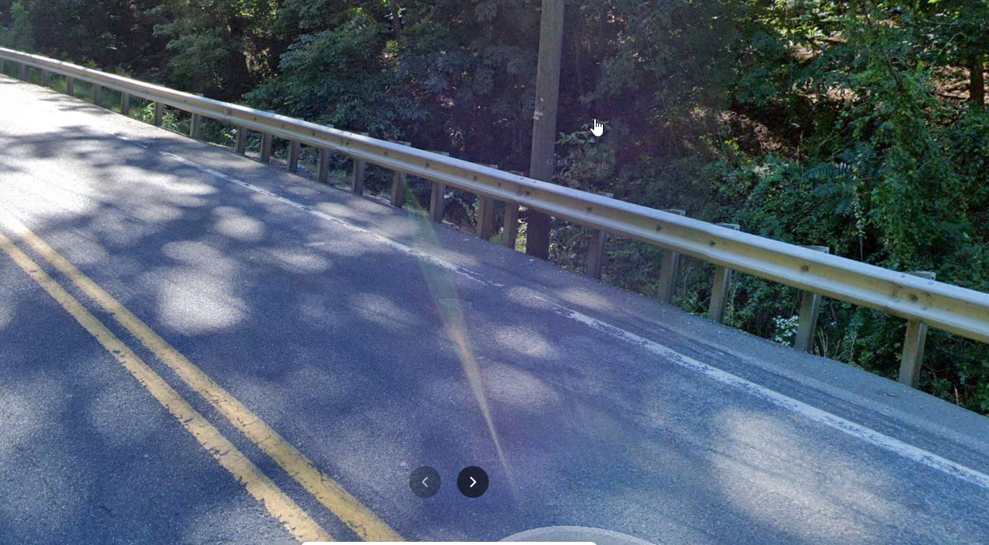
Systems to be Evaluated
Half post spacing and quarter post spacing
in combination with no soil backup (slopes steeper than 2:1)
  Previous research on MGS w/ no soil back-up
  Previous research on reduced post spacing
  This research will use previous research
  Goal:
  MASH Compliance, TL-3
  If project resources allow, simulations would evaluate deflections at lower speeds, i.e., 45mph (TL-2) and/or 25 mph(TL-1)

Slide 3
Project Needs
Sometimes there are trees, utility poles and other hazards right behind guide rail in situations with no soil back-up.
Then a reduced post spacing guide rail system is needed to reduce deflection.
Need to determine MASH compliance of this combination.
If deflections are known at lower speeds, then some reduced post spacings could be avoided on low-speed roadways.

Slide 4
Proposed Work Plan
Literature Review
Engineering Analysis and Simulation
Crash Testing
Documentation/Reporting

Slide 5
Costs
Total Estimated Cost = $220,000
Total Estimated Time = 15 months

