Slide 1
2024-04-BD MASH Evaluation of Square Tubing Slip Base Sign Support Systems
Scott Jollo, P.E.
Oregon DOT
scott.u.jollo@odot.oregon.gov

Slide 2
Project Goals
Evaluate MASH compliance of critical configuration of square post slip base sign support system.
Determine MASH compliance of less critical configurations through engineering analysis that do not require full-scale crash testing.

Slide 3
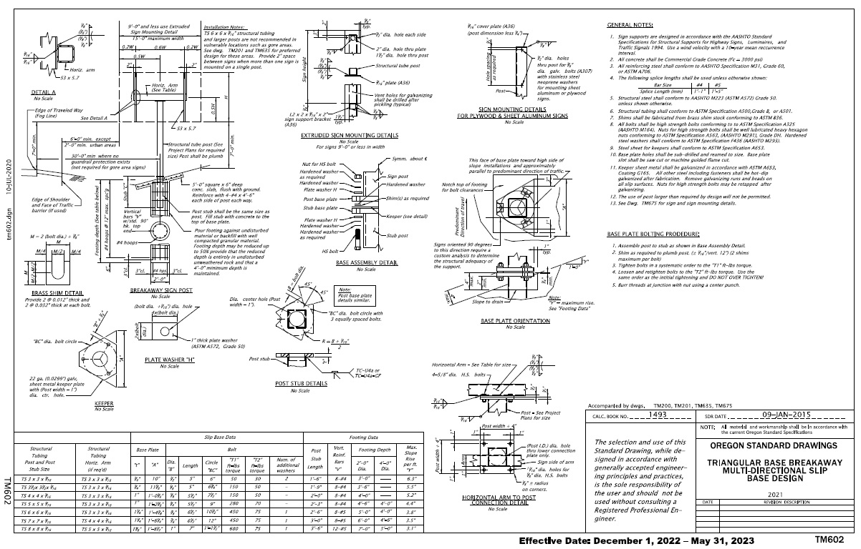
Background
Oregon DOT uses the Standard Drawing TM602 for square tube triangular base slip base sign support system

Slide 4
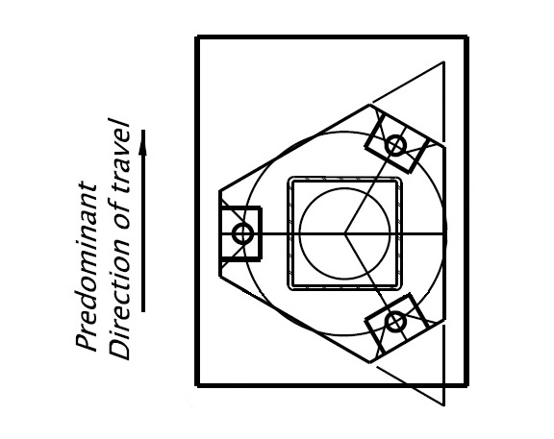
Background

Slide 8
Previous Testing

Slide 9
Previous Testing

Slide 10
Previous Testing

Slide 11
Previous Testing

Slide 12
Previous Testing

Slide 13
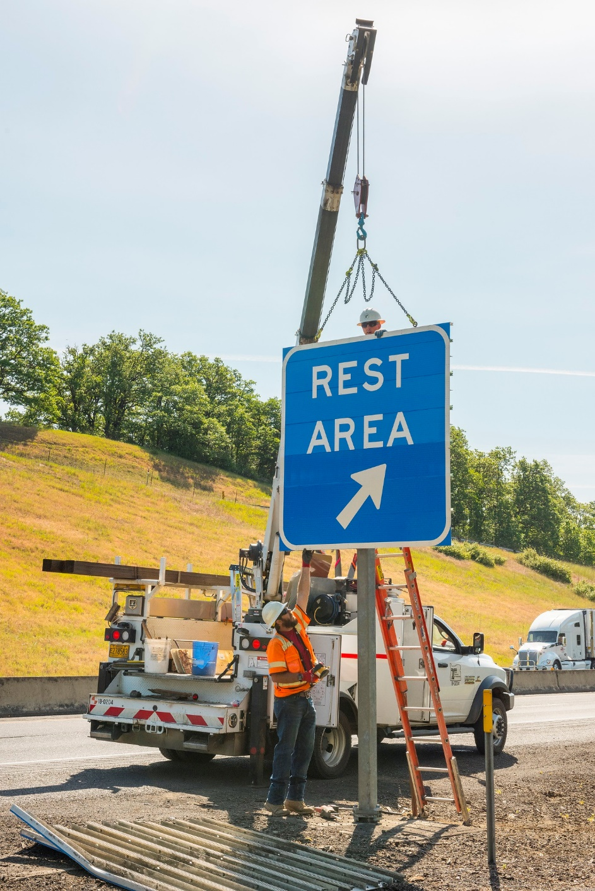

Slide 14
Previous Testing

Slide 16
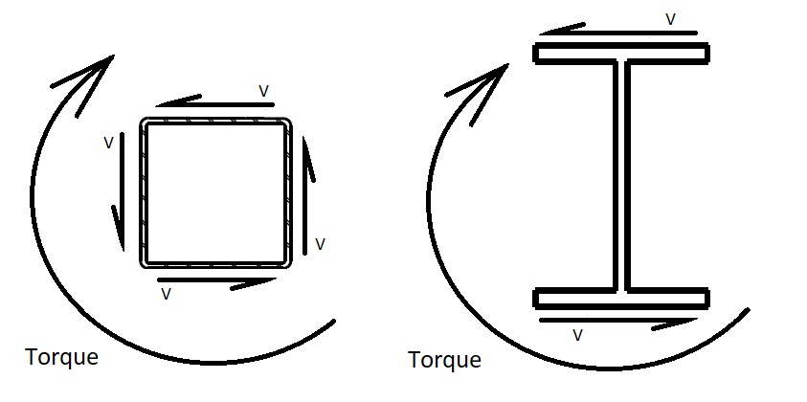
Square Tube Post Benefits
Square tube support can mount medium sized signs.
An 8”x8”x3/16” square tube can typically support an estimated sign size of 7’ x 14’
Resists Torsion forces

Slide 17
Proposed Work Plan – Task 1
Task 1: Literature Review and Engineering Analysis
Review previous and ongoing research related to the evaluation of slip base sign support systems.
Review current state standards for slip base sign support systems with square tube posts. If additional information is needed, conduct a survey of state DOTs to collect additional information on sign support sizes, sign sizes, and other installation details.
Identify and select the most critical configuration for full-scale crash testing. Other less critical configurations would be considered acceptable if the crash tests are satisfactory.

Slide 18
Proposed Work Plan – Task 2
Task 2: Full scale crash testing
MASH Tests
Test 3-60: 1100C, Passenger Car, 2,420 lb, 19 mph, Critical Impact Angle
Test 3-61: 1100C, Passenger Car, 2,420 lb, 62 mph, Critical Impact Angle
Test 3-62: 2270P, Pickup Truck, 5,000 lb, 62 mph, Critical Impact Angle

Slide 19
Proposed Work Plan – Task 3
Task 3: Report and recommendations
Document research, testing performed, and conclusions.

Slide 20
Deliverables
Final Report to document research effort
Literature review
Summary of State survey if performed
Crash Testing
Documentation of MASH compliance for applicable installation types
Recommendations for further research
Based on system failing MASH testing criteria

Slide 21
Urgency and Expected Benefit
Evaluation of these signs supports is needed to determine their MASH compliance and use on roadways.
If MASH compliance is verified through research, it can provide states with a non-proprietary option for square tube sign support systems.

Slide 22
Funding and Research Period
Estimated project cost = $117,000
Research Period of 18 months

Slide 23
Developer of Problem Statement
Name: Scott Jollo, Oregon DOT
Email: scott.u.jollo@odot.oregon.gov
Phone: 503.510.2204

