Slide 1
2024-06-LSRB: MASH TL-3 Enhancement of Short Radius Guardrail System (SRGS) – Design Modification
October 2023, Annual Meeting
Tim Moeckel, P.E., WSDOT
Notes:
The next problem statement for your consideration is 2024-06-LSRB: MASH TL-3 Enhancement of the Short Radius Guardrail System (also known as the SRGS).

Slide 2
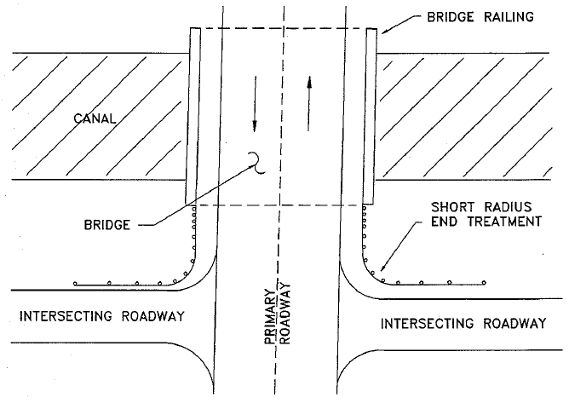
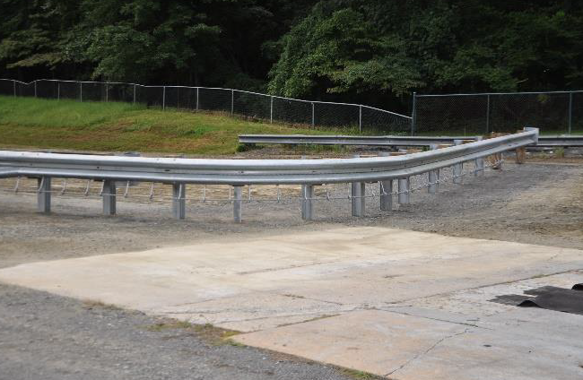
2024-06-LSRB: MASH TL-3 Enhancement of Short Radius Guardrail System (SRGS) – Design Modification
Background
States have a problem when installing crashworthy barrier systems at intersection locations where a bridge/structure on a major road is intersected by a side road or driveway in close proximity to the bridge/structure end.
Insufficient room to properly install a barrier that can shield both the bridge/structure end and the slope immediately adjacent to it.
NCHRP recently developed the MASH-compliant Short Radius Guardrail System (SRGS) which provides an excellent barrier option for states.
There are still many needs to explore and improve upon this system to make the system more effective and available for use at a higher number of locations, and easier/more cost-effective to construct.
Notes:
A common widespread problem that state have is installing crashworthy barrier systems at intersection locations where a bridge end or structure is located in close proximity to the intersecting roadway. In many cases, there is not enough room to properly install a barrier system that can shield both the bridge end or structure end, and the fill sloped areas adjacent to the intersection. Recently, NCHRP project 15-53 was completed which successfully developed and crash tested a short radius guardrail system (or SRGS) meeting MASH criteria. While this system provides a crashworthy MASH compliant barrier alternative at intersection locations, there are still many more design needs which need to be explored to improve the performance of the SRGS system to make it available for use at a greater number of locations and easier and more cost-effective to construct.

Slide 3
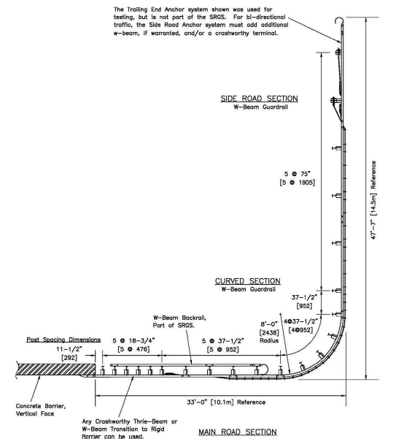
2024-06-LSRB: MASH TL-3 Enhancement of Short Radius Guardrail System (SRGS) – Design Modification
Project Synopsis
Recently, the MASH compliant Short Radius Guardrail System (SRGS) research project was completed by NCHRP (NCHRP Project 15-53, NCHRP Research Report 1013).
Use 10-guage rail (thicker than 12-guage), steel posts
MASH TL-3 compliant on flat ground
MASH TL-2 compliant with a 2:1 or flatter slope MASH compliant utilizing a 90-degree intersection angle
Overall length of 33 ft from bridge rail/barrier to the face of guardrail running perpendicular to the main roadway alignment.
There are still several design/implementation questions associated with the SRGS which need research, computer modeling, and/or crash testing.
Notes:
Last year, the SRGS project was able to successfully crash test the SRGS system to MASH TL-3 on flat ground and to MASH TL-2 with a 2:1 or flatter slope behind it. The as-tested SRGS system utilized a 90-degree intersection angle, a 33-feet distance from bridge/structure end to the face of guardrail running perpendicular to the main roadway, 10 guage rail which is thicker than standard 12 guage rail, and steel posts. There are still several design/implementation questions associated with the SRGS system which still need research, computer modeling, and/or crash testing in order to optimize this system and allow it to be used at a greater number of locations.

Slide 4
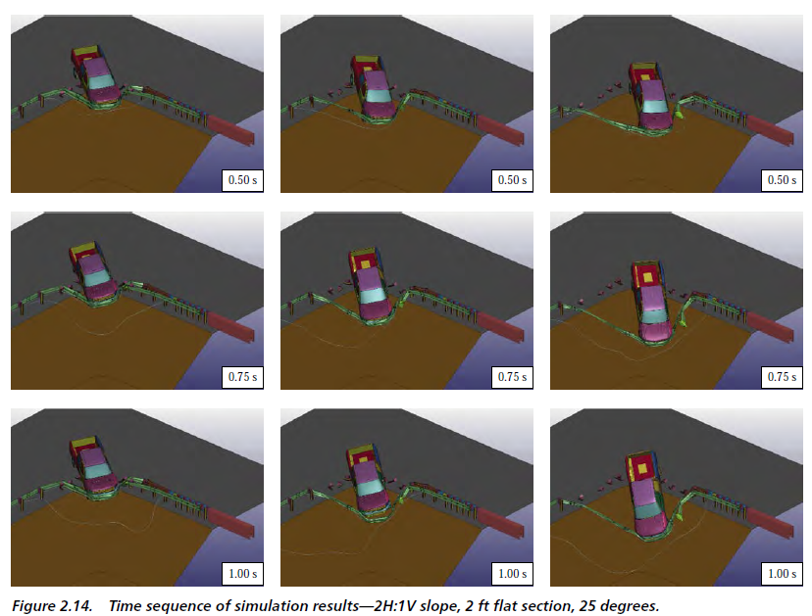
2024-06-LSRB: MASH TL-3 Enhancement of Short Radius Guardrail System (SRGS) – Design Modification
70 km/h
80 km/h (50mph)
90 km/h
Based on the simulation results conducted in NCHRP Report 1013, at the higher speeds, 90 km/hr and 100 km/hr (62 mph), the vehicle was less stable, and significant roll and pitch were observed.
Need a design modification / improvement for MASH TL-3
PASS
PASS
FAIL
Notes:
During the NCHRP 15-53 project, researchers performed computer simulations of the SRGS with a 2:1 slope behind it. Their simulations indicated that the system is likely MASH crashworthy at 70 km/h (44 mph) and 80 km/h (50 mph). However, their computer simulations at 90 km/hr (56-mph) and 100 km/hr (62 mph) indicated the system would not likely meet MASH standards due to concerns with vehicle stability in the form of excessive roll and pitch. As a result of these computer simulations, the NCHRP 15-53 project opted to crash test the SRGS with a 2:1 slope at 50-mph. The crash test was successful giving the current SRGS system a MASH TL-2 rating with a 2:1 slope behind it.

Slide 5
2024-06-LSRB: MASH TL-3 Enhancement of Short Radius Guardrail System (SRGS) – Design Modification
Currently, SRGS is MASH TL-2 compliant with a 2:1 or flatter slope (tested at 50 mph (80km/hr)).
The greatest interest was to conduct MASH TL-3 testing on SRGS with 2:1 slope.
A preliminary Poll of the PF states prioritized the needed design modifications
Notes:
As a result of NCHRP 15-53 project outcomes, the SRGS system needs further research for potential design modifications in order to improve the SRGS system so that it can meet MASH TL-3 compliance with a 2:1 slope behind it.
Recent polling shows that our pooled fund members are most interested in MASH TL-3 testing of the SRGS with a 2:1 slope behind it.

Slide 6
2024-06-LSRB: MASH TL-3 Enhancement of Short Radius Guardrail System (SRGS) – Design Modification
Task Plan
Task 1: Literature review and State survey
Review past barrier intersection systems and the SRGS including TTI’s with mass dissipation.
Review a guardrail system with 2:1 or steeper slope and other related devices such as transitions
Task 2: Design and Simulation Analysis
Develop, calibrate and verify FE model using MASH TL-2 tests data and other pertinent test.
Modify SRGS design with a 2:1 slope as needed in order to meet MASH TL-3
Perform FE simulations with pickup truck and small car models for modified SRGS with a 2:1 slope (MASH Tests 3-333, MASH 3-33).
Identify critical tests and critical impact points for the SRGS chosen by the TAC.
Task 3: Recommended Design and Project Report
Documenting background, research effort, computer simulations, engineering drawings, and implementation guidance for the selected design.
Recommend options for the next phase of project to evaluate the SRGS any further (likely crash testing).
Notes:
As a result of the poll, the goal of this project is to research and look for ways to improve the design of the as-tested SRGS system so that the system is likely to pass MASH TL-3 crash testing.
The task plan for the project is as follows:
<READ SLIDE>

Slide 7
2024-06-LSRB: MASH TL-3 Enhancement of Short Radius Guardrail System (SRGS) – Design Modification
Objectives
To conduct further simulation and design modification Short Radius Guardrail System (SRGS).
Develop a SRGS with a 2:1 slope behind the system based on the design developed on NCHRP 15-53 project.
Benefits
Provide a functional enhancement of this short radius design and allow it to be used at a greater number of intersections with a 2:1 ditch behind it.
Estimated Costs and Duration
$171,026
17 months
Notes:
In summary the objective of this project is to conduct further computer simulations and implement SRGS system design modifications as necessary in order to design an SRGS system with 2:1 slopes behind it that will likely meet MASH TL-3 testing standards and indicated by the computer simulations.
The benefit of from this project is that it will provide the first step needed to provide an improved SRGS system with 2:1 slopes behind it capable of meeting MASH TL-3 standards. Ultimately, the improved SRGS design will allow this system to be used at a greater number of intersection areas with 2:1 slopes behind it.
The estimated cost of the project is approximately $171,000 with a duration of 17-months. And if successful, this will lead to a phase II of the project which will likely be crash testing to MASH TL-3.
Are there any questions?

