Slide 1
2024-07-LSRB: MASH TL-3 Design, Testing, and Evaluation of a Flared Guardrail System - Phase 2
October 2023, Annual Meeting
PS Developer: Tim Moeckel, P.E., WSDOT
Notes:
Good afternoon everyone. I will be presenting the problem statement 2024-07-LSRB: MASH TL-3 Design, Testing, and Evaluation of a Flared Guardrail System – Phase 2 for your consideration.

Slide 2
2024-07-LSRB: MASH TL-3 Design, Testing, and Evaluation of a Flared Guardrail System - Phase 2
Background
  Pooled fund project 609971-01 performed three tests of flared MGS that did not pass MASH:
    7:1 flared MGS system with small car – failed, ruptured rail
    11:1 flared MGS system with pickup truck – failed, failed anchor
    11:1 flared MGS section with non-flared MASH end-terminal with a pickup truck – failed, ruptured rail
Notes:
First, I’ll give a summary of pertinent background information associated with this project proposal. Last year, pooled fund project 609971-01 was completed. The project’s goal was to successfully crash test a flared run of MGS guardrail to MASH TL-3 standards. Unfortunately, all the crash tests conducted on this project failed. The project crash tested the MGS system using three different configurations. The first crash test installed the MGS system at a 7:1 flare rate and impacted it with a small car. The test failed due to ruptured rail. Next, the second crash test installed the MGS system at an 11:1 flare rate and impacted it with a pickup truck. The test failed due to failure of the anchor. The third and final test was very similar to the second test and installed the MGS system at an 11:1 flare rate while using a MASH end terminal and impacted it with a pickup truck. The test failed due to ruptured rail.

Slide 3
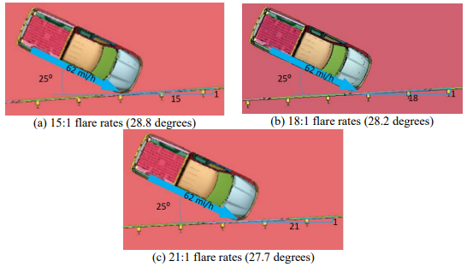
2024-07-LSRB: MASH TL-3 Design, Testing, and Evaluation of a Flared Guardrail System - Phase 2
Background
  Researchers then evaluated various modifications of the flared MGS system using simulation to propose a design likely to meet MASH:
    Unmodified MGS with flares of 15:1, 18:1, and 21:1 were simulated
      Simulations indicated likely failure due to excessive lateral deflection/pocketing leading to rail rupture and high ridedown acceleration
    Modified/retrofitted MGS including ½ post spacing, shortened blockouts, and rubrail were simulated
      Design using shortened blockouts and rubrail with regular post spacing likely to pass MASH
  The modified design was recommended for future MASH testing
Notes:
Based of the three failed tests, the project team decided to use its remaining resources to conduct computer simulations using the latest data obtained from the three failed crash tests.
First, computer simulations were run on an unmodified MGS system with flare rates of 15:1, 18:1, and 21:1. The three simulations indicated likely failure due to excessive lateral deflection/pocketing leading to rail rupture and high levels of ridedown acceleration forces.
Next computer simulations were run on a modified MGS system. The MGS system was modified by utilizing half post spacing, shortened blockouts, and rubrail. The simulations indicated that the modfied MGS system with a 15:1 flare rate would likely pass MASH crash testing.

Slide 4
2024-07-LSRB: MASH TL-3 Design, Testing, and Evaluation of a Flared Guardrail System - Phase 2
Synopsis
  Need to continue research from Project 609971 “Testing and Evaluation of the MGS System with Critical Flare at MASH Test Level 3 Conditions”.
  Develop a MASH TL-3 flared guardrail system.
  Poll conducted with member states to choose one option:
    Crash test the modified MGS system at a 15:1 flare recommended in Phase 1 of the flared MGS project; or,
    Evaluate shallower than 21:1 flare using simulation and test if likely to pass MASH (preferred option)
Notes:
Research needs to continue in order to develop a flared MGS guardrail system that is MASH compliant. A poll was conducted with member states to choose their preferred research option for flared guardrail. Crash test the unmodified MGS system at a flatter than 21:1 flare rate or crash test the modified MGS system at a 15:1 flare rate. A majority of pooled fund states who responded to the poll preferred to continue researching the unmodified MGS system.

Slide 5
2024-07-LSRB: MASH TL-3 Design, Testing, and Evaluation of a Flared Guardrail System - Phase 2
Objectives
  Evaluate MGS guardrail system with 21:1 or shallower flare rate for MASH TL-3 using simulation and testing
  Project will not make changes to the standard MGS design
Benefits
  A successful flared MGS design will provide a much-needed MASH compliant flared guardrail system for states.
Notes:
Based off the member polling, the objective of this project will be to evaluate the unmodified MGS guardrail system at a 21:1 or shallower flare rate to MASH TL-3 using computer simulation and crash testing.
If successful, this project will benefit member states by providing a flared MGS system that is MASH compliant. In flatter areas, flared guardrail systems provide benefits by moving the guardrail system away from the roadway and decrease the chances of vehicles impacting the barrier system. Reduced frequency of impacts is safer for the traveling public along with reduced long-term maintenance costs.

Slide 6
2024-07-LSRB: MASH TL-3 Design, Testing, and Evaluation of a Flared Guardrail System - Phase 2
Task Plan
  Task 1. Simulation Analysis
    Use simulation analysis to evaluate MGS guardrail with 21:1 flare rate or shallower
    Determine flare rate likely to meet MASH TL-3
    Identify CIP for MASH testing
  Task 2. Crash Testing
    Conduct MASH Tests 3-10 and 3-11 on the MGS with the identified flare rate
  Task 3. Reporting
    Prepare a report presenting the testing results, provide recommendations for implementation, and discuss opportunities for further research as needed.
    Support for request of an FHWA eligibility letter, if needed
Estimated Cost and Duration
  15 months
  $174,497
Notes:
The project will complete the following tasks:
Task 1 will be computer simulation. Simulation analysis will be used to evaluate the MGS guardrail run at a 21:1 or flatter flare rate. The simulations will be run until a flare configuration is found that indicates the flared MGS system will likely pass MASH. In addition, the computer simulation will identify the critical impact point for crash testing.
Task 2 will be construction of the test site and conducting MASH TL-3 crash tests.
Task 3 will be reporting. A final report will be prepared outlining the project background, test details and results, recommendations for implementation, and discuss opportunities for future research. Also, the project can support a request for an FHWA eligibility letter if requested by the pooled fund.
The total estimated cost of the project is $174,497 and the estimated duration is ????????

Slide 7
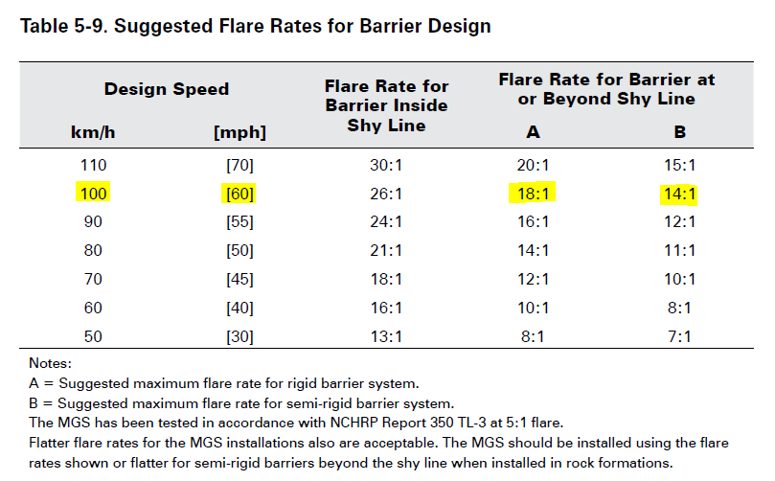
2024-07-LSRB: MASH TL-3 Design, Testing, and Evaluation of a Flared Guardrail System - Phase 2
    2011 Roadside Design Guide: Table 5-9 “Suggested Flare Rates for Barrier Design
Notes:
In summary, this project will provide a key data point in determining MASH compliancy of flared semi-rigid barrier systems at high TL-3 speeds. Currently, the 2011 Roadside Design Guide Table 5-9 provides a table of suggested flare rates for rigid and semi rigid barrier meeting NCHRP 350 standards and is out of date. Research must be continued in order to determine MASH compliant flare rates for flared rigid and semi rigid barriers at different design speeds. Significant time and resources have already been spent on MGS flared guardrail research. I strongly recommend that this project be implemented so we can find the key upper end value of semi-rigid barrier flare rates at MASH TL-3 high speed impacts.
Thank you for your time and consideration of this project. Does anyone have any questions?

