Slide 1
2024-08-LSRB Development and Evaluation of a Thrie Beam Transition between 31″ Median Guardrail and Median Single Slope Concrete Barrier
Khamsai Yang

Slide 2
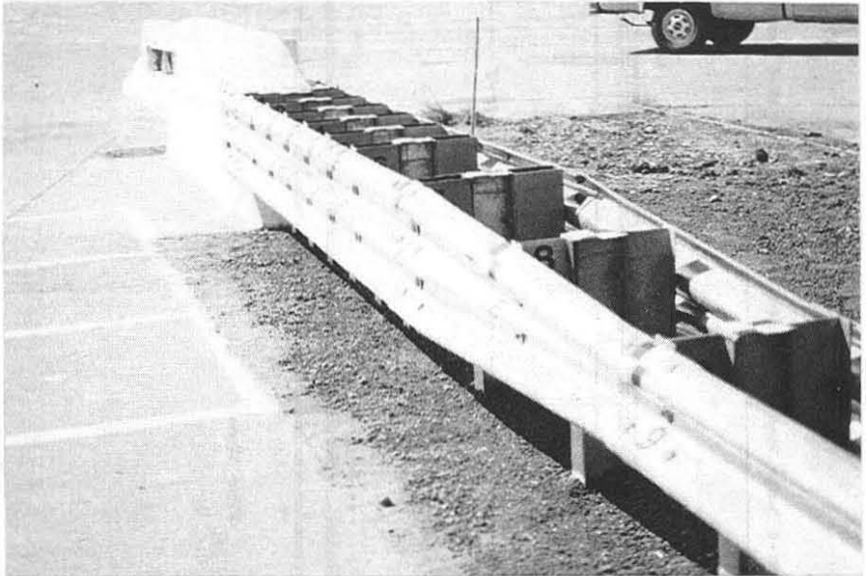
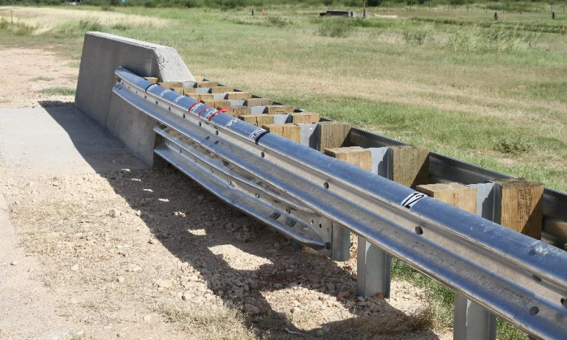
2024-08-LSRB Development and Evaluation of a Thrie Beam Transition between 31″ Median Guardrail and Median Single Slope Concrete Barrier
Need
MASH design that matches thrie-beam components of one-sided AGTs.
Design with curb to connect with median MGS system on raised/curbed medians.
Design may be compatible with F and J shape median barriers

Slide 3
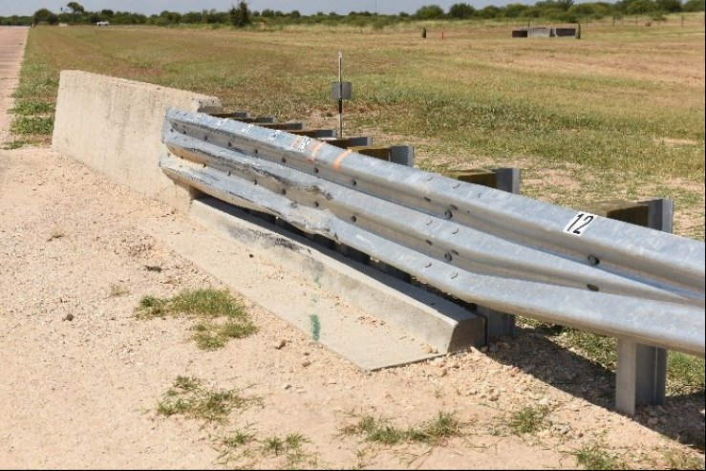
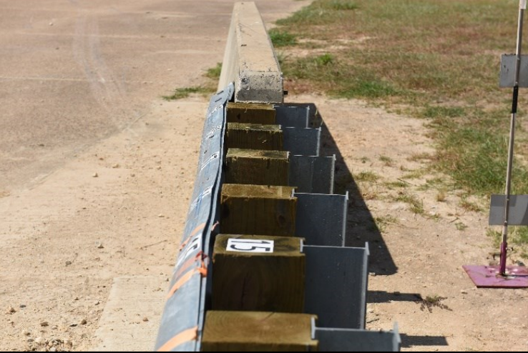
2024-08-LSRB Development and Evaluation of a Thrie Beam Transition between 31″ Median Guardrail and Median Single Slope Concrete Barrier
Prior Research
MwRSF TRP-03-47-95: NCHRP 350 thrie-beam median transition
MwRSF TRP-03-425-20: MASH Hawaii thrie-beam AGT
TTI 0-6946-R3: MASH TxDOT thrie-beam AGT to single-slope end post
TTI 0-6990-R1: MASH stacked W-beam median guardrail transition
Notes:
- MwRSF TRP-03-47-95: NCHRP 350 thrie-beam median transition
Non-curbed
MwRSF TRP-03-425-20: MASH Hawaii thrie-beam AGT
One of many Hawaii thrie-beam AGTs test, with curb
TTI 0-6946-R3: MASH TxDOT thrie-beam AGT to single-slope end post
AGT test non-curb
TTI 0-6990-R1: MASH stacked W-beam median guardrail transition
Median transition, but with stacked w-beam, non-curb

Slide 4
2024-08-LSRB Development and Evaluation of a Thrie Beam Transition between 31″ Median Guardrail and Median Single Slope Concrete Barrier
Proposed Work Plan
Design development
Simulation analysis to ID critical impact points and design modifications, if necessary
Full-scale crash testing, MASH TL-3

Slide 5
2024-08-LSRB Development and Evaluation of a Thrie Beam Transition between 31″ Median Guardrail and Median Single Slope Concrete Barrier
Final Report to document research effort
Design analysis
Design details
Full-scale crash test results
Documentation of MASH compliance for applicable installation types
Recommendations for further research

Slide 6
2024-08-LSRB Development and Evaluation of a Thrie Beam Transition between 31″ Median Guardrail and Median Single Slope Concrete Barrier
Estimated project cost = $105,000
Research Period of 18 months

