Slide 1
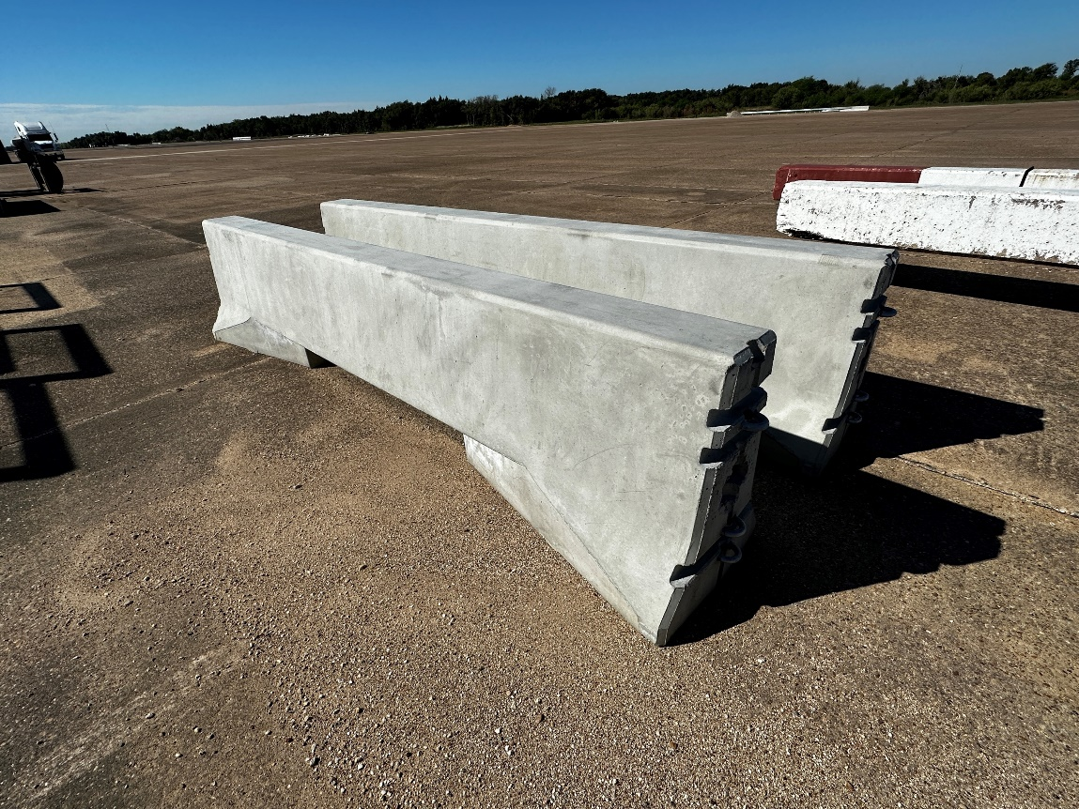
I-90 Snoqualimie Pass Barrier Gap Design and Testing to MASH TL-3 Phase 2
Status: Ongoing
Research Need
  To have a Concrete Barrier Section that can be used with WSDOT’s standard 12’-6” temporary concrete median barrier to span across features and aid in snow removal
  Several design concepts were developed in 2022.
  One design was selected for construction and full-scale crash testing for 2023 (Phase 2)
Objectives
  To have a barrier gap design that meets MASH TL—3 that can be used with WSDOT’s temporary concrete median barrier.
Workplan
  Fabricate and construct full-scale test installation
  Perform MASH Test 3-10 and 3-11

Slide 2
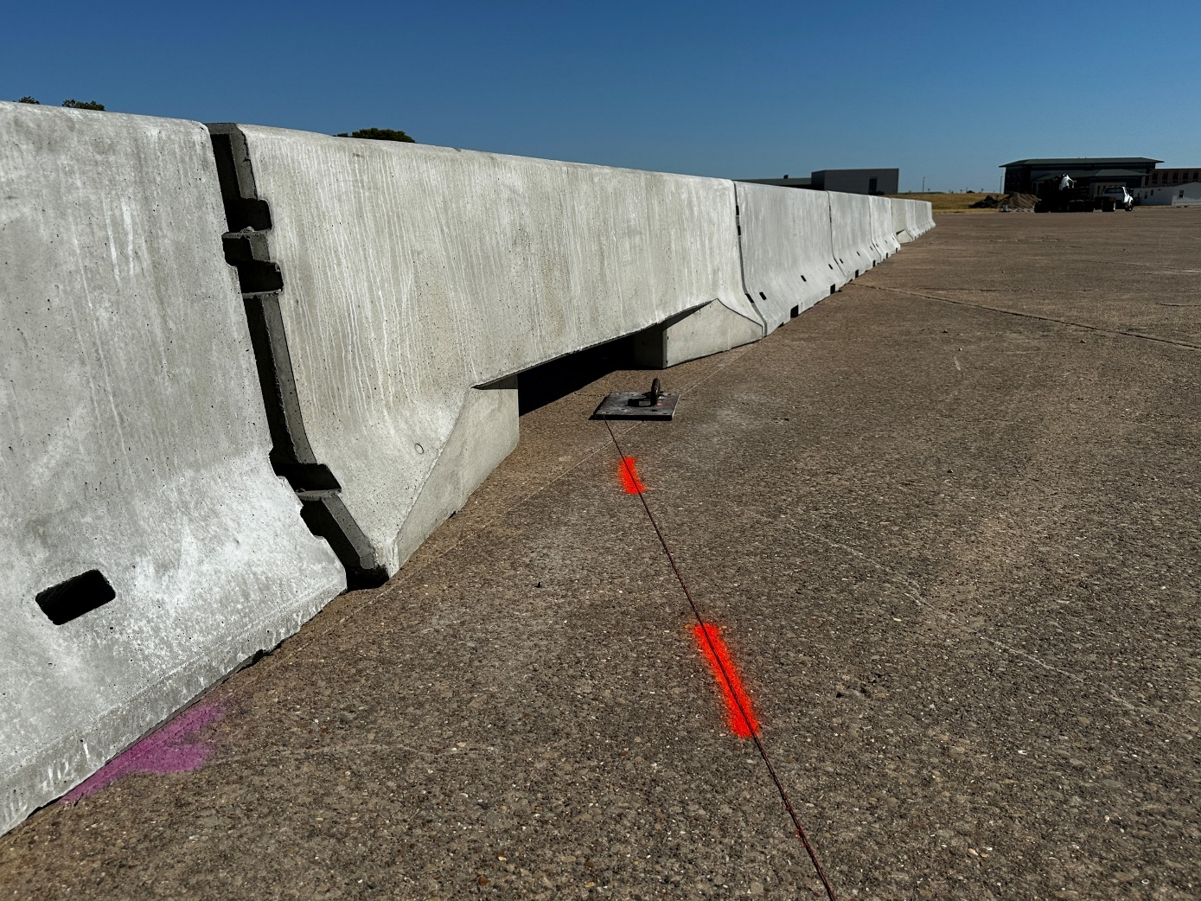
I-90 Snoqualimie Pass Barrier Gap Design and Testing to MASH TL-3 Phase 2
Transition developed using simulation
Test installation constructed

Slide 3
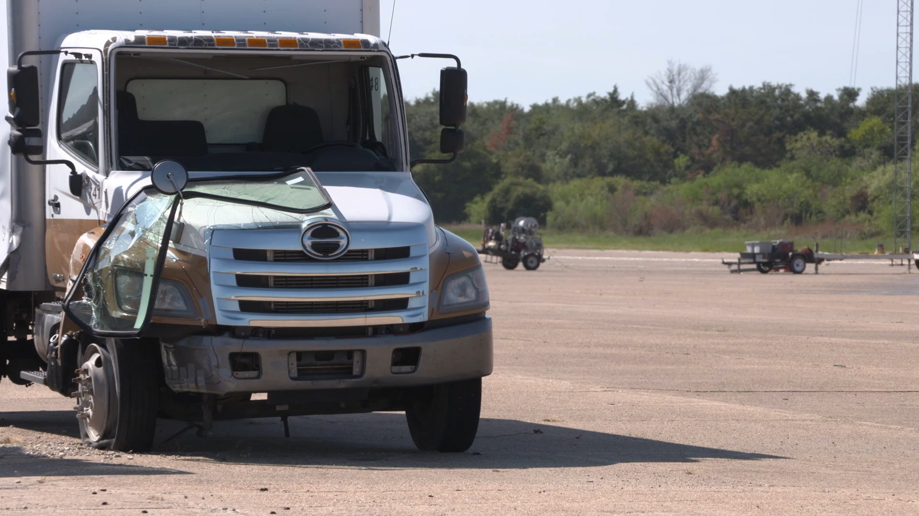
I-90 Snoqualimie Pass Barrier Gap Design and Testing to MASH TL-3 Phase 2
MASH Test 3-10 PASS and 3-11 FAIL (rolled)
Currently evaluating the path forward

