Slide 1
Multi-directional Base Design for Steel Beam Non-proprietary Large Sign Supports
James Kovar

Slide 2
Multi-directional Base Design for Steel Beam Non-proprietary Large Sign Supports
Background and Objective:
Non-proprietary large sign support design typically includes unidirectional slip base
Goal: Design a multi-directional system needed for installations with raised concrete islands or at T-intersections with larger signs

Slide 3
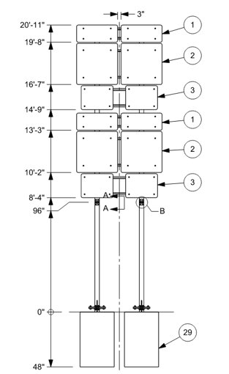
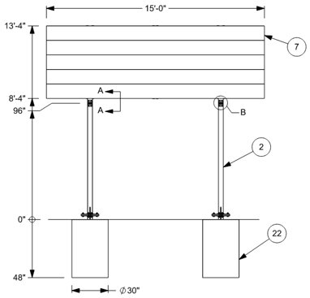
Multi-directional Base Design for Steel Beam Non-proprietary Large Sign Supports
Technical Representative:
Ted Whitmore (WVDOT)
Work Plan:
Literature Review
Design Development
MASH Crash Testing
Documentation

Slide 4
Multi-directional Base Design for Steel Beam Non-proprietary Large Sign Supports
MASH Crash Testing
3-60 Route Marker
8-ft mounting height
0-degree & 90-degree impact (PASS)
3-62 Guide Sign
8-ft mounting height
90-degree impact (FAIL)
**Videos removed to lower file size**

Slide 5
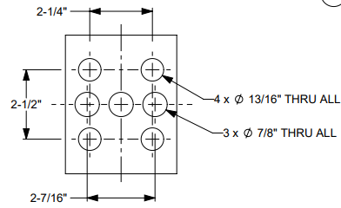
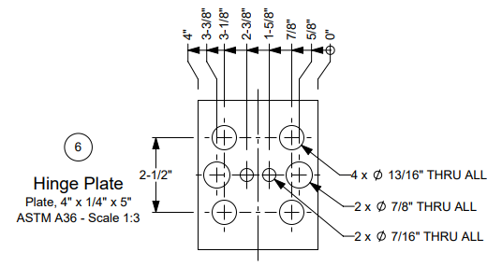
Multi-directional Base Design for Steel Beam Non-proprietary Large Sign Supports
Fuse Plate Redesign
Previous 3-62 test’s fuse plate failed to activate
Fuse plate redesigned to help with activation
3-62 Guide Sign Retest
90-degree impact (FAIL)
Next Steps
Retest with a raised mounting height of 9-ft

Slide 6
Evaluation of Four Bolt Slip Base for Breakaway Luminaire supports for Various Pole Configurations
James Kovar

Slide 7
Evaluation of Four Bolt Slip Base for Breakaway Luminaire supports for Various Pole Configurations
Technical Representative:
Shawn Debenham (UDOT)
Background & Objective
Evaluate the MASH TL-3 crashworthiness for critical configurations of non-proprietary four-bolt slip base luminaire support
Work Plan
Literature Review & Survey
Engineering Analysis
Full-scale Crash Testing

Slide 8
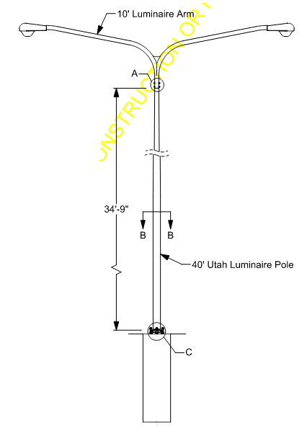
Evaluation of Four Bolt Slip Base for Breakaway Luminaire supports for Various Pole Configurations
Status
Survey and literature review has been completed
Luminaire test configurations and drawings have been determined
Waiting for components provided by Utah

