Slide 1
Portable Sign Supports for Aluminum Signs with Variation on Mounting Height
James Kovar

Slide 2
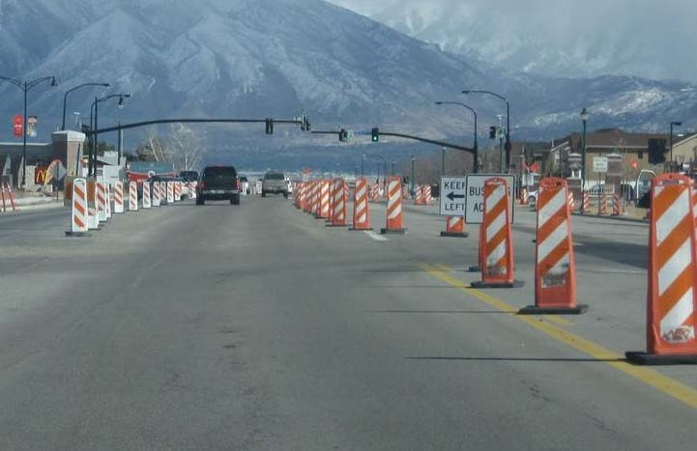
Portable Sign Stands with Mounting Height Variation
Technical Representatives:
Brian Crossley (PennDOT), Michelle Moser (MnDOT), Shawn Debenham, Justin Wilstead (UDOT)
Objective:
MASH crashworthiness evaluation of sign supports with mounting heights above channelizing devices
Next Steps:
Crash testing and documentation

Slide 3
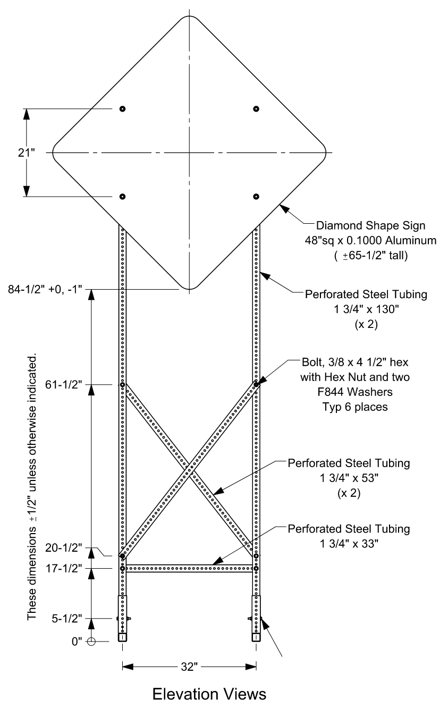
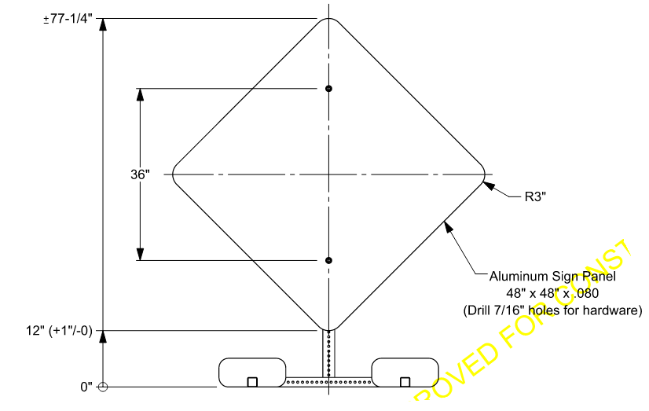
Designs for Testing

Slide 4
Barrier Deformations at Lower Impact Severities
James Kovar

Slide 5
Barrier Deformations at Lower Impact Severities
Objective: Perform computer simulations to estimate dynamic deflections of impacts at lower impact severities
Not all site conditions allow for full deflections under TL-3 conditions
Some site conditions prevent full TL-3 conditions
Ex. Mountain paths: slower speeds but rocky wall faces are close to the road.
Technical Representative:
Tim Moeckel (WSDOT)

Slide 6
Barrier Deformations at Lower Impact Severities
Work Plan:
Literature Review & State Survey
Computer Simulations
Documentation
Survey Results:
14 respondents
Prioritized Systems
F-shape Concrete barriers
MGS with Full & Half-Post Spacing

Slide 7
Optimized Guardrail Blockouts
James Kovar

Slide 8
Optimized Guardrail Blockouts
Background and Objective:
Since MASH implementation, w-beam ruptures during crash testing have become more common
Research has identified possible performance benefits associated with the use of shortened blockouts
This project will evaluate and quantify those benefits with the goal of further improving the impact performance of W-beam barriers

Slide 9
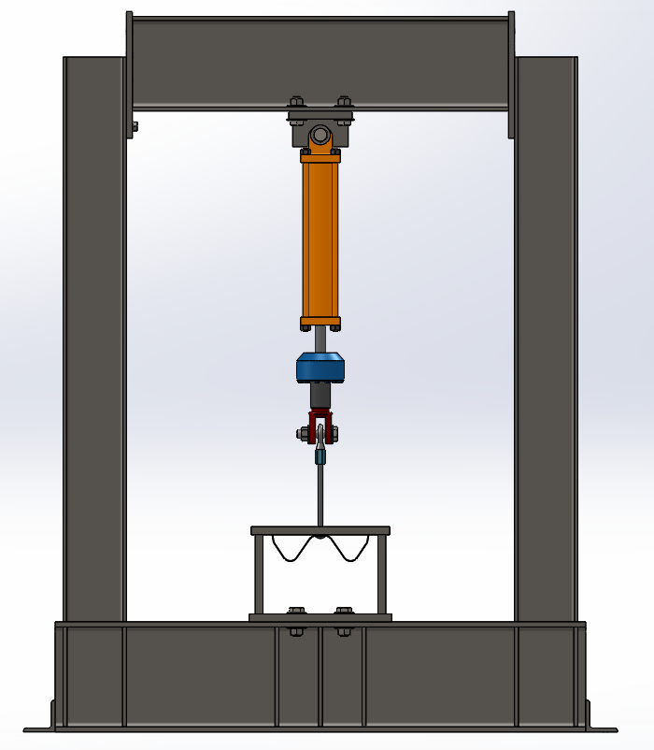
Optimized Guardrail Blockouts
Technical Representative:
Tim Moeckel (WSDOT)
Work Plan:
Engineering Analysis
Crash Testing
Documentation
Current Status:
Performing engineering analyses and component testing
Technical Representative:
Tim Moeckel (WSDOT)
Work Plan:
Engineering Analysis
Crash Testing
Documentation
Current Status:
Performing engineering analyses and component testing

