Slide 1
Tall Precast F-shape Concrete Median Barrier Pinned to Asphalt MASH TL-3
Developer of Problem Statement: Nina Ertel, P.E., Brian Crossley and Evan Pursel (all PennDOT)
Presented by: Jim Borino, P.E., PennDOT

Slide 2
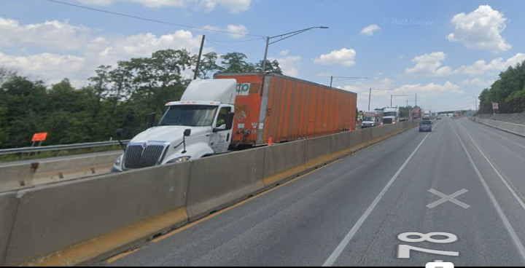
System to be Evaluated and Tested
Tall Pre-Cast F- Shape Concrete Median Barrier
Pinned to Asphalt
Evaluate both 42” and 50” tall
No embedment
Pin and Loop connection
Use for Permanent or Temporary
Pinned one or both sides
MASH TL-3

Slide 3
Project Needs
Work zones on freeways frequently involve high trucks volumes.
The work zone median is often only the width of the barrier with opposing traffic on each side.
Headlights from opposing vehicles can be blinding and cause safety concerns.
Currently there are no tall (50”) MASH temporary concrete median barriers.
Proprietary MASH temporary barriers are typically around 32” tall.
When the current NCHRP 350 temporary tall (52” w/o embedment) median barrier sunsets in 2026 in PA, there will not be any available.

Slide 4
Proposed Work Plan
Task 1. Engineering & Simulation
Develop barrier design concept.
Perform finite element simulation analysis for both 42” and 50” barriers.
Perform impact simulations with MASH 3-10 and 3-11 test conditions.
Determine critical design for crash testing.
Determine critical impact point for crash testing.
Develop reinforcement design for both barrier heights.
Task 2. Construction & Crash Testing (MASH 3-10 & 3-11)
Crash test would probably only be required for one height and the other height could likely get a Professional Engineering Opinion for MASH compliance.
Task 3. Reporting/Documentation

Slide 5
Costs
Total Estimated Cost = $325,966

